Slide 1


G∀min∃: Exploring the Boundary between Executable Specification Languages & Behavior Analysis Tools
www.obpcdl.org
Habilitation à diriger des recherches
Ciprian TEODOROV
https://www.ensta-bretagne.fr/teodorov
ciprian.teodorov@ensta-bretagne.fr
P4S, Lab-STICC, UMR CNRS 6285
3 april 2023

Slide 2
Thank you Frédéric, Stéphane, Hans, Jeff, Frank, Alain, Emmanuel for accepting my invitation to this jury.
Thank you colleagues from the SHARP pole of Lab-STICC and dear collaborators from academia & industry.
You and the numerous organizations that financed our projects made my work possible.
Special thanks to Patricia, Michèle & Annick for smoothing over the whole experience.

Slide 3
’08-’11 PhD in CS @ UBO (Lab-STICC) – UMass (Nanoscale Computing Lab)
  Model-driven Physical Design for Emerging Nanoscale Architectures
  Toolflow reification: Link domain modeling – Algorithms & Toolflow
’11-’13 EDA Sofware Engineer @ Dolphin Integration
  Transforming VHDL to a C-based mixed-signal simulation engine
  Tracer-based debugging (waveforms) vs Interaction-based debugging (gdb)
’13 Exfiltration to academia @ ENSTA Bretagne
  Postdoc: Multiformalism Model-checking
  ‘15 Associate professor
    McF CNU27-Computer science
    CNU61-Computer engineering
The story today
Highlights:
6 postdocs
8 PhDs
12 funded projects
acquired > 1.3M€

Slide 4
Overview
Executable specifications & behavior analysis monitors
The shy semantics and the inaccessible monitors.
G∀min∃: If the semantics opens up the monitors are interested.
When G∀min∃ experiences the real world.
Sum up and ways forward.

Slide 5
Context: Domain-specific languages
General-purpose languages introduce accidental complexities.
Domain experts rely on a shared domain-specific language to alleviate these problems.
Domain-specific languages enable
abstractions (models) focused on the domain of discourse.
tools (conceptual or computer-assisted) adapted to the domain

Slide 6
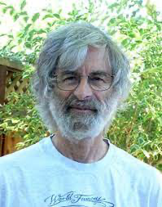
Context: Executable specifications
eXecutable Domain-Specific Languages (xDSL) for handling behaviors.
  Programming languages = prescriptive xDSLs
    force the computer to perform some behavior.
  Thinking above the code [1], specifying, requires a problem-oriented mindset
Executable-Specifications capture the behavior to study it in captivity
  Descriptive xDSL that reflects how the object behaves
Descriptive [2]:
presenting observations about the characteristics of something
factually grounded or informative rather than normative, prescriptive or emotive
[1] Leslie Lamport: Thinking Above the Code
[2] (https://www.merriam-webster.com/dictionary/descriptive)

Slide 7
a Zoo of Executable Specification Languages
Physical processes
Temporal logic
LTL
CTL*
Temporal Logic of Actions (TLA+)
Computable functions
Lambda calculus
Turing machines
Automata
NFA
PDA
Statecharts
Concurrency
HDLs
VHDL[-AMS]
[System-]Verilog[-A]
Calculus [Newton and Leibniz]
Actor models – Hewitt
Petri nets
CSP – Hoare

Slide 8
Terminology
Language monitoring[KHC91] is the process of observing
the execution of a computer program
expressed in a given programming language.
[KHC91] Amir Kishon, Paul Hudak, and Charles Consel. 1991. Monitoring semantics: a formal framework for specifying, implementing, and reasoning about execution monitors. In Proceedings of the ACM SIGPLAN 1991 conference on Programming language design and implementation (PLDI '91). Association for Computing Machinery, New York, NY, USA, 338–352. https://doi.org/10.1145/113445.113474

Slide 9
Terminology: In our context
Language monitoring[KHC91] is the process of observing
the behavior of an executable specification
expressed in a given specification language.
In the following:
the tools that enable this process will be referred to as:
language monitors, or simply monitors
runtime monitors are a subclass of language monitors

Slide 10
a Zoo of Language Monitors
Runtime
Monitor
Model-checker
Debugger
Profiler
Tracer
Executor
Moldable [1]
Omniscient [2]
Multiverse [3]
MetaSpy [4]
DSProfile [5]
LTSmin [6]
[1] Chiş et al. ”The Moldable Debugger: A Framework for Developing Domain-Specific Debuggers.” SLE 2014.
[2] Bousse et al. “Omniscient Debugging for Executable DSLs.” JSS 2018.
[3] Torres Lopez et al. "Multiverse debugging: Non-deterministic debugging for non-deterministic programs." ECOOP 2019.
[4] Bergel et al. "Domain-specific profiling." TOOLS 2011.
[5] Sloane et al. "Domain-specific program profiling and its application to attribute grammars and term rewriting." SCP 2014.
[6] Kant et al. ”LTSmin: High-Performance Language-Independent Model Checking.” TACAS 2015.

Slide 11
Questions to ponder
Does your favorite specification language:
has a debugger? Can it go back in time?
comes with a model-checker?
offers support for random testing?
Why do we still lack these basic tools for so many practically important specification languages?

Slide 12
How to bridge the gap between the specification languages and the language monitors running on ever more heterogeneous platforms?
Languages
Monitors
Platforms

Slide 13
2. The Shy Semantics and the Inaccessible Monitors.
Understanding the problem
Looking for high-level solutions

Slide 14
Many semantics Many Monitors
gap
equivalence
needed
Model 1
transformation
| compilation
Formal
Semantics
Monitor 1
Result 1
gives
meaning
Executable
Specification
gap
Model 2
Model 3
interprets
Executable
Semantics
code
Monitor 2
Monitor 3
Processor
Processor
Result 2
Result 3

Slide 15


, IF [Dragomir+22]
SPOT [DP04], LTSmin [Kan+15]
A#1
A#7
A#4
AnimUML [MODELS’20]
EMI [SoSyM’21]
A#2
Spin [Hol97]
A#5
P#1 Semantic gap between design model and analysis model
P#2 Semantic gap between design model and executable code
P#3 Equivalence problems between the analysis model and executable code
A#3
Divine [Bar+17]
A#6
Java PathFinder [Bra+00]
V. BESNARD, “EMI: Une approche pour unifier l’analyse et l’exécution embarquée à l’aide d’un interpréteur de modèles pilotable”,
Application aux modèles UML des systèmes embarqués, Ph.D. Thesis, Dec. 2020.

Slide 16
A#1
A#7
A#4
A#2
A#5
 | A#1 | A#2 | A#3 | A#4 | A#5 | A#6 | A#7
P#1 | ✘ | ✘ | ✓ | ✓ | ✓ | ✓ | ✓
P#2 | ✘ | ✘ | ✘ | ✘ | ✘ | ✓ | ✓
P#3 | ✘ | ✘ | ✘ | ✘ | ✘ | ✘ | ✓
A#3
A#6
V. BESNARD, “EMI: Une approche pour unifier l’analyse et l’exécution embarquée à l’aide d’un interpréteur de modèles pilotable”,
Application aux modèles UML des systèmes embarqués, Ph.D. Thesis, Dec. 2020.

Slide 17
3. G∀min∃: If the Semantics Opens Up the Monitors are Interested.
Requirements
G∀min∃ Semantic Language Interface
An illustration

Slide 18
Make it simple
Execution & Monitoring
Properties
(metrics)
Subject Language
Syntax
Definition
computes
conformsTo
interprets
Semantics
Semantic
Language
Interface (SLI)
Monitor
Model
providesA
dependsOn
Q1: What is the SLI interface?
Q2: How to build the monitors?

Slide 19
SLI Goals
[SLE’16]
Execution & Monitoring
Properties
(metrics)
Subject Language
Syntax
Definition
computes
conformsTo
interprets
Semantics
Semantic
Language
Interface (SLI)
Monitor
Model
providesA
dependsOn
[G01] Completeness
[G02] Non-Interference
[G03] Break the Rules
[G04] Minimize the Gap
[G05] Composability
[G06] Portability
[G07] Genericity
[G08] Unanticipated Monitoring
[G09] Ease the Integration

Slide 20
One semantics Many Monitors
gap
A#7
Model 1
Formal
Semantics
Monitor 1
Connect the semantics
not the syntax!
Result 1
gives
meaning
Executable
Specification
gap
Model 2
Model 3
interprets
Executable
Semantics
Semantic
Language
Interface (SLI)
Monitor 2
Semantic
Language
Interface (SLI)
Monitor 3
Processor
Result 2
Result 3
20/50

Slide 21
Monitor Structure
Execution & Monitoring
Properties
(metrics)
Subject Language
Syntax
Definition
computes
Monitor
conformsTo
interprets
Semantics
Semantic
Language
Interface (SLI)
Monitoring
Bridge
Model
providesA
dependsOn
runs
Execution
Controler
Sequencer
Emptiness
Checker
Interactive

Slide 22
G∀min∃ Semantic Language Interface (SLI)
SLI {
semantics: (C A) {
initial: set C
actions: C → set A
execute: A → C → set C
}
evaluate: E → (C x A x C) → V -- questions
reduce: R → C → ⍺ -- reductions
π: (C A V ⍺ T) {…} -- projections
}
Generic Types:
Configuration:
Example CEK-style
C ≜ ⟨control, env, [Frame]⟩
Expression
execution step
Value
Action:
Example CEK-style
A ≜ from-predicate ⟶ to-C

Slide 23
Expression
Sequencer
interprets
execute
CEK-style
Semantics
SLI
Example CEK-style
C ≜ ⟨control, env, [Frame]⟩
A ≜ from-predicate ⟶ to-C
SLI Semantics for a CEK-style abstract machine
rules: { lookup, app, arg, body, … }
SLI.semantics: (C A) {
initial: set C := {⟨exp, ∅, []⟩}
actions: C → set A
| c => rules.where(r => r.enabledIn c)
execute: A → C → set C
| r c => { r.applyIn c }
}
Sequencer(sli) {
current = sli.initial.any
while (current != NULL) {
action = sli.actions(current).any
if (actions == NULL) break;
current= sli.execute(action,current).any
}
}
If sli exposes a deterministic semantics → exactly one sequence
<=>
∀ a c, |initial| = |actions c| = |execute a c| = 1

Slide 24
4. When G∀min∃ experiences the real world.
  Some experiences unravel reusable monitoring bridges
  Exploring hardware execution
  Multiverse debugging made simple and more powerful
  Transfer to commercial products -- OBP2 inside
  Transfer to future practitioners -- From zero to model-checker

Slide 25
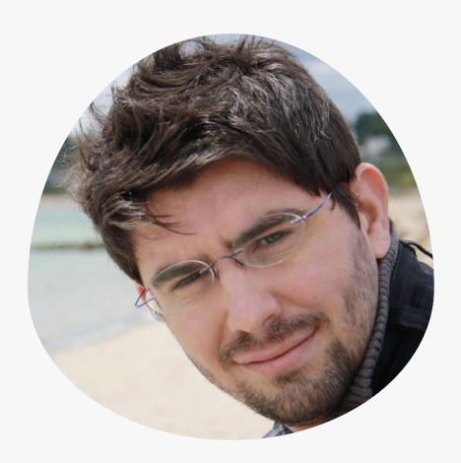
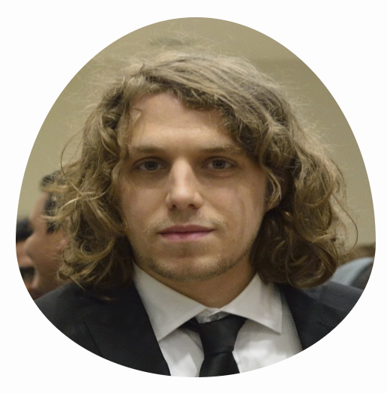
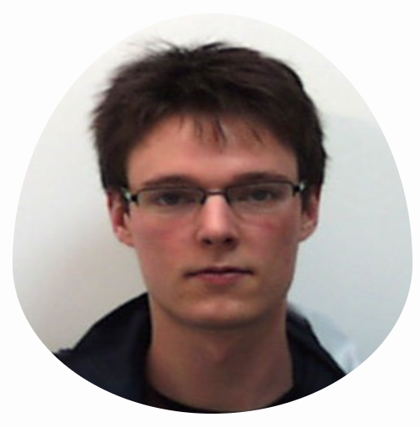
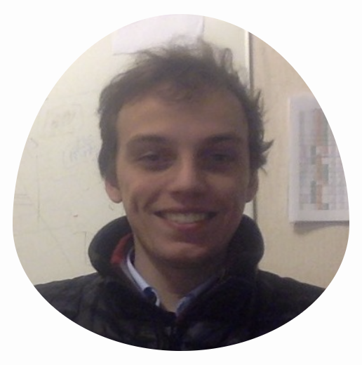
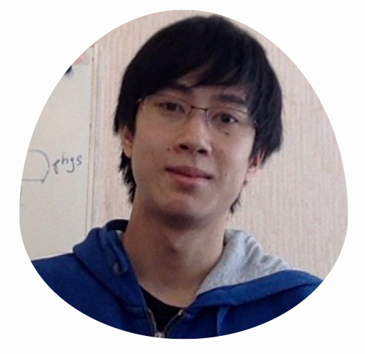
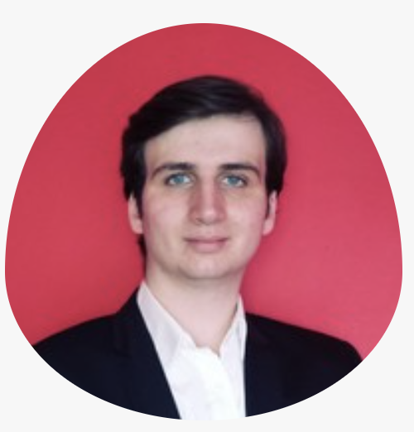
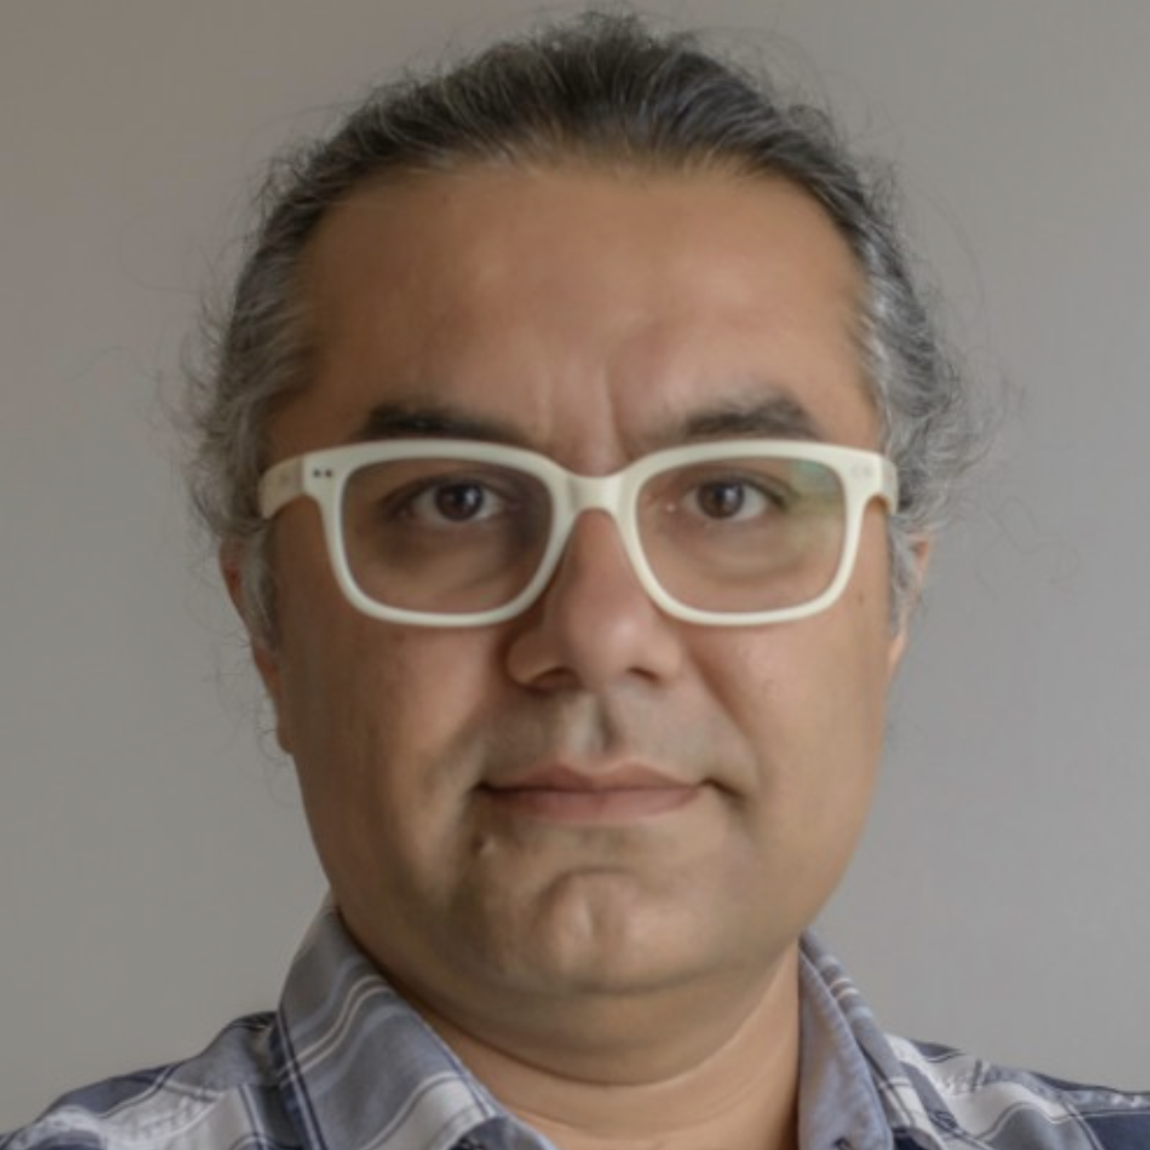
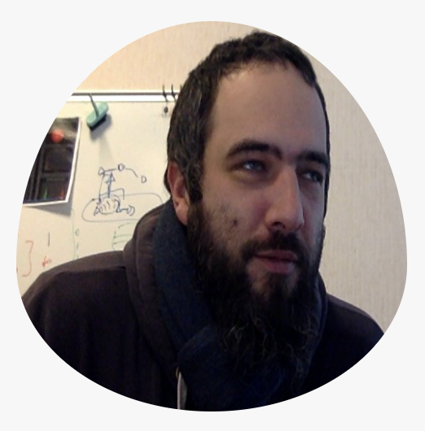
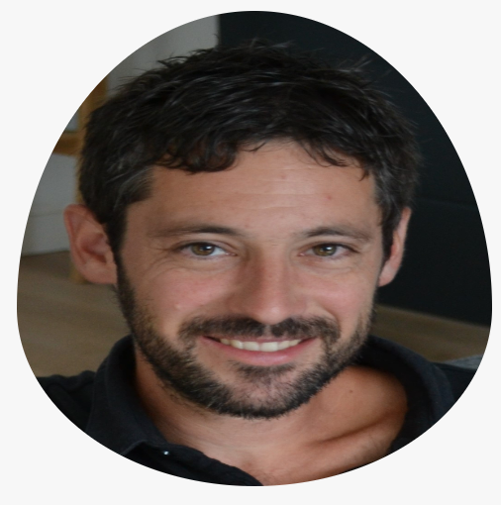
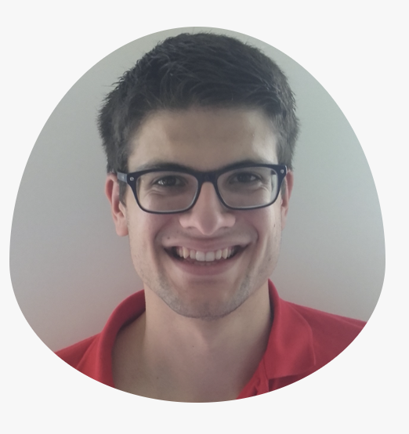











OBP2 Research Vehicle (>1.3M€)
2015-2023
Safety & Liveness
Temporal Requirements
J.C. ROGER
B. DROUOT
T. BOLLENGIER
Emilien
FOURNIER
2022
Nicolas
SUN
2022
Matthias
PASQUIER
in progress
L.LE ROUX
F. GOLRA
Projects:
ONEWAY (DGAC)
Ker-SEVECO (R.Bretagne,EU)
JoinSafeCyber (AID)
VeriMoB (RAPID)
EASE4SE (RAPID)
DEPARTS (PIA)
GeMoC (ANR)
Semantic
Language
Interface
Luka
LE ROUX
2018
Vincent
LEILDE
2019
Valentin
BESNARD
2020
Commercial Products [ PragmaDEV ]
Academic Prototypes [ in-house ]
Reuse [ OTS ]
AnimUML
EMI-UML
AEFD
TLA+
Fiacre

Slide 26

AEFD
Specification
interprets
AEFD
Semantics
SLI
PhD Luka
LE ROUX
verify
Language-agnostic
synchronous composition operator
⨯
SLI
Model-checker
⨯
SLI
Property
Semantics
interprets
Safety
Specification
SLI
Emptiness
Checker
PIA DEPARTS

Slide 27
Partially Bounded
Context-Aware Verification,
Fiacre
Specification
interprets
[SEFM’19]
Fiacre
Semantics
SLI
PhD Luka
LE ROUX
verify
Model-checker
⨯
SLI
Guide
Semantics
interprets
Verification
Guide
SLI
⨯
SLI
CDL
Semantics
interprets
CDL Prop
Specification
Past-Free[ze] Reachability Analysis: Reaching Further with DAG-directed Exhaustive State-space Analysis.
[STVR’16]
SLI
PastFree[ze]
Checker
Emptiness
Checker
PIA DEPARTS

Slide 28
Executable
Specification
Sequencer
interprets
execute
Semantics
SLI
verify
Model-checker
⨯
SLI
Property
Semantics
interprets
Temporal
Specification
SLI
Emptiness
Checker

Slide 29
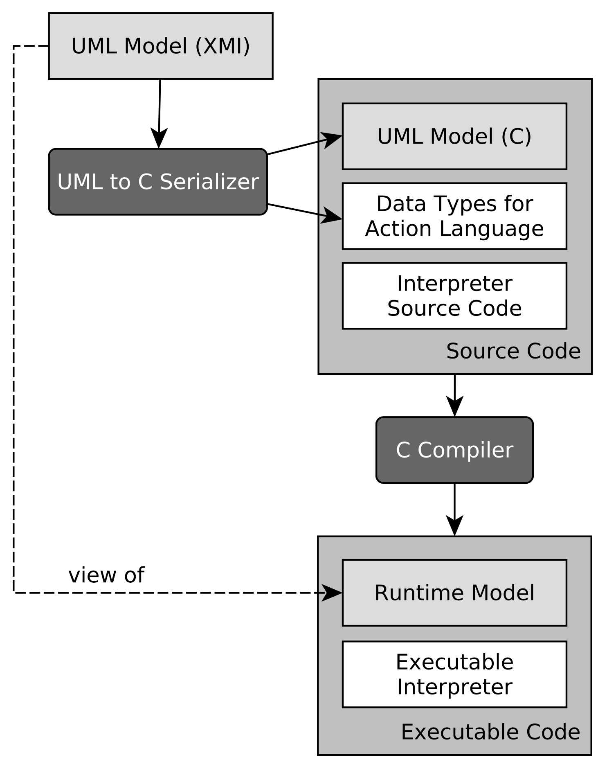


Bare-metal STM32 - ARM A9
UML
Specification
Sequencer
interprets
EMI
Semantics
SLI
PhD Valentin
BESNARD
Unified LTL Verification and Embedded Execution of UML Models,
[MODELS’18]
Model-checker
⨯
SLI
GPSL
Semantics
interprets
GPSL
Specification
SLI
✔︎Formalization in
L∃∀N Theorem Prover
Emptiness
Checker

Slide 30
Bare-metal STM32 - ARM A9
UML
Specification
Scheduling
Policy
Sequencer
interprets
interprets
EMI
Semantics
SLI
Scheduler
SLI
PhD Valentin
BESNARD
Model-checker
⨯
SLI
PUSM EMI
Semantics
interprets
PUSM
Specification
Unified verification and monitoring of executable UML specifications.
A transformation-free approach.
[SoSyM’21].
SLI
✔︎Formalization in
L∃∀N Theorem Prover
Emptiness
Checker

Slide 31
Bare-metal STM32 - ARM A9
UML
Specification
Scheduling
Policy
Sequencer
interprets
interprets
EMI
Semantics
SLI
Scheduler
SLI
PhD Valentin
BESNARD
EMI
Semantics
SLI
||
||
Language-agnostic
asynchronous composition
operator
interprets
SLI
SLI
UML
Environment
Model-checker
⨯
SLI
PUSM EMI
Semantics
interprets
PUSM
Specification
Unified verification and monitoring of executable UML specifications.
A transformation-free approach.
[SoSyM’21].
SLI
✔︎Formalization in
L∃∀N Theorem Prover
Emptiness
Checker

Slide 32
Bare-metal STM32 - ARM A9
UML
Specification
Scheduling
Policy
Sequencer
interprets
interprets
EMI
Semantics
SLI
Scheduler
SLI
PhD Valentin
BESNARD
EMI
Semantics
SLI
||
interprets
SLI
UML
Environment
Model-checker
Filter
interprets
Filtering
Policy
SLI
⨯
SLI
PUSM EMI
Semantics
interprets
PUSM
Specification
Unified verification and monitoring of executable UML specifications.
A transformation-free approach.
[SoSyM’21].
SLI
✔︎Formalization in
L∃∀N Theorem Prover
Emptiness
Checker

Slide 33
Bare-metal STM32 - ARM A9
UML
Specification
Scheduling
Policy
Sequencer
Sequencer
interprets
interprets
EMI
Semantics
SLI
Scheduler
SLI
⨯
SLI
Acceptance
Asserter
PhD Valentin
BESNARD
EMI
Semantics
SLI
||
SLI
PUSM EMI
Semantics
interprets
PUSM Monitor
Specification
interprets
SLI
UML
Environment
Model-checker
Filter
interprets
Filtering
Policy
Verifying and Monitoring UML Models with Observer Automata. [MODELS’19].
SLI
⨯
SLI
PUSM EMI
Semantics
interprets
PUSM
Specification
Unified verification and monitoring of executable UML specifications.
A transformation-free approach.
[SoSyM’21].
SLI
✔︎Formalization in
L∃∀N Theorem Prover
Emptiness
Checker

Slide 34
4. When G∀min∃ experiences the real world.
  Some experiences unravel reusable monitoring bridges
  Exploring hardware execution
  Multiverse debugging made simple and more powerful
  Transfer to commercial products -- OBP2 inside
  Transfer to future practitioners -- From zero to model-checker

Slide 35
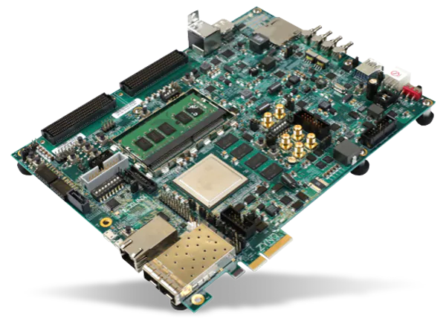
From Embedded
to Hardware Execution
UML
Specification
EMI
Semantics
SLI
Menhir
VCore
PhD Valentin
BESNARD
UML
Specification
GPSL
Properties
PhD Emilien
FOURNIER
ARM A9
Artix-7 FPGA
EMI
Semantics
SLI
Zynq XC7Z020-CLG484
ARM A9
x64
[DSD’20]
[FPL’21]
[DATE’22]
STM32F4 Discovery
Workstation
DVE C
Semantics
SLI
Menhir
VCore
ARM A9
Artix-7 FPGA
DVE
Specification
DVE
Properties
Zynq XC7Z020-CLG484
DVE2VHDL
VHDL
Model
SLI
Dolmen
VCore
VHDL
Model
SLI
Menhir
VCore
Virtex UltraScale+ XCVU37P FPGA
Artix-7 FPGA
Région Bretagne
CPER CyberSSI
Zynq XC7Z020-CLG484
✔︎Guided by TLA+ formalization

Slide 36
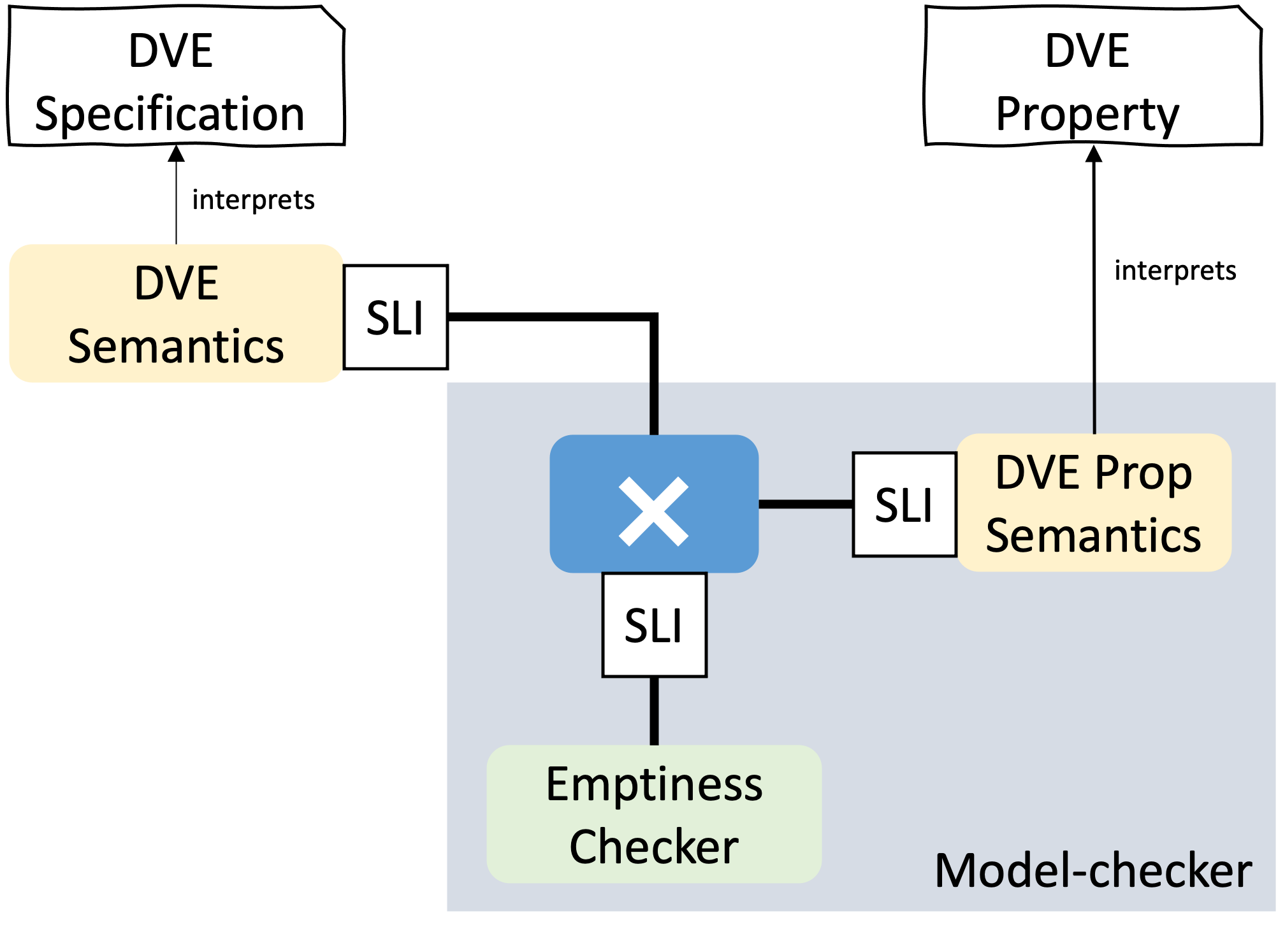
[DATE’22]
Dolmen: 1st Hardware Swarm Engine
for Both Safety & Liveness Verification
PhD Emilien
FOURNIER
  Swarm of 32 deeply pipelined verification cores
  Distributed control architecture, for large SSI-FPGAs
  4874x average speedup over software (Divine 3)
Virtex FPGA
M_{action}
M_{action}
Prop_{action}
distribute
M_{action}
serialize
distribute
Prop_{action}
serialize
M_{action}
Prop_{action}
M_{action}
Prop_{action}
M_{action}
Pred
Frontier
Known
Mixer
Région Bretagne
CPER CyberSSI

Slide 37
4. When G∀min∃ experiences the real world.
  Some experiences unravel reusable monitoring bridges
  Exploring hardware execution
  Multiverse debugging made simple and more powerful
  Transfer to commercial products -- OBP2 inside
  Transfer to future practitioners -- From zero to model-checker

Slide 38
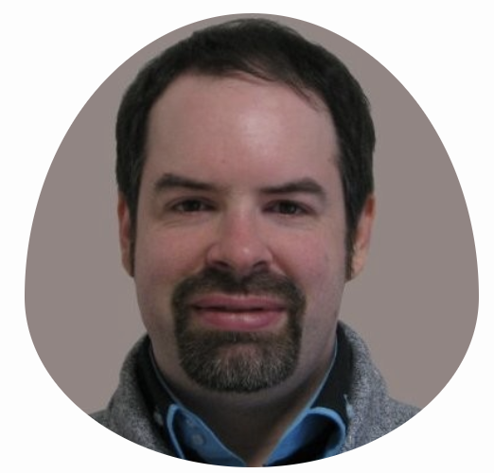
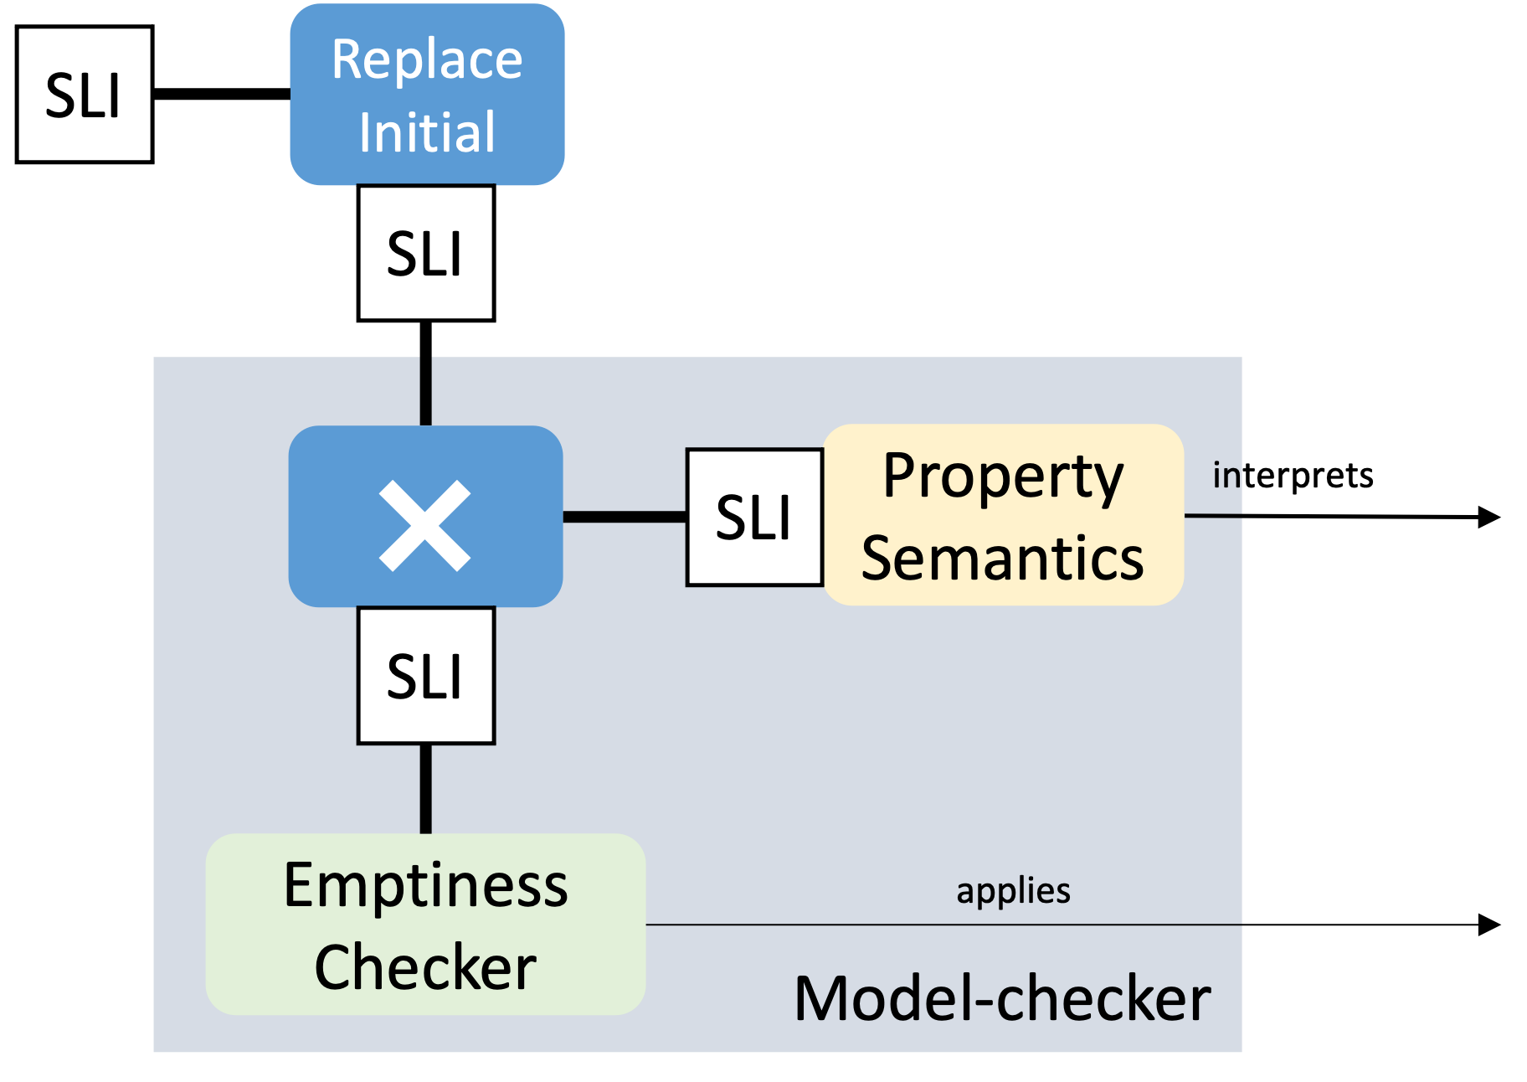


AnimUML
Specification
Multiverse Debugger
Semantics
✔︎Formalization in
L∃∀N Theorem Prover
interprets
AnimUML
Semantics
SLI
SLI
step
PhD Matthias
PASQUIER
Language-agnostic
jump
Non-trivial Monitor Composition
select
run2breakpoint
Scalability
4
+Expressivity, no instrumentation
1
2
3
8
7
9
Temporal
Breakpoint
[Submitted]
5
6
Reduction
[MODELS’22]
SLI
User
uses
Interactive
Controler

Slide 39
4. When G∀min∃ experiences the real world.
  Some experiences unravel reusable monitoring bridges
  Exploring hardware execution
  Multiverse debugging made simple and more powerful
  Transfer to commercial products -- OBP2 inside
  Transfer to future practitioners -- From zero to model-checker

Slide 40
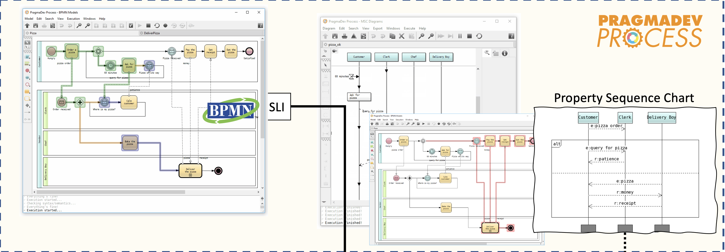

Model-checker
⨯
SLI
GPSL
Semantics
interprets
GPSL
Specification
SLI
[ERTS’20]
[CSD&M’20]
Emptiness
Checker
RAPID VeriMoB
DGAC OneWay

Slide 41
Successful transfer to industry leads to
Adoption in new products – PROCESS for BPMN
Retrofitting existing products – STUDIO for SDL
inside

Slide 42
4. When G∀min∃ experiences the real world.
  Some experiences unravel reusable monitoring bridges
  Transfer to commercial products -- OBP2 inside
  Exploring hardware execution
  Multiverse debugging made simple and more powerful
  Transfer to future practitioners -- From zero to model-checker

Slide 43
From Zero to Model-Checker in 28 Hours
Transfer to
Future Practioners
Python eDSL
Model
interprets
eDSL Semantics
SLI
Master-level class at ENSTA Bretagne
the last 2 years
seven 4-hour sessions
Z2MC
Safety & Liveness
eDSL
Dependent
Semantics
⨯
SLI
interprets
Python eDSL
Specification
SLI
Model-independent graph traversal
Predicate-based search and witness construction
SLI by refactoring the graph API
Lambda-based guard-action eDSL with SLI semantics
Dependent SLI semantics
Step-based synchronous composition
Büchi emptiness checking
Büchi
emptiness
checking
Reachability
searches
Configuration
Predicate

Slide 44
5. Sum Up & Ways Forward
Conclusion
Major Breakthroughs
Perspectives
Track Record

Slide 45
G∀min∃ = a way to bridge the gap between the specification languages and the language monitors running on ever more heterogeneous platforms?
Languages
Monitors
Platforms
embedded: Bare-metal
hardware: FPGA
Model-checker
Multiverse Debugger
Runtime Monitors
industrial: BPMN, SDL
reuse: TLA+, Fiacre
academic: UML, AEFD

Slide 46
Model-checker
  My students implement it in 28 hours
  They reuse the specification language for expression properties --> minimize the gap
With Matthias we have implemented the debugger in a week
Random testing needs only a way to specify the environment ||
  Luka implemented random testing in Oneway in an afternoon.

Slide 47
Major Contributions
A sustainable & composable approach for language monitoring
simple and versatile, the SLI offers a radically better cost structure
step-based evaluation plays a major role
1st Hardware Swarm Engine for Both Safety and Liveness Verification
pipelined reformulation of the verification architecture
Established a continuum between debugging and model-checking
language-agnostic under-approximations for scalability
temporal breakpoints for expressivity without instrumentation

Slide 48
Ways Forward
Generalizing the G∀min∃ language monitoring
for the future of specification-driven engineering.

Slide 49
Ways Forward
Platform constraints
Platform-induced
abstraction
Specification
Scheduling
Policy
interprets
interprets
Semantics
SLI
Scheduler
SLI
1st successful step: PhD V. BESNARD
Kernel Formalized
Model-checker
Filter
interprets
Filtering
Policy
Is scheduling-aware functional verification a viable platform-induced partial-order-reduction strategy?
SLI
⨯
SLI
Property
Semantics
interprets
Property
SLI
Emptiness
Checker

Slide 50
Ways Forward
Platform constraints
Platform-induced
abstraction
Specification
Timing Spec
interprets
interprets
Semantics
SLI
Timed
SLI
1st successful step: DGAC ONEWAY
Timed BPMN without transformations
Model-checker
How to obtain a timed automata abstraction on-the-fly?
⨯
SLI
Property
Semantics
interprets
Property
SLI
Emptiness
Checker

Slide 51
Ways Forward
Modular semantics and proofs
Subject Language
Spec A
interprets
Composition
Policy
Semantics A
SLI
||
Language-agnostic
asynchronous composition
operator
interprets
Spec B
Composer
SLI
SLI
Composition algebras: channel, clocks, events
interprets
Semantics B
SLI
Model-checker
Can the SLI be used for defining semantic-level operators?
⨯
SLI
Property
Semantics
interprets
Property
SLI
Emptiness
Checker

Slide 52
Ways Forward
Modular semantics and proofs
Spec A
interprets
Composition
Policy
Abstraction Spec
Semantics A
SLI
1st successful step: DGAC ONEWAY
Timed BPMN
interprets
interprets
Spec B
Composer
SLI
abstraction
SLI
interprets
Semantics B
SLI
Model-checker
Filtering
Policy
  How to maximize semantic reuse for cheaper overapproximations?
  Can the SLI help to bring Modular SOS [1] to practice?
⨯
SLI
Property
Semantics
interprets
Property
SLI
Emptiness
Checker
[1] Peter D. Moses, “Foundation of Modular SOS”,
Mathematical Foundations of Computer Science 1999, Lecture Notes in Computer Science, vol 1672. Springer.

Slide 53
Ways Forward
Modular semantics and proofs
Specification
interprets
1st successful step: PhD E. FOURNIER
TLA+ formalization of reachability
subsuming explicit and symbolic
traversals
Semantics
SLI
Model-checker
⨯
SLI
Property
Semantics
interprets
Property
  Does the separation
  execution controller -- algorithm logic
  simplifies algorithm design and analysis?
SLI
Emptiness
checker
SLI
Sequencer

Slide 54
Ways Forward
How to get a provably sound language-agnostic
portfolio-based diagnosis toolkit?
Will it be fast enough?
How to standardize the SLI?
Harmonization with the LSP and Debug Adapter Protocol
Generalizing the G∀min∃ language monitoring
for the future of specification-driven engineering.
[1] Peter D. Moses, “Foundation of Modular SOS”,
Mathematical Foundations of Computer Science 1999, Lecture Notes in Computer Science, vol 1672. Springer.

Slide 55
Ways Forward
How to get a provably sound language-agnostic
portfolio-based diagnosis toolkit?
Will it be fast enough?
How to standardize the SLI?
Harmonization with the LSP and Debug Adapter Protocol
Are live specification environments
the next revolution?
Is scheduling-aware functional verification a viable platform-induced partial-order-reduction strategy?
Generalizing the G∀min∃ language monitoring
for the future of specification-driven engineering.
Modular semantics and proofs:
  Can the SLI be used for defining semantic-level operators (timed, channels, clocks)?
  Can the SLI help to bring Modular SOS [1] to practice?
  How to maximize semantic reuse for cheaper overapproximations?
[1] Peter D. Moses, “Foundation of Modular SOS”,
Mathematical Foundations of Computer Science 1999, Lecture Notes in Computer Science, vol 1672. Springer.

Slide 56
Track Record
Be curious, Explore,
Expand our understanding,
Share the insights
Phd students:
Matthias Pasquier
Emilien Fournier
Tithnara Sun
Valentin Besnard (GDR-GPL award)
Vincent Leilde
Luka Le Roux
Lamia Allal
Jean-Philippe Schneider
Postdocs:
Luka Le Roux
Valery Monthe
Bastien Drouout
Fahad Golra
Jean-Charles Roger
Vincent Leilde
Engineers:
Hiba Hnaini
Sylvain Guerin
Fatma Zarka
Nadia Menad
Sebastien Tleye
Ismail Chaida
Papers:
1 patent
9 journal papers
49 conference papers
Software:
OBP2 nominated Systematic Paris-Région ’20
ClockSystem
Phadeo
EMI UML
AnimUML
50+ github repos
Main Projects: ONEWAY, Ker-SEVECO, JoinSafeCyber, VeriMoB, EASE4SE, DEPARTS, GEMOC, Ardyt, Morpheus, ValMadeo
Contracts: DAVIDSON, ERTOSGENER
www.obpcdl.org

Slide 57

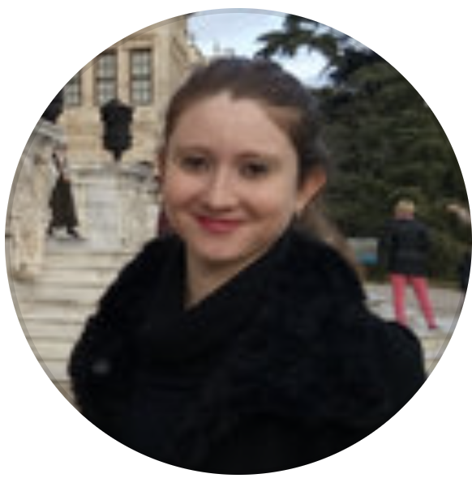
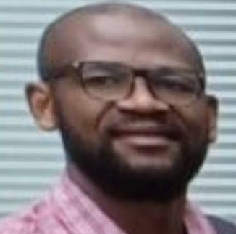
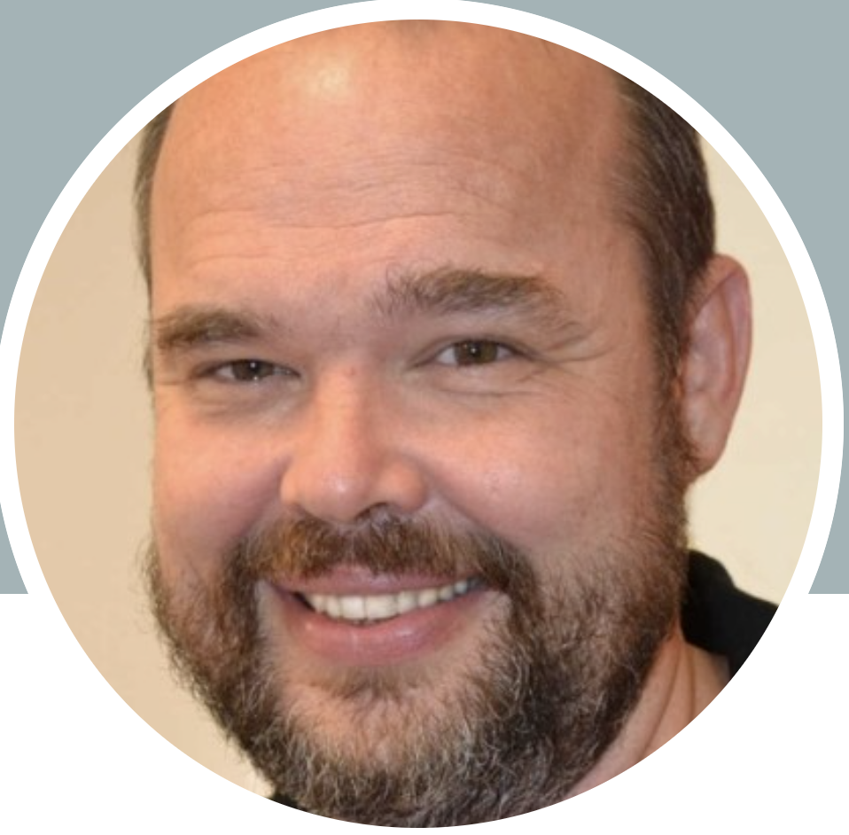
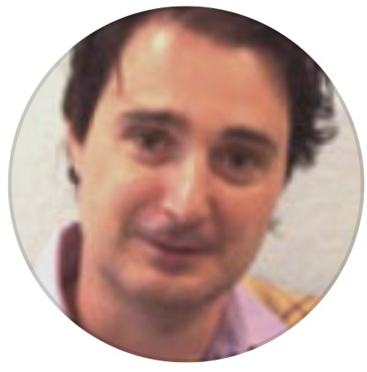

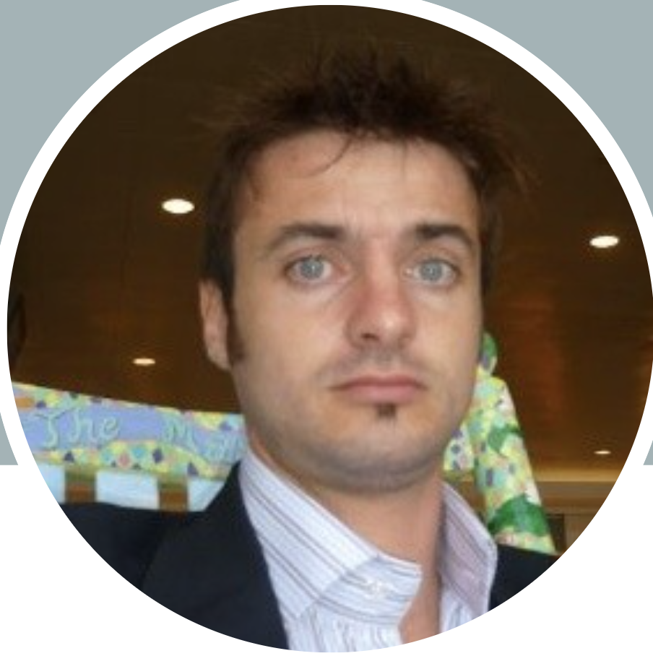
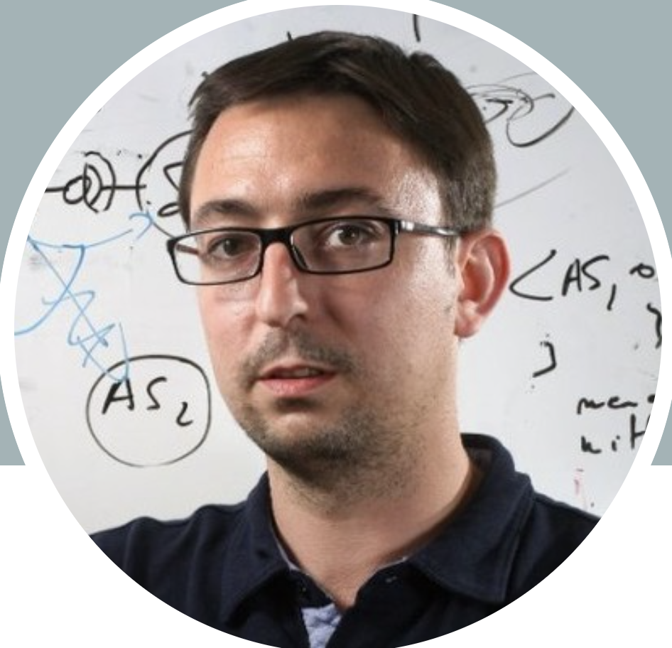
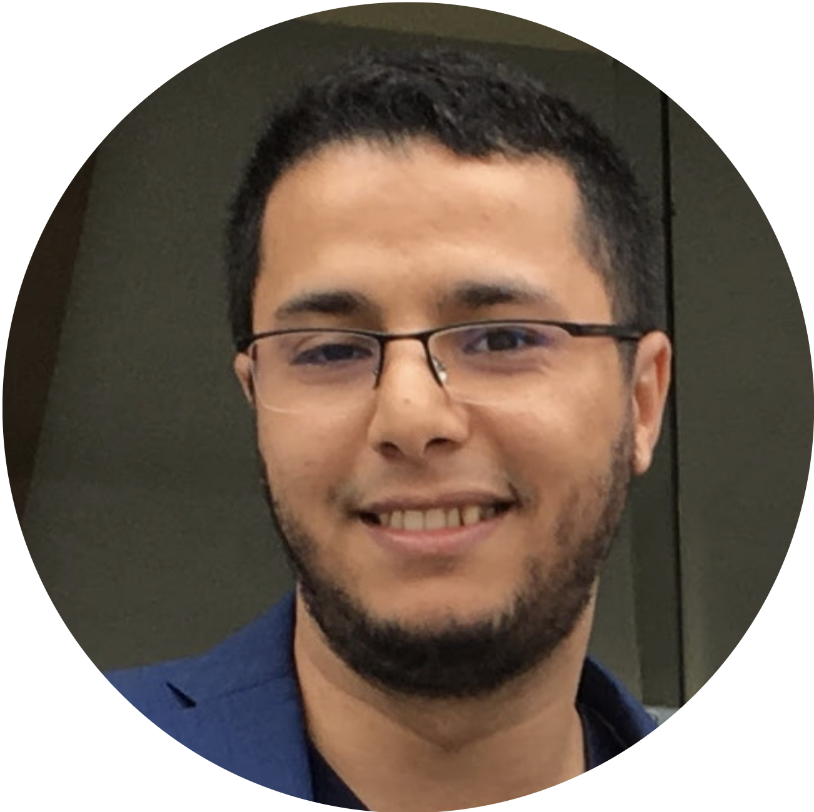
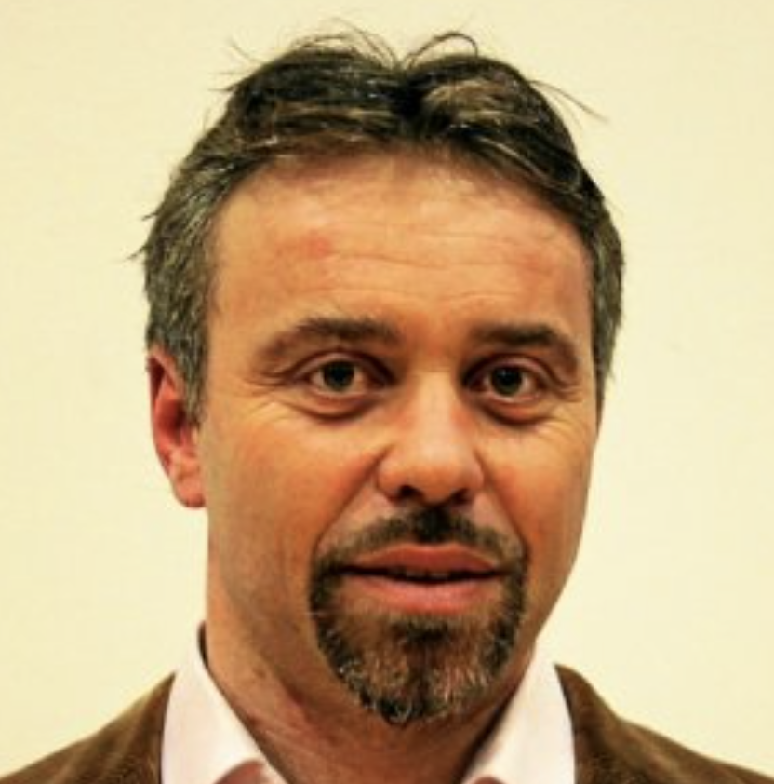

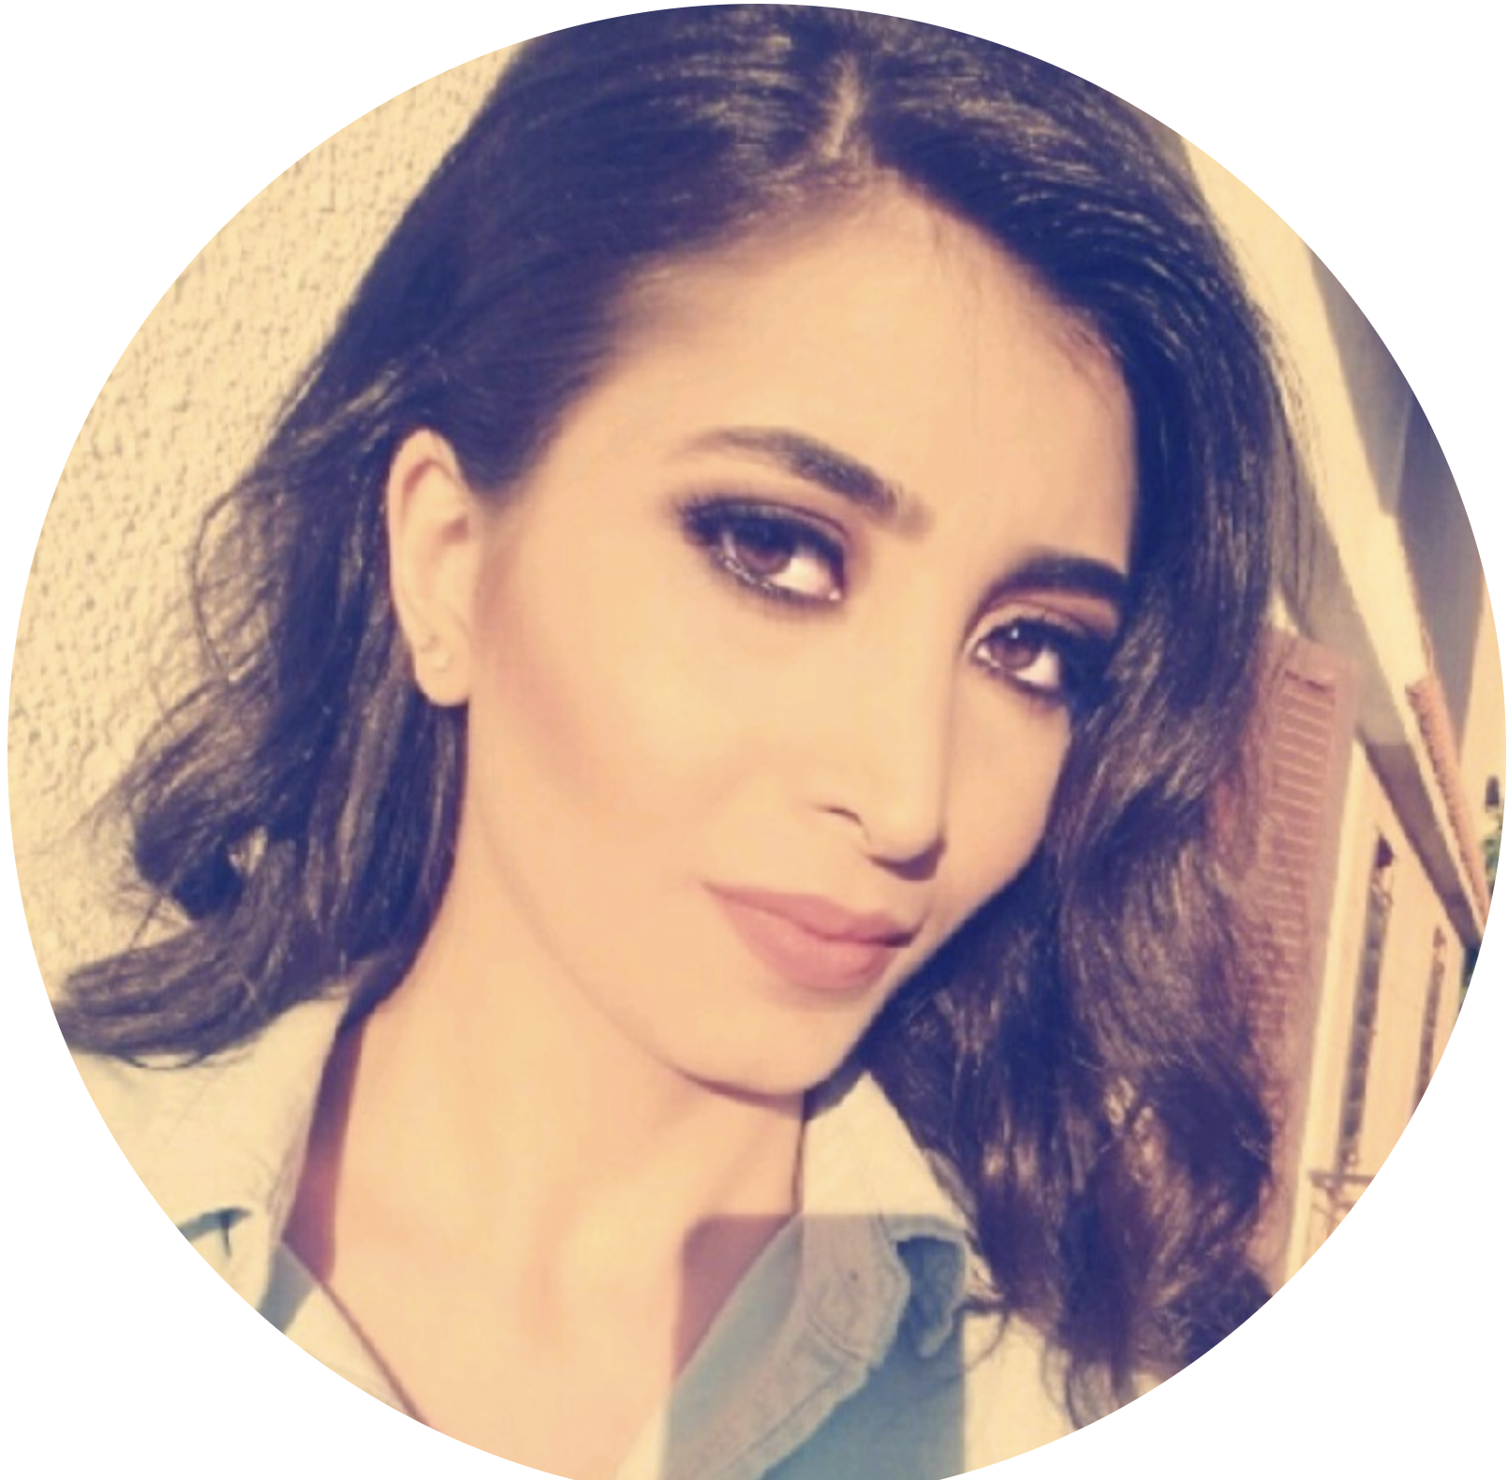
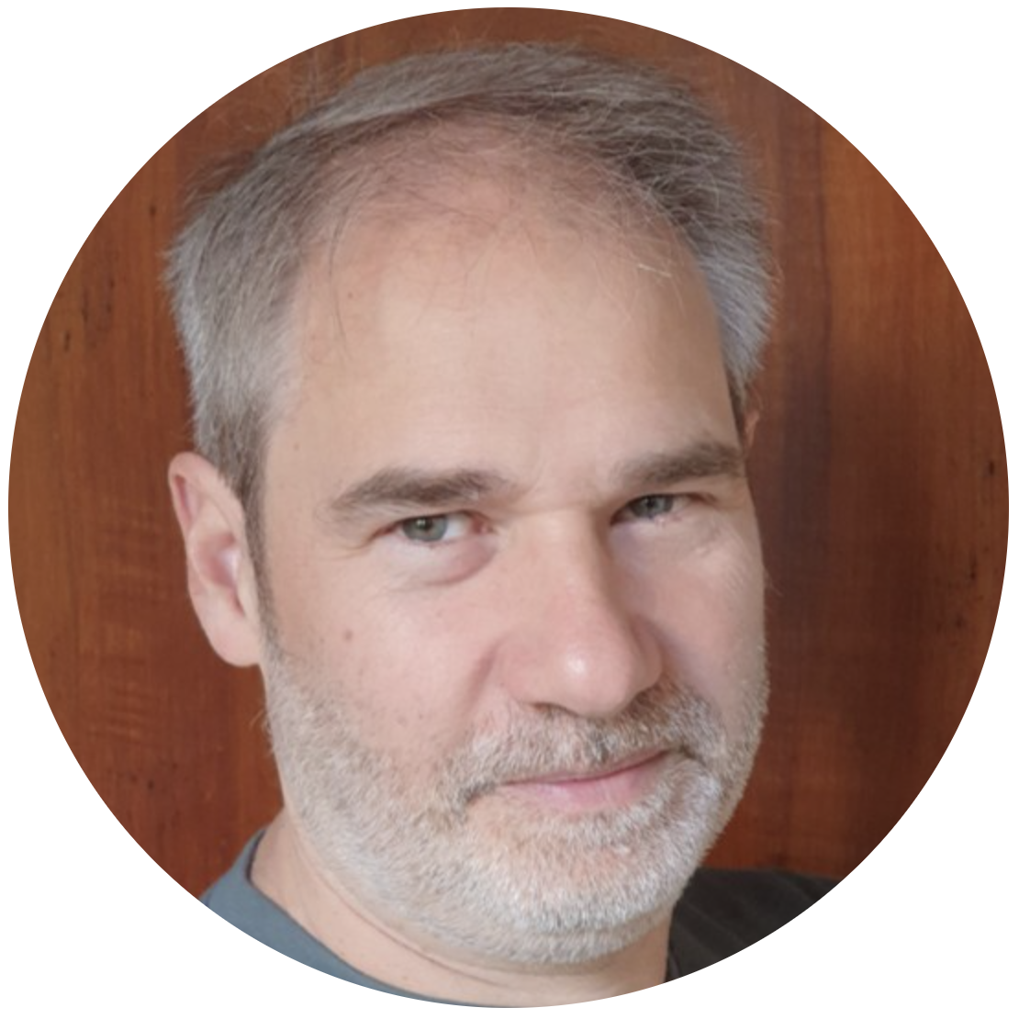
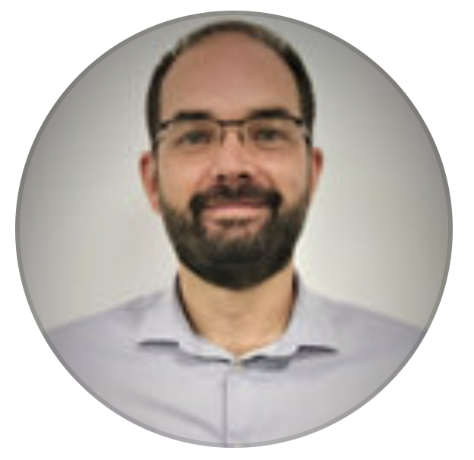
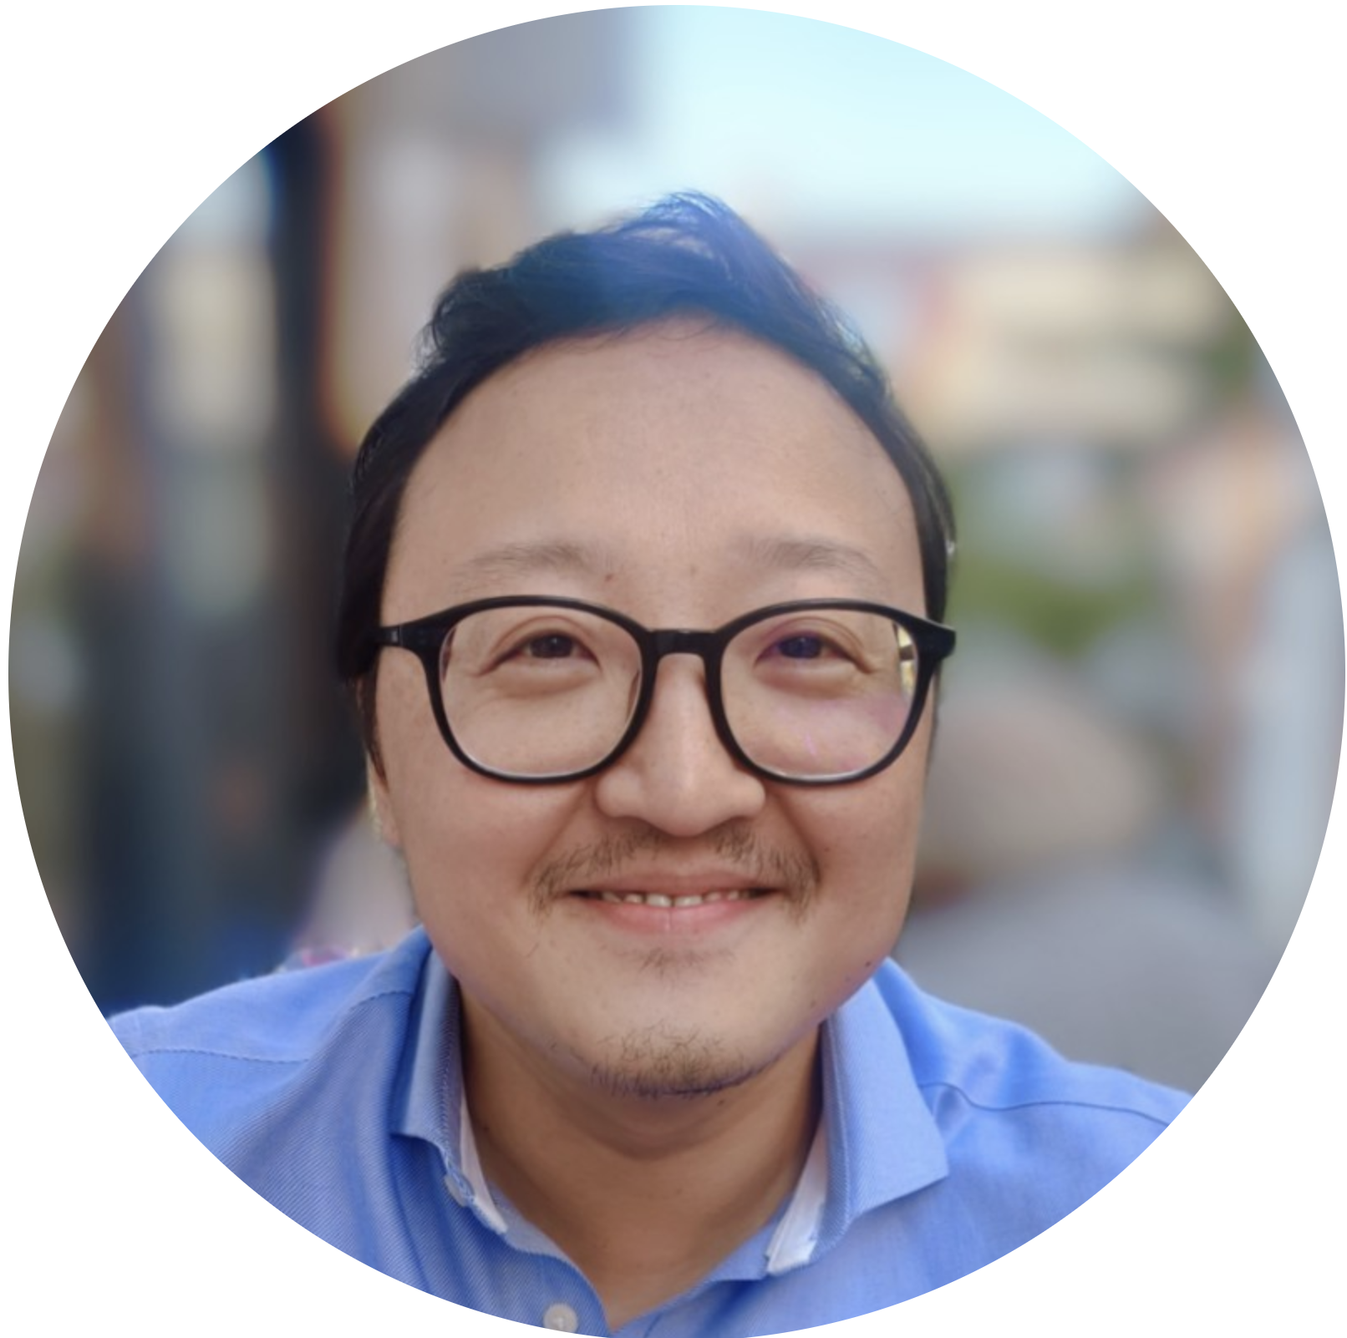
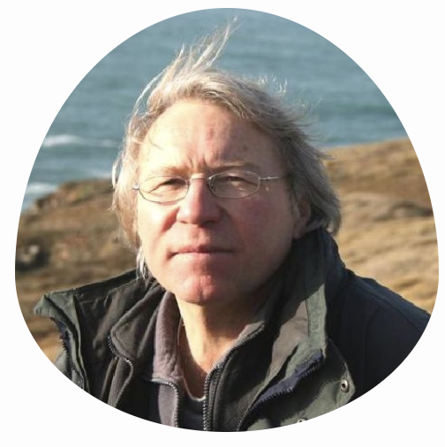
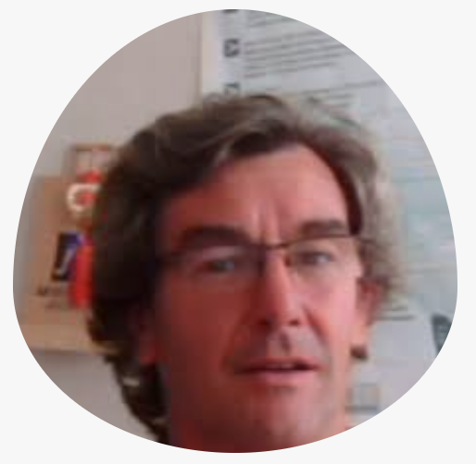
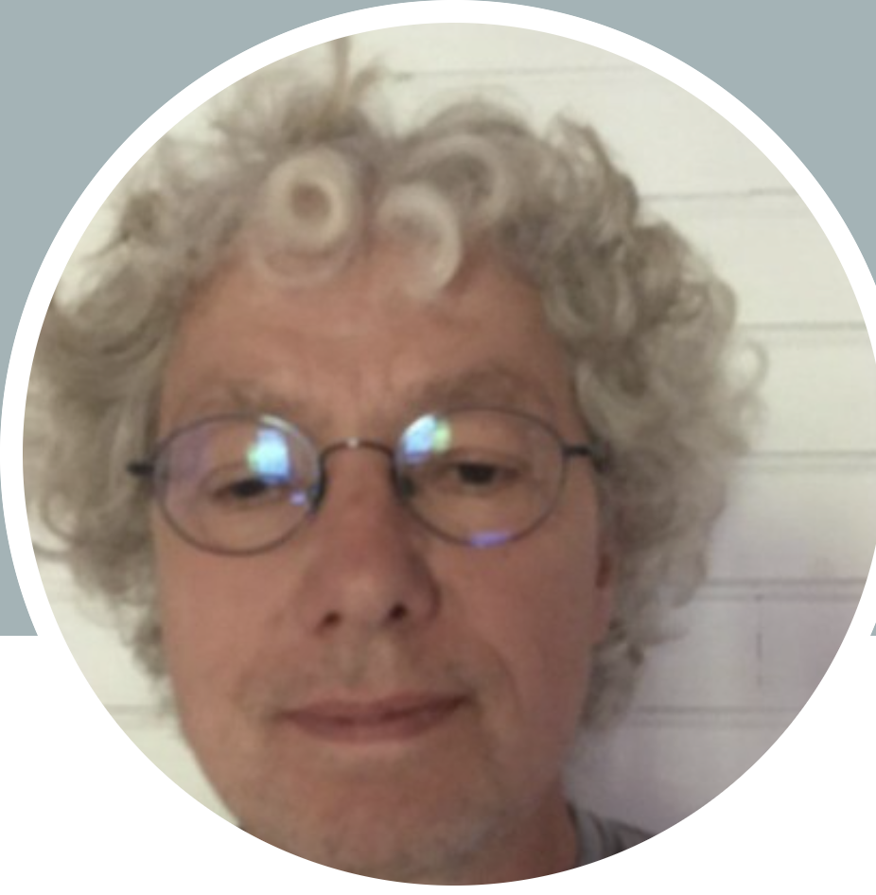
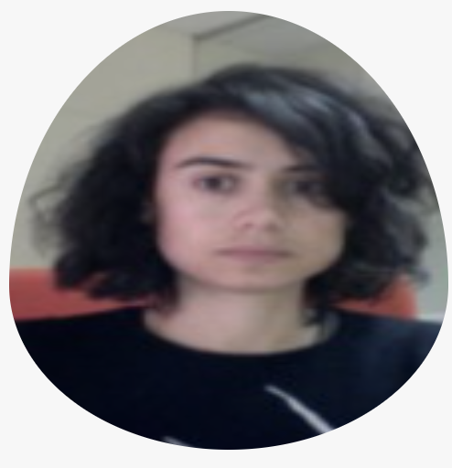
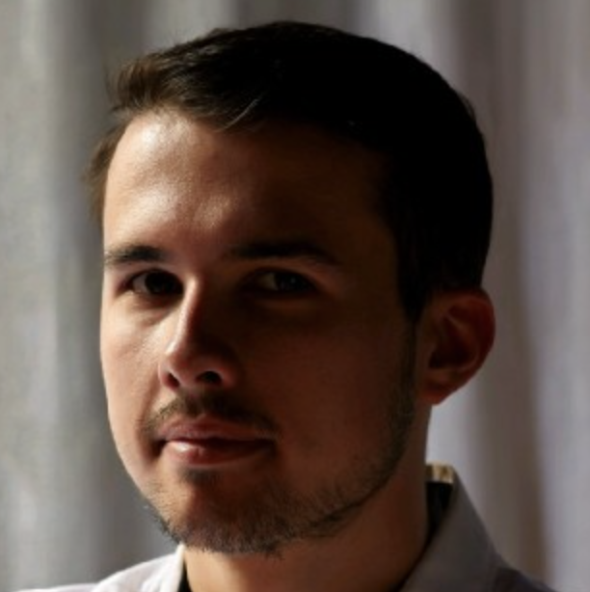
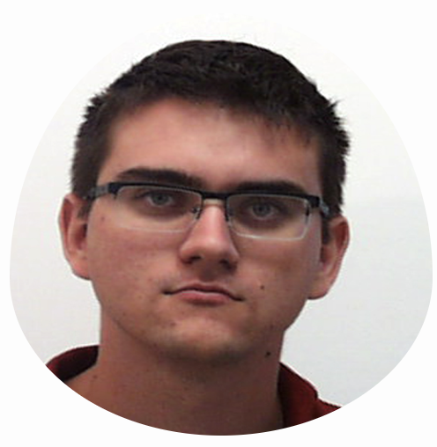
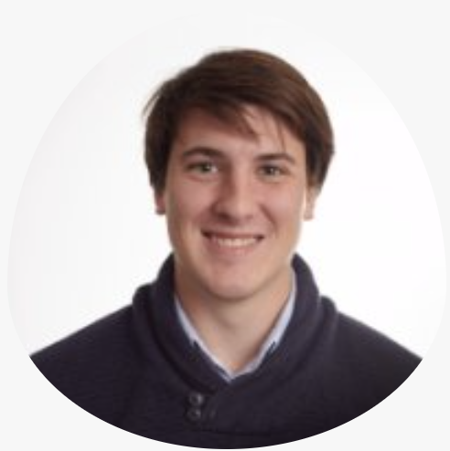
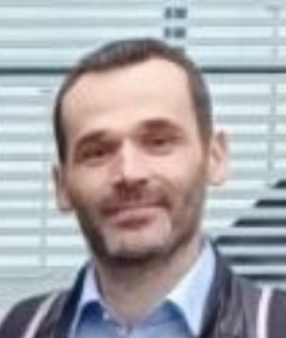
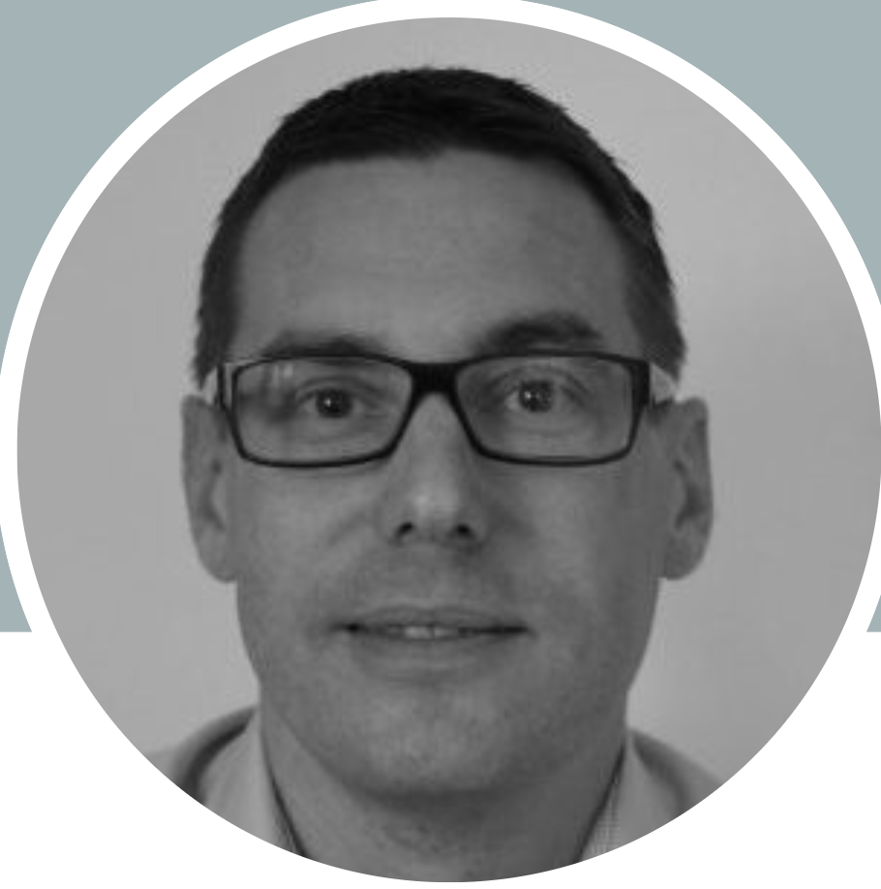
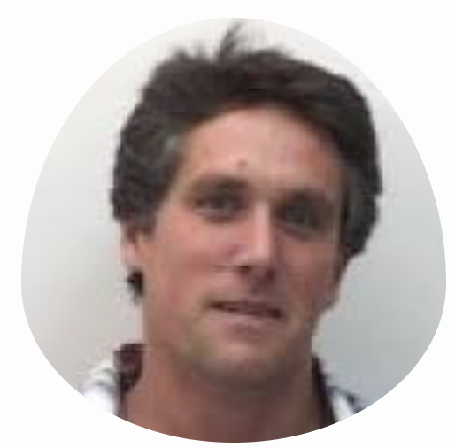
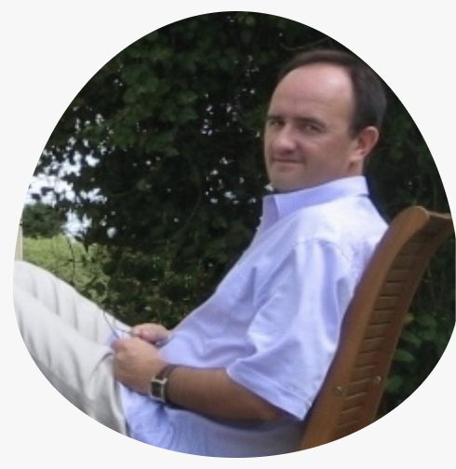
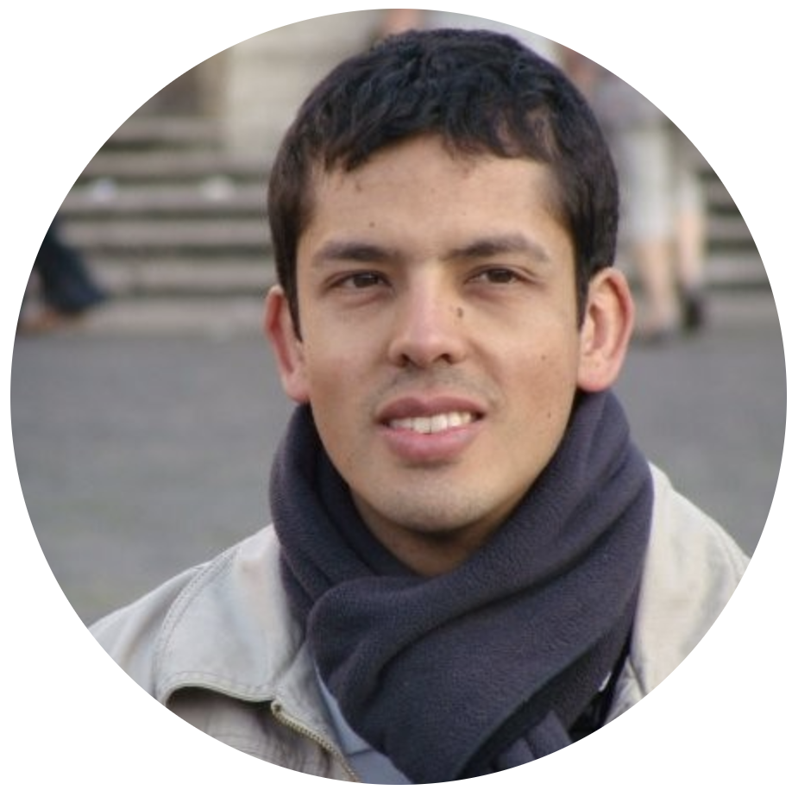
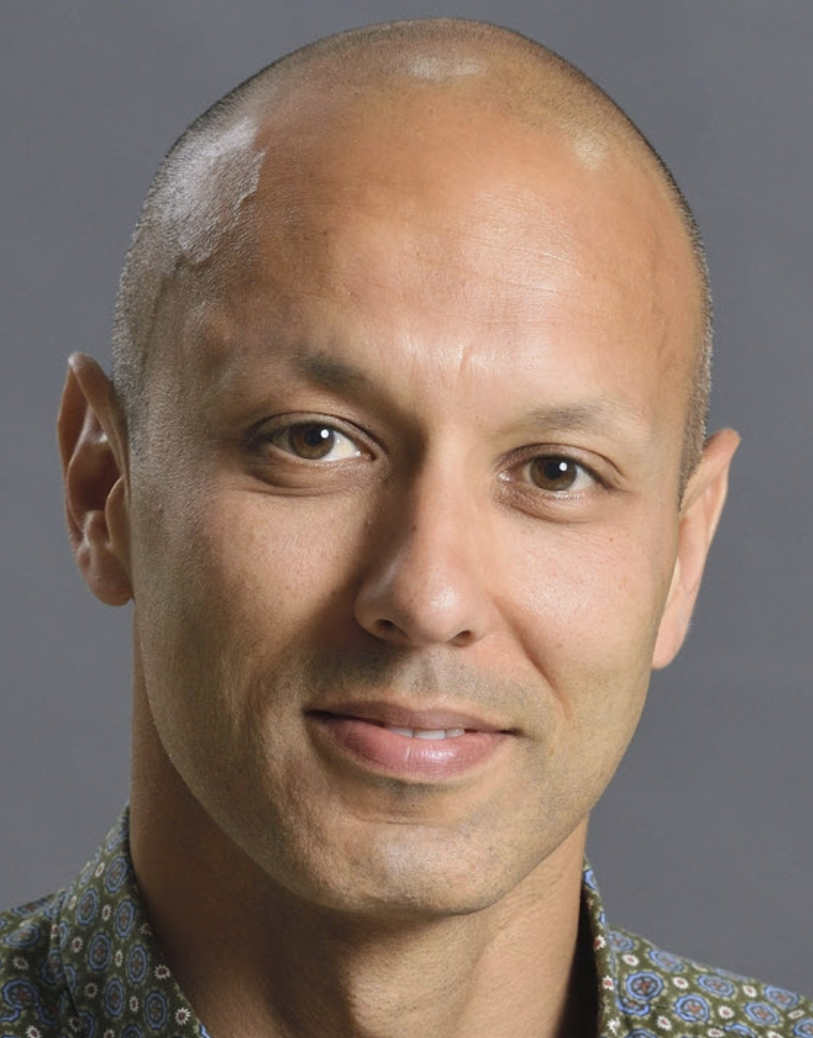

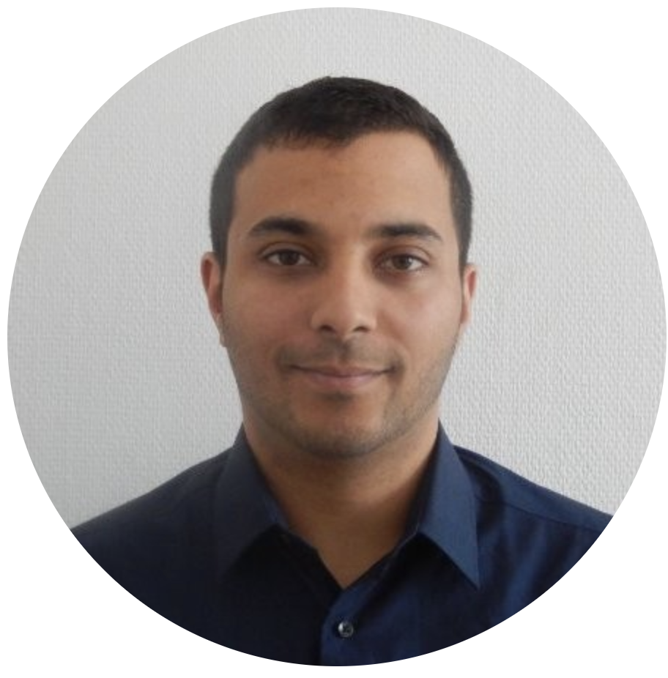
PhDs
Academic collaborators
Postdocs
Jean-Philippe
Schneider
Thank
you!
Research Engineers
Practitioners from industry
Etienne
Prun
Highly influential colleagues
Some exceptional students
Eric
Brunel

Slide 58
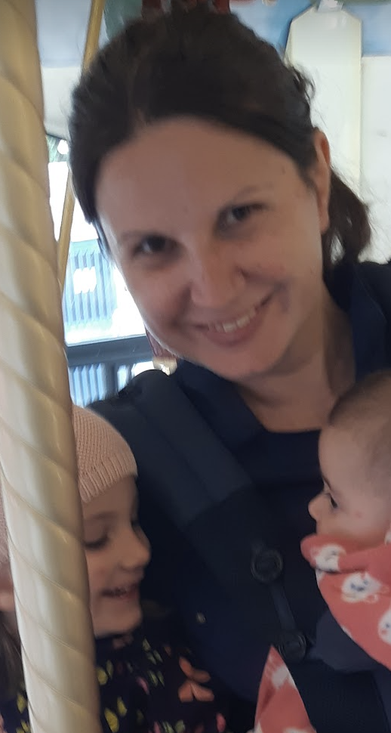
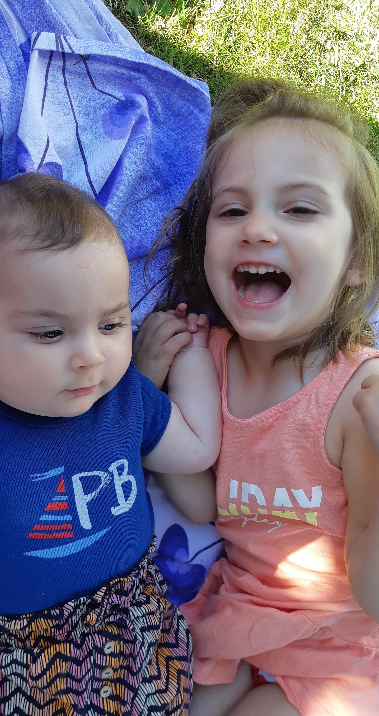
Thank you!

