Slide 1

G∀min∃: Exploring the Boundary between Executable Specification Languages & Behavior Analysis Tools
www.obpcdl.org
Habilitation à diriger des recherches
Ciprian TEODOROV
https://www.ensta-bretagne.fr/teodorov
ciprian.teodorov@ensta-bretagne.fr
P4S, Lab-STICC, UMR CNRS 6285
3 april 2023

Slide 2
Overview
Executable specifications & behavior analysis monitors
Transformations: The shy semantics and the inaccessible monitors.
When the semantics decides to open up the monitors are interested.
When G∀min∃ experiences the real world.
Sum up and ways forward.

Slide 3
Context: Domain-specific languages
General-purpose languages introduce accidental complexities.
Domain experts rely on a shared domain-specific language to alleviate these problems.
Domain-specific languages enable
abstractions (models) focused on the domain of discourse.
tools (conceptual or computer-assisted) adapted to the domain

Slide 4
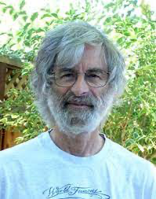
Context: Executable specifications
eXecutable Domain-Specific Languages (xDSL) for handling behaviors.
  Programming languages = prescriptive xDSLs
    force the computer to perform some behavior.
  Thinking above the code[1], specifying, requires a problem-oriented mindset
Executable-Specifications capture the behavior to study it in captivity
  Descriptive xDSL that reflect how the object behaves
Descriptive [2]:
presenting observations about the characteristics of something
factually grounded or informative rather than normative, prescriptive or emotive
[1] Leslie Lamport: Thinking Above the Code
[2] (https://www.merriam-webster.com/dictionary/descriptive)

Slide 5
a Zoo of Executable Specification Languages
Physical processes
Temporal logic
LTL
CTL*
Temporal Logic of Actions (TLA+)
Computable functions
Lambda calculus
Turing machines
Automata
NFA
PDA
Statecharts
Concurrency
HDLs
VHDL[-AMS]
[System-]Verilog[-A]
Calculus [Newton and Leibniz]
Actor models – Hewitt
Petri nets
CSP – Hoare

Slide 6
Terminology
Language monitoring[KHC91] is the process of observing
the execution of a computer program
expressed in a given programming language.
[KHC91] Amir Kishon, Paul Hudak, and Charles Consel. 1991. Monitoring semantics: a formal framework for specifying, implementing, and reasoning about execution monitors. In Proceedings of the ACM SIGPLAN 1991 conference on Programming language design and implementation (PLDI '91). Association for Computing Machinery, New York, NY, USA, 338–352. https://doi.org/10.1145/113445.113474

Slide 7
Terminology: In our context
Language monitoring[KHC91] is the process of observing
the behavior of an executable specification
expressed in a given specification language.
In the following:
the tools that enable this process will be referred to as:
language monitors, or simply monitors
runtime monitors are a subclass of language monitors

Slide 8
a Zoo of Language Monitors
Monitor
Model-checker
Debugger
Profiler
Tracer
Executor
Moldable [1]
Omniscient [2]
Multiverse [3]
MetaSpy [4]
DSProfile [5]
LTSmin [6]
[1] Chiş et al. ”The Moldable Debugger: A Framework for Developing Domain-Specific Debuggers.” SLE 2014.
[2] Bousse et al. “Omniscient Debugging for Executable DSLs.” JSS 2018.
[3] Torres Lopez et al. "Multiverse debugging: Non-deterministic debugging for non-deterministic programs." ECOOP 2019.
[4] Bergel et al. "Domain-specific profiling." TOOLS 2011.
[5] Sloane et al. "Domain-specific program profiling and its application to attribute grammars and term rewriting." SCP 2014.
[6] Kant et al. ”LTSmin: High-Performance Language-Independent Model Checking.” TACAS 2015.

Slide 9
How to bridge the gap between the specification languages and the language monitors running on ever more heterogeneous platforms?
Languages
Monitors
Platforms

Slide 10
2. Transformations: the Shy Semantics and the Inaccessible Monitors.
Understanding the problem
Looking for high-level solutions

Slide 11
Many Semantics – Many Runtime Monitors
Model 1
Formal
Semantics
Monitor
Runtime 1
Semantic gaps
Equivalence problems
Model 2
Executable
Specification
Monitor
Runtime 2
Model 3
Execution
Runtime
Monitor
Runtime 3
Result 3
Model 4
Monitor
Runtime 4

Slide 12


, IF [Dragomir+22]
SPOT [DP04], LTSmin [Kan+15]
A#1
A#7
A#4
AnimUML [Jouault+20]
EMI [Besnard+21]
A#2
Spin [Hol97]
A#5
P#1 Semantic gap between design model and analysis model
P#2 Semantic gap between design model and executable code
P#3 Equivalence problem between the analysis model and executable code
A#3
Divine [Bar+17]
A#6
Java PathFinder [Bra+00]
V. BESNARD, “EMI: Une approche pour unifier l’analyse et l’exécution embarquée à l’aide d’un interpréteur de modèles pilotable”,
Application aux modèles UML des systèmes embarqués, Ph.D. Thesis, Dec. 2020.

Slide 13
A#1
A#7
A#4
A#2
A#5
 | A#1 | A#2 | A#3 | A#4 | A#5 | A#6 | A#7
P#1 | ✘ | ✘ | ✓ | ✓ | ✓ | ✓ | ✓
P#2 | ✘ | ✘ | ✘ | ✘ | ✘ | ✓ | ✓
P#3 | ✘ | ✘ | ✘ | ✘ | ✘ | ✘ | ✓
A#3
A#6
V. BESNARD, “EMI: Une approche pour unifier l’analyse et l’exécution embarquée à l’aide d’un interpréteur de modèles pilotable”,
Application aux modèles UML des systèmes embarqués, Ph.D. Thesis, Dec. 2020.

Slide 14
One Semantics – Many Language Monitors

Slide 15
Make it Simple & Modular
Semantic
Language
Interface

Slide 16
Make it Simple & Modular
Q1: What is the SLI interface?
Q2: Where is the toolbox?
Missing toolbox ?
Semantic
Language
Interface

Slide 17
3. When the Semantics Decides to Open up the Monitors are Interested.
Requirements
G∀min∃ Semantic Language Interface
An illustration

Slide 18
Ingredients:
Subject Language
Syntax
Definition
Execution & Monitoring
conformsTo
interprets
Semantics
Semantic
Language
Interface (SLI)
Monitoring
Bridge
Model
providesA
dependsOn
runs
Execution
Controler
Sequencer
Emptiness
Checker
Interactive

Slide 19
Requirements:
Subject Language
Syntax
Definition
Execution & Monitoring
conformsTo
Semantics
Semantic
Language
Interface (SLI)
Monitoring
Bridge
Model
interprets
providesA
dependsOn
runs
[R01] Completeness
[R02] Non-Interference
[R03] Genericity
[R04] Composability
[R05] Unanticipated Monitoring
[R06] Minimize the Gap
[R07] Break the Rules
[R08] Portability
[R09] Ease Semantics Integration
[R10] Ease Monitor Integration
Execution
Controler
Sequencer
Emptiness
Checker
Interactive

Slide 20
G∀min∃ Semantic Language Interface (SLI)
SLI (C A E V R ⍺) {
semantics: (C A) {
initial: set C
actions: C → set A
execute: A → C → set C
}
evaluate: E → (C → A → C) → V -- questions
reduce: R → C → ⍺ -- reductions
π: (C A V ⍺ T) {…} -- projections
}
Generic Types:
Configuration,
Action,
Expression,
Value,
Reduction Exp.
⍺: Reduced Config.
execution step

Slide 21
SLI for Lambda Calculus
Syntax:
E ≜ x //variable
| E₁ E₂ //application
| λ x. E //abstraction
CEK-style Semantics [ABM’14]:
lookup≜⟨ x, ρ , κ⟩⟶⟨ ρ[x].1, ρ[x].2 , κ⟩
app ≜⟨e₁ e₂, ρ , κ⟩⟶⟨ e₁, ρ ,⟨◯ e₂ ρ ⟩::κ⟩
arg ≜⟨ v, ρ₁, ⟨◯ e ρ₂⟩::κ⟩⟶⟨ e , ρ₂ ,⟨v ◯ ρ₁⟩::κ⟩
body ≜⟨ v, ρ₁, ⟨λx.e ◯ ρ₂⟩::κ⟩⟶⟨ e , ρ₂[x↦⟨v,ρ₁⟩], κ⟩
SLI Semantics Definition
rules: { lookup, app, arg, body }
semantics: (C A) {
initial: set C := {⟨exp, ∅, []⟩}
actions: C → set A
| c => rules.where(r => r.enabledIn c)
execute: A → C → set C
| r c => { r.applyIn c }
}
Domains:
Value ≜ λx.e Closure ≜ ⟨v,ρ⟩
ρ ≜ {variable ↦ closure}// Environment
Frame ≜ ⟨c ◯⟩ | ⟨◯ e ρ⟩
C ≜ ⟨E, ρ, [Frame]⟩ //Configuration
A ≜ ⟨ ⟩⟶⟨ ⟩ //Action = rule
[ABM’14] B. Accattoli, P. Barenbaum, and D. Mazza.
Distilling Abstract Machines. ICFP '14

Slide 22
Lambda
Expression
Sequencer
interprets
execute
λ CEK
Semantics
SLI
Sequencer(sli) {
current = sli.initial.any
while (current != ∅) {
action = sli.actions(current).any
current= sli.execute(action,current).any
}
}
where:
sli is deterministic <=> ∀ a c, |initial| = |actions c| = |execute a c| = 1

Slide 23
4. When G∀min∃ experiences the real world.
  Some experiences unravel reusable monitoring bridges
  Transfer to commercial products -- OBP2 inside
  Exploring hardware execution
  Multiverse debugging made simple and more powerful
  From zero to model-checker in 30 Hours

Slide 24
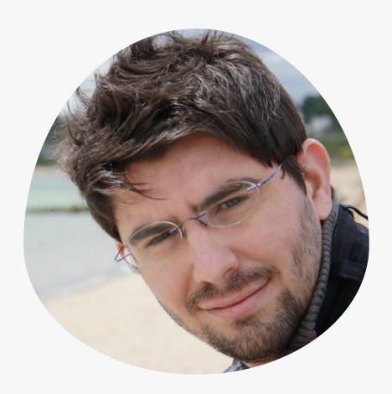
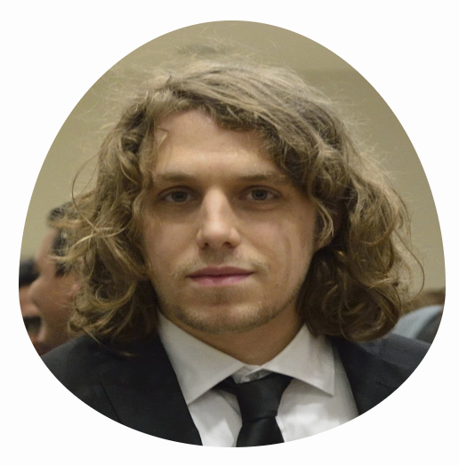
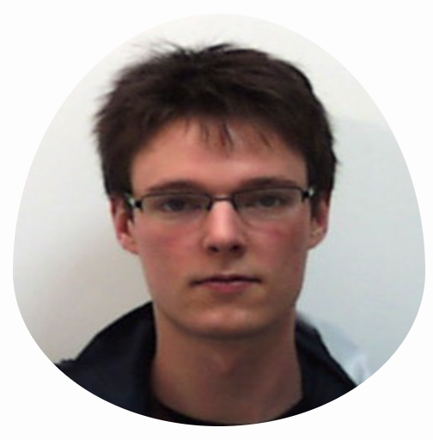
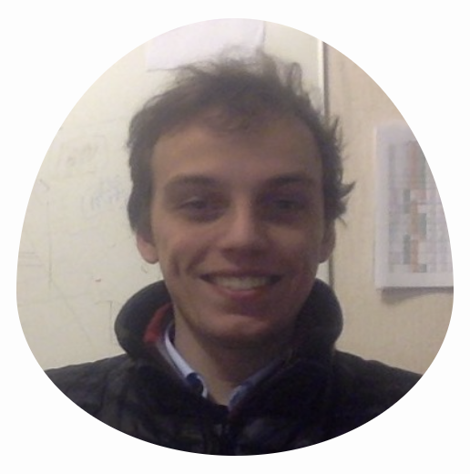
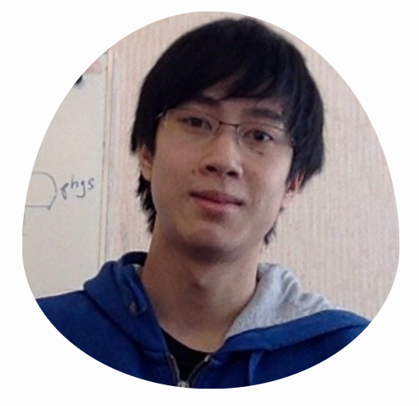

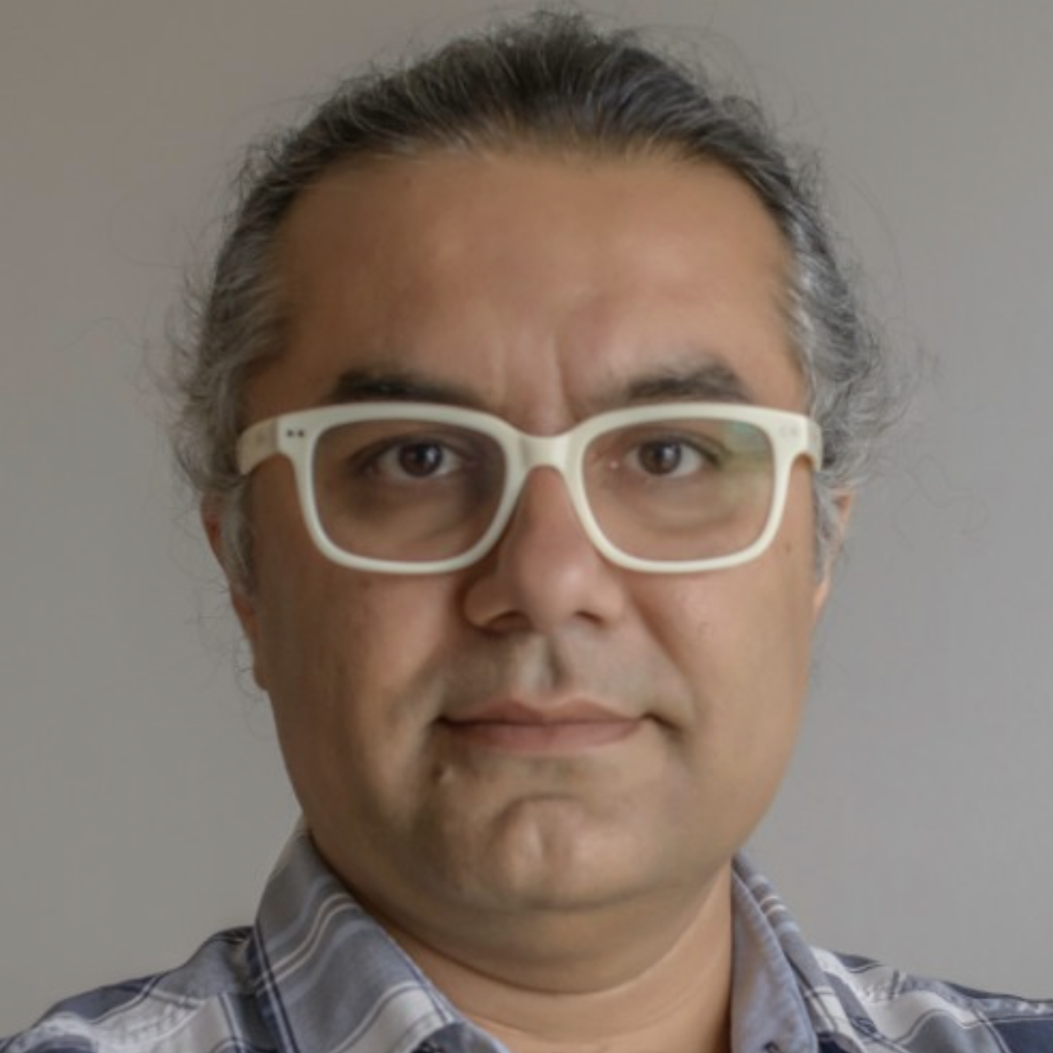
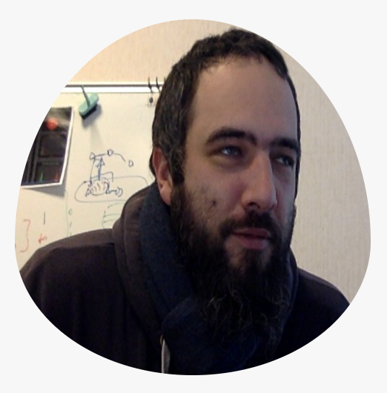
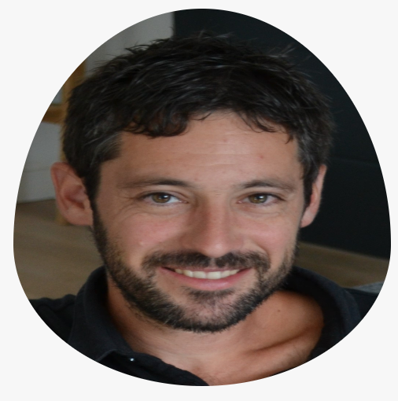












OBP2 Research Vehicle
Safety & Liveness
Temporal Requirements
2015-2023
B. DROUOT
J.C. ROGER
T. BOLLENGIER
Emilien
FOURNIER
2022
Nicolas
SUN
2022
Matthias
PASQUIER
in progress
L.LE ROUX
F. GOLRA
Projects:
ONEWAY (DGAC)
Ker-SEVECO (R.Bretagne,ERDF)
JoinSafeCyber (AID)
VeriMoB (RAPID)
EASE4SE (RAPID)
DEPARTS (PIA)
GeMoC (ANR)
Semantic
Language
Interface
Luka
LE ROUX
2018
Vincent
LEILDE
2019
Valentin
BESNARD
2020
Commercial Products [ PragmaDEV ]
Academic Prototypes [ in-house ]
Reuse [ OTS ]
AnimUML
EMI-UML
AEFD
TLA+
Fiacre

Slide 25
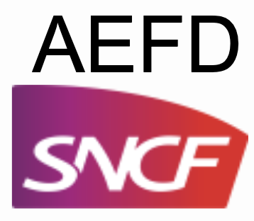
AEFD
Specification
interprets
AEFD
Semantics
SLI
PhD Luka
LE ROUX
verify
Model-checker
⨯
SLI
Property
Semantics
interprets
Safety
Specification
SLI
Emptiness
Checker
PIA DEPARTS
PIA DEPARTS

Slide 26
Partially Bounded
Context-Aware Verification, SEFM’19
Fiacre
Specification
interprets
Fiacre
Semantics
SLI
PhD Luka
LE ROUX
verify
Model-checker
⨯
SLI
Guide
Semantics
interprets
Verification
Guide
SLI
⨯
SLI
CDL
Semantics
interprets
CDL Prop
Specification
SLI
PastFree[ze]
Checker
Emptiness
Checker
PIA DEPARTS
PIA DEPARTS

Slide 27
Executable
Specification
Sequencer
interprets
execute
Semantics
SLI
?
verify
Model-checker
⨯
SLI
Property
Semantics
interprets
Temporal
Specification
SLI
Emptiness
Checker

Slide 28
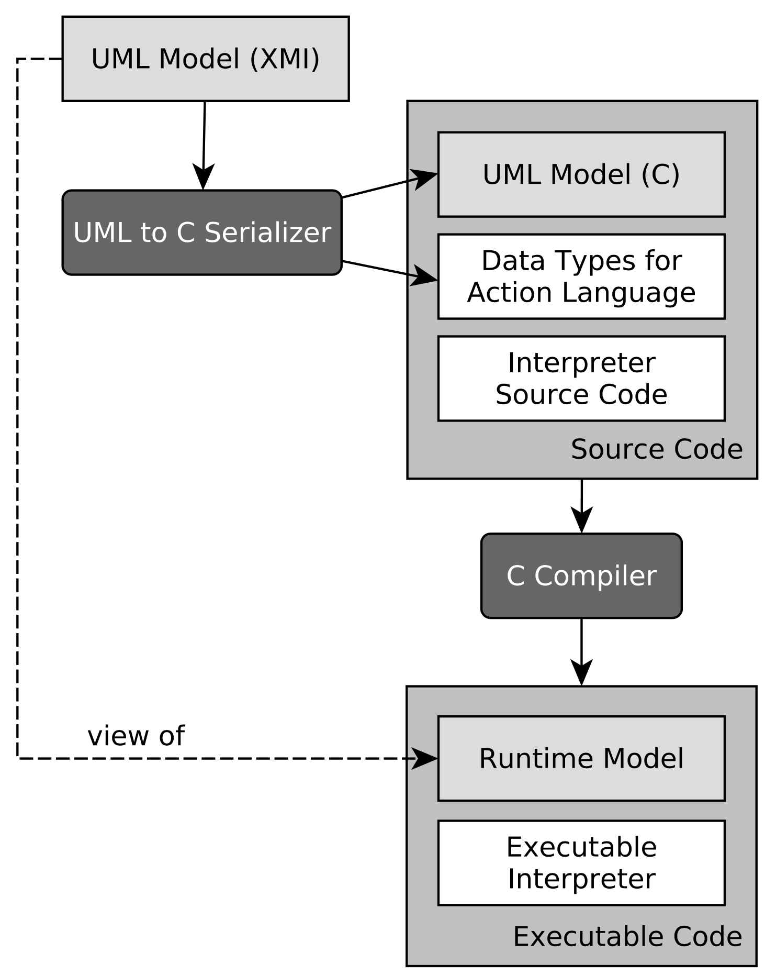


Bare-metal STM32 - ARM A9
UML
Specification
Sequencer
interprets
EMI
Semantics
SLI
?
PhD Valentin
BESNARD
Unified LTL Verification and Embedded Execution of UML Models, MODELS’18
Model-checker
⨯
SLI
GPSL
Semantics
interprets
GPSL
Specification
SLI
Emptiness
Checker

Slide 29
Bare-metal STM32 - ARM A9
UML
Specification
Scheduling
Policy
Sequencer
interprets
interprets
EMI
Semantics
SLI
Scheduler
SLI
?
PhD Valentin
BESNARD
Modular Scheduling for Both Verification & Embedded Execution.
to appear.
Model-checker
⨯
SLI
PUSM EMI
Semantics
interprets
PUSM
Specification
Unified verification and monitoring of executable UML specifications.
A transformation-free approach.
SoSyM’21.
SLI
Emptiness
Checker

Slide 30
Bare-metal STM32 - ARM A9
UML
Specification
Scheduling
Policy
Sequencer
interprets
interprets
EMI
Semantics
SLI
Scheduler
SLI
?
PhD Valentin
BESNARD
EMI
Semantics
SLI
||
interprets
SLI
UML
Environment
Modular Scheduling for Both Verification & Embedded Execution.
to appear.
Model-checker
⨯
SLI
PUSM EMI
Semantics
interprets
PUSM
Specification
Unified verification and monitoring of executable UML specifications.
A transformation-free approach.
SoSyM’21.
SLI
Emptiness
Checker

Slide 31
Bare-metal STM32 - ARM A9
UML
Specification
Scheduling
Policy
Sequencer
interprets
interprets
EMI
Semantics
SLI
Scheduler
SLI
?
PhD Valentin
BESNARD
EMI
Semantics
SLI
||
interprets
SLI
UML
Environment
Model-checker
Filter
interprets
Filtering
Policy
Modular Scheduling for Both Verification & Embedded Execution.
to appear.
SLI
⨯
SLI
PUSM EMI
Semantics
interprets
PUSM
Specification
Unified verification and monitoring of executable UML specifications.
A transformation-free approach.
SoSyM’21.
SLI
Emptiness
Checker

Slide 32
Bare-metal STM32 - ARM A9
UML
Specification
Scheduling
Policy
Sequencer
Sequencer
interprets
interprets
EMI
Semantics
SLI
Scheduler
SLI
?
⨯
SLI
Acceptance
Asserter
PhD Valentin
BESNARD
EMI
Semantics
SLI
||
SLI
PUSM EMI
Semantics
interprets
PUSM Monitor
Specification
interprets
SLI
UML
Environment
Model-checker
Filter
interprets
Filtering
Policy
Unified verification and monitoring of executable UML specifications.
A transformation-free approach.
SoSyM’21.
Verifying and Monitoring UML Models with Observer Automata. MODELS’19.
SLI
⨯
SLI
PUSM EMI
Semantics
interprets
PUSM
Specification
SLI
Emptiness
Checker

Slide 33
4. When G∀min∃ experiences the real world.
  Some experiences unravel reusable monitoring bridges
  Transfer to commercial products -- OBP2 inside
  Exploring hardware execution
  Multiverse debugging made simple and more powerful
  From zero to model-checker in 30 Hours

Slide 34
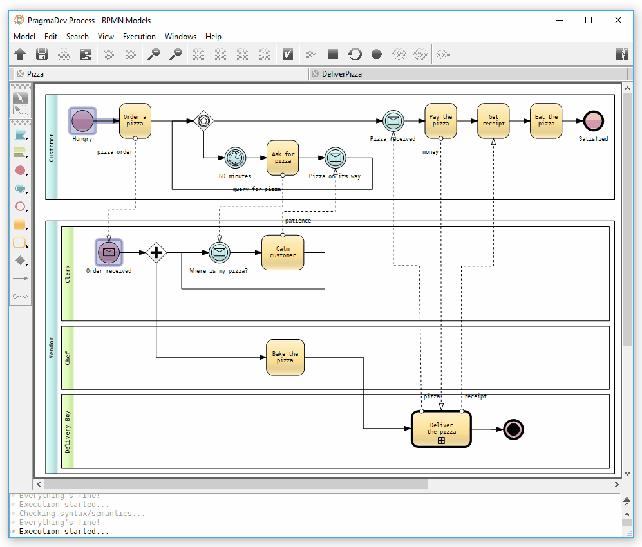
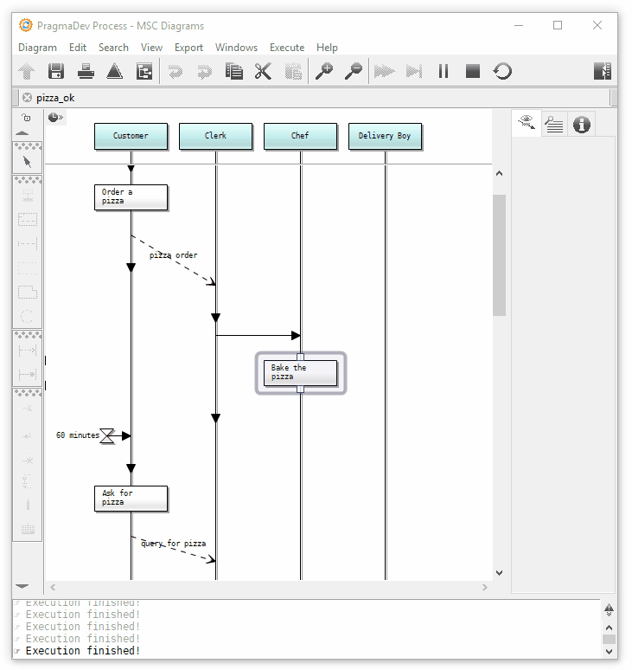
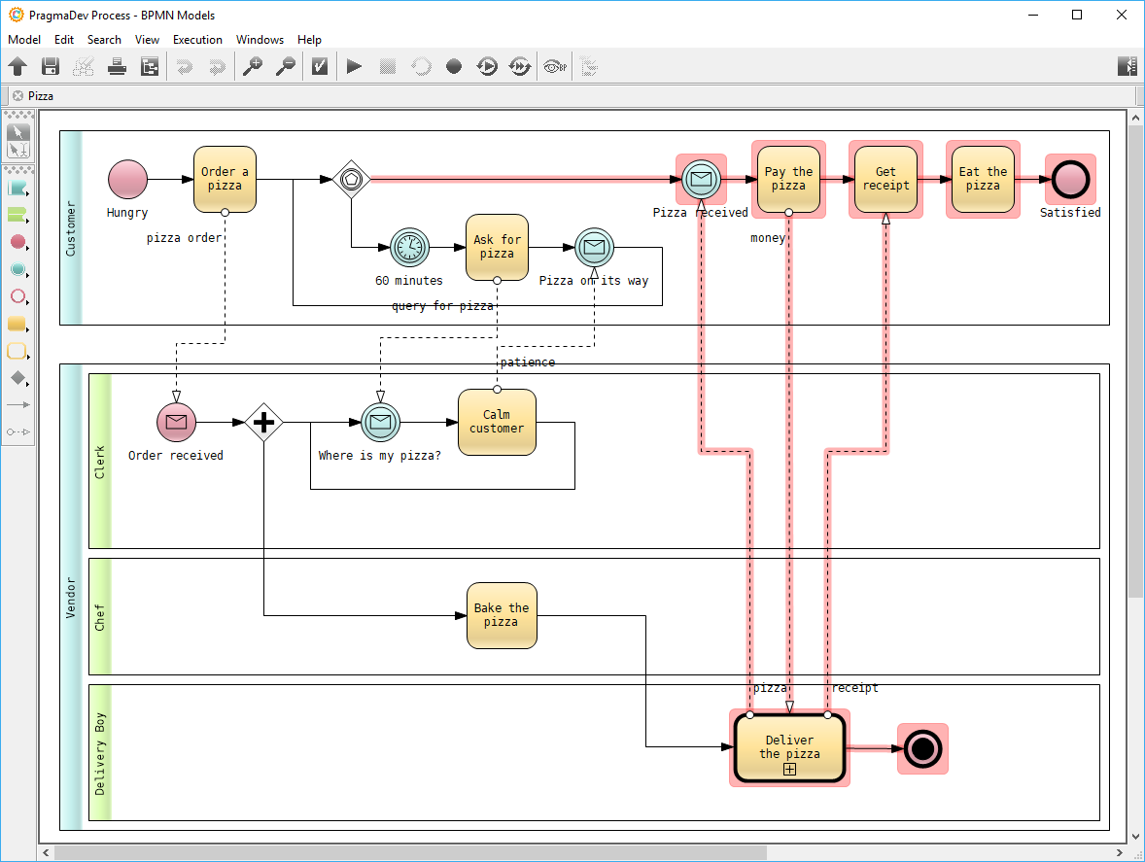
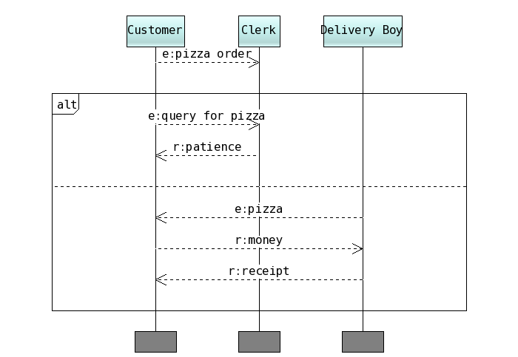

SLI
Property Sequence Chart
Model-checker
⨯
SLI
GPSL
Semantics
interprets
GPSL
Specification
SLI
M. Brumbulli et al., ERTS 2020
M. Brumbulli et al., CSD&M 2020
Emptiness
Checker
RAPID VeriMoB

Slide 36
4. When G∀min∃ experiences the real world.
  Some experiences unravel reusable monitoring bridges
  Transfer to commercial products -- OBP2 inside
  Exploring hardware execution
  Multiverse debugging made simple and more powerful
  From zero to model-checker in 30 Hours

Slide 37
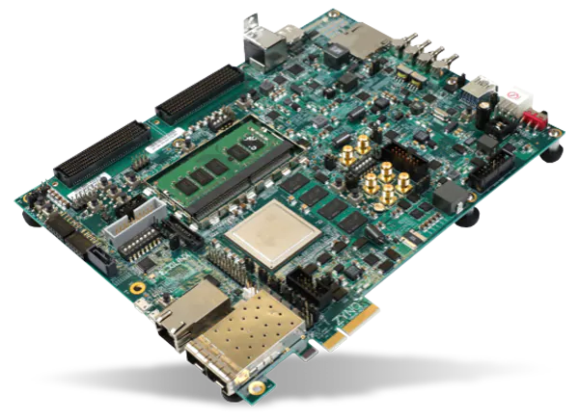
From Embedded
to Hardware Execution
UML
Specification
EMI
Semantics
SLI
Menhir
VCore
PhD Valentin
BESNARD
UML
Specification
GPSL
Properties
PhD Emilien
FOURNIER
ARM A9
Artix-7 FPGA
EMI
Semantics
SLI
Zynq XC7Z020-CLG484
ARM A9
x64
STM32F4 Discovery
Workstation
DVE C
Semantics
SLI
Menhir
VCore
DSD’20
FPL’21
DATE’22
ARM A9
Artix-7 FPGA
DVE
Specification
DVE
Properties
Zynq XC7Z020-CLG484
DVE2VHDL
VHDL
Model
SLI
Dolmen
VCore
VHDL
Model
SLI
Menhir
VCore
Virtex UltraScale+ XCVU37P FPGA
Artix-7 FPGA
Région Bretagne
CPER CyberSSI
Zynq XC7Z020-CLG484

Slide 38
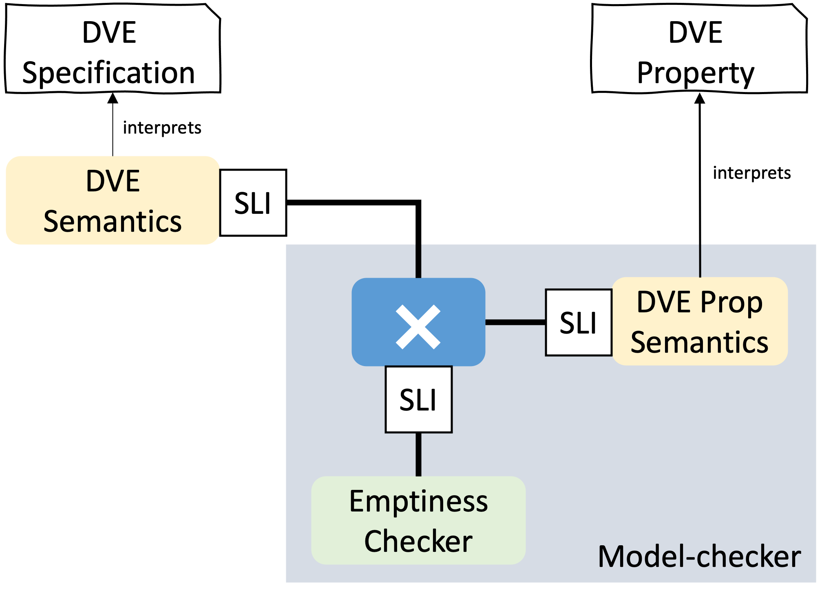
DATE’22
Dolmen: 1st Hardware Swarm Engine
for Both Safety & Liveness Verification
PhD Emilien
FOURNIER
  Swarm of 32 deeply pipelined verification cores
  Distributed control architecture, for large SSI-FPGAs
  4874x average speedup over software (Divine 3)
Virtex FPGA
M_{action}
M_{action}
Prop_{action}
distribute
M_{action}
serialize
distribute
Prop_{action}
serialize
M_{action}
Prop_{action}
M_{action}
Prop_{action}
M_{action}
Pred
Frontier
Known
Mixer
Région Bretagne
CPER CyberSSI

Slide 39
4. When G∀min∃ experiences the real world.
  Some experiences unravel reusable monitoring bridges
  Transfer to commercial products -- OBP2 inside
  Exploring hardware execution
  Multiverse debugging made simple and more powerful
  From zero to model-checker in 30 Hours

Slide 40
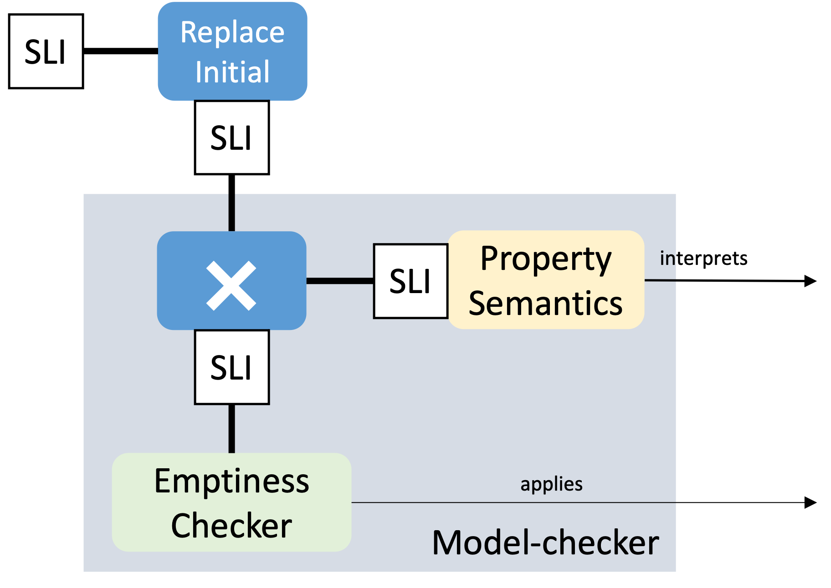


AnimUML
Specification
Multiverse Debugger
Semantics
interprets
AnimUML
Semantics
SLI
step
PhD Matthias
PASQUIER
jump
select
run2breakpoint
Non-trivial Monitor Composition
4
1
2
3
8
7
Submitted to
ECMFA’23
9
Temporal
Breakpoint
5
6
Reduction
Models’22
SLI
User
uses
Interactive
Controler

Slide 41
4. When G∀min∃ experiences the real world.
  Some experiences unravel reusable monitoring bridges
  Transfer to commercial products -- OBP2 inside
  Exploring hardware execution
  Multiverse debugging made simple and more powerful
  Transfer to future practioners -- From zero to model-checker in 30 Hours

Slide 42
From Zero To Model-Checker in 30 Hours
Class at ENSTA Bretagne the last 2 years

Slide 43
5. Sum Up & Ways Forward
Conclusion
Major Breakthroughs
Perspectives
Track Record

Slide 44
G∀min∃ = a way to bridge the gap between the specification languages and the language monitors running on ever more heterogeneous platforms?
Languages
Monitors
Platforms
embedded: Bare-metal
hardware: FPGA
Model-checker
Multiverse Debugger
Execution Monitor
industrial: BPMN, SDL
reuse: TLA+, Fiacre
academic: UML, AEFD

Slide 45
Major Breakthroughs
A sustainable & composable approach for language monitoring
step-based evaluation plays a major role
1st Hardware Swarm Engine for Both Safety and Liveness Verification
pipelined reformulation of the verification architecture
Established a continuum between debugging and model-checking
language-agnostic under-approximations for scalability
temporal breakpoints

Slide 46
Perspectives
Generalizing the G∀min∃ language monitoring for specification-driven software engineering.
Short term:
  Unifying scheduling and partial-order reduction
  Language-agnostic timed semantics
Midterm:
  Towards open and dynamic abstraction-refinement
    Heterogeneous refinement mappings
    Overapproximations with maximal reuse of the base semantics
  Heterogeneous models
Long term:
  Moldable diagnosis cockpit: language-agnostic portofolio-based diagnosis
    Derive the proof of the soundness of the monitor
  Algebraic algorithm specification
    The isolation of the execution controller in Gamine can be seen as a generalization of recursion schemes from trees to arbitrary graphs.
    Allow non-determinism during algorithm design = design algorithm families
    Dataflow-focus to reduce over-constraining

Slide 47
Track Record
Be curious, Explore,
Expand our understanding,
Share the insights
Phd students:
Matthias Pasquier
Emilien Fournier
Tithnara Sun
Valentin Besnard (prix GDR-GPL)
Vincent Leilde
Luka Le Roux
Lamia Allal
Jean-Philippe Schneider
Postdocs:
Luka Le Roux
Valery Monthe
Bastien Drouout
Fahad Golra
Jean-Charles Roger
Vincent Leilde
Engineers:
Hiba Hnaini
Sylvain Guerin
Fatma Zarka
Nadia Menad
Sebastien Tleye
Ismail Chaida
Papers:
1 patent
9 journal papers
49 conference papers
Software:
OBP2 nominated Systematic Paris-Région ’20
ClockSystem
Phadeo
EMI UML
AnimUML
50+ github repos
Main Projects: ONEWAY, Ker-SEVECO, JoinSafeCyber, VeriMoB, EASE4SE, DEPARTS, GEMOC, Ardyt, Morpheus, ValMadeo
Contracts: DAVIDSON, ERTOSGENER
www.obpcdl.org

Slide 48
Generalizing the G∀min∃ language monitoring for specification-driven software engineering.
Temporal breakpoints.
Scheduling-aware functional verification.
Fully-verified Language Monitors.
Hardware model-checkers
Open and dynamic abstraction-refinement environments
Moldable diagnosis cockpit
Algebraic specifications of complex algorithms
Perspectives

Slide 49
BPMN
Specification
interprets
BPMN
Semantics
SLI
PhD Luka
LE ROUX
Model-checker
⨯
SLI
Property
Semantics
interprets
Safety
Specification
SLI
Emptiness
Checker
PragmaDEV
Airbus
PIA DEPARTS

Slide 50
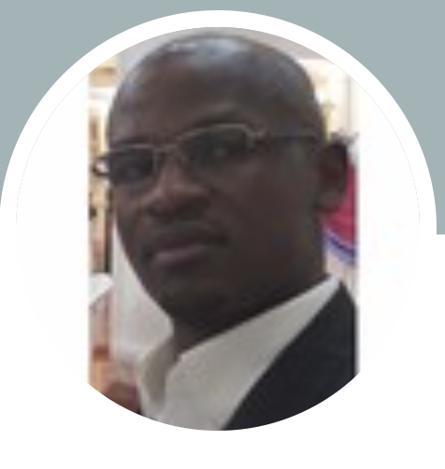
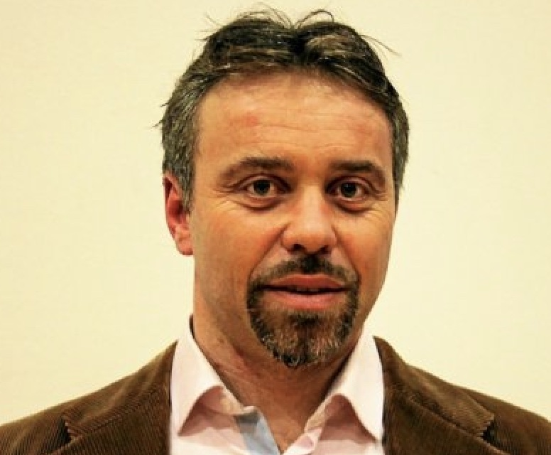
OneWay

Slide 51
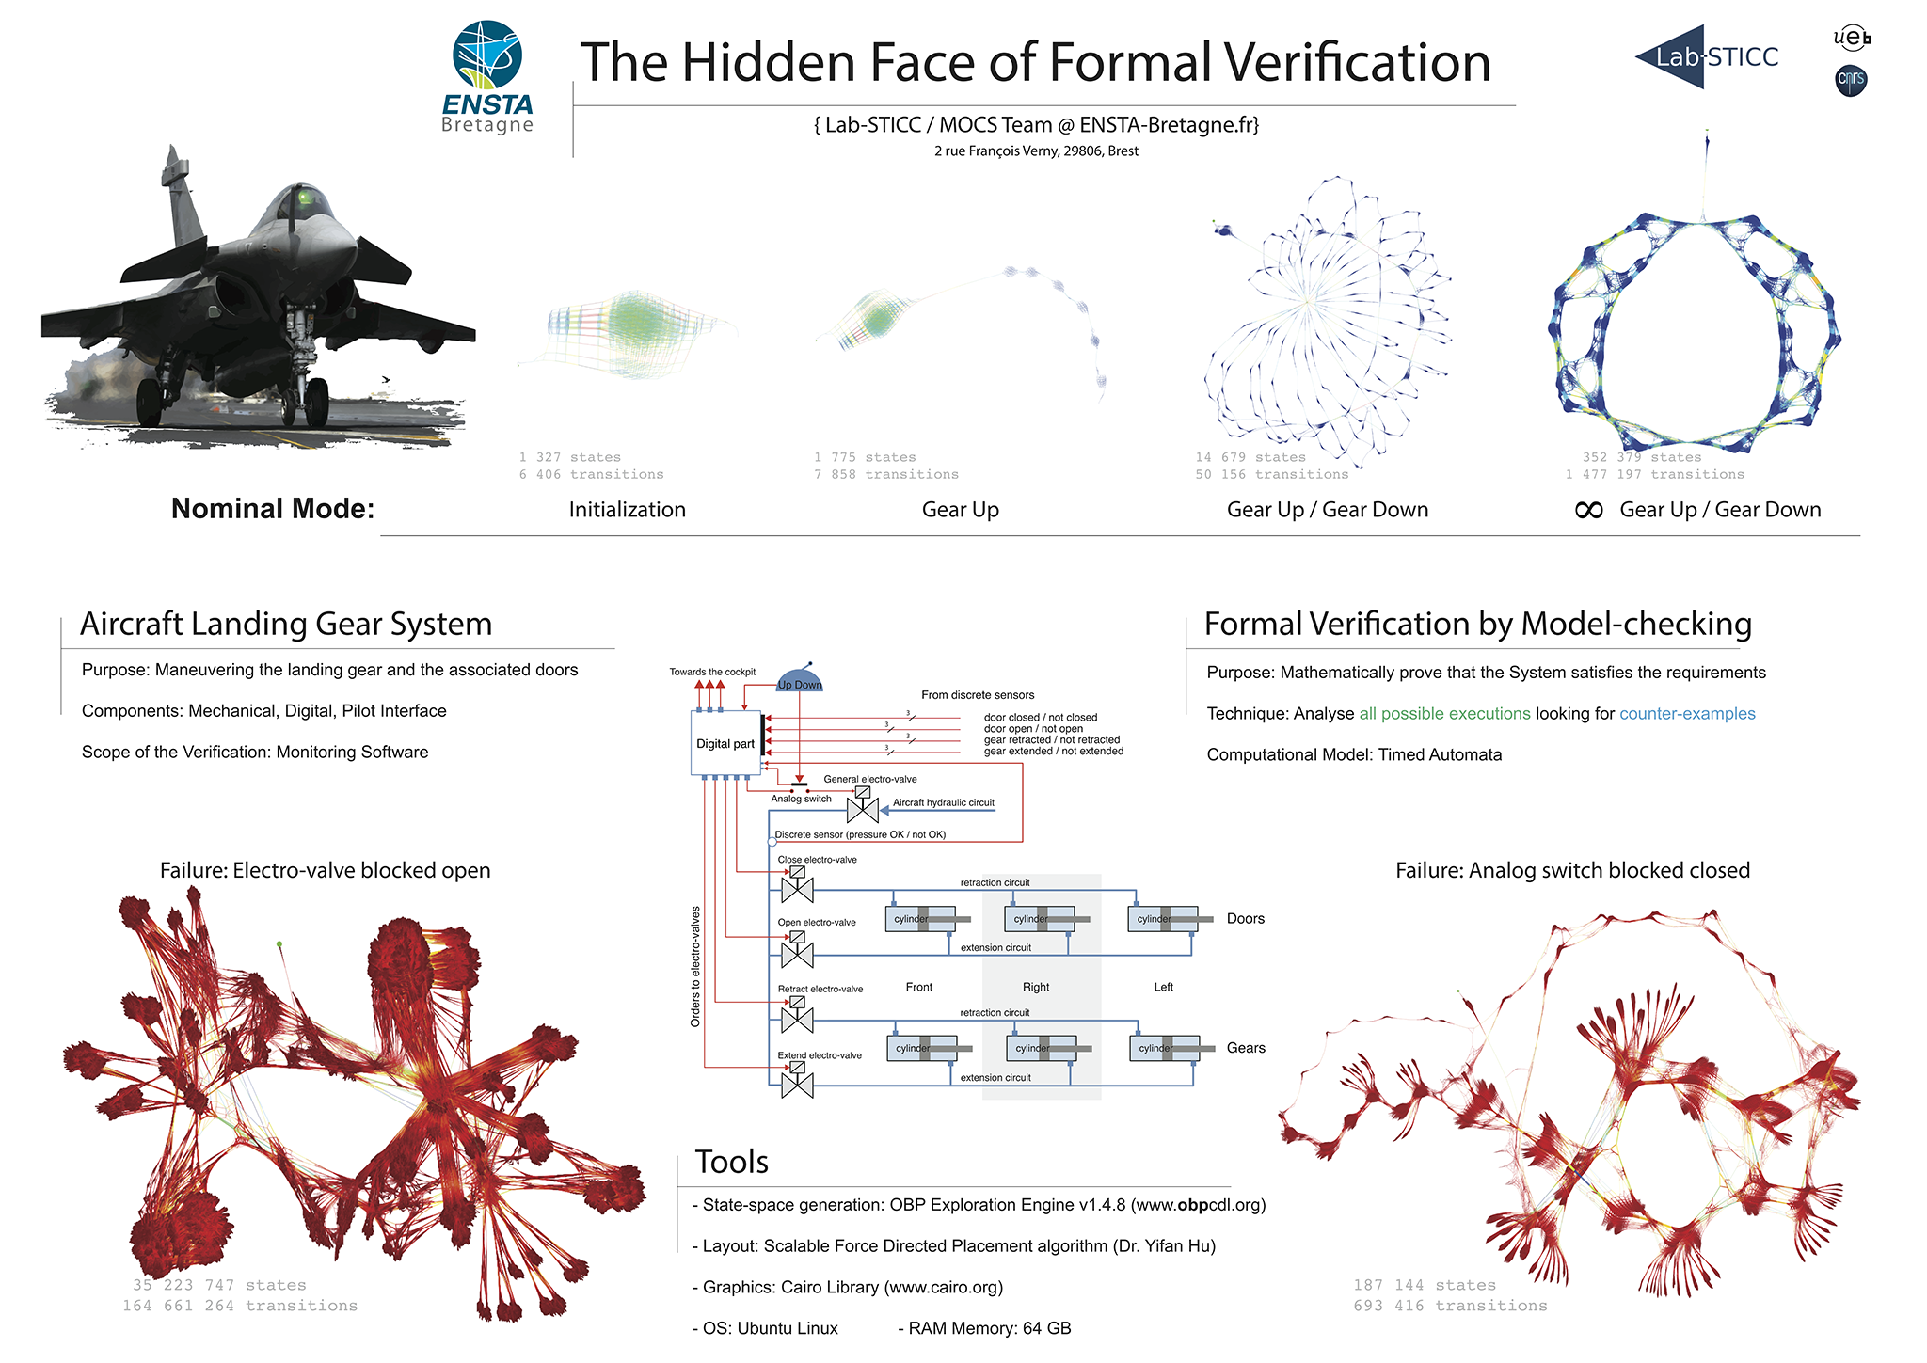

Slide 52
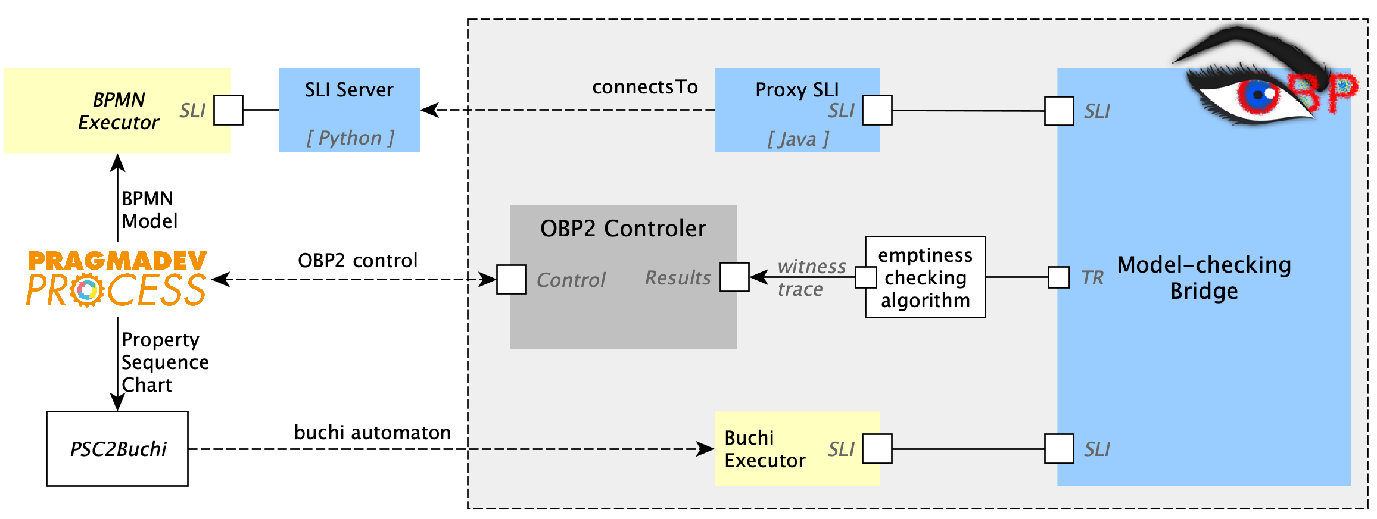
Integration of the PROCESS BPMN with the OBP2 model-checker

Slide 53
SLI
RAPID EASE4SE
Model-checker
⨯
SLI
GPSL
Semantics
interprets
GPSL
Specification
SLI
Emptiness
Checker
RAPID VeriMoB
RAPID EASE4SE

Slide 54
M. Brumbulli et al., ERTS 2020
M. Brumbulli et al., CSD&M 2020

Slide 55
Economical perspective -- https://youtu.be/ZzsK8Am6dKU
Opportunity cost: the loss of other alternatives when one alternative is chosen.
  What do you sacrifice/give up?
    [parser derivatives] performance, thread-safety, non-blocking I/O
Transaction cost
  Time to set up the framework ... vs ... time to hack it up from scratch...
Barriers to entry
  Know that it exists
  How does it work?
  Learn each tool
  Does the tool exist in your context? (for your language)
How do we change the *economy* (the costs)?

Slide 56
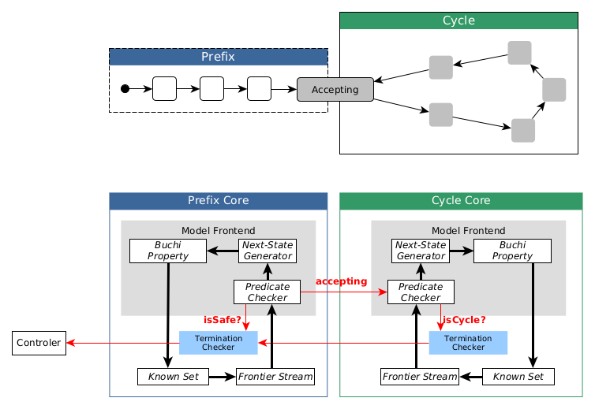
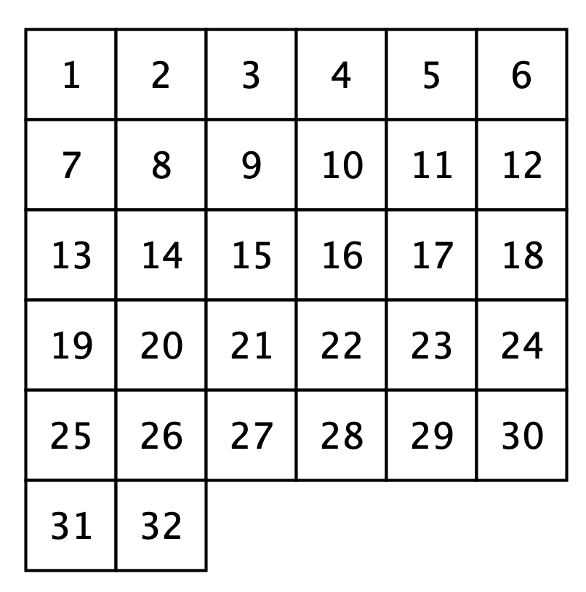
DVE
Specification
DVE
Property
Dolmen
FPGA
interprets
DVE
Semantics
SLI
interprets
Model-checker
⨯
SLI
DVE Prop
Semantics
SLI
Emptiness
Checker

Slide 57
Finder
Executable
Specification
Semantics
SLI
Replace
Initial
SLI
Model-checker
⨯
SLI
Property
Semantics
interprets
Temporal
Specification
SLI
Emptiness
Checker
applies
Reduction

