Slide 1

Exploring the Boundary between Executable Languages and Verification Tools
Ciprian TEODOROV

Slide 2
Overview
Context
  Executable specification monitoring
  Model-checking scalability
Problematique
  Executable specification monitoring
  Model-checking scalability
Contributions
  Executable specification monitoring
  Model-checking scalability

Slide 3
Context: Domain-specific languages
The use of general-purpose languages sometimes introduce accidental complexities.
Domain experts rely on a shared domain-specific language to aleviate these problems.
Domain-specific languages enable
The creation of domain-specific abstractions (models) focused on the domain of discourse.
The design of domain-specific tools (conceptual or computer-assisted)

Slide 4
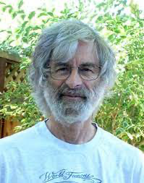
Context: Executable specifications
eXecutable Domain-Specific Languages (xDSL) for handling behaviors.
  Programming languages are prescriptive xDSL, they are used to force the computer to perform some behavior.
  Thinking above the code[1], specifying, requires a problem-oriented mindset
  Reasoning about computer programs requires a descriptive view on the code
Executable-Specification (ES) languages capture the behavior to study it in captivity
  Can be seen as descriptive xDSL: an ES reflects how the object behaves
Descriptive [2]:
presenting observations about the characteristics of something
factually grounded or informative rather than normative, prescriptive or emotive
[1] Leslie Lamport: Thinking Above the Code
[2] (https://www.merriam-webster.com/dictionary/descriptive)

Slide 5
Context 1: Executable specifications [Examples]
Calculus – dynamics of physical processes [Newton and Leibniz]
Temporal logic: LTL, CTL*, Temporal Logic of Actions (TLA+)
Lambda calculus – computable functions
Petri nets
CCS – Milner
CSP - Hoare
Actor models – Hewitt
Automata: NFA, PDA, Statecharts

Slide 6
Context 2:
Scalability of Model-checking
Handle large state-spaces
  Model-level (reduce the number of states)
  state-space decomposition (CaV)
  Algorithmic level (reduce the memory footprint)
  lossless: BDD, minimal DFA
  lossy: bitstate, hashcompaction
  Mixed: on-the-fly algorithms
Exploit the execution platform (parallelism)
  Shared-memory
  Distributed
  SIMD
  FPGA

Slide 7
Challenges
Executable specification monitoring
  Designing dynamical systems is hard
  Specification writing is hard
  Lack of tools : Temporal logic specification
  Too many semantics
  Wrong focus
Scalability of model-checking
  Decompose state-space
  Isolate model/algorithm?
  Hardware acceleration

Slide 8
Many Semantics – Many Runtime Monitors

Slide 9


SPOT [DP04], LTSmin [Kan+15]
A#1
A#7
A#4
AnimUML [Jouault+20]
EMI [Besnard+21]
A#2
Spin [Hol97]
A#5
P#1 Semantic gap between design model and analysis model
P#2 Semantic gap between design model and executable code
P#3 Equivalence problem between the analysis model and executable code
A#3
Divine [Bar+17]
A#6
Java PathFinder [Bra+00]
V. BESNARD, “EMI: Une approche pour unifier l’analyse et l’exécution embarquée à l’aide d’un interpréteur de modèles pilotable”,
Application aux modèles UML des systèmes embarqués, Ph.D. Thesis, Dec. 2020. [PDF] [slides]

Slide 10
A#1
A#7
A#4
A#2
A#5
 | A#1 | A#2 | A#3 | A#4 | A#5 | A#6 | A#7
P#1 | ✘ | ✘ | ✓ | ✓ | ✓ | ✓ | ✓
P#2 | ✘ | ✘ | ✘ | ✘ | ✘ | ✓ | ✓
P#3 | ✘ | ✘ | ✘ | ✘ | ✘ | ✘ | ✓
A#3
A#6
V. BESNARD, “EMI: Une approche pour unifier l’analyse et l’exécution embarquée à l’aide d’un interpréteur de modèles pilotable”,
Application aux modèles UML des systèmes embarqués, Ph.D. Thesis, Dec. 2020. [PDF] [slides]

Slide 11
One Semantics – Many Runtime Monitors

Slide 12
Make it Simple & Modular
Semantic
Language
Interface

Slide 13
Make it Simple & Modular
Q1: What is the SLI interface?
Q2: Where is the toolbox?
Missing toolbox ?
Semantic
Language
Interface

Slide 14

Executable
Specification
Monitoring

Slide 15
A Semantic Language Interface (SLI)
SLI (C A E V ⍺) { -- Configuration, Action, Expression, Value, Reduced
semantics: (C A) { -- defines the execution semantics
initial: set C
actions: C → set A
execute: C → A → set C
}
evaluate: E → C → A → C → V -- questions on the execution
reduce: E → C → ⍺
accepting: set C -- for model-checking
π: (C A T) { -- marshalling/unmarshalling
(π_{c} : C → T) (π⁻¹_{c} : T → C)
(π_{A} : A → T) (π⁻¹_{A} : T → A)
(π_{V} : V → T) (π⁻¹_{V} : T → V)
}
}
V. Besnard, C. Teodorov, F. Jouault, M. Brun, P. Dhaussy, “Unified verification and monitoring of executable UML specifications. A transformation-free approach”, Software and Systems Modeling, Springer Verlag, 2021
Matthias Pasquier, Ciprian Teodorov, Frédéric Jouault, Matthias Brun, Luka Le Roux, and Loïc Lagadec. “Practical Multiverse Debugging through User-defined Reductions. Application to UML Models.” In: Proceedings of the 24rd ACM/IEEE International Con- ference on Model Driven Engineering Languages and Systems. MODELS ’22. 2022.

Slide 16
Global Overview
Ingredients:
Subject Language
SLI
Tooling bridge
Execution control

Slide 17
Gamine Operators
Standard semantic operators
  Asynchronous composition (shared memory interleaving)
  Synchronous product (needs to be asymmetric)
    Composes the system with a dependent semantics reasoning on system steps
Filtering operator
  Explicitly capture some hypotheses: ex. reactive system hypothesis
  Behavioral symmetry reductions: ex. partial order reduction
  Platform constraints: ex. Scheduling
Semantic lowering towards simpler transition relation

Slide 18
The SLI Semantics for
Multiverse
Debugging

Slide 19
Modular Finder

Slide 20
SLI
Model-Checking
Bridge

Slide 21
The scheduler during the verification

Slide 22








OBP2: Semantical Diagnosis and Formal Verification
Model-checking
Omniscient Debugging
Multiverse Debugging
Semantic
Language
Interface
Langage independent
Vérification SE-LTL
Continuum debug - verification
Embedded execution monitoring
Semantic-based scheduling
Executable specifications
TLA+
AEFD
Fiacre
©2007-2022

Slide 23
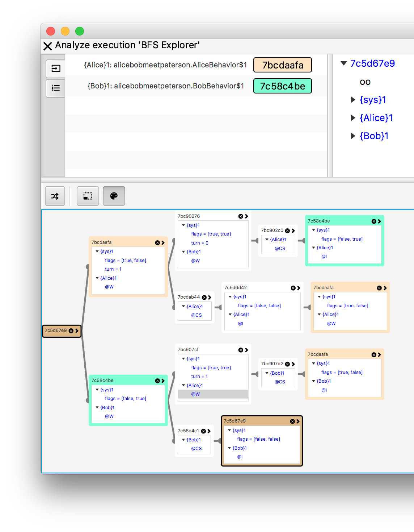
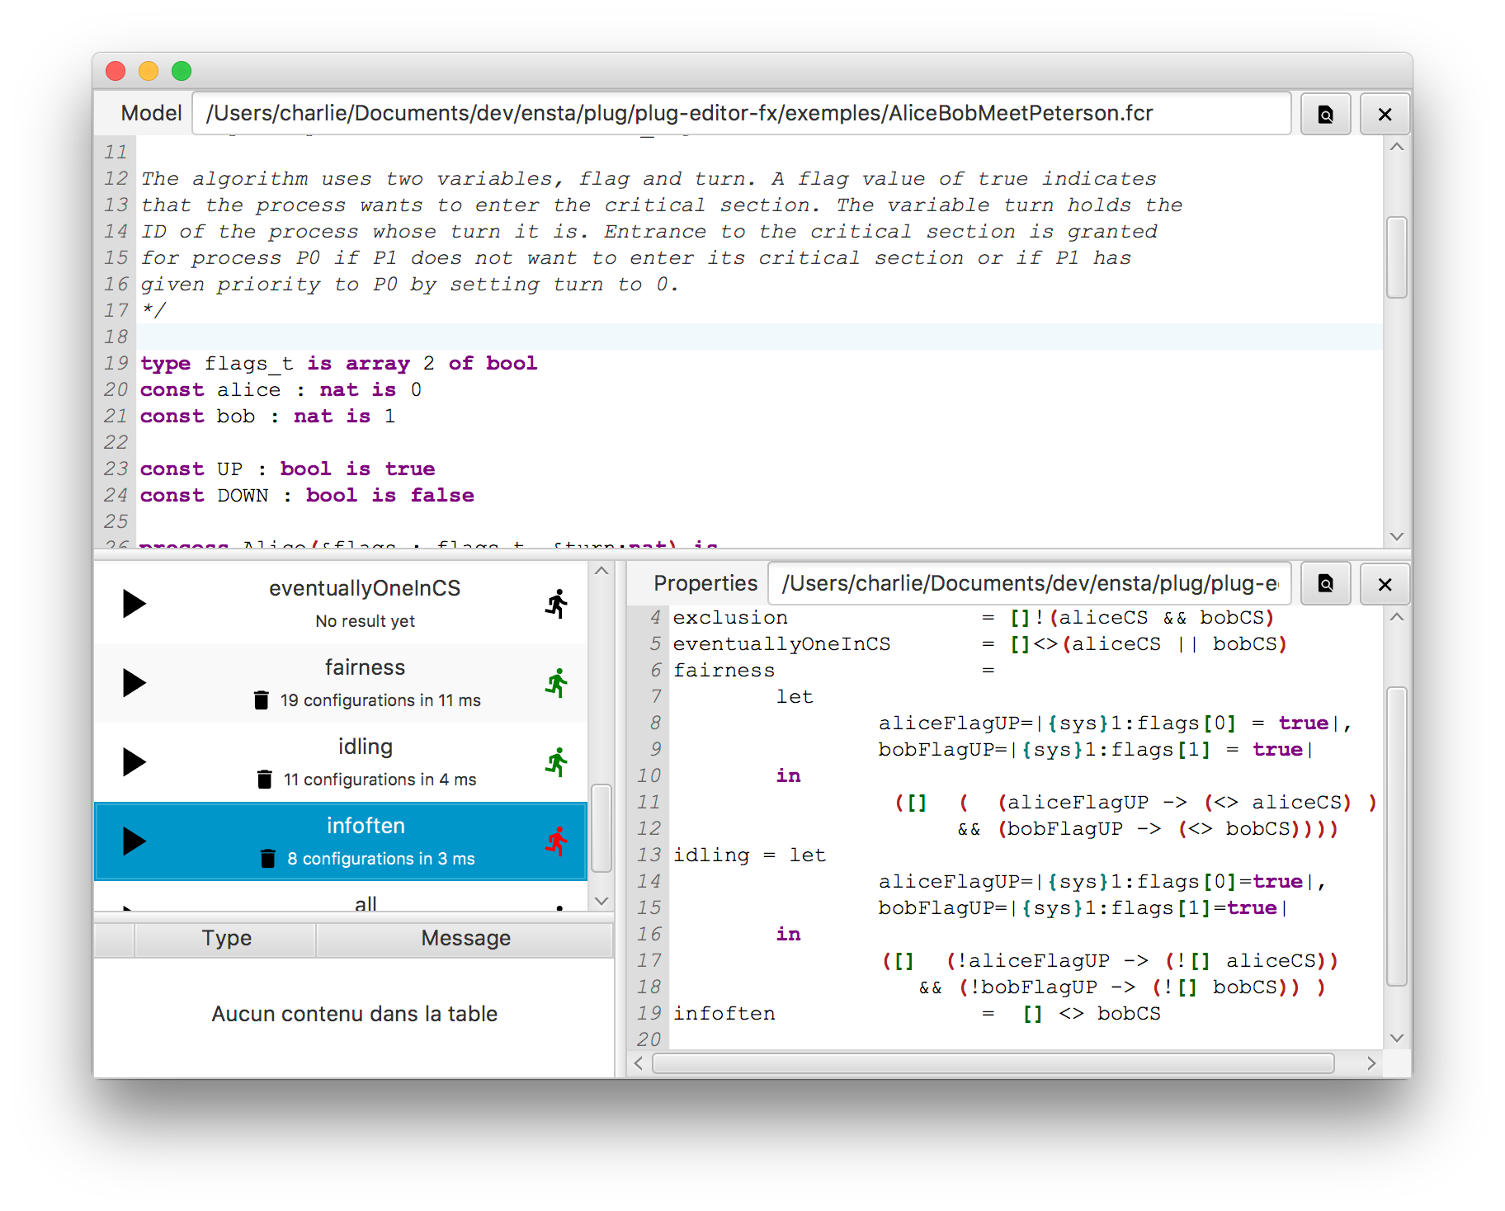
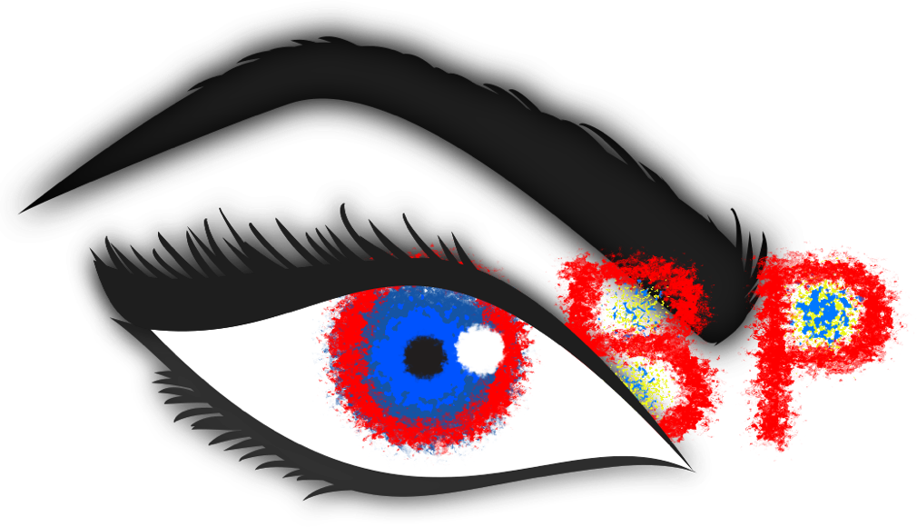
Meta-level GUI

Slide 24
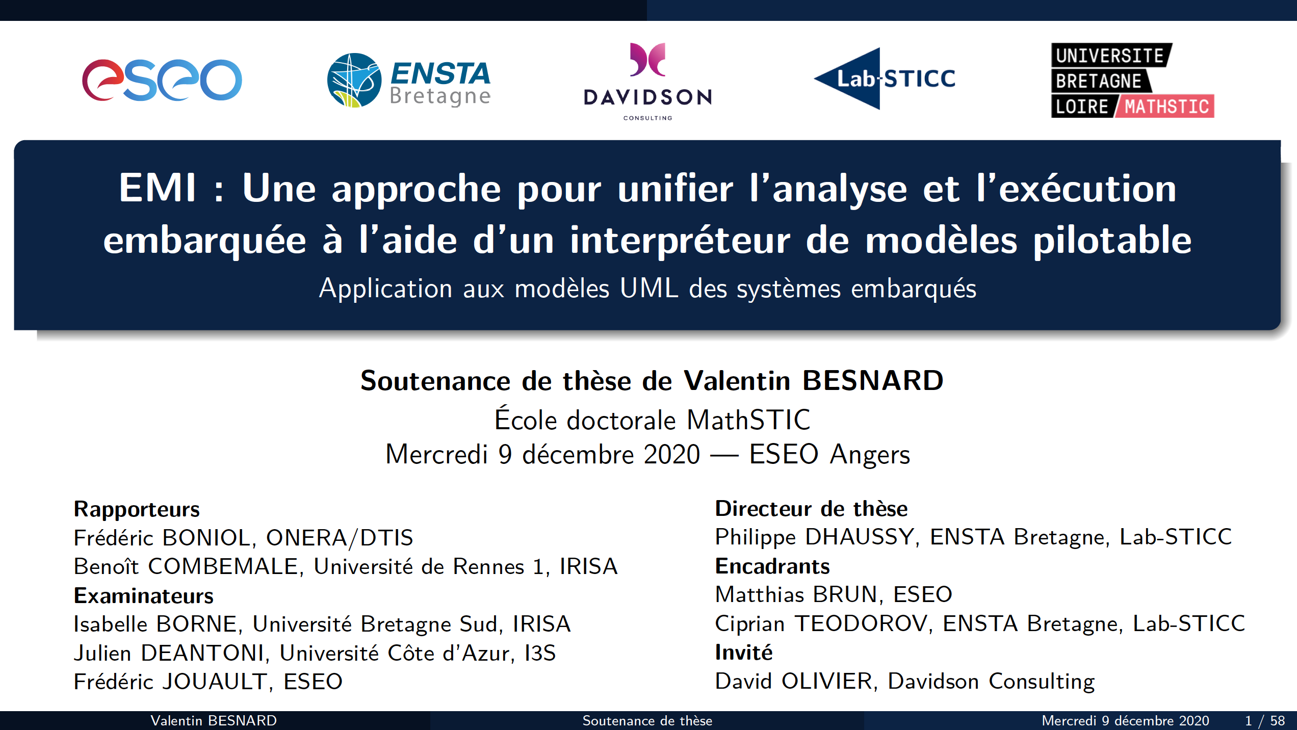
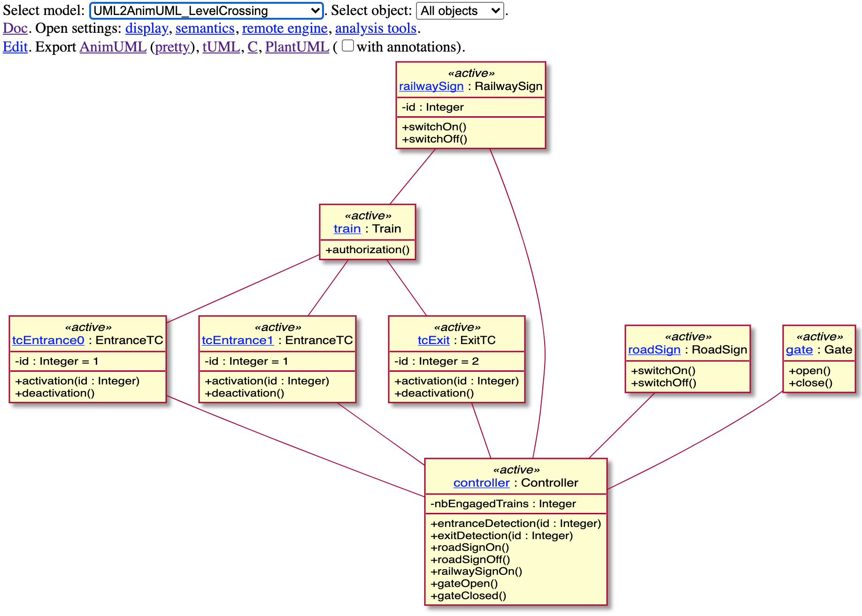
Executable UML Specifications
LTL model-checking & Execution
Besnard, Valentin, Matthias Brun, Frédéric Jouault, Ciprian Teodorov, and Philippe Dhaussy. "Unified LTL Verification and Embedded Execution of UML Models." MODELS. 2018.
Verification & Monitoring
Bare-metal
Besnard, Valentin, Ciprian Teodorov, Frédéric Jouault, Matthias Brun, and Philippe Dhaussy. "Verifying and Monitoring UML Models with Observer Automata: A Transformation-Free Approach." MODELS. 2019.
V. Besnard, C. Teodorov, F. Jouault, M. Brun, P. Dhaussy, “Unified verification and monitoring of executable UML specifications. A transformation-free approach”, Software and Systems Modeling, Springer Verlag, 2021
Playing with models
Cloud
Jouault, Frédéric, Valentin Besnard, Théo Le Calvar, Ciprian Teodorov, Matthias Brun, and Jerome Delatour. "Designing, animating, and verifying partial UML Models”, MODELS. 2020.

Slide 25
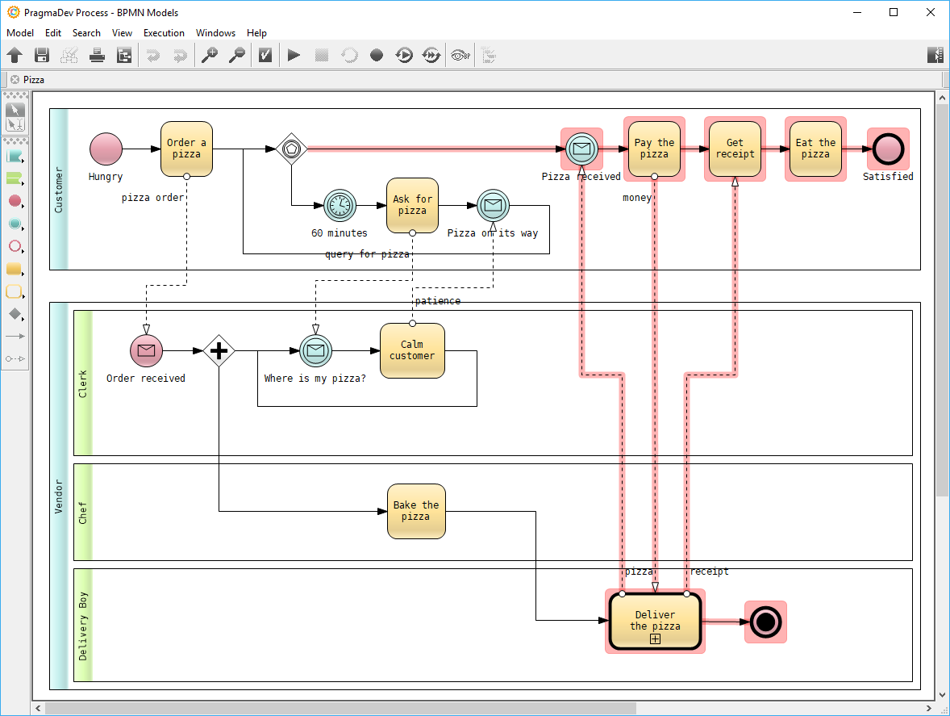
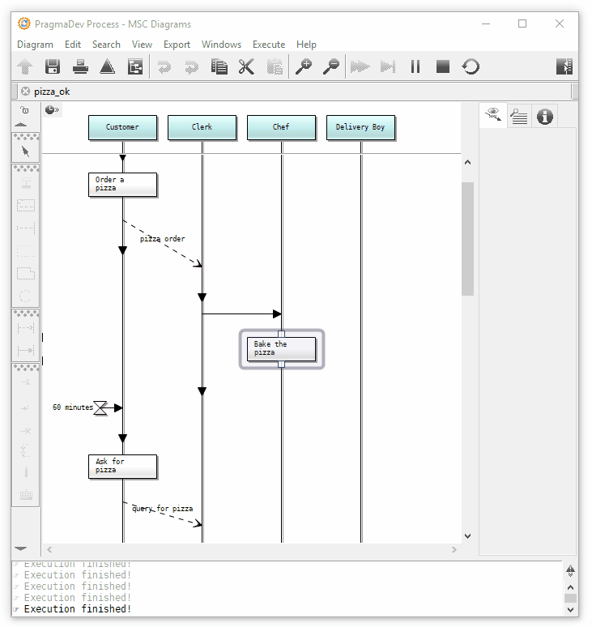
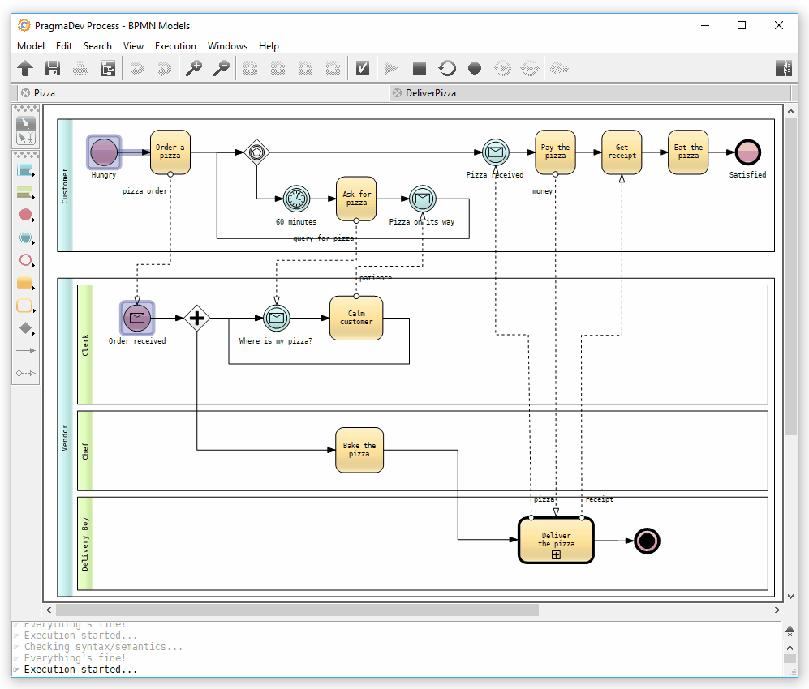
Executable BPMN Specifications
https://www.pragmadev.com/product/process.html
M. Brumbulli, E. Gaudin, C. Teodorov, “Identifying unreachable paths in BPMN models”, Complex Systems Design & Management (CSD&M’20), Dec. 2020, Virtual event, Paris.
M. Brumbulli, E. Gaudin, C. Teodorov. “Automatic Verification of BPMN Models”, 10th European Congress on Embedded Real Time Software and Systems (ERTS 2020), Jan 2020, Toulouse, France.

Slide 26
Scalability of
Model-Checking

Slide 27
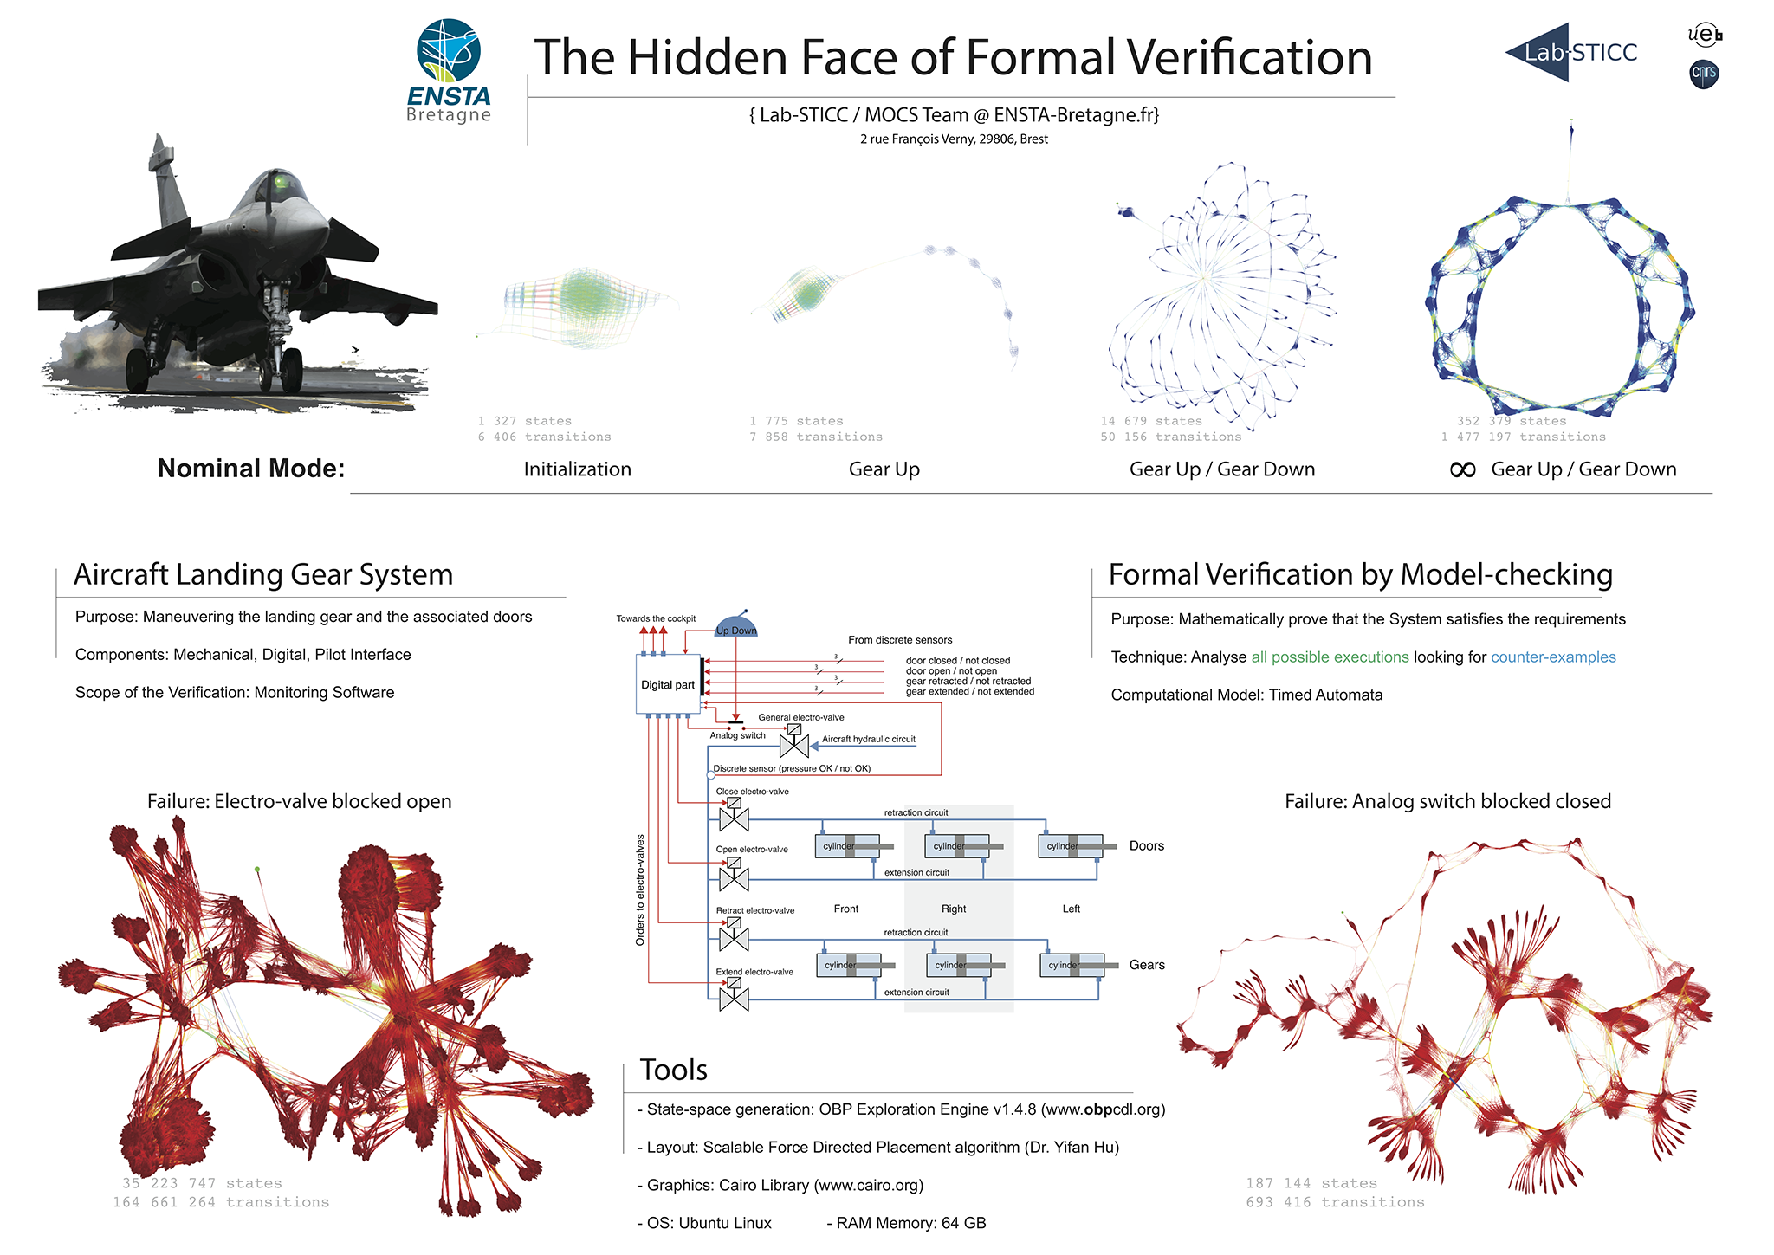

Slide 28
Context-aware Verification
Explicit environment modeling
  Operating modes, External actors, Environmental conditions
Contexts guides : encode design hypotheses
Requirements associated to contexts
Methodological advantages
Focus on safety and bounded liveness
(
(Environment || System-under-study)
Ⓧ Guide)
Ⓧ Temporal Requirements

Slide 29
Optimization due to structure of context
  PastFree[ze] reachability analysis
    Reduced memory presure during a run
  Automatic context split
    Decomposes the verification multiple runs

Slide 30
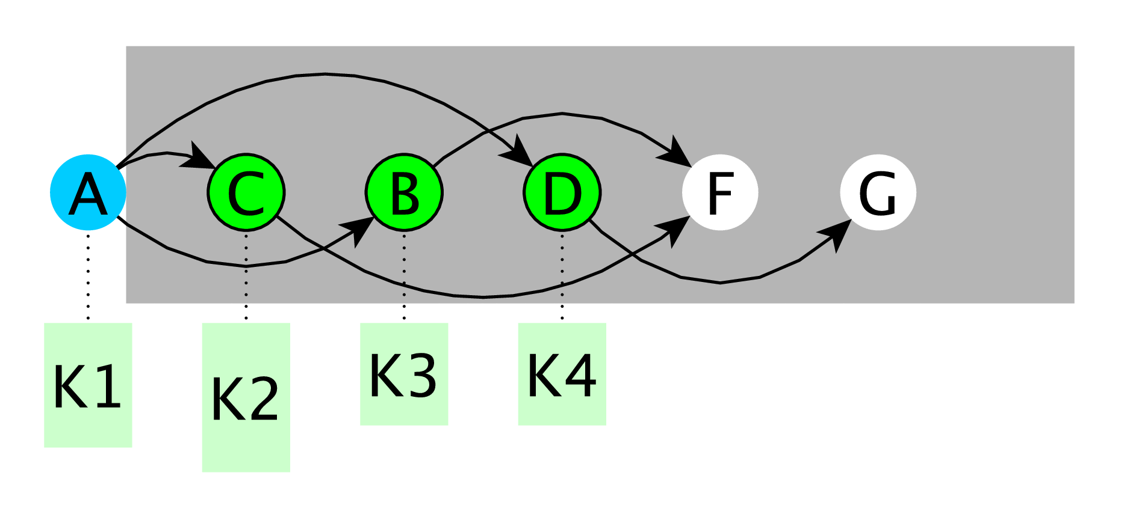

Traditional Context-aware Reachability

Slide 31
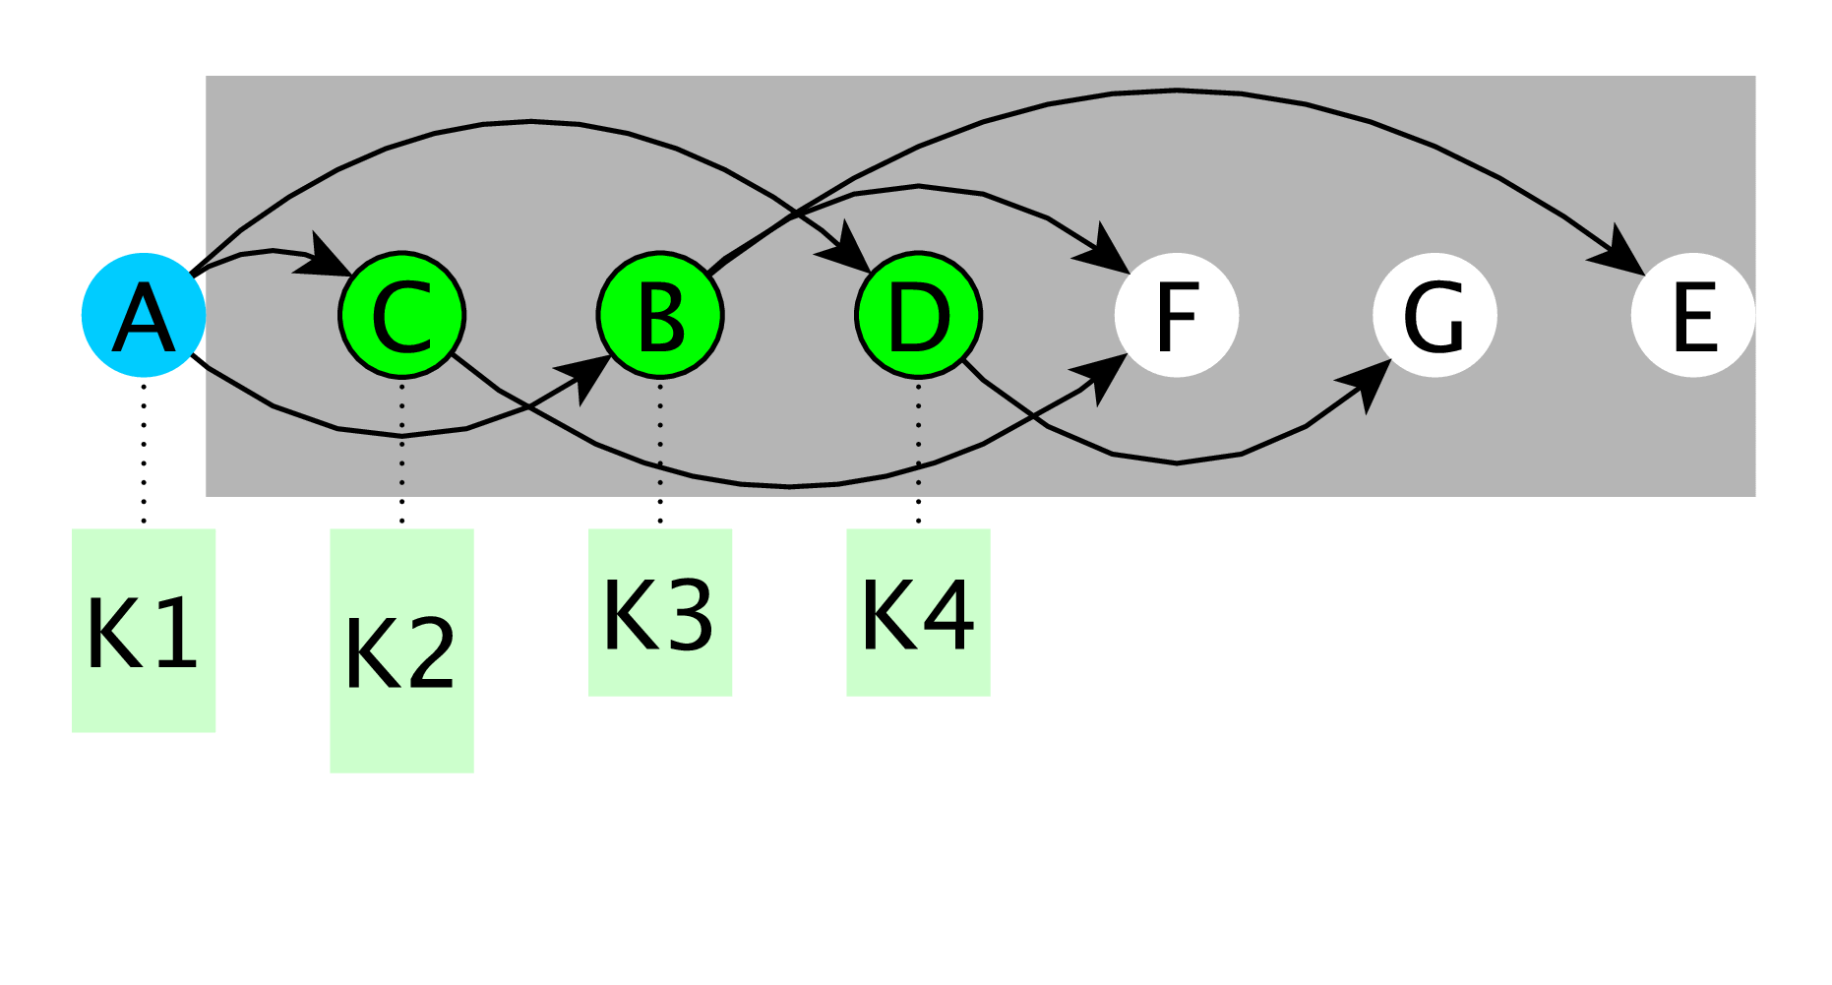
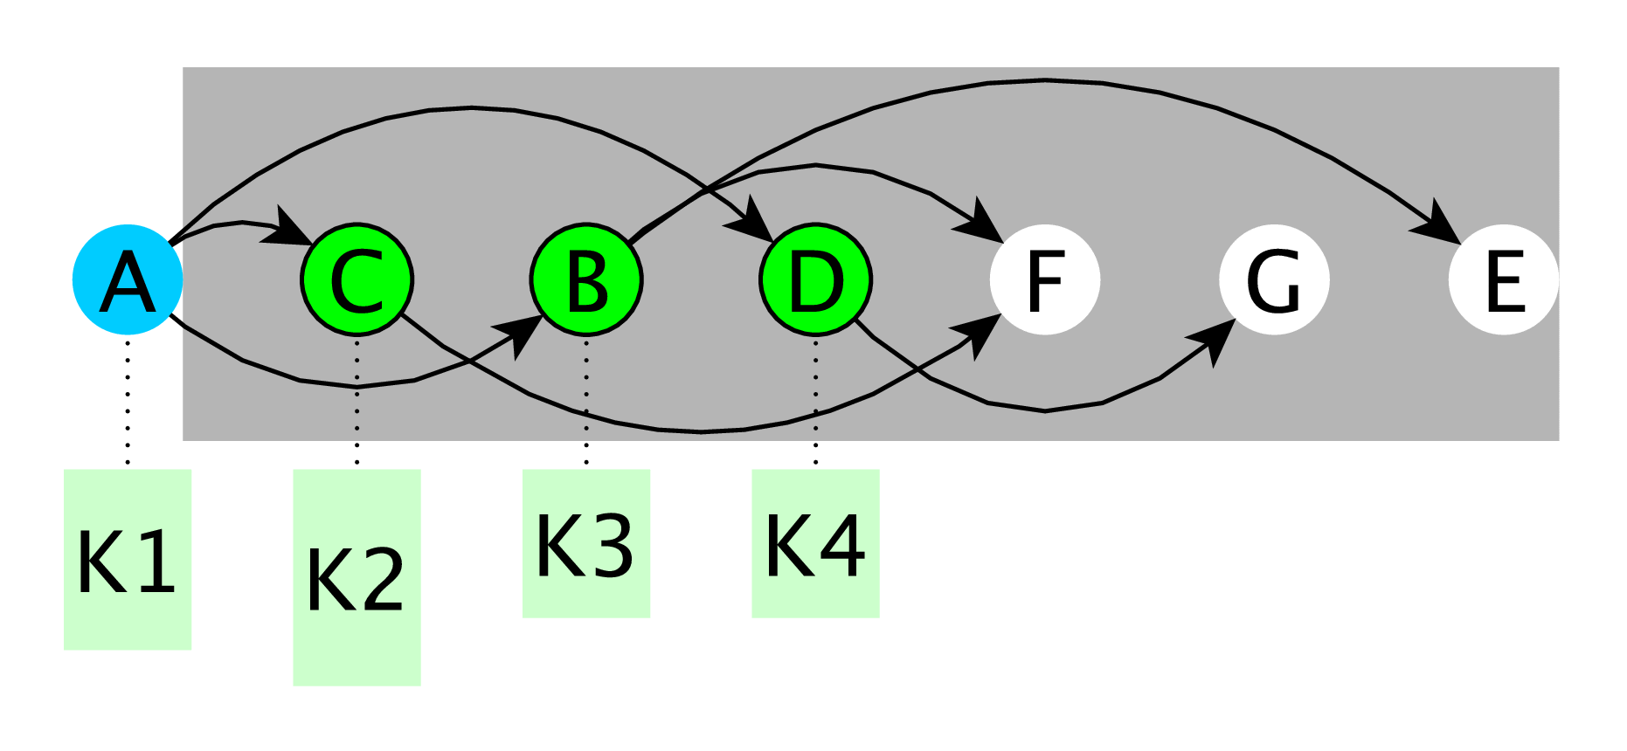
PastFree[ze] Reachability

Slide 33
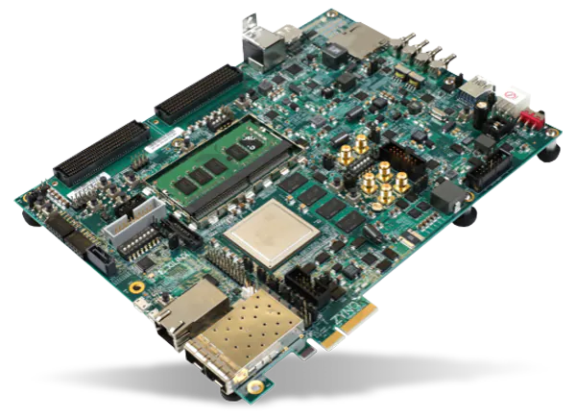
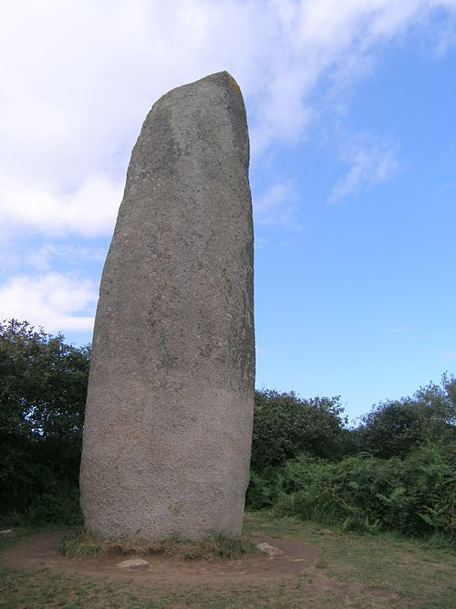

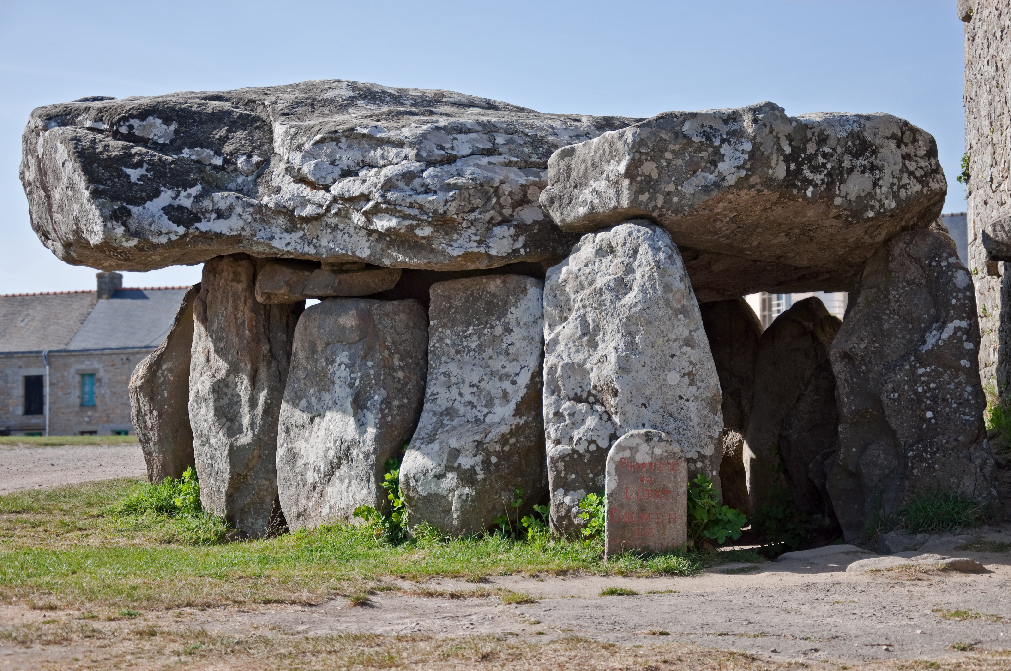
FPGA Model-Checking
MENHIR, Fournier+DSD’20
CARNAC, Fournier+FPL’21
DOLMEN, Fournier+DATE’22
Menhir de Kerloas, (Finistere)
Menec alignment, CARNAC (Morbihan)
DOLMEN de Crucuno, à Plouharnel (Morbihan)

Slide 34
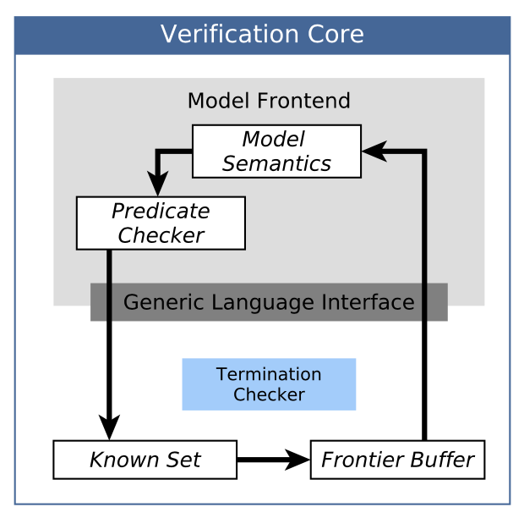
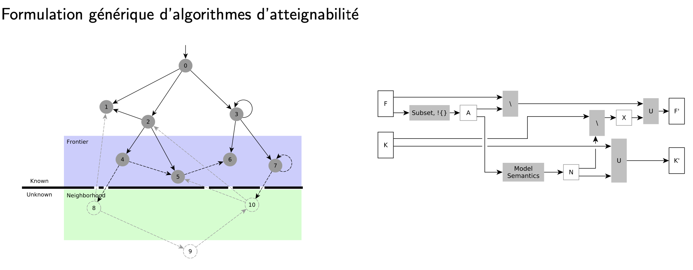

Slide 35
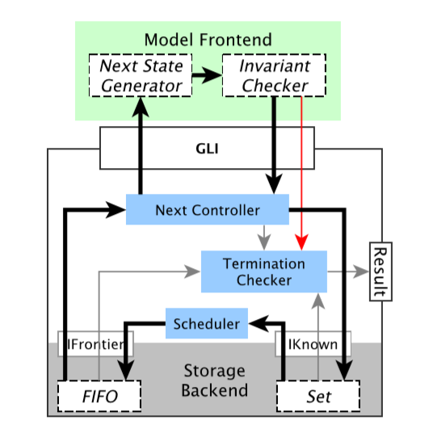
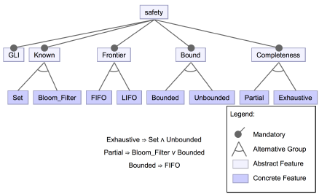
Menhir:
Generic High-Speed FPGA Model-Checker
Multiple semantic frontends: UML, DVE, VHDL

Slide 36
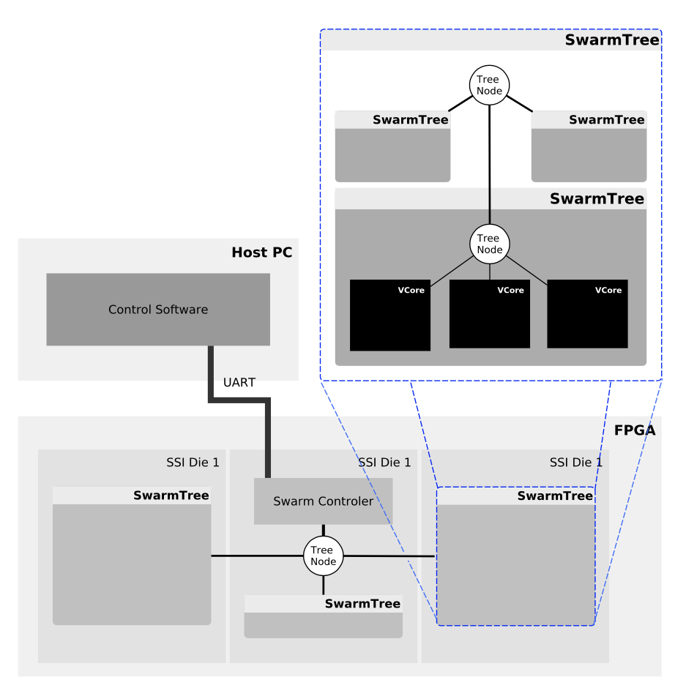
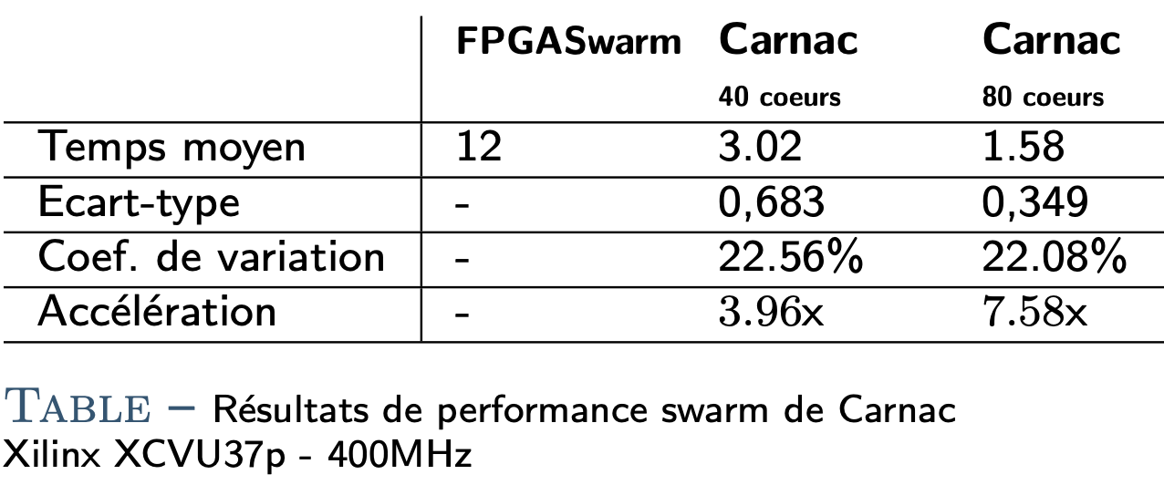
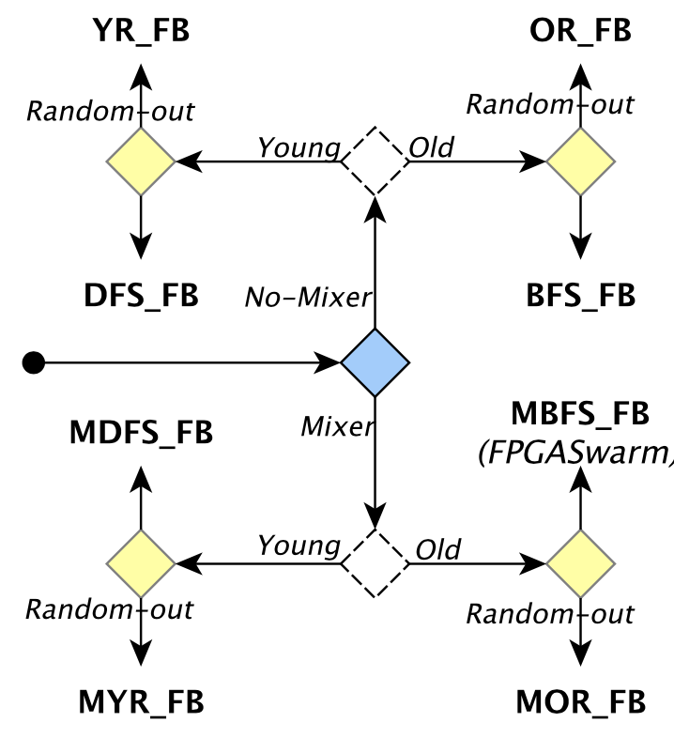
Carnac: Algorithmic variability
4 Swarm FPGA

Slide 37
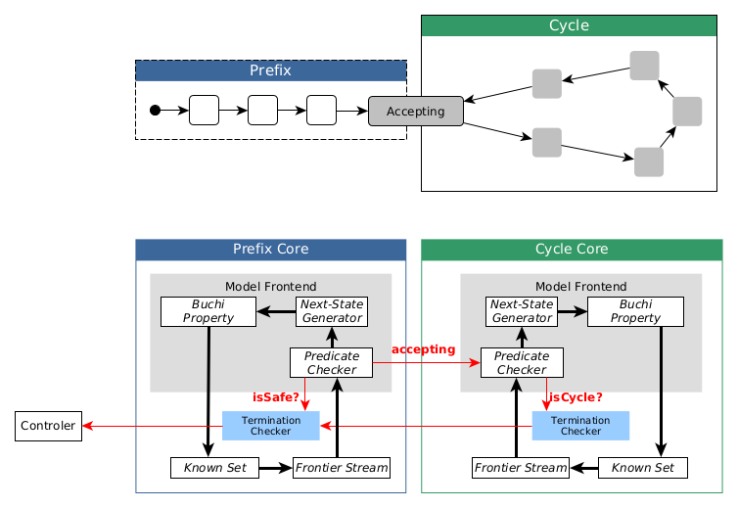
Dolmen : FPGA Swarm for Safety and Liveness Verification
Fournier+DATE’2022
First hardware swarm engine for liveness verification
  On-the-fly nested-DFS algorithm
  Distributed control architecture, for SSI-FPGAs
  Evaluation on models from the BEEM Benchmark
  4874x average speedup over software (Divine 3)

Slide 38
Conclusions
A
B
C

Slide 39
Generalizing the G∀min∃ language monitoring for specification-driven software engineering.
Temporal breakpoints.
Scheduling-aware functional verification.
Fully-verified Language Monitors.
Hardware model-checkers
Open and dynamic abstraction-refinement environments
Moldable diagnosis cockpit
Algebraic specifications of complex algorithms
Perspectives

