Slide 1




Semantics as Infrastructure: Reconnecting Behavioral Modeling and Formal Analysis
www.obpcdl.org
FDL 2025
Forum on specification & Design Languages
Schloß Rheinfels, St. Goar, Germany
September 10-12
Ciprian TEODOROV
https://teodorov.github.io/
ciprian.teodorov@ensta.fr
ENSTA | Institut Polytechnique de Paris
P4S, Lab-STICC, UMR CNRS 6285

Slide 2
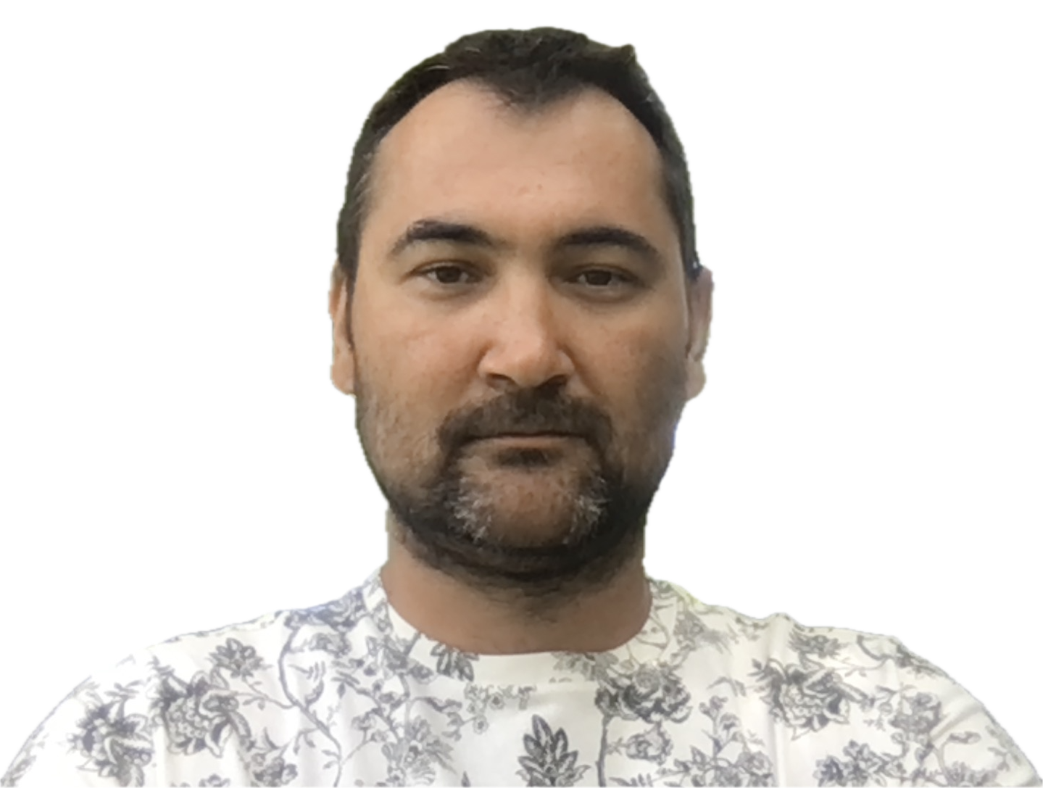
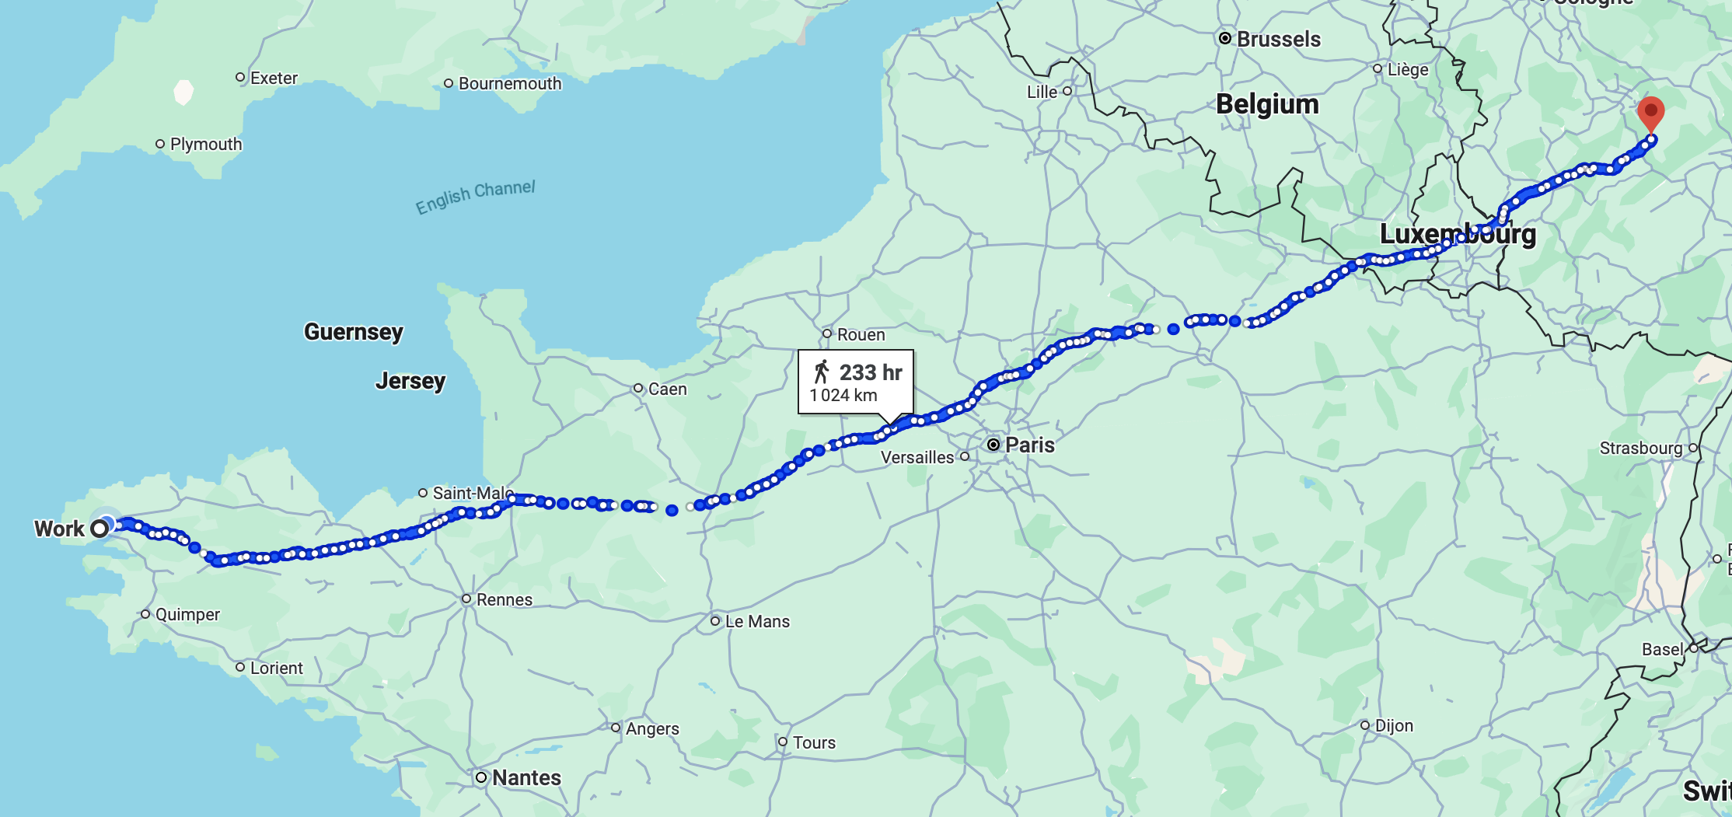
Academia @ Lab-STICC, ENSTA, Brest
Full Professor [23-… ]
Associate professor [15-23]
Lead the OBP2 Semantic Diagnosis & Formal Verification Lab. (http://www.obpcdl.org/)
Postdoc [13-15]
Verification MBSE, Concurrent system modeling, and verification (https://gemoc.org/)
  Industry @ Dolphin Integration - Grenoble Area
Electronics CAD engineer [11-13]
Compilation of VHDL, VHDL-AMS for mixed-signal simulation
  PhD in Computer Science @ UBO – Brest
  Model-driven physical design for future nanoscale architectures [08-11]
teodorov.github.io
FDL’25

Slide 3


Our Journey Today
The Vantage Point
The Hidden Semantics and the Inaccessible Monitors.
G∀min∃: When Semantics Reveals Itself, Monitors Engage.
Multiverse Debugging to Breath Life in your Specification
Sum-up and Ways Forward

Slide 4
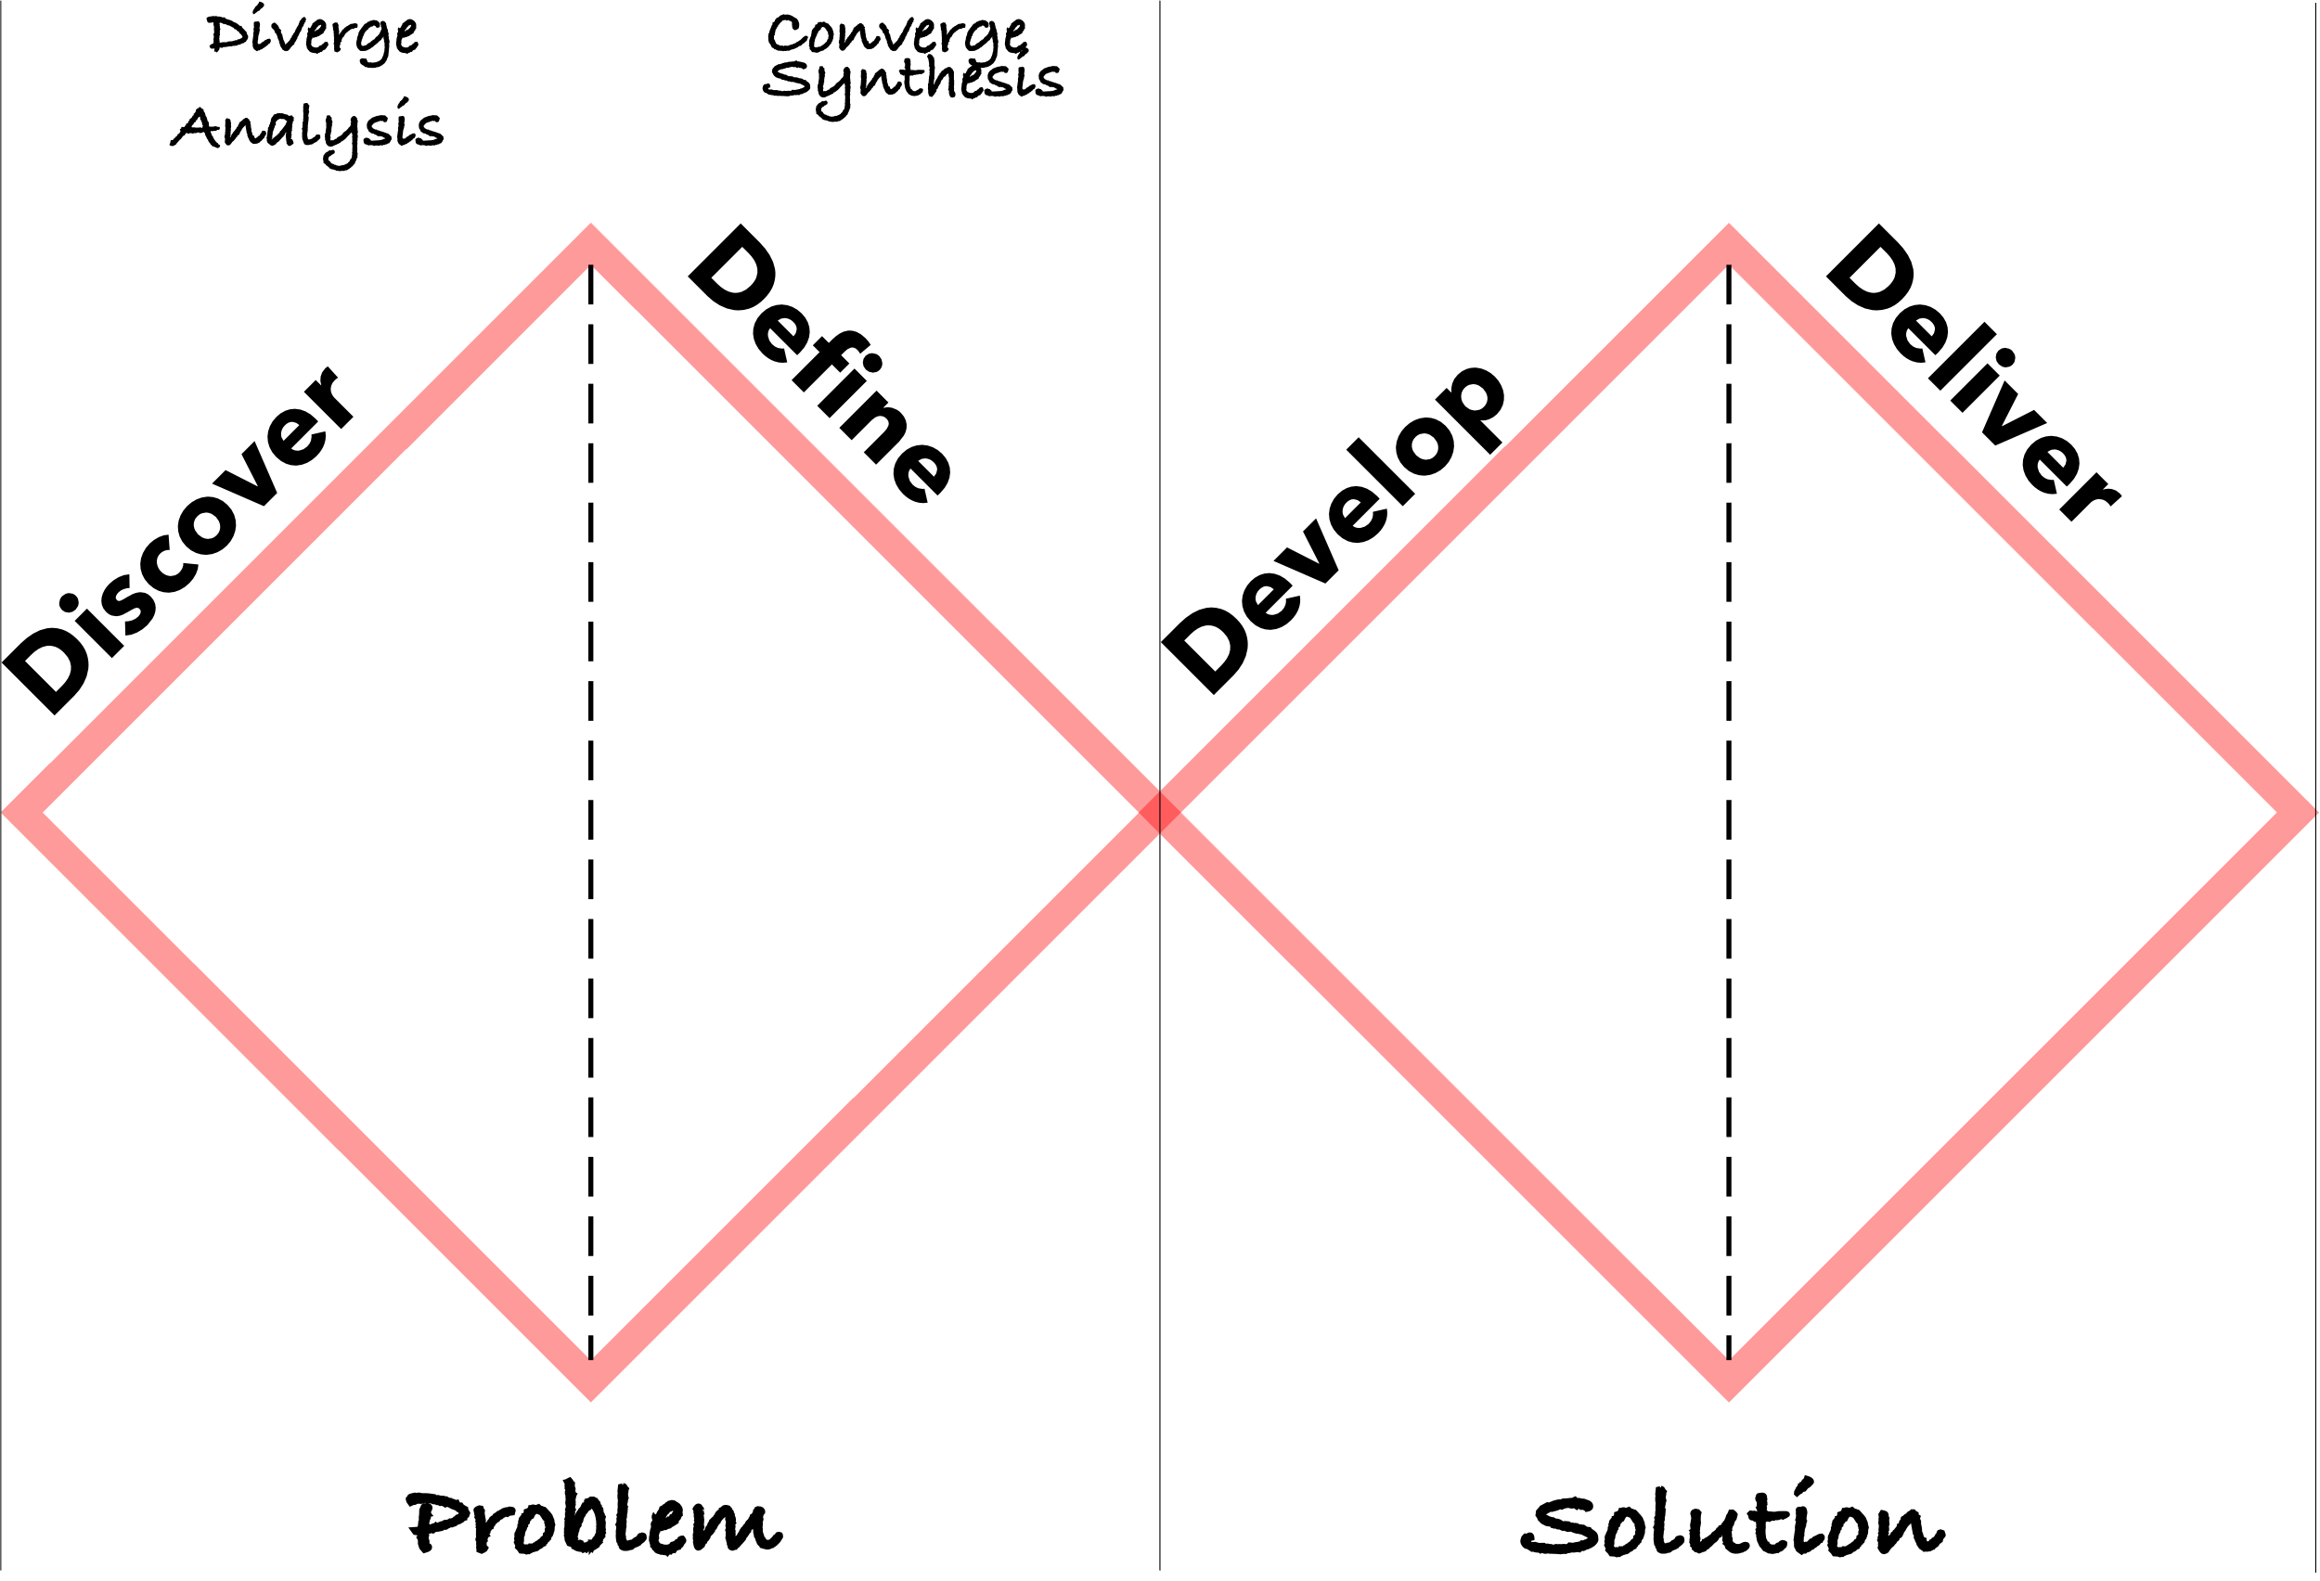
From the Double Diamond
https://www.designcouncil.org.uk/our-resources/the-double-diamond/

Slide 5
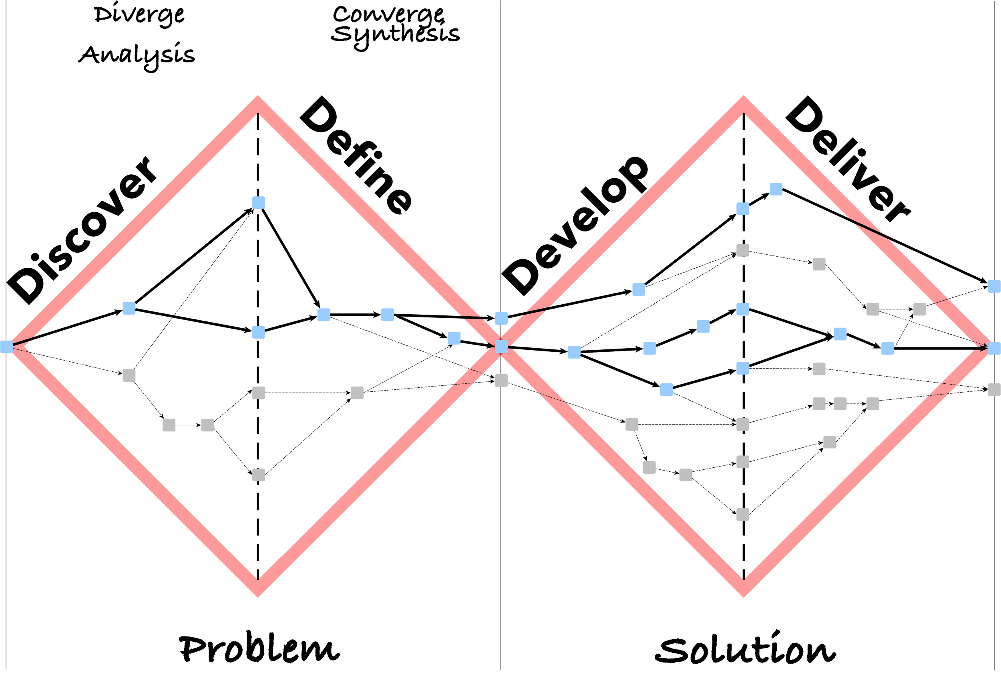
To the Design Multiverse
https://www.designcouncil.org.uk/our-resources/the-double-diamond/

Slide 6
To the Design Multiverse
https://www.designcouncil.org.uk/our-resources/the-double-diamond/

Slide 7

To the Design Multiverse
Family | Zeidae
Genus | Zeus
Species | Specificatio
Specificatio
https://en.wikipedia.org/wiki/John_Dory
https://www.designcouncil.org.uk/our-resources/the-double-diamond/

Slide 8
Domain-specific languages
General-purpose languages introduce accidental complexities.
Domain experts rely on a shared domain-specific language to alleviate these problems.
Domain-specific languages enable
abstractions (models) focused on the domain of discourse.
tools (conceptual or computer-assisted) adapted to the domain

Slide 9
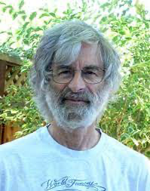
Executable specifications
eXecutable Domain-Specific Languages (xDSL) for handling behaviors.
  Programming languages = prescriptive xDSLs
    force the computer to perform some behavior.
  Thinking above the code [1], specifying, requires a problem-oriented mindset
Executable-Specifications capture the behavior to study it in captivity
  Descriptive xDSL that reflects how the object behaves
Descriptive [2]:
presenting observations about the characteristics of something
factually grounded or informative rather than normative, prescriptive or emotive
[1] Leslie Lamport: Thinking Above the Code
[2] (https://www.merriam-webster.com/dictionary/descriptive)

Slide 10

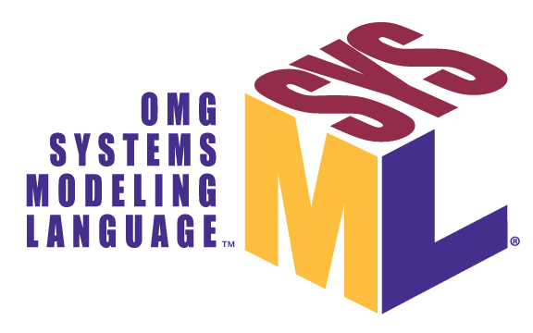

a Zoo of Executable Specification Languages
Physical processes
Temporal logic
LTL
CTL*
Temporal Logic of Actions (TLA+)
Computable functions
Lambda calculus
Turing machines
Automata
NFA
PDA
Statecharts
Concurrency
HDLs
VHDL[-AMS]
[System-]Verilog[-A]
Calculus [Newton and Leibniz]
Actor models – Hewitt
Petri nets
CSP – Hoare

Slide 11
Terminology
Language monitoring[KHC91] is the process of observing
the execution of a computer program
expressed in a given programming language.
[KHC91] Amir Kishon, Paul Hudak, and Charles Consel. 1991. Monitoring semantics: a formal framework for specifying, implementing, and reasoning about execution monitors. In Proceedings of the ACM SIGPLAN 1991 conference on Programming language design and implementation (PLDI '91). Association for Computing Machinery, New York, NY, USA, 338–352. https://doi.org/10.1145/113445.113474

Slide 12
Terminology: In our context
Language monitoring[KHC91] is the process of observing
the behavior of an executable specification
expressed in a given specification language.
In the following:
the tools that enable this process will be referred to as:
language monitors, or simply monitors
runtime monitors are a subclass of language monitors

Slide 13
a Zoo of Language Monitors
Model-checker
Debugger
Profiler
Tracer
Executor
Moldable [1]
Omniscient [2]
Multiverse [3]
MetaSpy [4]
DSProfile [5]
LTSmin [6]
Monilogger [7]
Monilogger [7]
Runtime Monitor
Testing, Coverage, Fault Localization [8]
[1] Chiş et al. ”The Moldable Debugger: A Framework for Developing Domain-Specific Debuggers.” SLE 2014.
[2] Bousse et al. “Omniscient Debugging for Executable DSLs.” JSS 2018.
[3] Torres Lopez et al. "Multiverse debugging: Non-deterministic debugging for non-deterministic programs." ECOOP 2019.
[4] Bergel et al. "Domain-specific profiling." TOOLS 2011.
[5] Sloane et al. "Domain-specific program profiling and its application to attribute grammars and term rewriting." SCP 2014.
[6] Kant et al. ”LTSmin: High-Performance Language-Independent Model Checking.” TACAS 2015.
[7] Leroy et al. “Monilogging for executable domain-specific languages.” SLE 2021
[8] Khorram et al. “From Coverage Computation to Fault Localization: A Generic Framework for Domain-Specific Languages.“ SLE 22

Slide 14
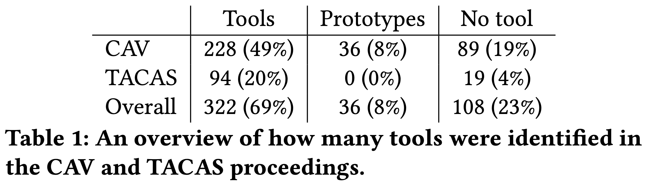
Program Verification Tools [1]
https://slebok.github.io/proverb/
tool papers from TACAS 2016–2021
all papers from CAV 2017–2021
[1] Sophie Lathouwers and Vadim Zaytsev. 2022. Modelling program verification tools for software engineers. In Proceedings of the 25th International Conference on Model Driven Engineering Languages and Systems (MODELS '22). Association for Computing Machinery, New York, NY, USA, 98–108. https://doi.org/10.1145/3550355.3552426

Slide 15
Questions to ponder
Sustainability?
How to write code that survives?
Does your favorite specification language:
has a debugger? Can it go back in time?
comes with a model-checker?
offers support for random testing?
Why do we still lack these basic tools for so many practically important specification languages?

Slide 16
How to bridge the gap between the specification languages and the language monitors ?
Languages
Monitors

Slide 17
2. The Hidden Semantics and the Inaccessible Monitors.
Understanding the problem
Looking for high-level solutions

Slide 18
Many semantics Many Monitors
gap
equivalence
needed
Model 1
transformation
| compilation
Formal
Semantics
Monitor 1
Result 1
gives
meaning
Executable
Specification
gap
Model 2
Model 3
interprets
Executable
Semantics
code
Monitor 2
Monitor 3
Processor
Processor
Result 2
Result 3

Slide 19



Constraints:
black box semantics
-> any meta-language
Reuse based on
Pivot Language
Reuse based on
Meta-Language
Reuse based on
Confluent Tool Requirements (API)
T
C
D
Fixed
Meta
Language
Meta
Language
Tool Family
Meta
Language
Meta
Language
T
Pivot
Language
Meta
Language
T
C
D
C
Pivot
Model
Language
Definition
Language
Definition
D
OD
MD
GAP
MC0
MC
1
MC
2
Mon
DSL Model
DSL Model
DSL Model
Sch
Sch
LSP
Family members
Manuel Wimmer Keynote, MLE’23

Slide 20
3. G∀min∃: When Semantics Reveals Itself, Monitors Engage.
Requirements
G∀min∃ Semantic Language Interface
An illustration

Slide 21
Make it simple
Execution & Monitoring
Properties
(metrics)
Subject Language
Syntax
Definition
computes
conformsTo
interprets
Semantics
Semantic
Language
Interface (SLI)
Monitor
Model
providesA
dependsOn
Q1: What is the SLI interface?

Slide 22
SLI Goals
[SLE’16]
Execution & Monitoring
Properties
(metrics)
Subject Language
Syntax
Definition
computes
conformsTo
interprets
Semantics
Semantic
Language
Interface (SLI)
Monitor
Model
providesA
dependsOn
[G01] Completeness
[G02] Non-Interference
[G03] Break the Rules
[G04] Minimize the Gap
[G05] Composability
[G06] Portability
[G07] Genericity
[G08] Unanticipated Monitoring
[G09] Ease the Integration

Slide 23
One semantics Many Monitors
gap
A#7
Model 1
Formal
Semantics
Monitor 1
Connect the semantics
not the syntax!
Result 1
gives
meaning
Executable
Specification
gap
Model 2
Model 3
interprets
Executable
Semantics
Semantic
Language
Interface (SLI)
Monitor 2
Semantic
Language
Interface (SLI)
Monitor 3
Processor
Result 2
Result 3

Slide 24
Monitor Structure
Execution & Monitoring
Properties
(metrics)
Subject Language
Syntax
Definition
computes
Monitor
conformsTo
interprets
Semantics
Semantic
Language
Interface (SLI)
Monitoring
Bridge
Model
providesA
dependsOn
runs
Execution
Controler
Sequencer
Emptiness
Checker
Interactive

Slide 25
G∀min∃ Semantic Language Interface (SLI)
SLI {
semantics: (C A) {
initial: set C
actions: C → set A
execute: A → C → set C
}
evaluate: E → (C x A x C) → V -- questions
reduce: R → C → ⍺ -- reductions
π: (C A V ⍺ T) {…} -- projections
}
Generic Types:
Configuration:
Example CEK-style
C ≜ ⟨control, env, [Frame]⟩
Expression
execution step
Value
Action:
Example CEK-style
A ≜ from-predicate ⟶ to-C
API for: Category of set and relations ~ Kleisli category of the powerset monad
Similar semantic approaches:
Lamport L. “The temporal logic of actions.” TOPLAS. 1994 https://doi.org/10.1145/177492.177726
Charguéraud, et al. “Omnisemantics: Smooth Handling of Nondeterminism.” TOPLAS. 2023, https://doi.org/10.1145/3579834
Lang:
Math:

Slide 26



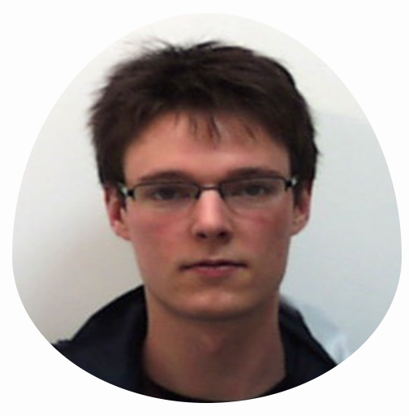






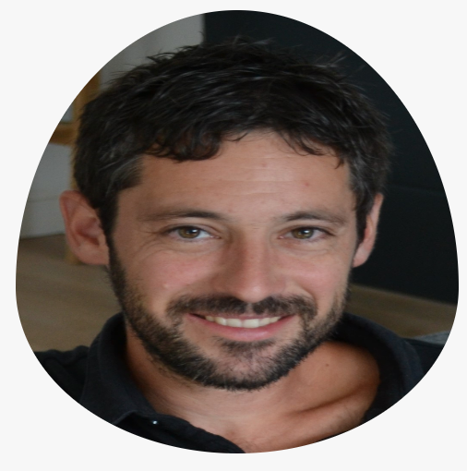












OBP2 Research Vehicle
2015-2025
Safety & Liveness
Temporal Requirements
J.C. ROGER
B. DROUOT
T. BOLLENGIER
Emilien
FOURNIER
2022
Nicolas
SUN
2022
Matthias
PASQUIER
2024
L.LE ROUX
F. GOLRA
Projects:
ONEWAY (DGAC)
Ker-SEVECO (R.Bretagne,EU)
JoinSafeCyber (AID)
VeriMoB (RAPID)
EASE4SE (RAPID)
DEPARTS (PIA)
GeMoC (ANR)
Semantic
Language
Interface
Luka
LE ROUX
2018
Vincent
LEILDE
2019
Valentin
BESNARD
2020
Commercial Products [ PragmaDEV ]
Academic Prototypes [ in-house ]
Reuse [ OTS ]
AnimUML
EMI-UML
AEFD
TLA+
Fiacre

Slide 27
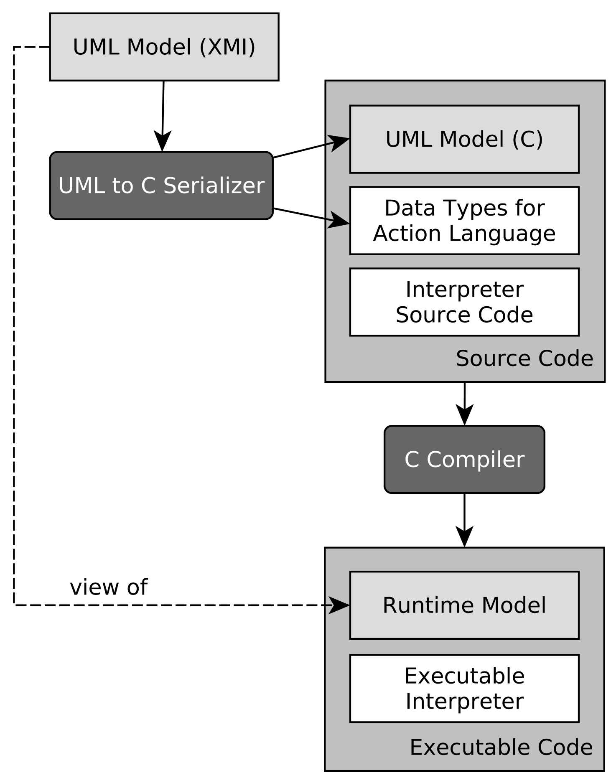
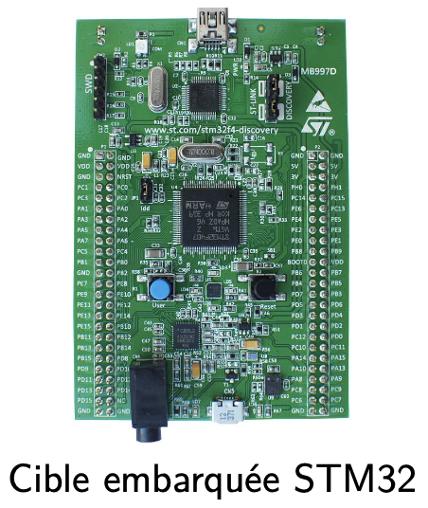


Bare-metal STM32 - ARM A9
UML
Specification
Sequencer
interprets
EMI
Semantics
SLI
PhD Valentin
BESNARD
Unified LTL Verification and Embedded Execution of UML Models,
[MODELS’18]
Model-checker
⨯
SLI
TL
Semantics
interprets
Temporal Logic
Specification
SLI
✔︎Formalization in
L∃∀N Theorem Prover
Emptiness
Checker

Slide 28
Bare-metal STM32 - ARM A9
UML
Specification
Scheduling
Policy
Sequencer
interprets
interprets
EMI
Semantics
SLI
Scheduler
SLI
PhD Valentin
BESNARD
Model-checker
⨯
SLI
PUSM EMI
Semantics
interprets
PUSM
Specification
Unified verification and monitoring of executable UML specifications.
A transformation-free approach.
[SoSyM’21].
SLI
✔︎Formalization in
L∃∀N Theorem Prover
Emptiness
Checker

Slide 29
Bare-metal STM32 - ARM A9
UML
Specification
Scheduling
Policy
Sequencer
interprets
interprets
EMI
Semantics
SLI
Scheduler
SLI
PhD Valentin
BESNARD
EMI
Semantics
SLI
||
||
Language-agnostic
asynchronous composition
operator
interprets
SLI
SLI
UML
Environment
Model-checker
⨯
SLI
PUSM EMI
Semantics
interprets
PUSM
Specification
Unified verification and monitoring of executable UML specifications.
A transformation-free approach.
[SoSyM’21].
SLI
✔︎Formalization in
L∃∀N Theorem Prover
Emptiness
Checker

Slide 30
Bare-metal STM32 - ARM A9
UML
Specification
Scheduling
Policy
Sequencer
interprets
interprets
EMI
Semantics
SLI
Scheduler
SLI
PhD Valentin
BESNARD
EMI
Semantics
SLI
||
interprets
SLI
UML
Environment
Model-checker
Filter
interprets
Filtering
Policy
SLI
⨯
SLI
PUSM EMI
Semantics
interprets
PUSM
Specification
Unified verification and monitoring of executable UML specifications.
A transformation-free approach.
[SoSyM’21].
SLI
✔︎Formalization in
L∃∀N Theorem Prover
Emptiness
Checker

Slide 31
Bare-metal STM32 - ARM A9
UML
Specification
Scheduling
Policy
Sequencer
Sequencer
interprets
interprets
EMI
Semantics
SLI
Scheduler
SLI
⨯
SLI
Acceptance
Asserter
PhD Valentin
BESNARD
EMI
Semantics
SLI
||
SLI
PUSM EMI
Semantics
interprets
PUSM Monitor
Specification
interprets
SLI
UML
Environment
Model-checker
Filter
interprets
Filtering
Policy
Verifying and Monitoring UML Models with Observer Automata. [MODELS’19].
SLI
⨯
SLI
PUSM EMI
Semantics
interprets
PUSM
Specification
Unified verification and monitoring of executable UML specifications.
A transformation-free approach.
[SoSyM’21].
SLI
✔︎Formalization in
L∃∀N Theorem Prover
Emptiness
Checker

Slide 32
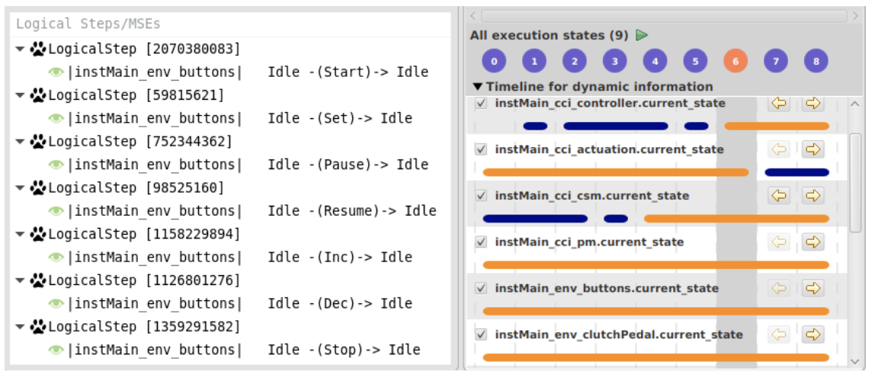
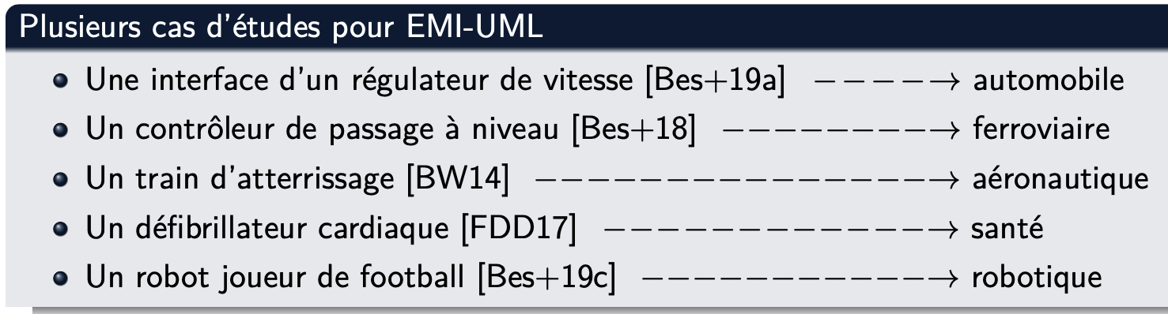
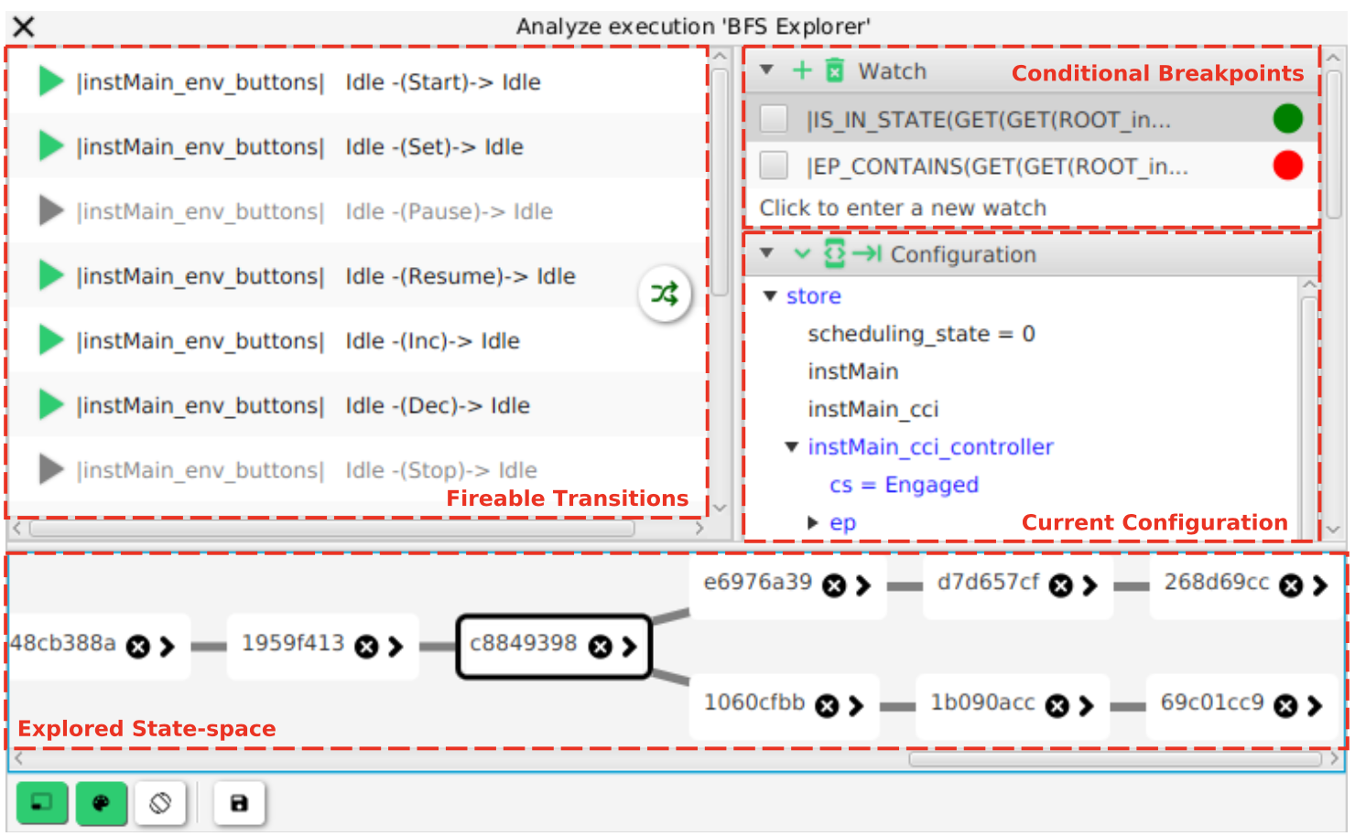
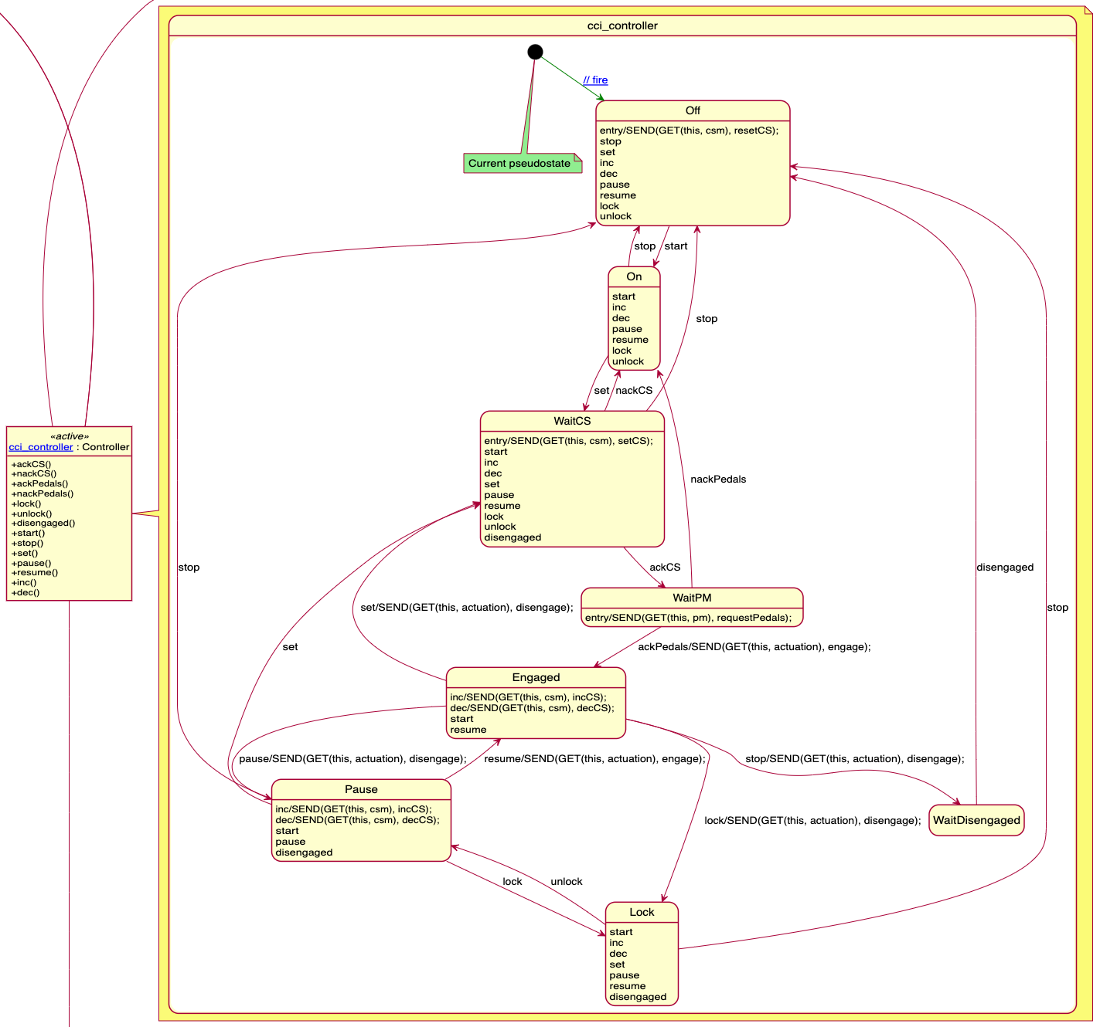
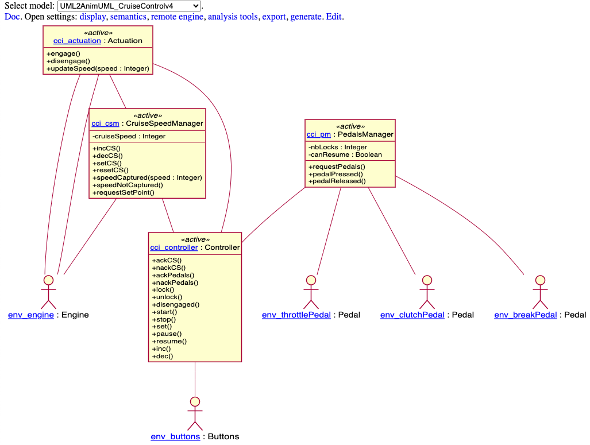
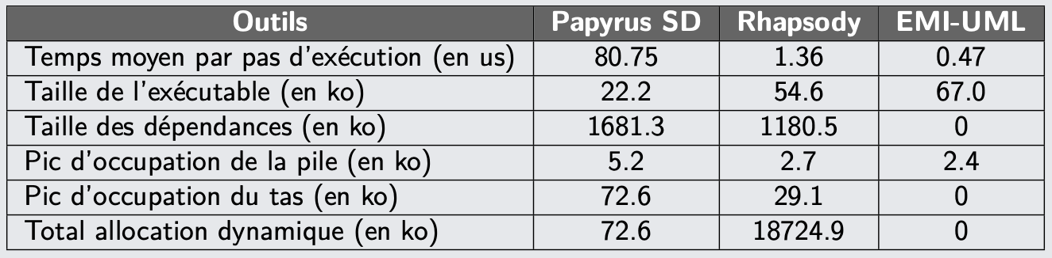
Gemoc Studio Debugger.
Bousse et al., « Execution Framework of the GEMOC Studio (Tool Demo) », 2016
PhD Valentin
BESNARD
OBP2 Debugger [SoSyM’21]

Slide 33
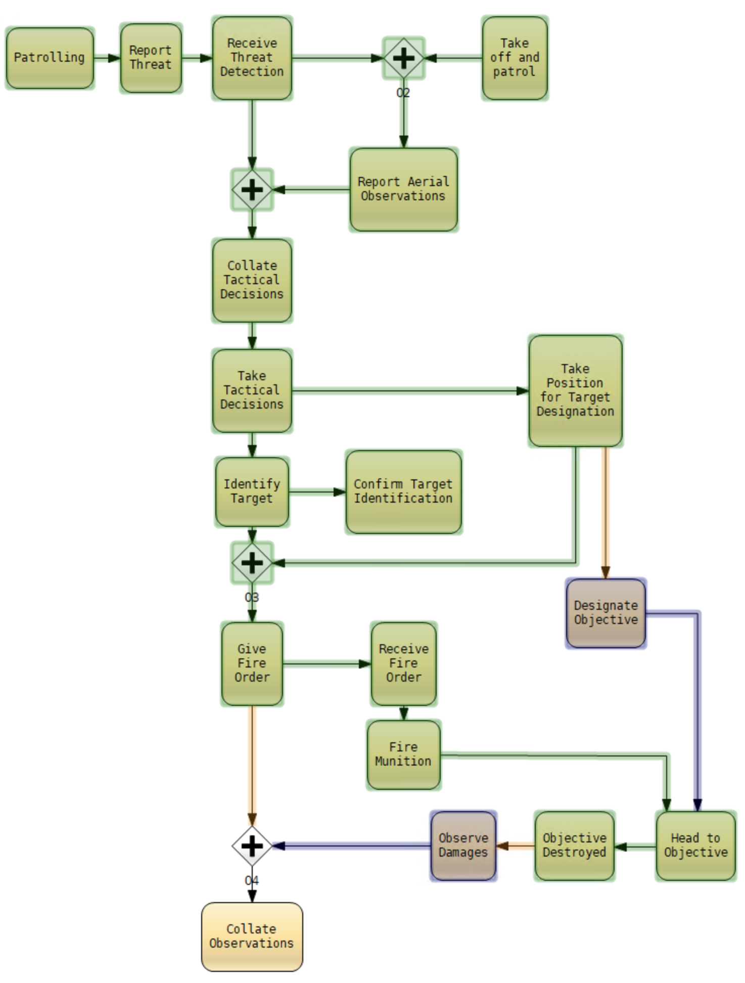
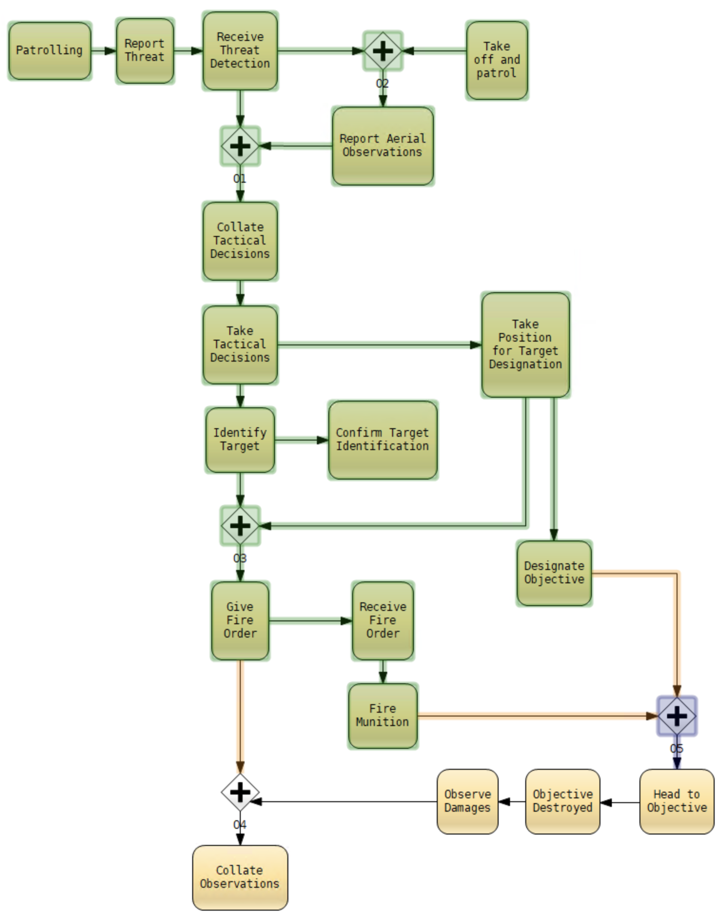
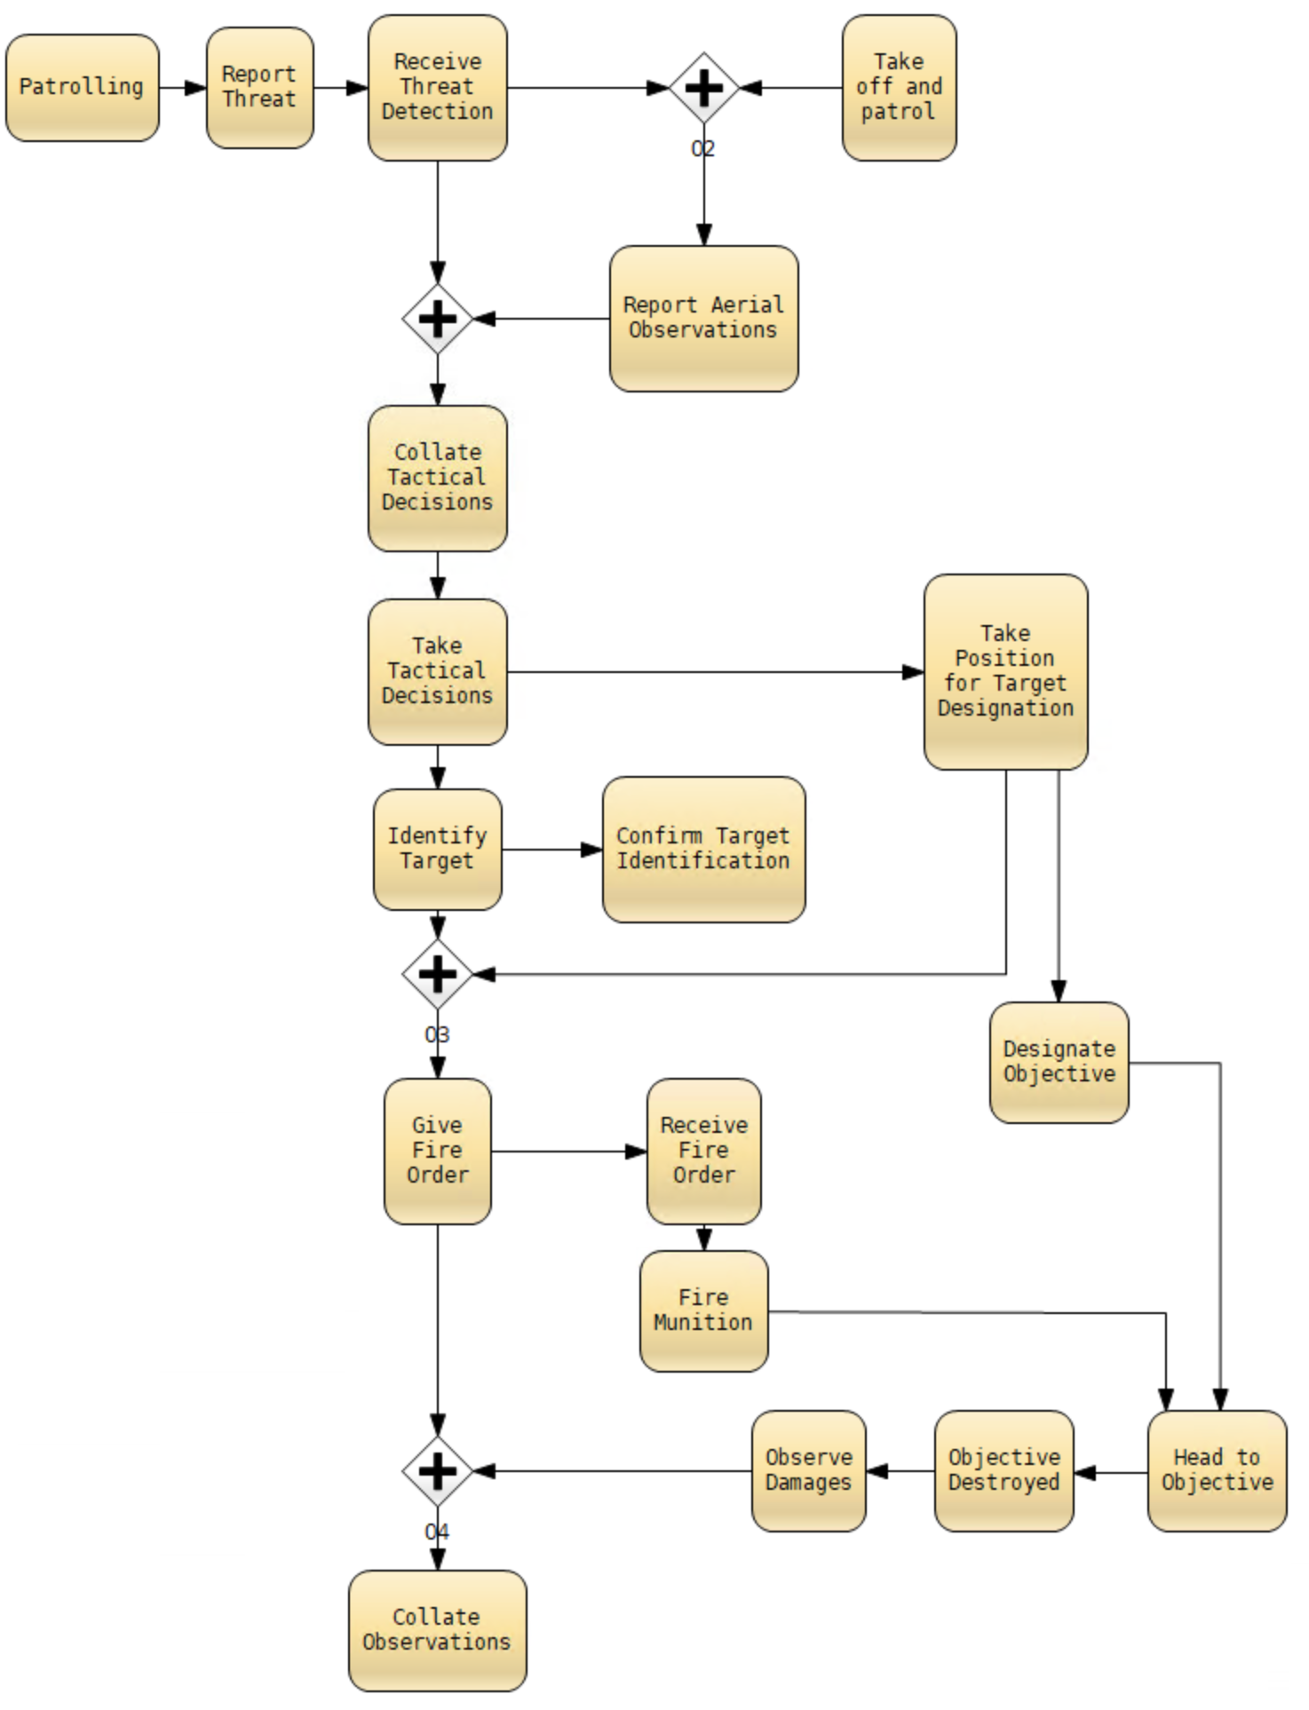
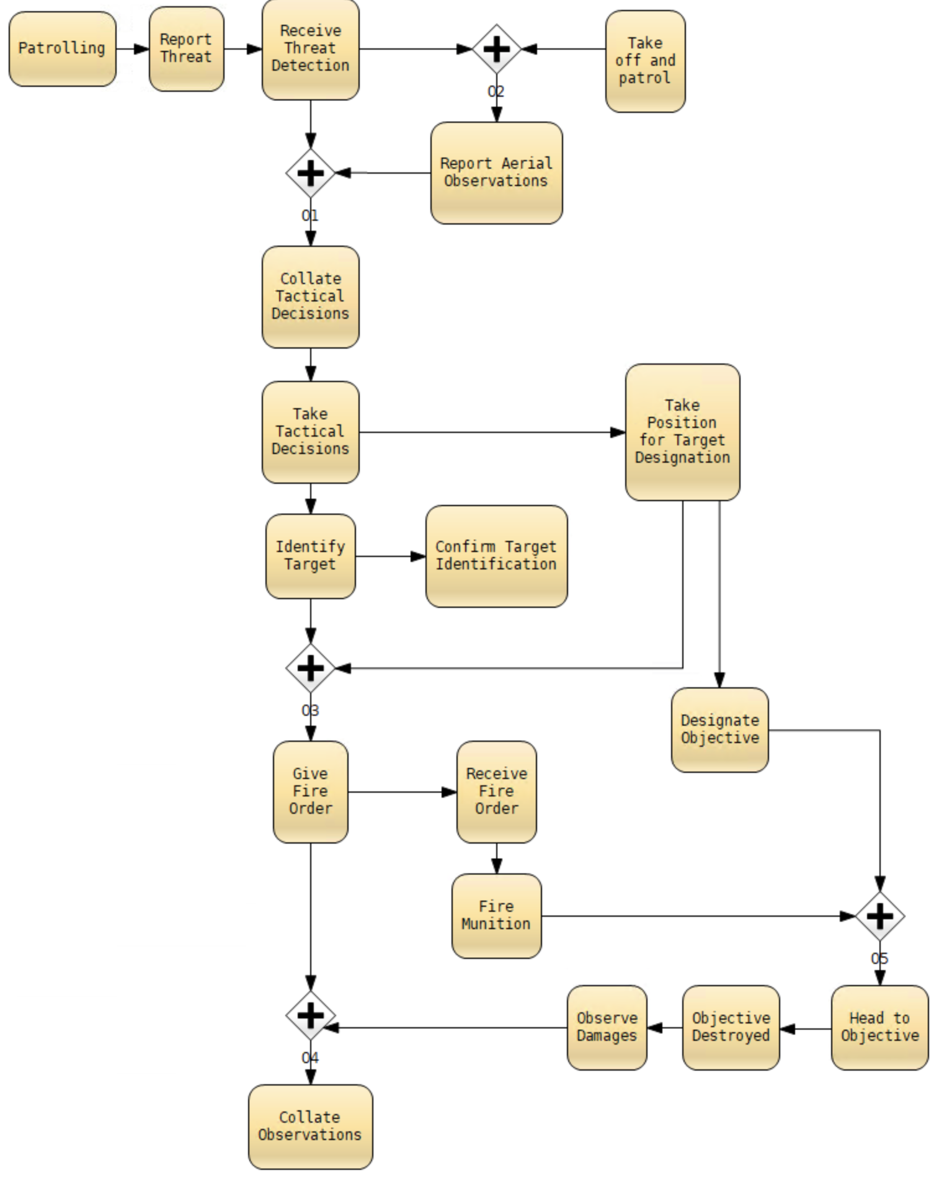
Close air support
RAPID VeriMoB
Find the problem

Slide 34
REQ:
The missile should head to the objective only when the objective was designated and the missile was fired
RAPID VeriMoB
DO = |=:E:cos00:SEM_SYMB_36| //'designate objective' was enabled
FM = |=:E:cos00:SEM_SYMB_42| //'fire munition' was enabled
HtO = |+:A:cos00:SEM_SYMB_55| //'head to objective' is active
//HtO only if both DO and FM
property = <>HtO -> (!HtO U DO) && (!HtO U FM)

Slide 35
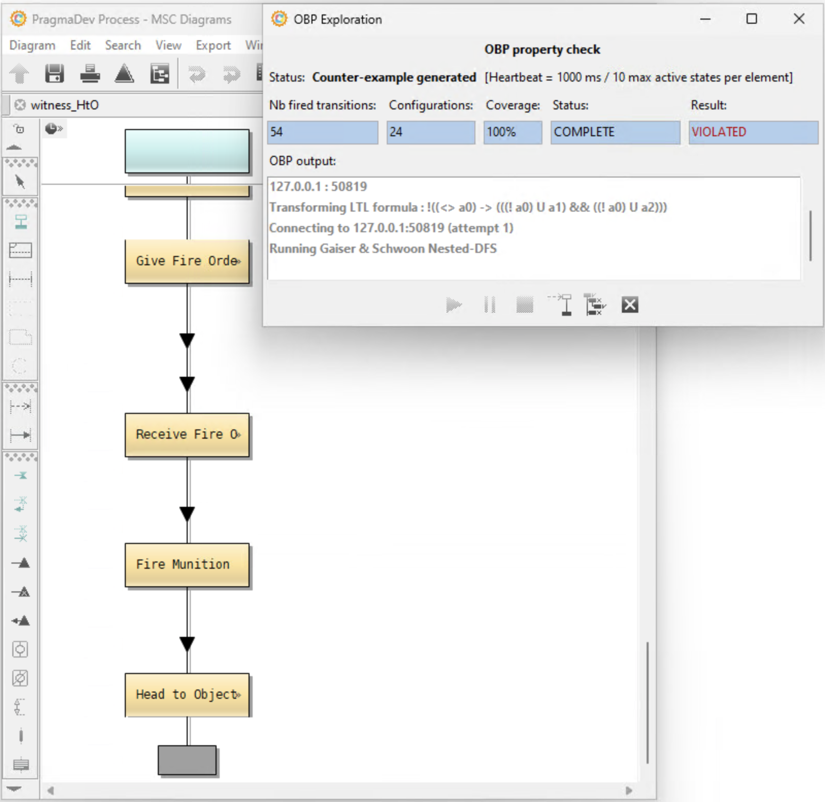
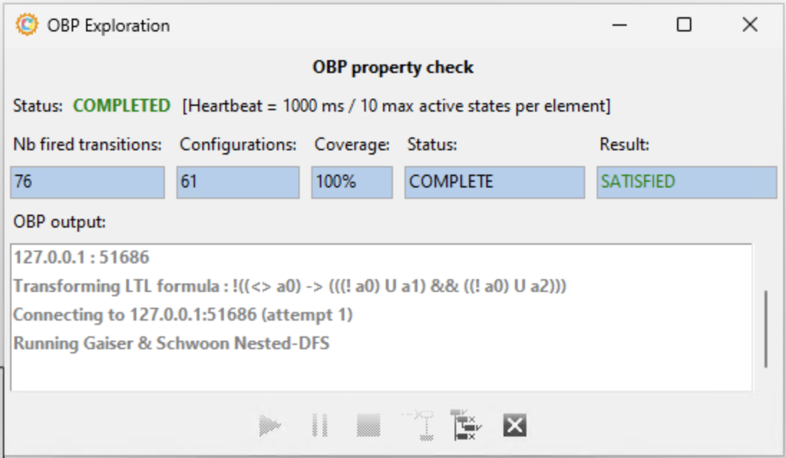
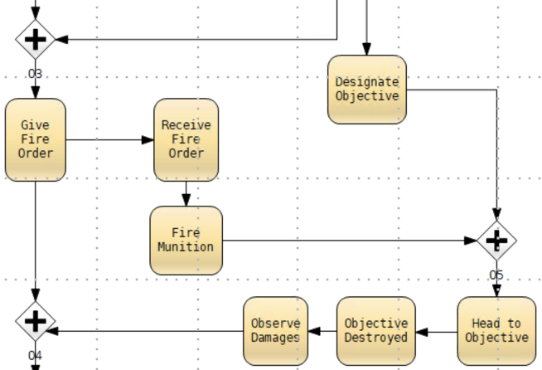
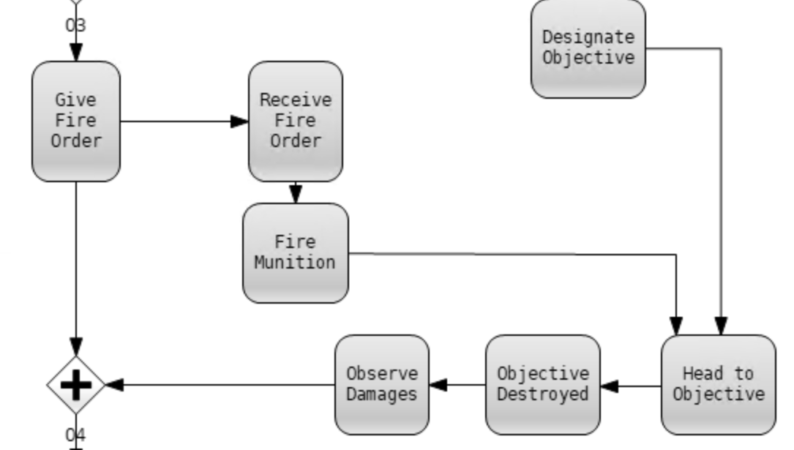
RAPID VeriMoB

Slide 36
Multiverse Debugging
PhD Matthias
PASQUIER

Slide 37
Concurrent programming
How do we get from one to a set of behaviors?
  To find schedule-sensitive bugs you might want to take the `scheduler` out during debugging.
  That brings non-determinism.
Formal specification
Is the specification aligned with the mental model?
Formal specification languages are wildly non-deterministic.
Early design phase: interacting with the `partial specification` increases the confidence
  - in the specification
  - in the properties, it needs to satisfy
Later design phase: if a property is violated, interactive debugging helps with differential diagnosis.
Temporal logics (TL) allow reasoning on sets of behaviors.
For scalability, abstraction is needed, which can increase the non-determinism.
Linear breakpoint lookup becomes graph reachability
Temporal Breakpoints
[Pasquier et al. SLE’23]
Temporal Logics
Reductions
[Pasquier et al. MODELS’22]
Under-approximations
Multiverse
Debugger
[Torres et al. ECOOP’19]
Interactive Debugging
Reachability Analysis
[Torres et al. ECOOP’19] C. Torres Lopez, R. Gurdeep Singh, S. Marr, E. Gonzalez Boix, and C. Scholliers. Multiverse Debugging: Non-Deterministic Debugging for Non-Deterministic Programs. ECOOP 2019
Notes:
C. Torres Lopez, R. Gurdeep Singh, S. Marr, E. Gonzalez Boix, and C. Scholliers. Multiverse Debugging: Non-Deterministic Debugging for Non-Deterministic Programs. ECOOP 2019

Slide 38



provide the subject
ask questions
stakeholders
observe
interact with
the behaviors
PhD Matthias
PASQUIER
Specification
Debug
Configuration
Debug Actions
Multiverse
Breakpoints
Multiverse Debugger
core semantics
Specification
Language
SLI
Temporal Finder
iSLI
Breakpoint
Language
Implements
the SLI
Implements
the iSLI
Subject Language
Provider
Breakpoint Language
Provider

Slide 39
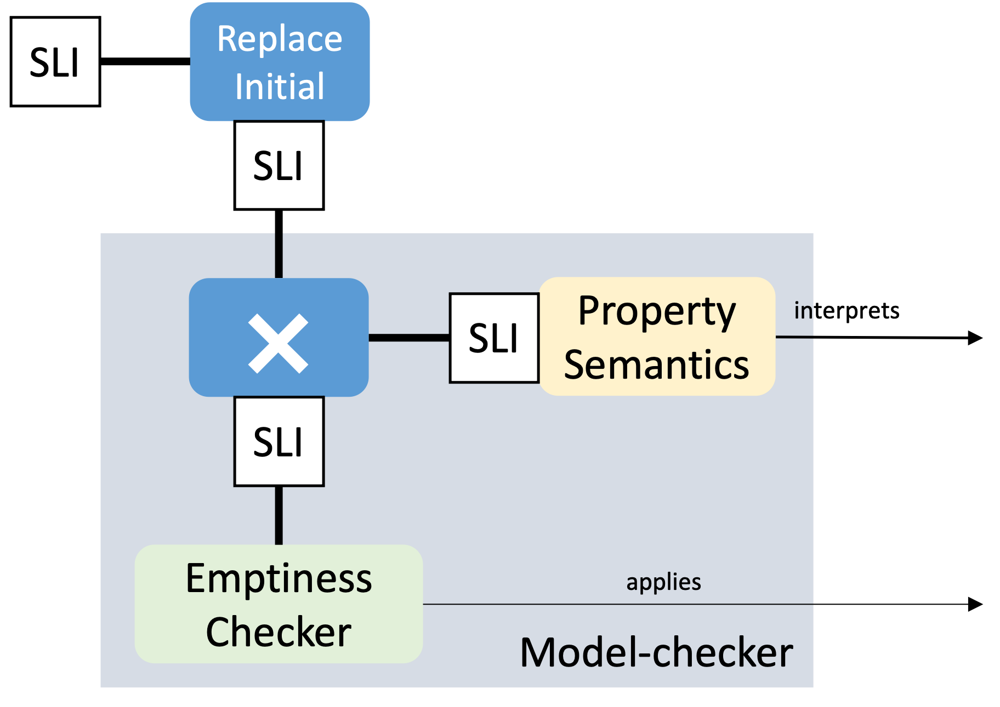

AnimUML
Specification
Multiverse Debugger
Semantics
✔︎Formalization in
L∃∀N Theorem Prover
interprets
AnimUML
Semantics
SLI
SLI
step
PhD Matthias
PASQUIER
Language-agnostic
jump
Non-trivial Monitor Composition
select
run2breakpoint
Scalability
4
+Expressivity, no instrumentation
1
2
3
8
7
9
Temporal
Breakpoints
@[SLE’23]
5
6
Reduction
[MODELS’22]
SLI
User
uses
Interactive
Controler

Slide 40
Breakpoints Types
4
1
2
3
8
7
9
4 types of breakpoints:
Configuration-based: bad state snapshot
5
6
PhD Matthias
PASQUIER
The breakpoint condition is evaluated by looking at one configuration at a time.
Examples:
Stop if the interceptor is armed while the radar is not tracking any target
a < 3
b == true
deadlock ≝ stuck && !<termination condition>

Slide 41
Breakpoints Types
4
1
2
3
8
7
9
4 types of breakpoints:
Configuration-based: bad state snapshot
Step-based: bad execution step
5
6
PhD Matthias
PASQUIER
The breakpoint condition is evaluated on two successive configurations linked by an action.
Examples:
Stop whenever when switch from Reconnaissance to EngageTarget without Authorization
Memory breakpoint: a changed, a@pre != a
Difference breakpoint: rising-edge b, falling-edge b
Activation breakpoint: f is triggered

Slide 42
Breakpoints Types
4
1
2
3
8
7
9
4 types of breakpoints:
Configuration-based: bad state snapshot
Step-based: bad execution step
History-based: bad pattern over the past
5
6
PhD Matthias
PASQUIER
The breakpoint condition is evaluated by integrating over the execution history (past information).
Examples:
stop if the same hostile aircraft is repeatedly dropped and reacquired by the radar 5 times in succession, indicating tracking instability.
3rd occurrence of f

Slide 43
Breakpoints Types
4
1
2
3
8
7
9
4 types of breakpoints:
Configuration-based: bad state snapshot
Step-based: bad execution step
History-based: bad pattern over the past
Liveness-based: bad future eventuality
5
6
PhD Matthias
PASQUIER
The breakpoint condition isolates loops that prevent useful work.
(Isolate `livelock-like` cyclic behaviors).
Examples:
mission-critical alert never propagates
a==5 is inevitable – forall behaviors, a==5 will necessarily become true at some point in the future
Eventually forever b == false – forall behaviors, if b == false at some point, then it will stay false forever

Slide 44


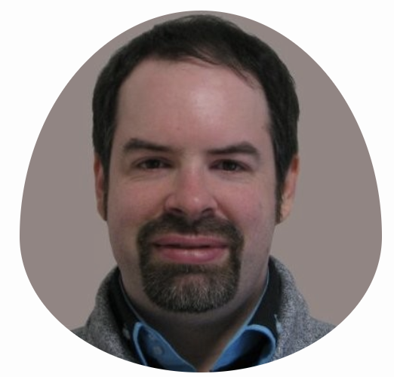
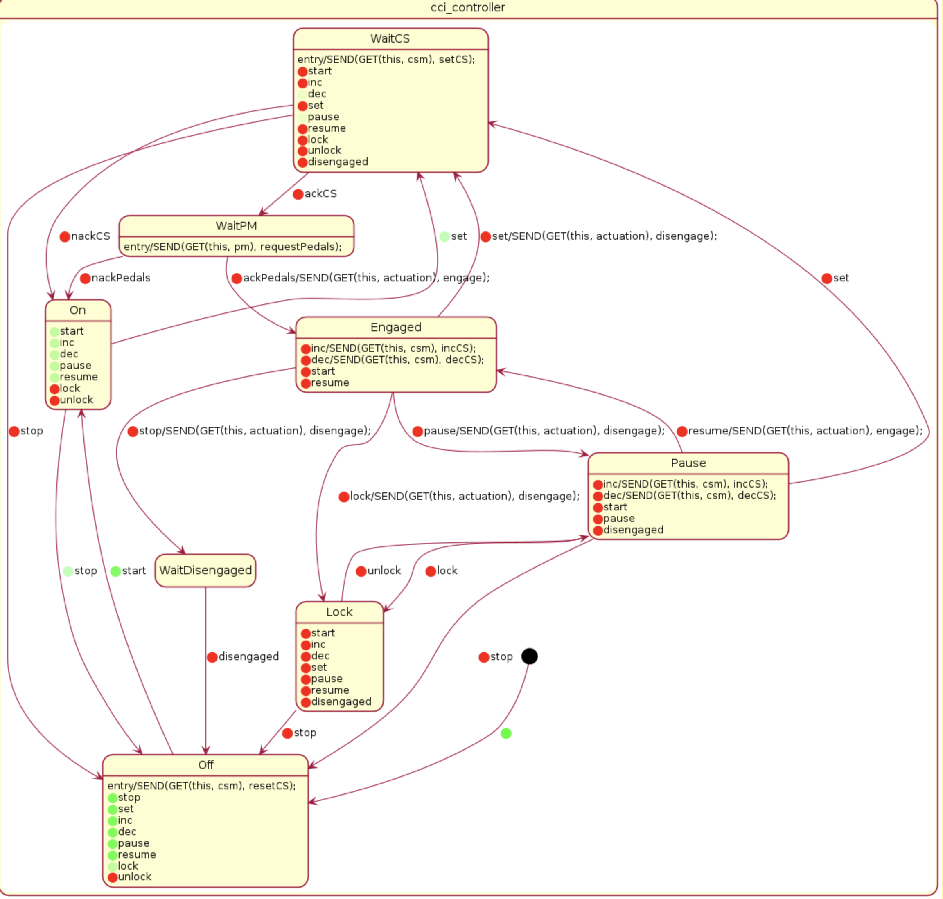
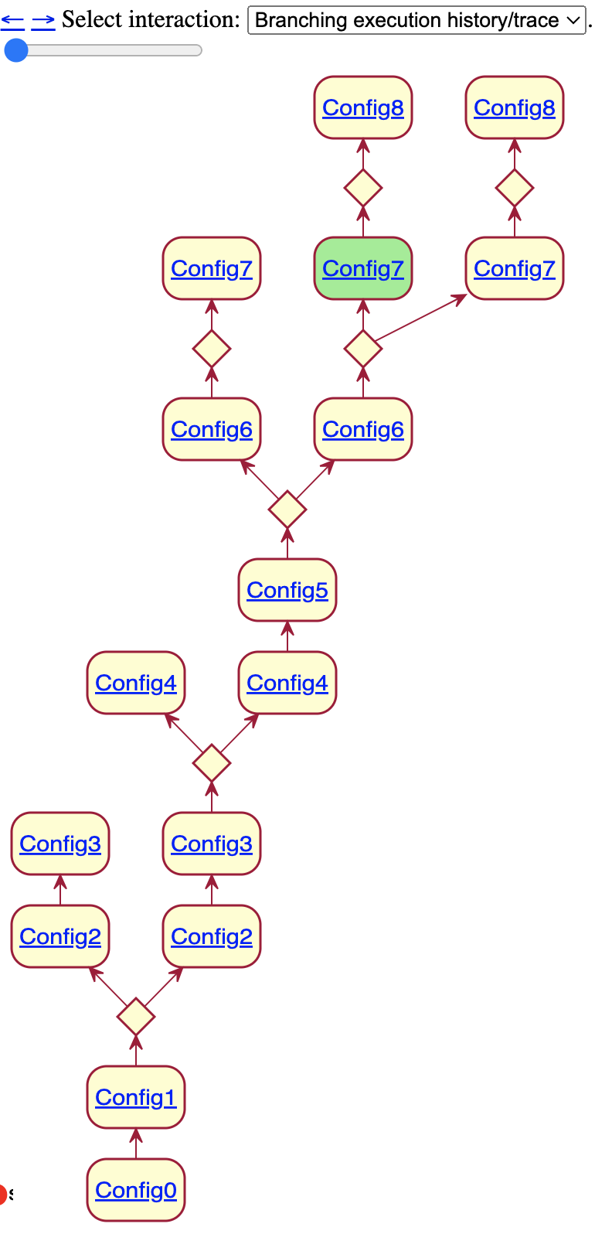
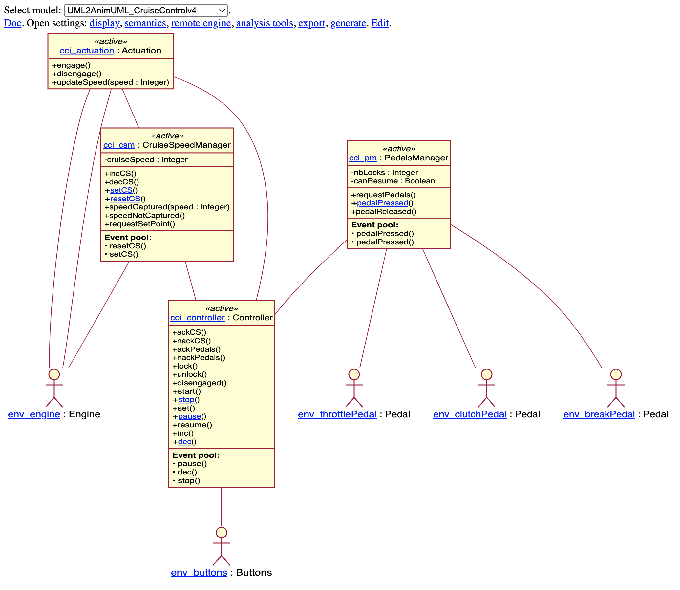
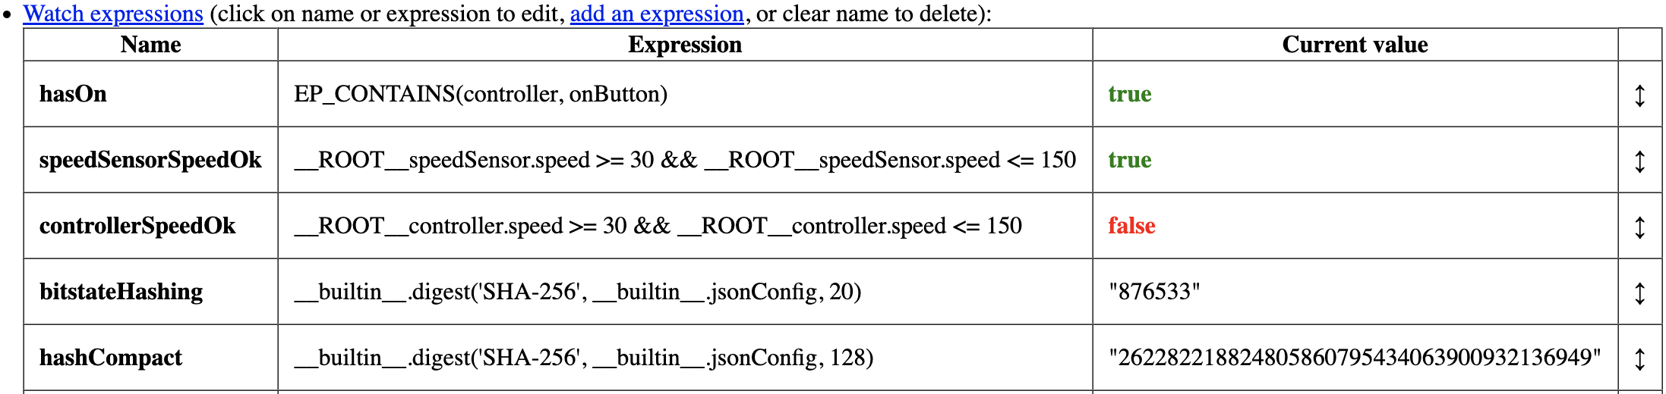
Designing, Animating, and Verifying Partial UML Models [MODELS’20].
AnimUML
https://github.com/ESEO-Tech/AnimUML
Reduced Multiverse Debugger
@ [MODELS’22]
Coverage
as heatmap overlay
Branching
history
generic
reductions

Slide 45
Sum-up & Ways Forward

Slide 46
The Interactive Debugger
pause, step, resume
PhD Matthias
PASQUIER
Safety queries/breakpoints:
Line/Syntax
Conditional
Watchpoint
Fonction
History [GP02]
  Hit counter
Interactive Debugging [GDB88]
Jump back in execution-time
Jump between execution traces
Omniscient Debugging [LB03]
Exploration of one execution trace
Multiverse Debugging [MD19]
Exploration of a subset of execution traces
Model-Checking
Liveness
Exhaustive exploration of execution traces
[MD19] C. T. Lopez, R. G. Singh, S. Marr, E. G. Boix, and C. Scholliers. Multiverse Debugging: Non-Deterministic Debugging for Non-Deterministic Programs. ECOOP 2019
[LB03] Lewis, B.: Debugging backwards in time. AADEBUG, 2003.
[GP02] Elsa Gunter et Doron Peled, « Temporal debugging for concurrent systems », 2002.
[GDB88] Stallman, Richard, Roland Pesch, and Stan Shebs. "Debugging with GDB." Free Software Foundation 675, 1988.
Notes:
Lewis, B.: Debugging backwards in time. In: Proceedings of the Fifth International Workshop on Automated Debugging (AADEBUG’03). (October 2003)

Slide 47
A continuum between debugging and model-checking
SLI renders multiverse debugging language agnostic
Reductions bring scalability @ [MODELS’22]
Temporal breakpoints increase conditional breakpoint expressivity @ [SLE23]
  taxonomy: state, step, history and liveness
Formalized in L∃∀N @ https://github.com/teodorov/temporal-multiverse-debugging
Experiences:
Integration in the AnimUML modeling environment @ https://github.com/ESEO-Tech/AnimUML
3 different breakpoint languages:
  RegExp (reB),
  Statecharts (scB),
  LTL & Buchi AnimUML (scB_{ba})
Case study: Debugging Paxos in the UML Multiverse @ [MoDeVVa’23]
Yesterday

Slide 48

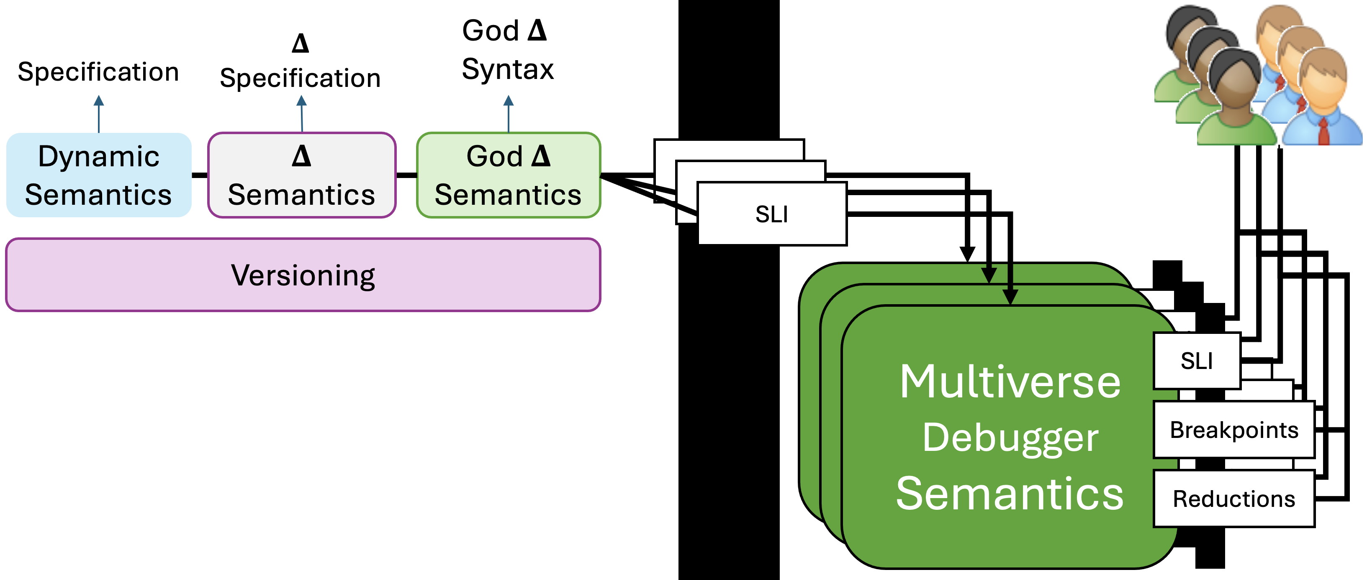
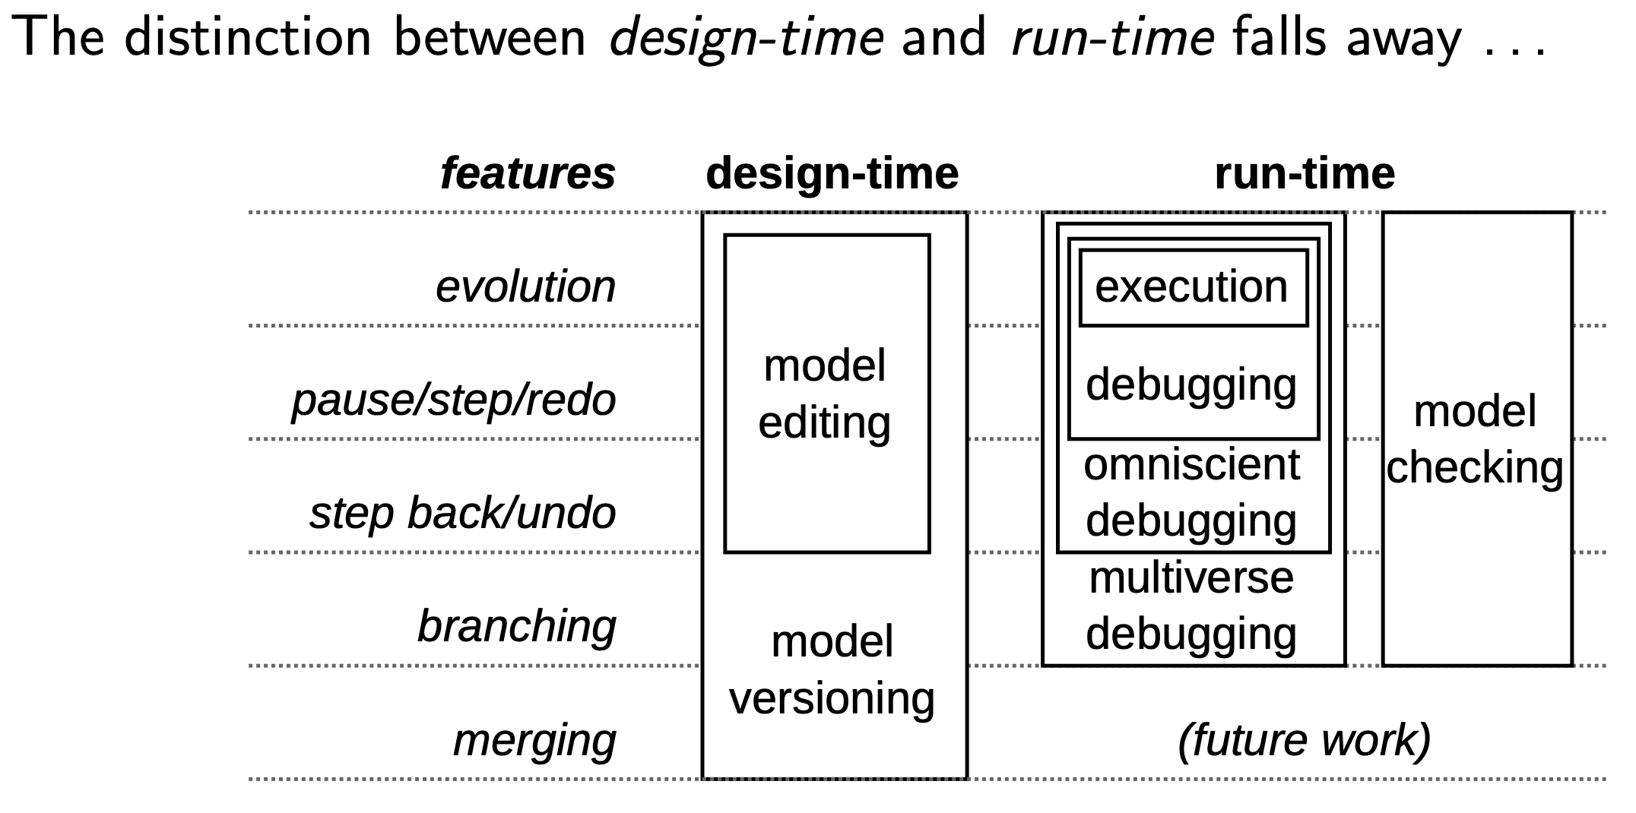
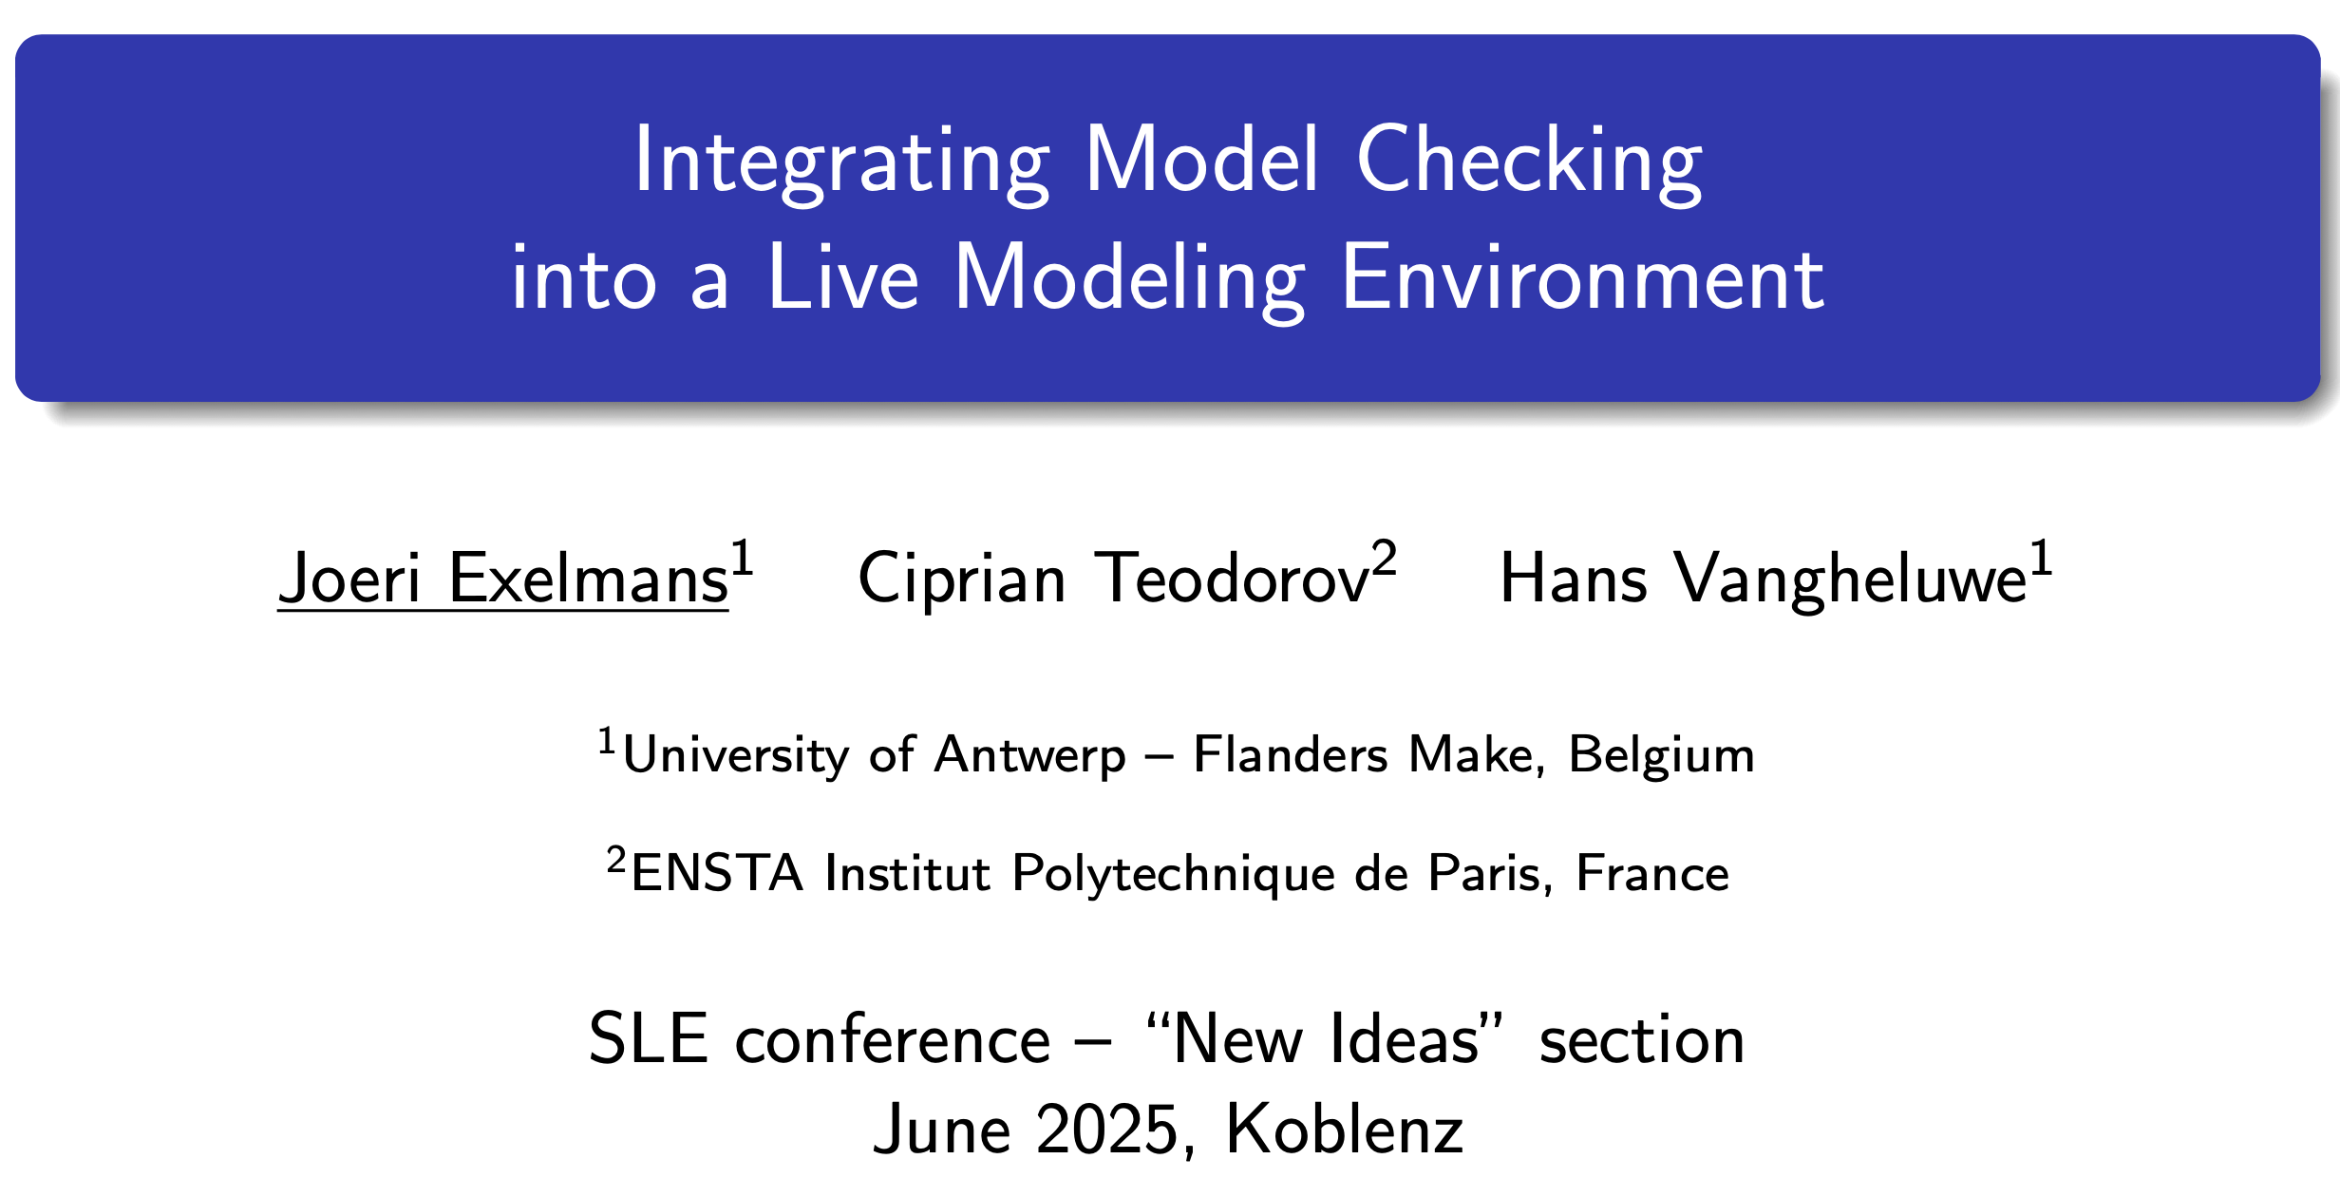
Collaborative Live Modelling
Joeri EXELMANS
Composition?
Language-agnostic?
Without redoing the language
edit actions
M
M
M
R
Live formal modeling
R
R
Today
https://deemz.org/public/live-soup/
M
R
M
R
run actions
reflective
mutation
M
M
god
action
R
R
R
M
R
M
[SLE’25]
[SoSyM’24]
[MLE’23]
R
M

Slide 49


The Living SysML v2 Blueprint
SysML v2
Specification
A Unified Execution and Verification Infrastructure
Multiverse Exploration as a Modeling Primitive
Transparent Execution, Observation, and Control API
Partial Spec Execution for a Continuum of Design
UFRPE.br
interprets
SysML v2 Blueprint VM
SLI
Action
Semantics
State
Semantics
DSL
Semantics
Multiverse Debugger
Semantics
SLI
KerML
Semantics
Breakpoints
Reductions
Challenges:
Combine meta-compilation (Truffle) with retargetable verification (LTSmin | OBP2)
Verification scalability
Federating Heterogeneous xDSL for Complex Multi-Abstraction Specifications
Heterogeneous Refinement between SysMl Spec & System
How to link with proof assistants ?
12/09/2025
FDL 2025

Slide 50
Ways Forward
Resource constraints
Resource-induced
abstraction
Specification
Timing Spec
interprets
interprets
Semantics
SLI
Timed
SLI
Multiverse Debugger
Semantics
SLI
Tomorrow
Breakpoints
Reductions
How to obtain a timed automata abstraction on-the-fly?
1st successful step: DGAC ONEWAY
Timed BPMN without transformations

Slide 51
Ways Forward
Spec A
Modular semantics and proofs
Subject Language
interprets
Composition
Policy
Semantics A
SLI
interprets
Spec B
Composer
SLI
SLI
interprets
Multiverse Debugger
Semantics
SLI
Semantics B
SLI
Tomorrow
Breakpoints
Reductions
Composition algebras: channel, clocks, events
||
Language-agnostic
asynchronous composition
operator
SLI
Can the SLI be used for defining semantic-level operators?

Slide 52
Ways Forward
Spec A
Modular semantics and proofs
interprets
Composition
Policy
Abstraction Spec
Semantics A
SLI
interprets
interprets
Spec B
Composer
SLI
abstraction
SLI
SLI
interprets
Multiverse Debugger
Semantics
SLI
Semantics B
SLI
Tomorrow
Breakpoints
1st successful step: DGAC ONEWAY
Timed BPMN
Reductions
  How to maximize semantic reuse for cheaper overapproximations?
  Can the SLI help to bring Modular SOS [1] to practice?
uses
[1] Peter D. Moses, “Foundation of Modular SOS”,
Mathematical Foundations of Computer Science 1999, Lecture Notes in Computer Science, vol 1672. Springer.

Slide 53
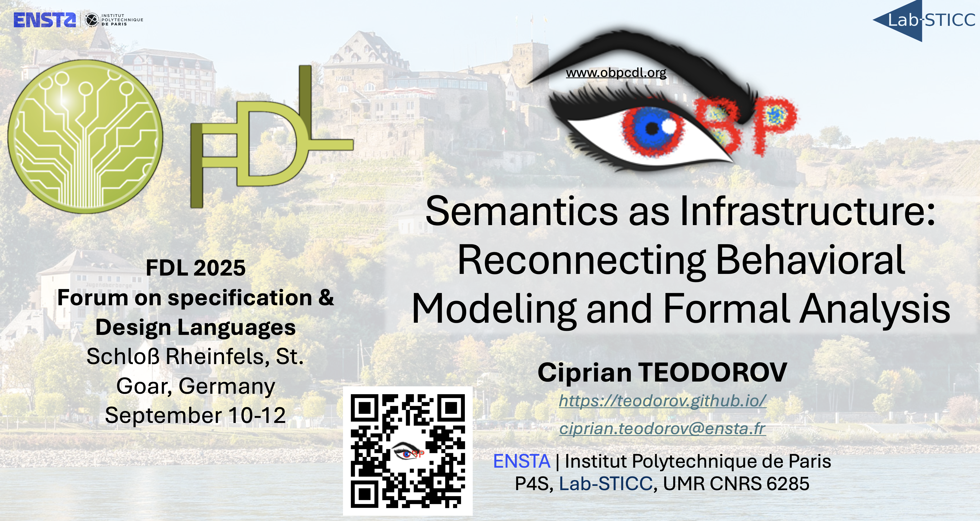
What do you think?
What do we miss?
How do we best help system designers?
Intuitive vs expressive breakpoints?
Can Live Specifications push us past Vibe Coding?
Let’s get cracking together
Postdoc, PhD, Research Engineer
opportunities!
Notes:
Vibe coding -- generating code from natural-language prompts to AI -- may get us prototypes fast, but it’s messy and we lose control and insight.
Live Specifications offer real-time understanding, rigor, and precision.
The big question is — can we move from vibe coding improvisations to clarity without losing creativity ?

