Slide 1






Temporal Breakpoints for Multiverse Debugging
Matthias Pasquier^{1, 2}, Ciprian Teodorov², Frédéric Jouault³,
Matthias Brun³, Luka Le Roux², Loïc Lagadec²
        ¹ LUCIO - Angers, France
        ² Lab-STICC CNRS UMR 6285, ENSTA Bretagne - Brest, France
        ³ LERIA, University of Angers & ESEO - Angers, France
SLE 2023 - October 23-24 2023 - Cascais, Portugal

Slide 2
Concurrent programming
How do we get from one to a set of behaviors?
  To find schedule-sensitive bugs you might want to take the `scheduler` out during debugging.
  That brings non-determinism.
Formal specification
Is the specification aligned with the mental model?
Formal specification languages are wildly non-deterministic.
Early design phase: interacting with the `partial specification` increases the confidence
  - in the specification
  - in the properties, it needs to satisfy
Later design phase: if a property is violated, interactive debugging helps with differential diagnosis.
  Linear breakpoint lookup becomes graph reachability
  For scalability, abstraction is needed, which can increase the non-determinism.
Temporal logics (TL) allow reasoning on sets of behaviors.
Question: How to get TL in interactive debugging?
Purpose: Leverage interactive debugging for formal specifications
Temporal Breakpoints
Temporal Logics
Reductions
[Pasquier et al. MODELS’22]
Under-approximations
Multiverse
Debugger
[Torres et al. ECOOP’19]
Interactive Debugging
Reachability Analysis

Slide 3

Questions to ponder
Temporal assessments in Simulink
[Rajhans et al. RV21]
Does your favorite debugger support temporal logic breakpoints?
Does your favorite modeling tool have a debugger?
  If yes does that debugger support temporal logic breakpoints?
  If not, start using good modeling tools

Slide 4
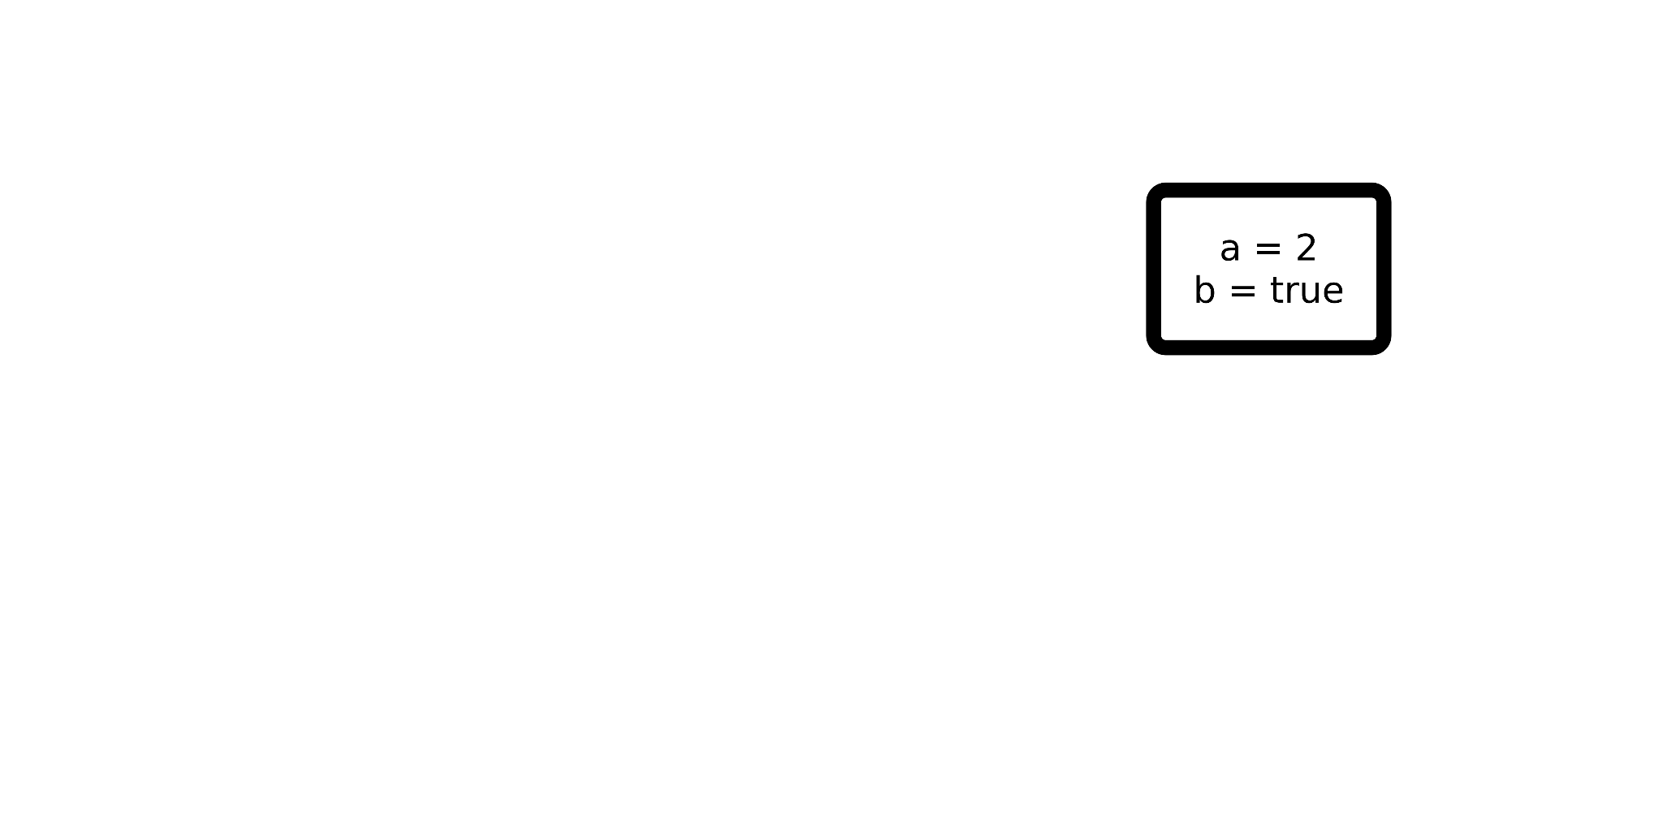
A new classification for breakpoints
4 types of breakpoints:
Configuration-based
The breakpoint condition is evaluated by looking at one configuration at a time.
Examples:
a < 3
b == true
deadlock ≝ stuck && !<termination_condition>

Slide 5
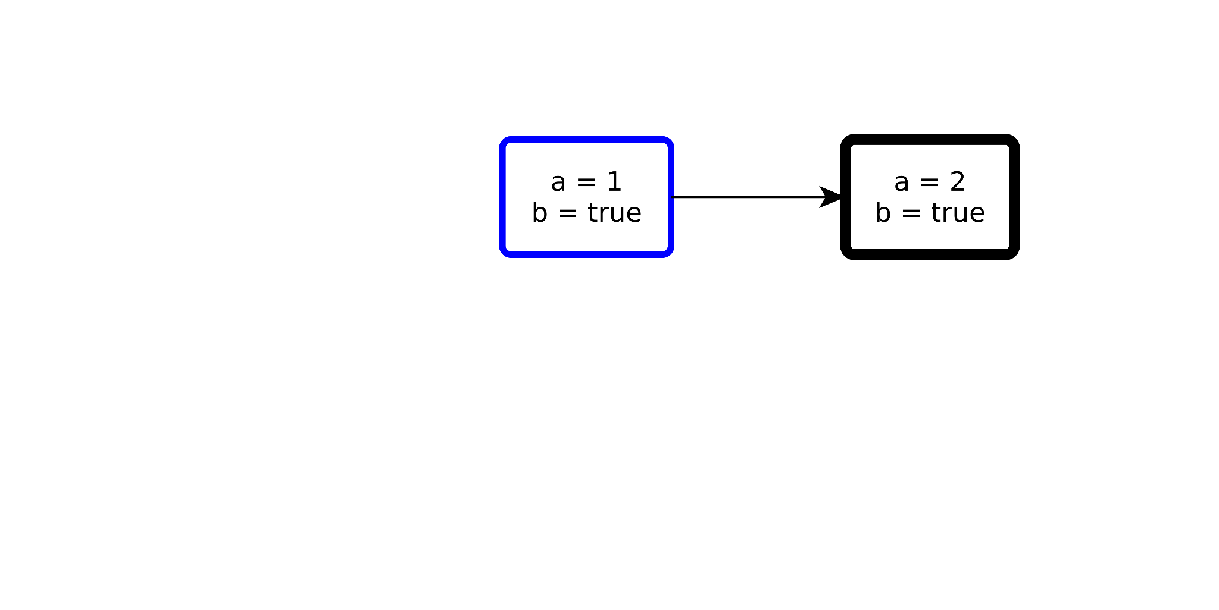
A new classification for breakpoints
4 types of breakpoints:
Configuration-based
Step-based
f
The breakpoint condition is evaluated on two successive configurations linked by an action.
Examples:
Memory breakpoint: a changed, a@pre != a
Difference breakpoint: rising-edge b, falling-edge b
Activation breakpoint: f is triggered

Slide 6
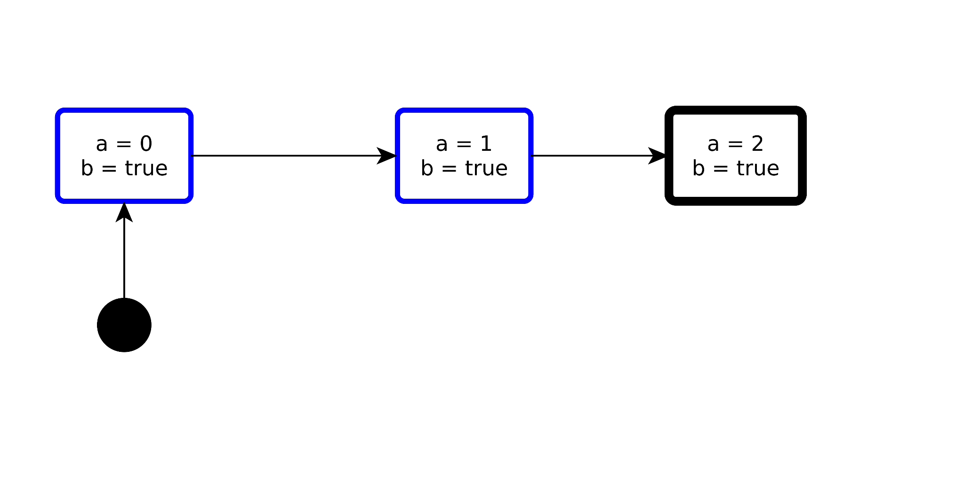
A new classification for breakpoints
4 types of breakpoints:
Configuration-based
Step-based
History-based
The breakpoint condition is evaluated by integrating over the execution history (past information).
Examples:
∑ a > 2
3rd occurrence of f

Slide 7
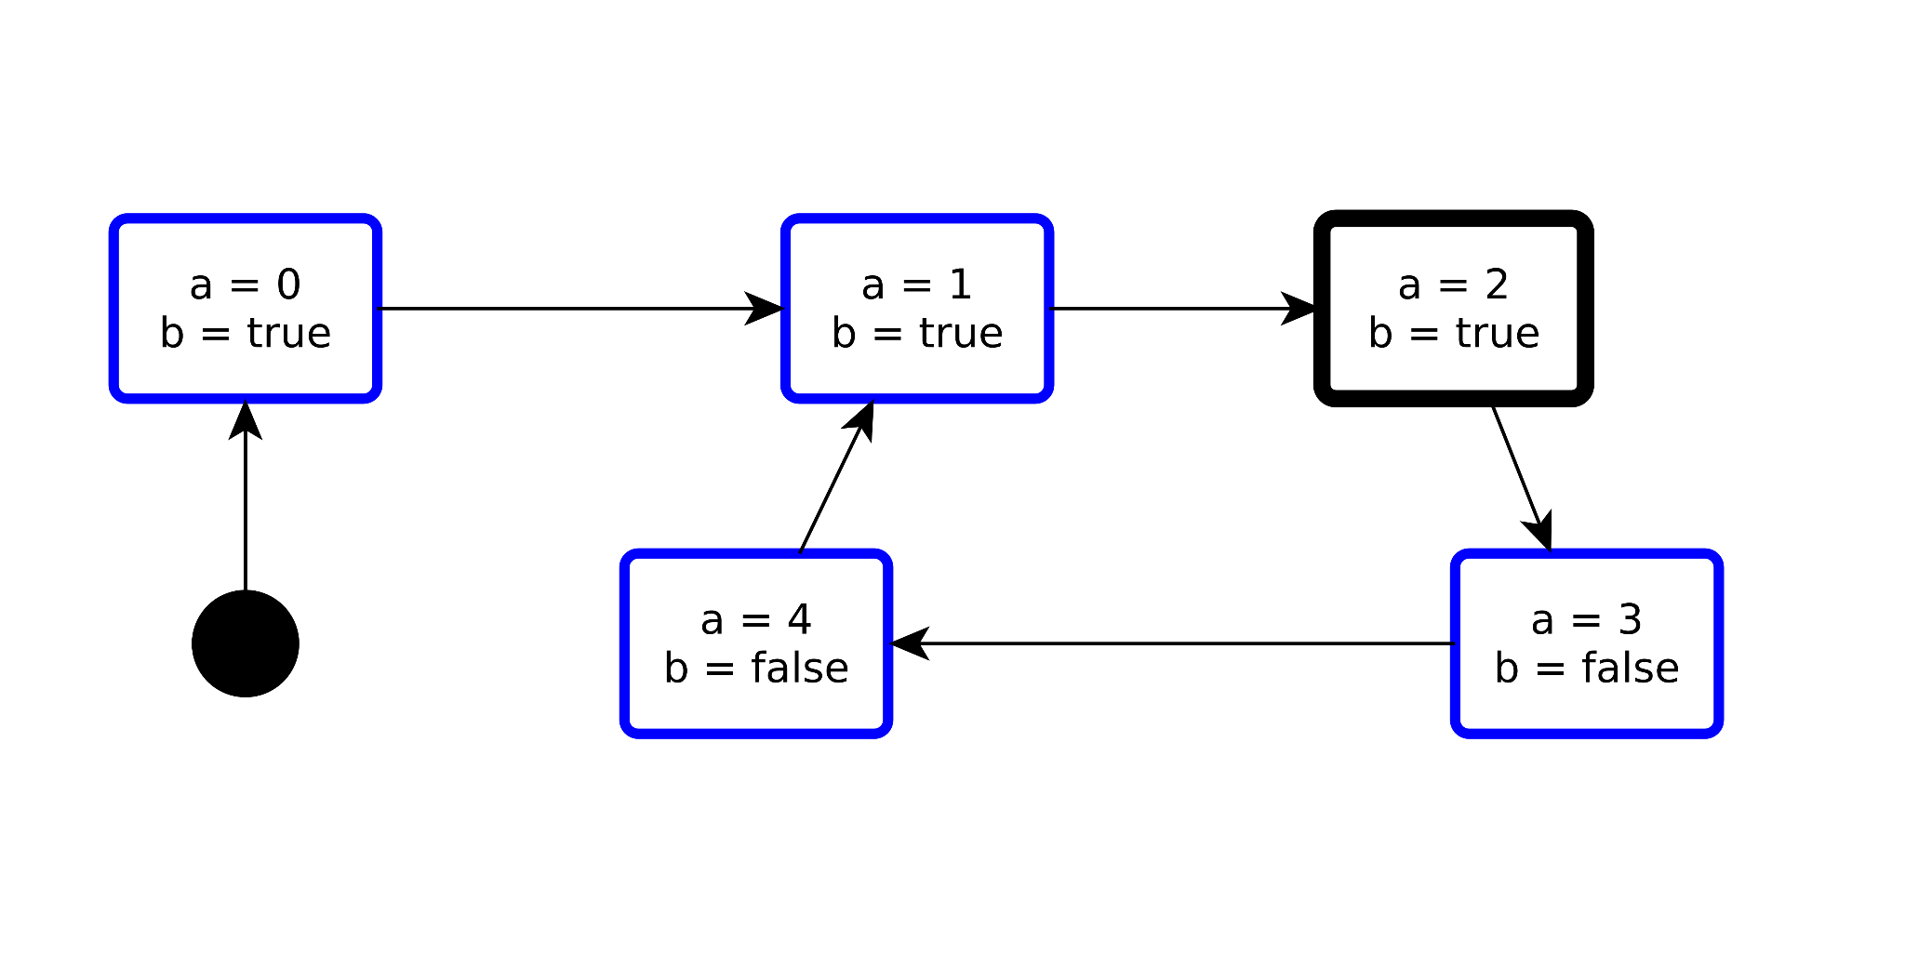
A new classification for breakpoints
4 types of breakpoints:
Configuration-based
Step-based
History-based
Liveness-based
The breakpoint condition isolates loops that prevent useful work.
(Isolate `livelock-like` cyclic behaviors).
Examples:
a==5 is inevitable – forall behaviors, a==5 will necessarily become true at some point in the future
Eventually forever b == false – forall behaviors, if b == false at some point, then it will stay false forever

Slide 8



How to write tools that survive?
Hypothesis:
black box semantics
-> any meta-language
Reuse based on
Pivot Language
Reuse based on
Meta-Language
Reuse based on
Confluent Tool Requirements
T
C
D
Meta
Language
T
Meta
Language
Tool Family
Meta
Language
C
Pivot Language
Meta
Language
Meta
Language
Debugging
D
OD
MD
T
C
D
Pivot Model
Language
Definition
Language
Definition
SLI
MC0
MC
1
MC
2
Mon
DSL Model
DSL Model
DSL Model
Sch
Sch
Manuel Wimmer Keynote @ MLE’23
Family members

Slide 9



provide the subject
ask questions
stakeholders
observe
interact with
the behaviors
Specification
Debug
Configuration
Debug Actions
Multiverse
Breakpoints
Multiverse Debugger
core semantics
Specification
Language
SLI
Temporal Finder
iSLI
Breakpoint
Language
Implements
the SLI
Implements
the iSLI
Subject Language
Provider
Breakpoint Language
Provider

Slide 10
Semantic Language Interface (SLI)
SLI {
semantics: (C A) {
initial: set C
actions: C → set A
execute: A → C → set C
}
evaluate: E → (C x A x C) → V -- questions
reduce: R → C → ⍺ -- reductions
π: (C A V ⍺ T) {…} -- projections
}
Generic Types:
Configuration:
Example CEK-style
C ≜ ⟨control, env, [Frame]⟩
Expression
execution step
Value
Action:
Example CEK-style
A ≜ from-predicate ⟶ to-C
Similar semantic approaches:
Lamport L. “The temporal logic of actions.” TOPLAS. 1994 https://doi.org/10.1145/177492.177726
Charguéraud, et al. “Omnisemantics: Smooth Handling of Nondeterminism.” TOPLAS. 2023, https://doi.org/10.1145/3579834

Slide 11
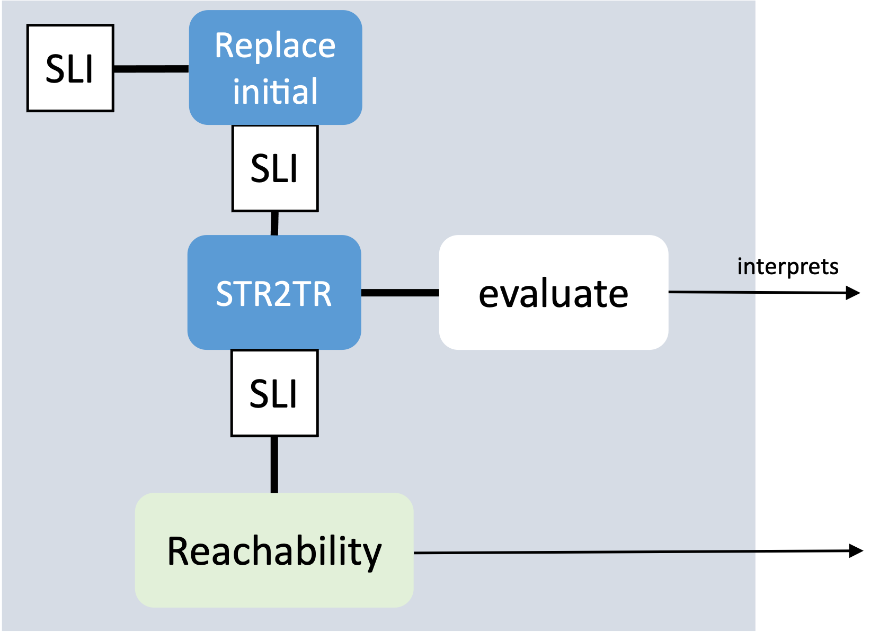

AnimUML
Specification
Multiverse Debugger
Semantics
✔︎Formalization in
L∃∀N Theorem Prover
interprets
AnimUML
Semantics
SLI
SLI
step
Language-agnostic
jump
Non-trivial Monitor Composition
select
run2breakpoint
Scalability
4
1
2
3
8
7
9
Configuration
Breakpoints
5
6
Reduction
[MODELS’22]
SLI
User
uses
Interactive
Controler

Slide 12
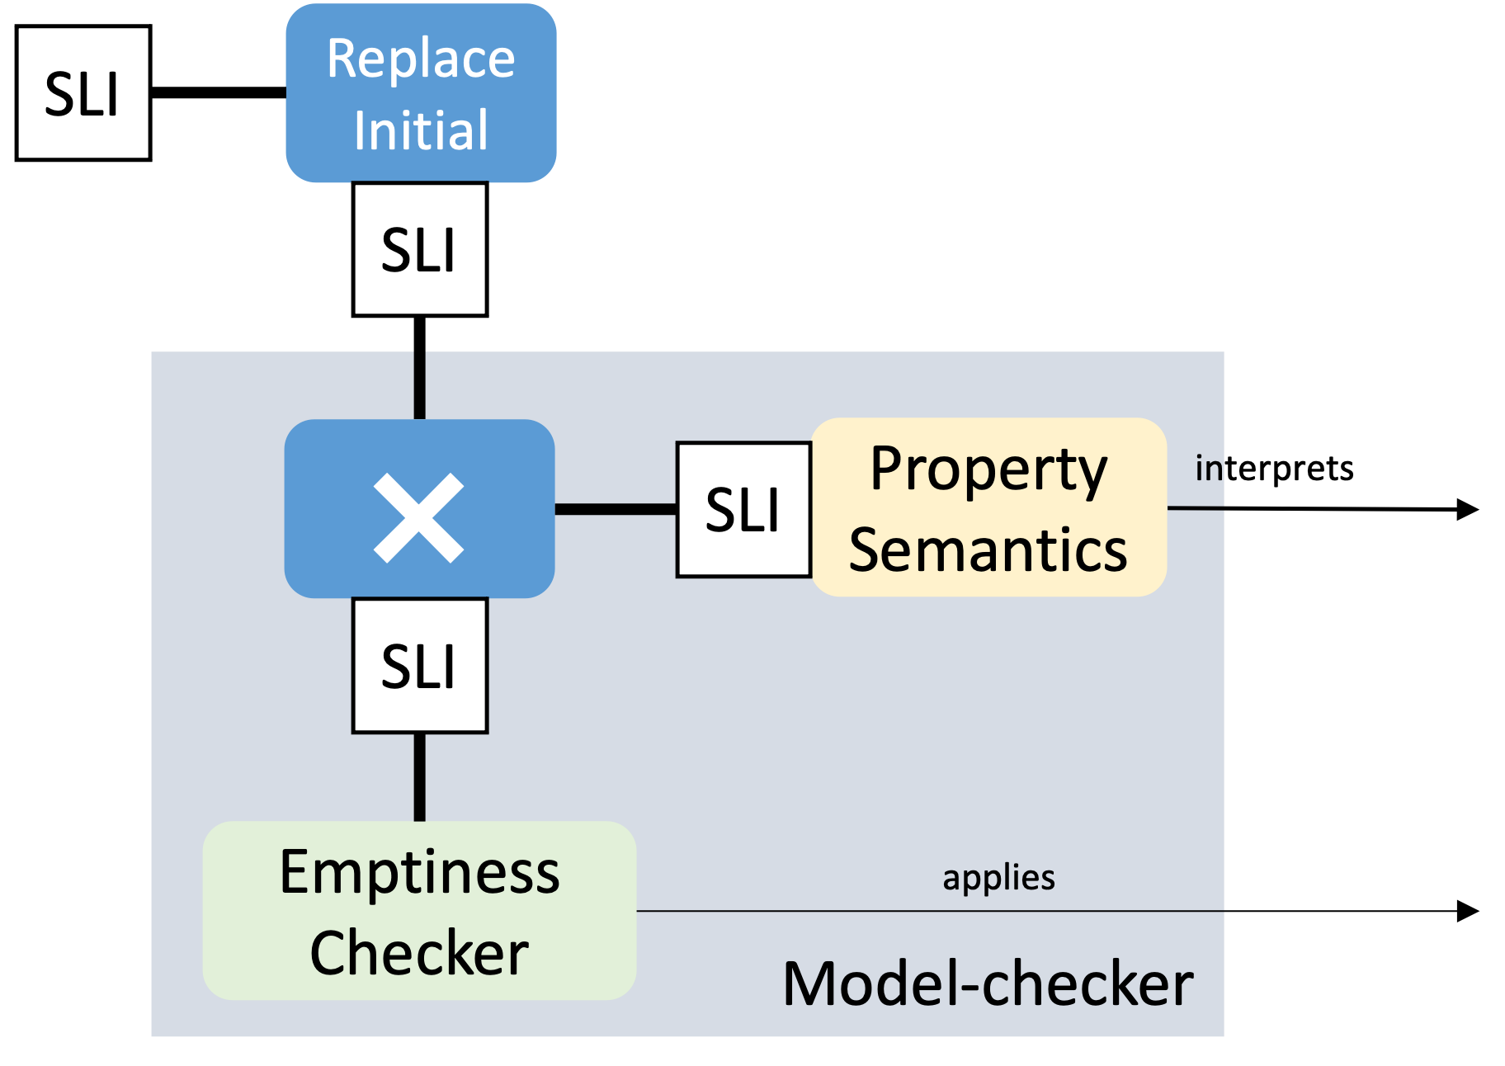
AnimUML
Specification
Multiverse Debugger
Semantics
✔︎Formalization in
L∃∀N Theorem Prover
interprets
AnimUML
Semantics
SLI
SLI
step
Language-agnostic
jump
Non-trivial Monitor Composition
select
run2breakpoint
Scalability
4
+Expressivity, no instrumentation
3
8
1
2
3
7
Temporal
Breakpoints
9
Configuration
Breakpoints
TODAY @[SLE’23]
5
6
Reduction
[MODELS’22]
SLI
User
uses
Interactive
Controler

Slide 13
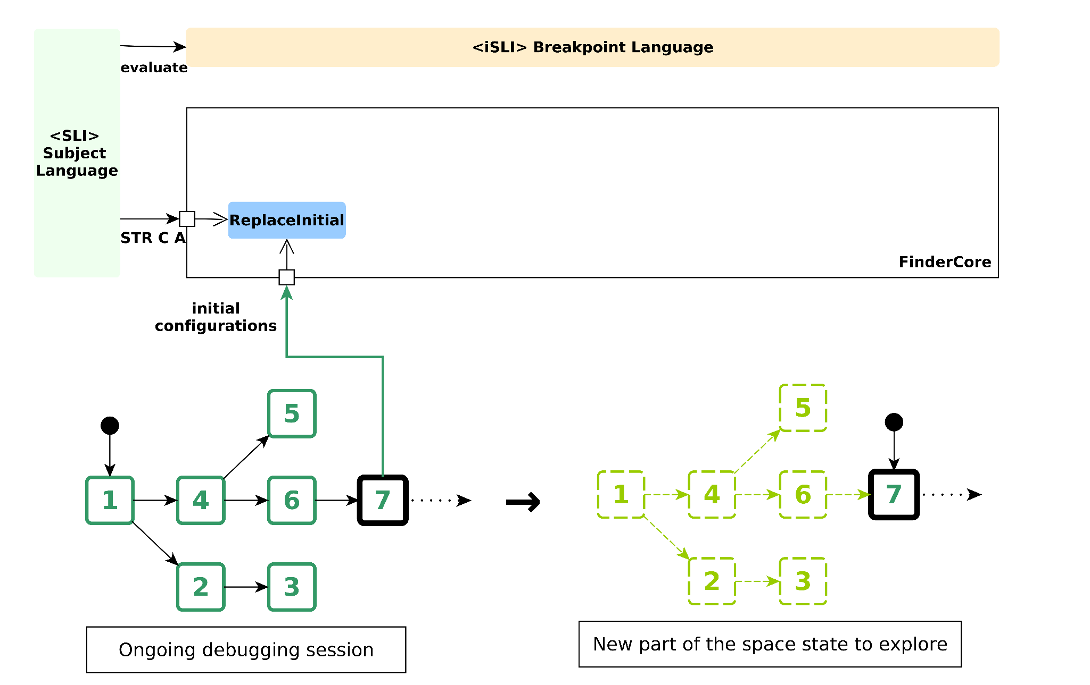

Slide 14
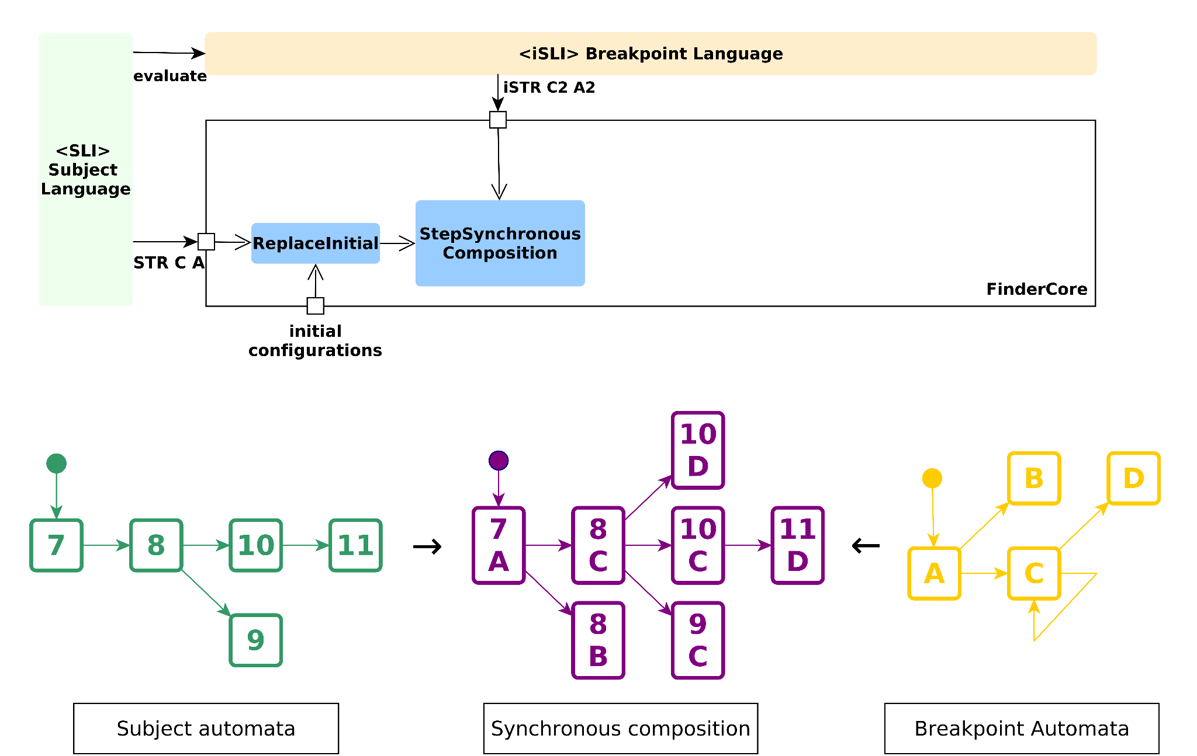

Slide 15
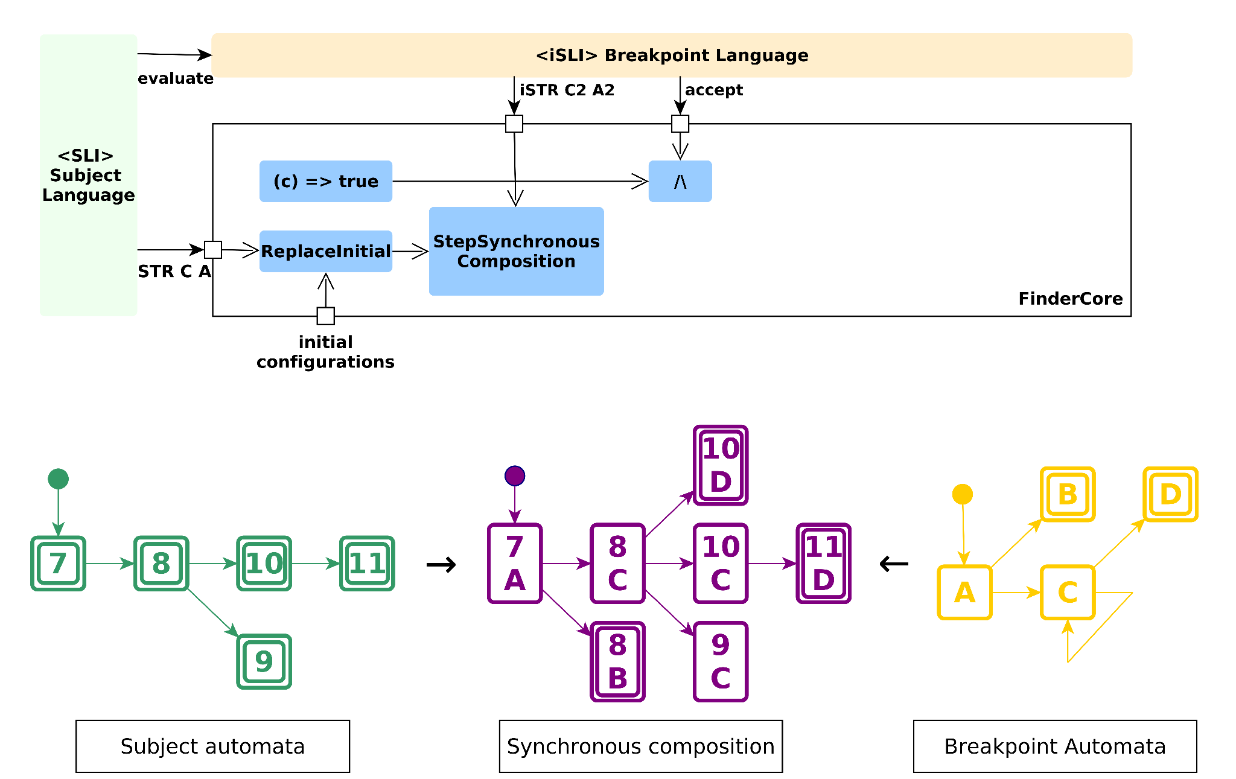

Slide 16
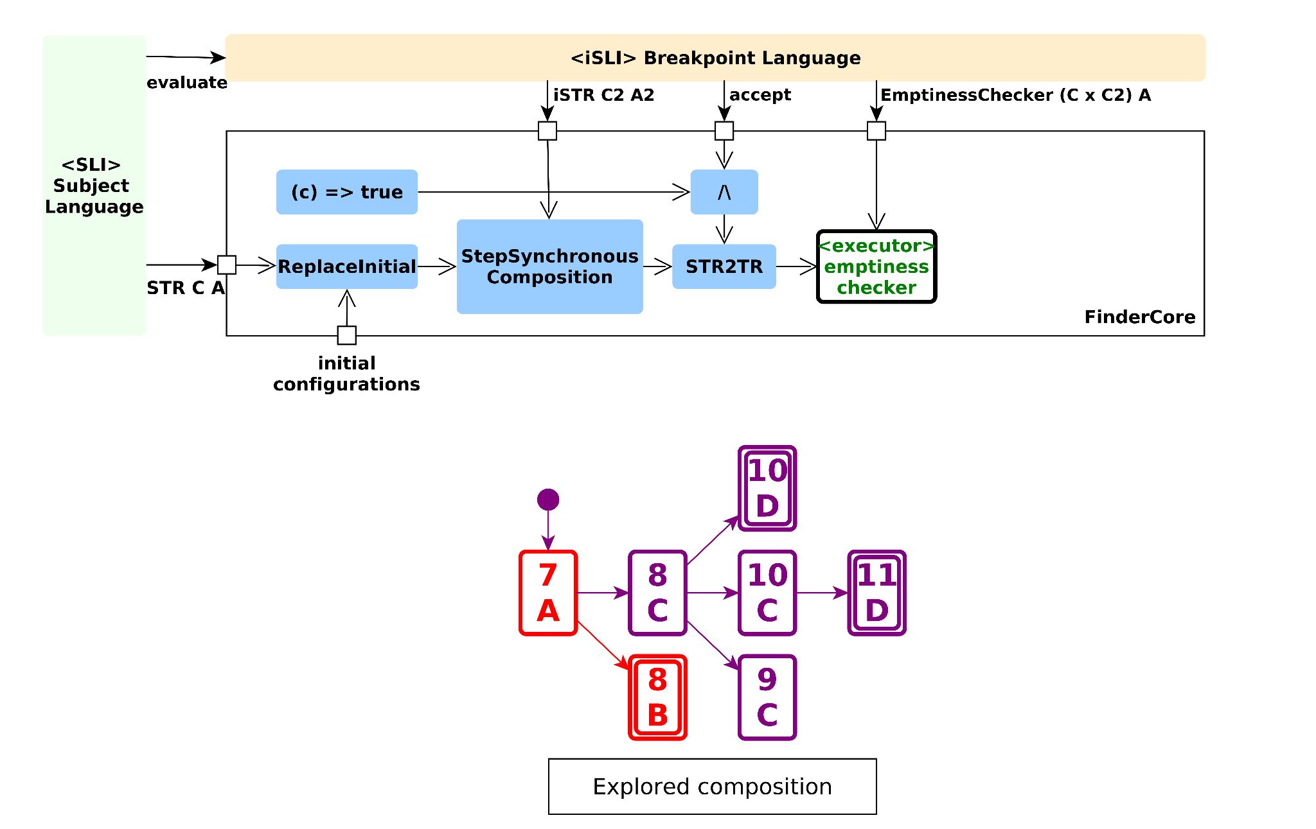
⍺

Slide 17
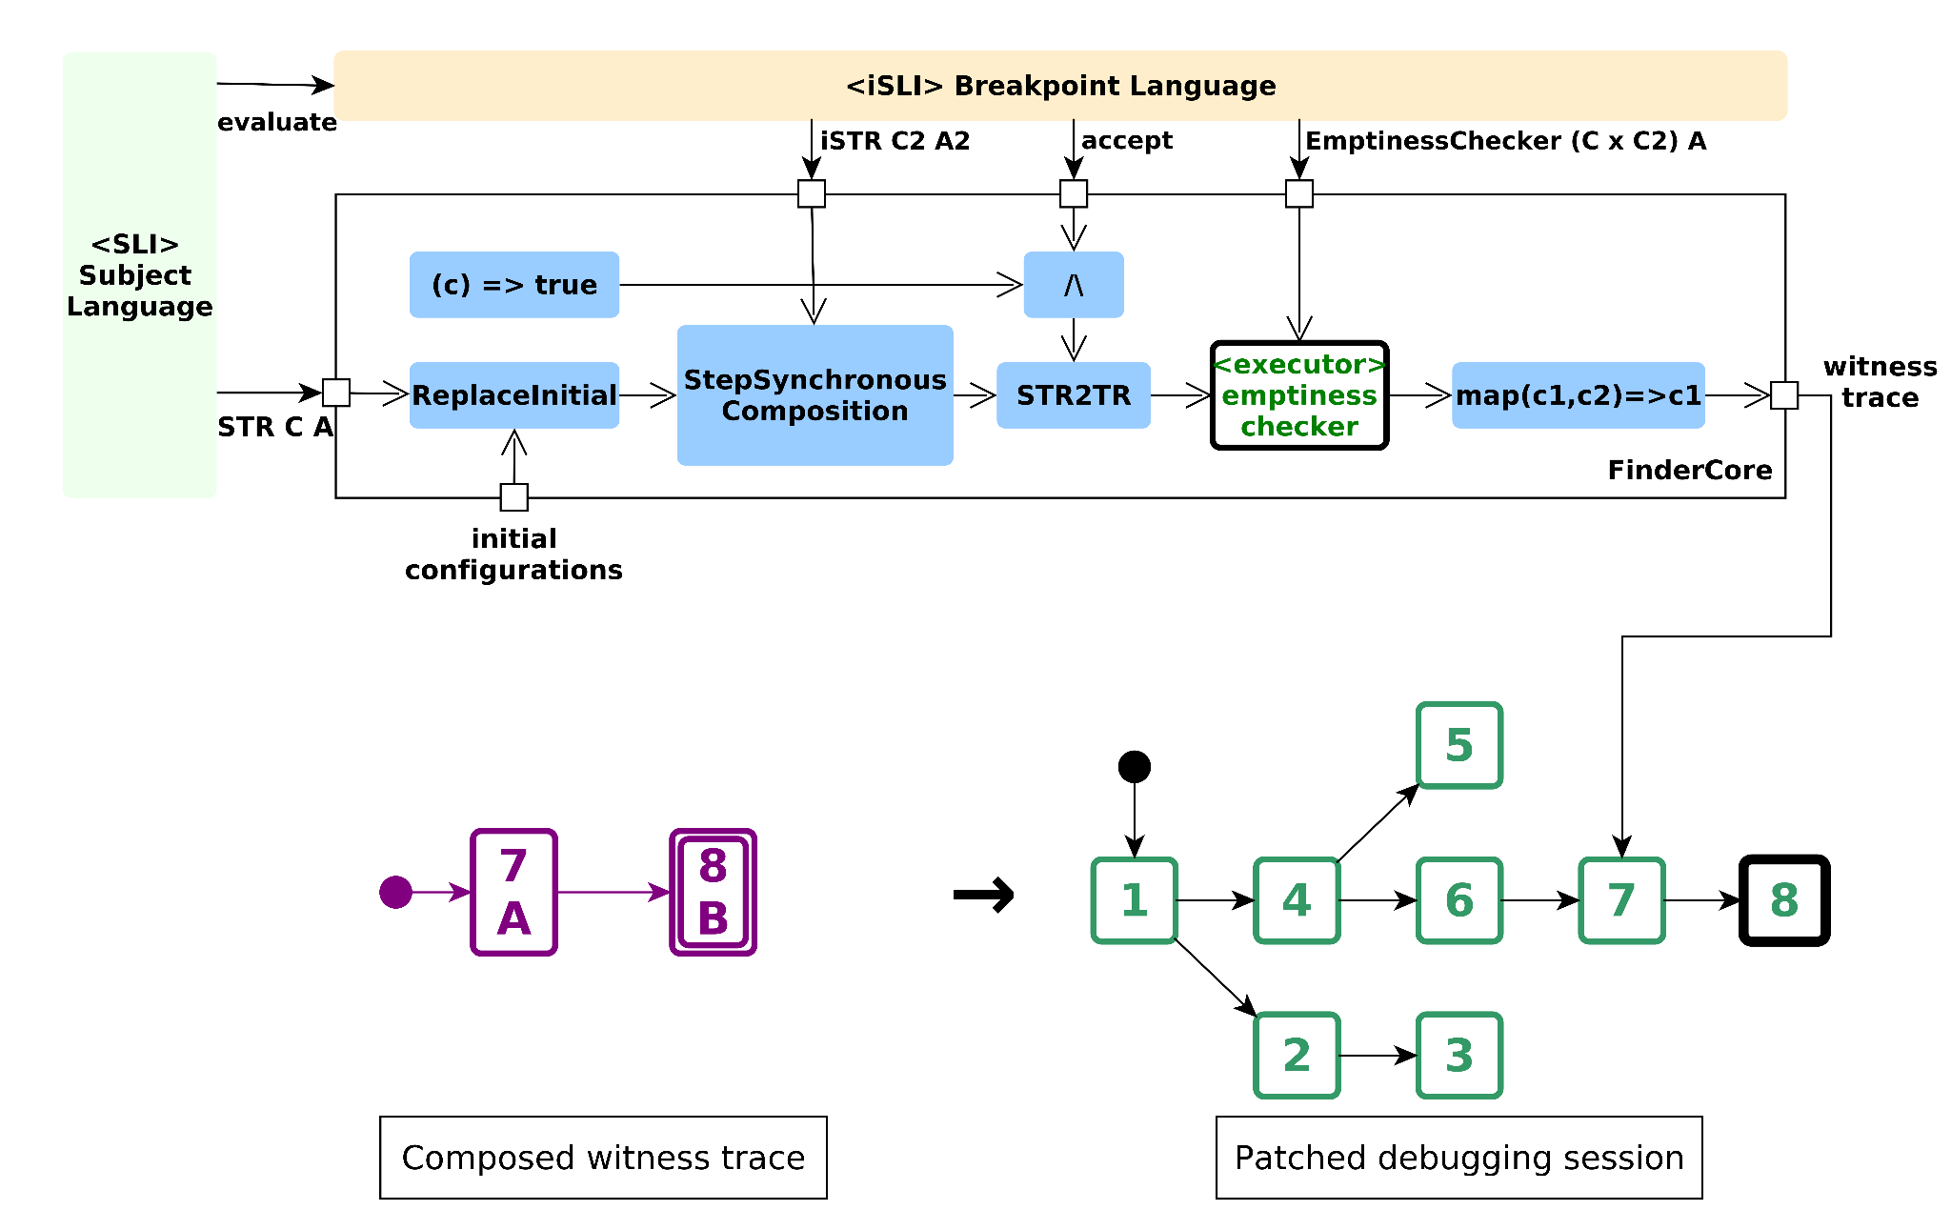
⍺

Slide 18


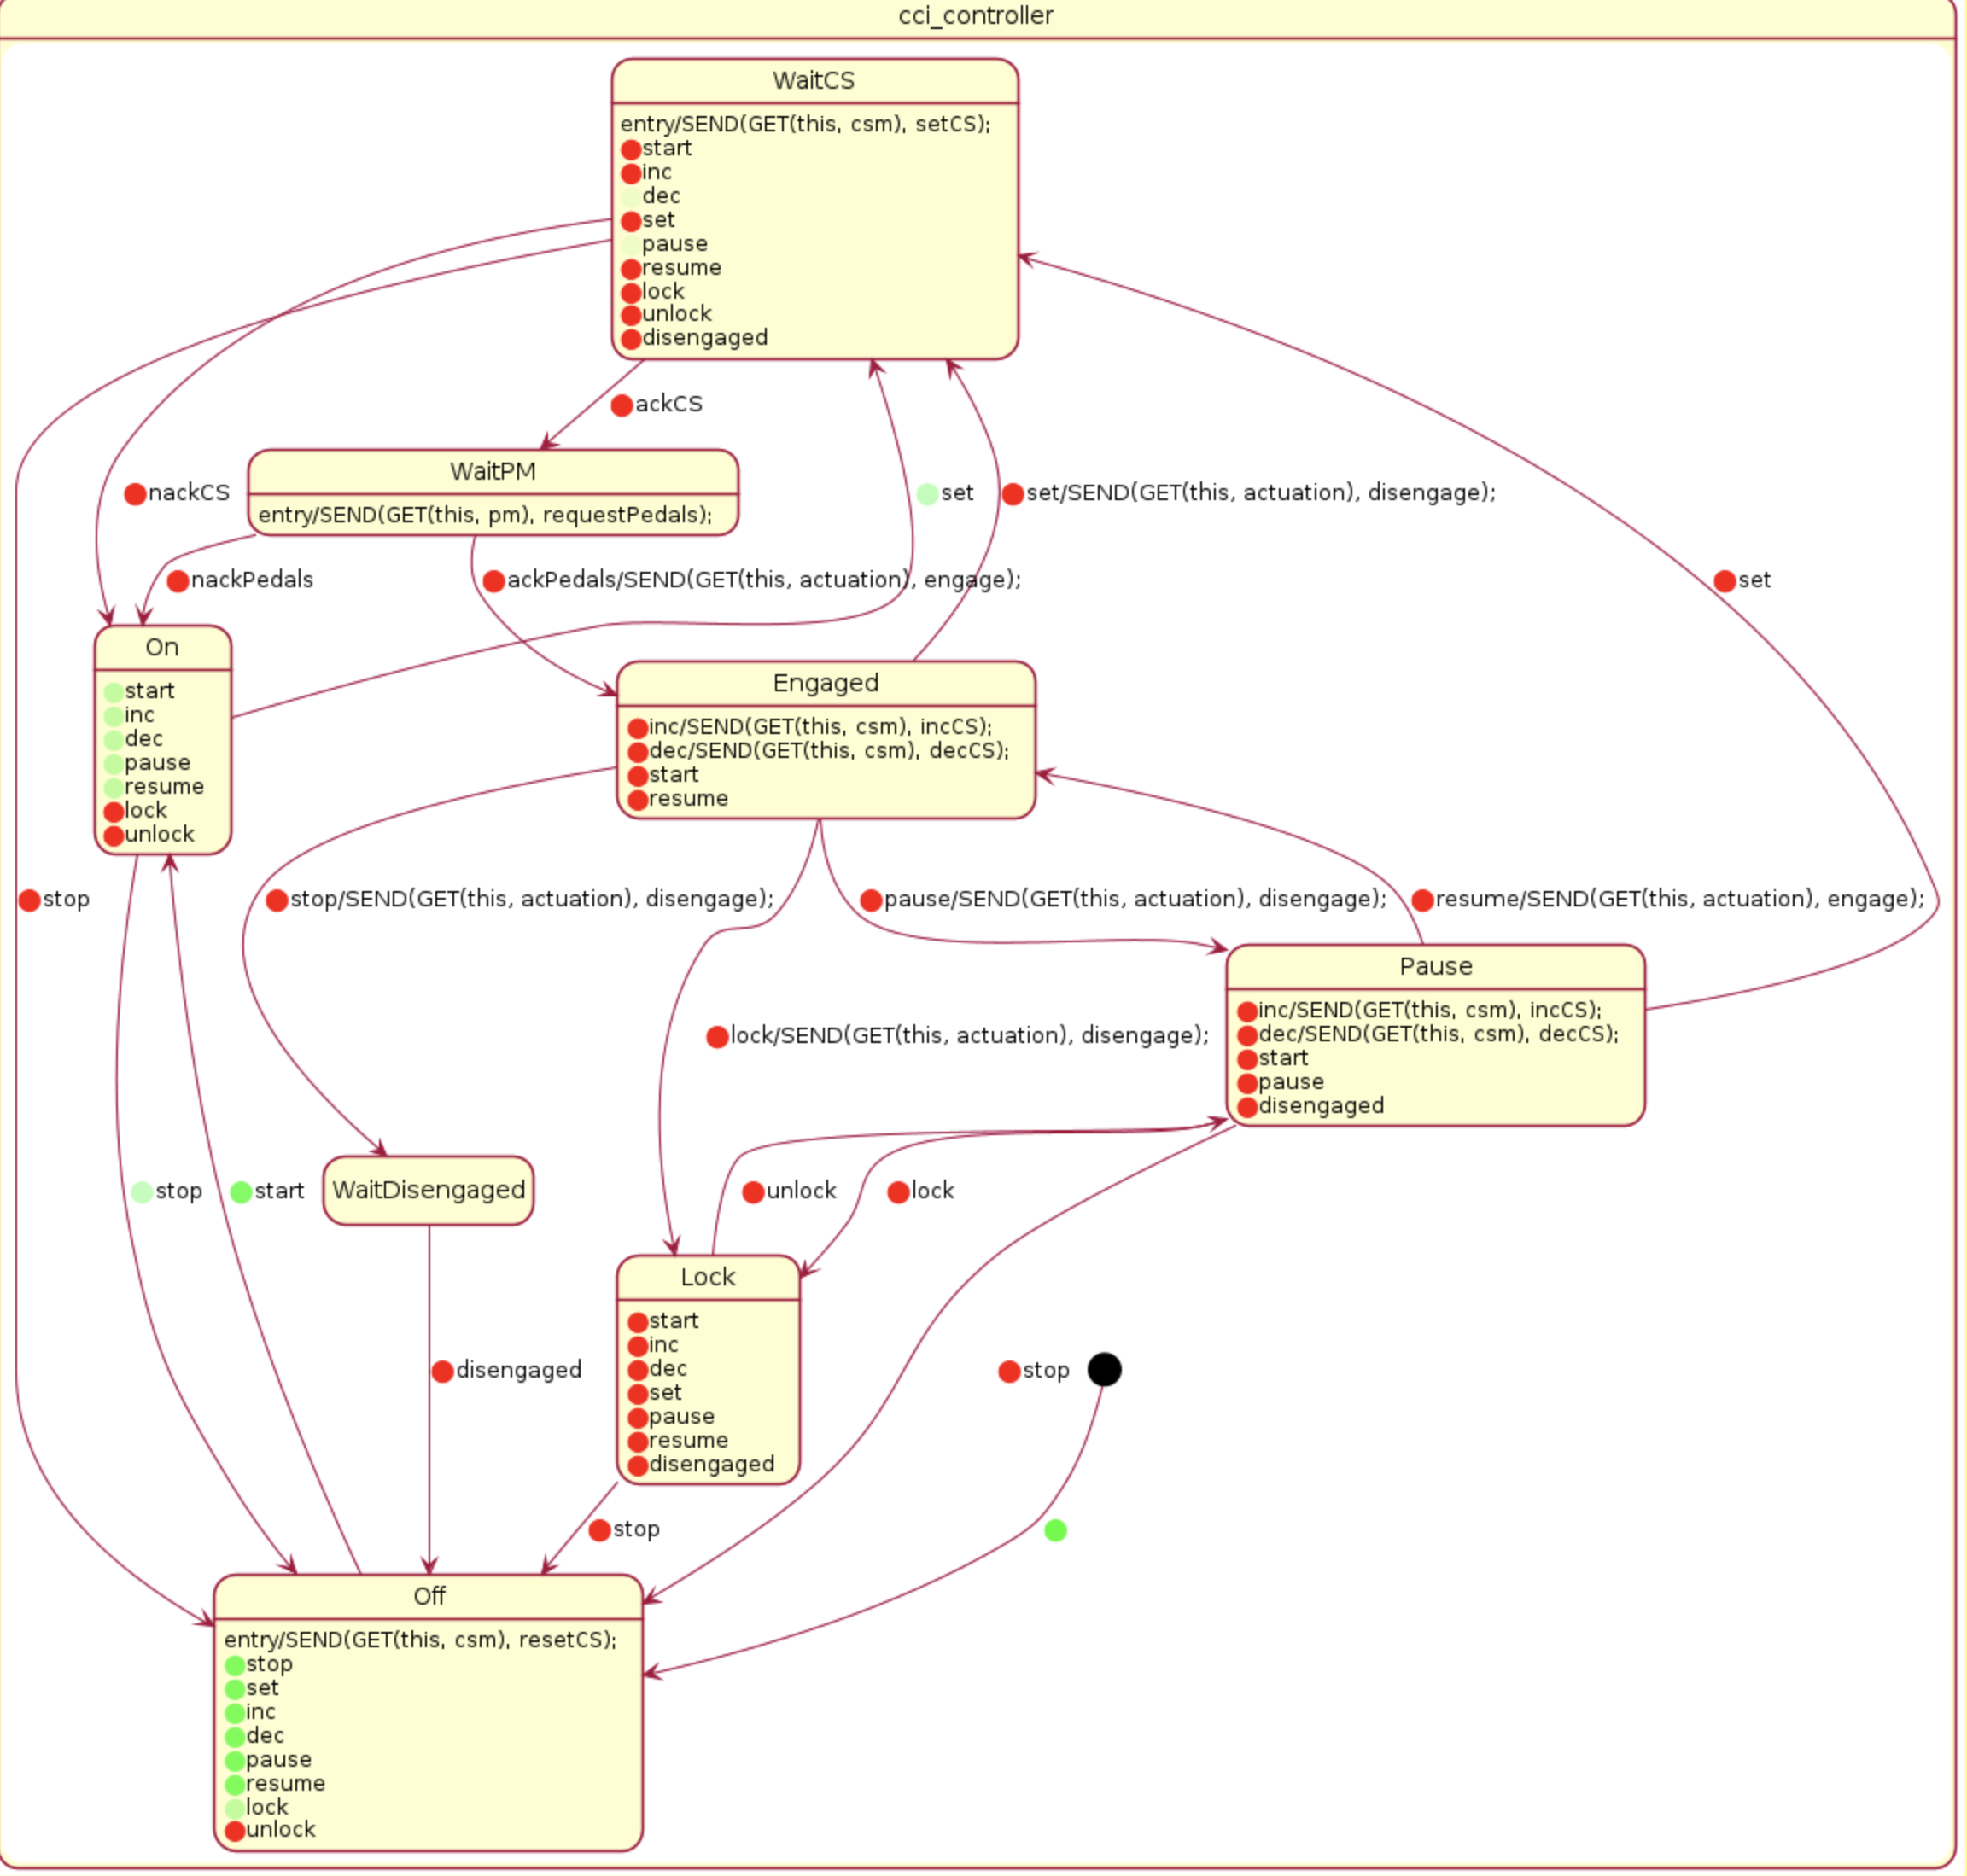
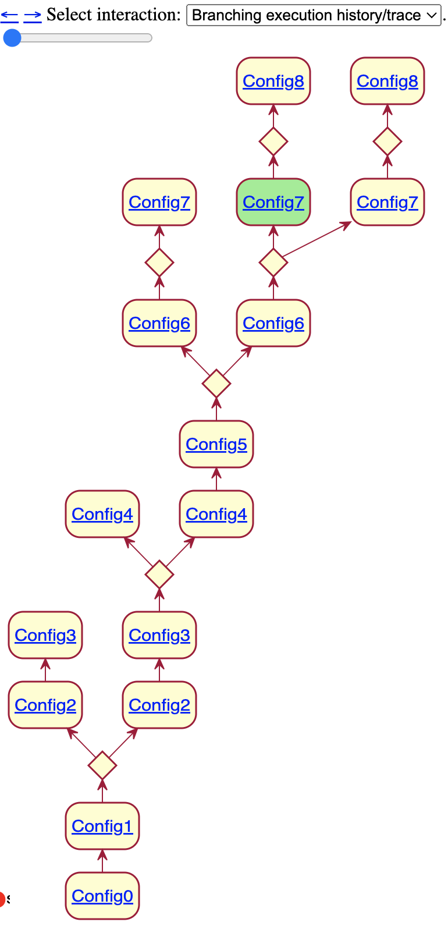
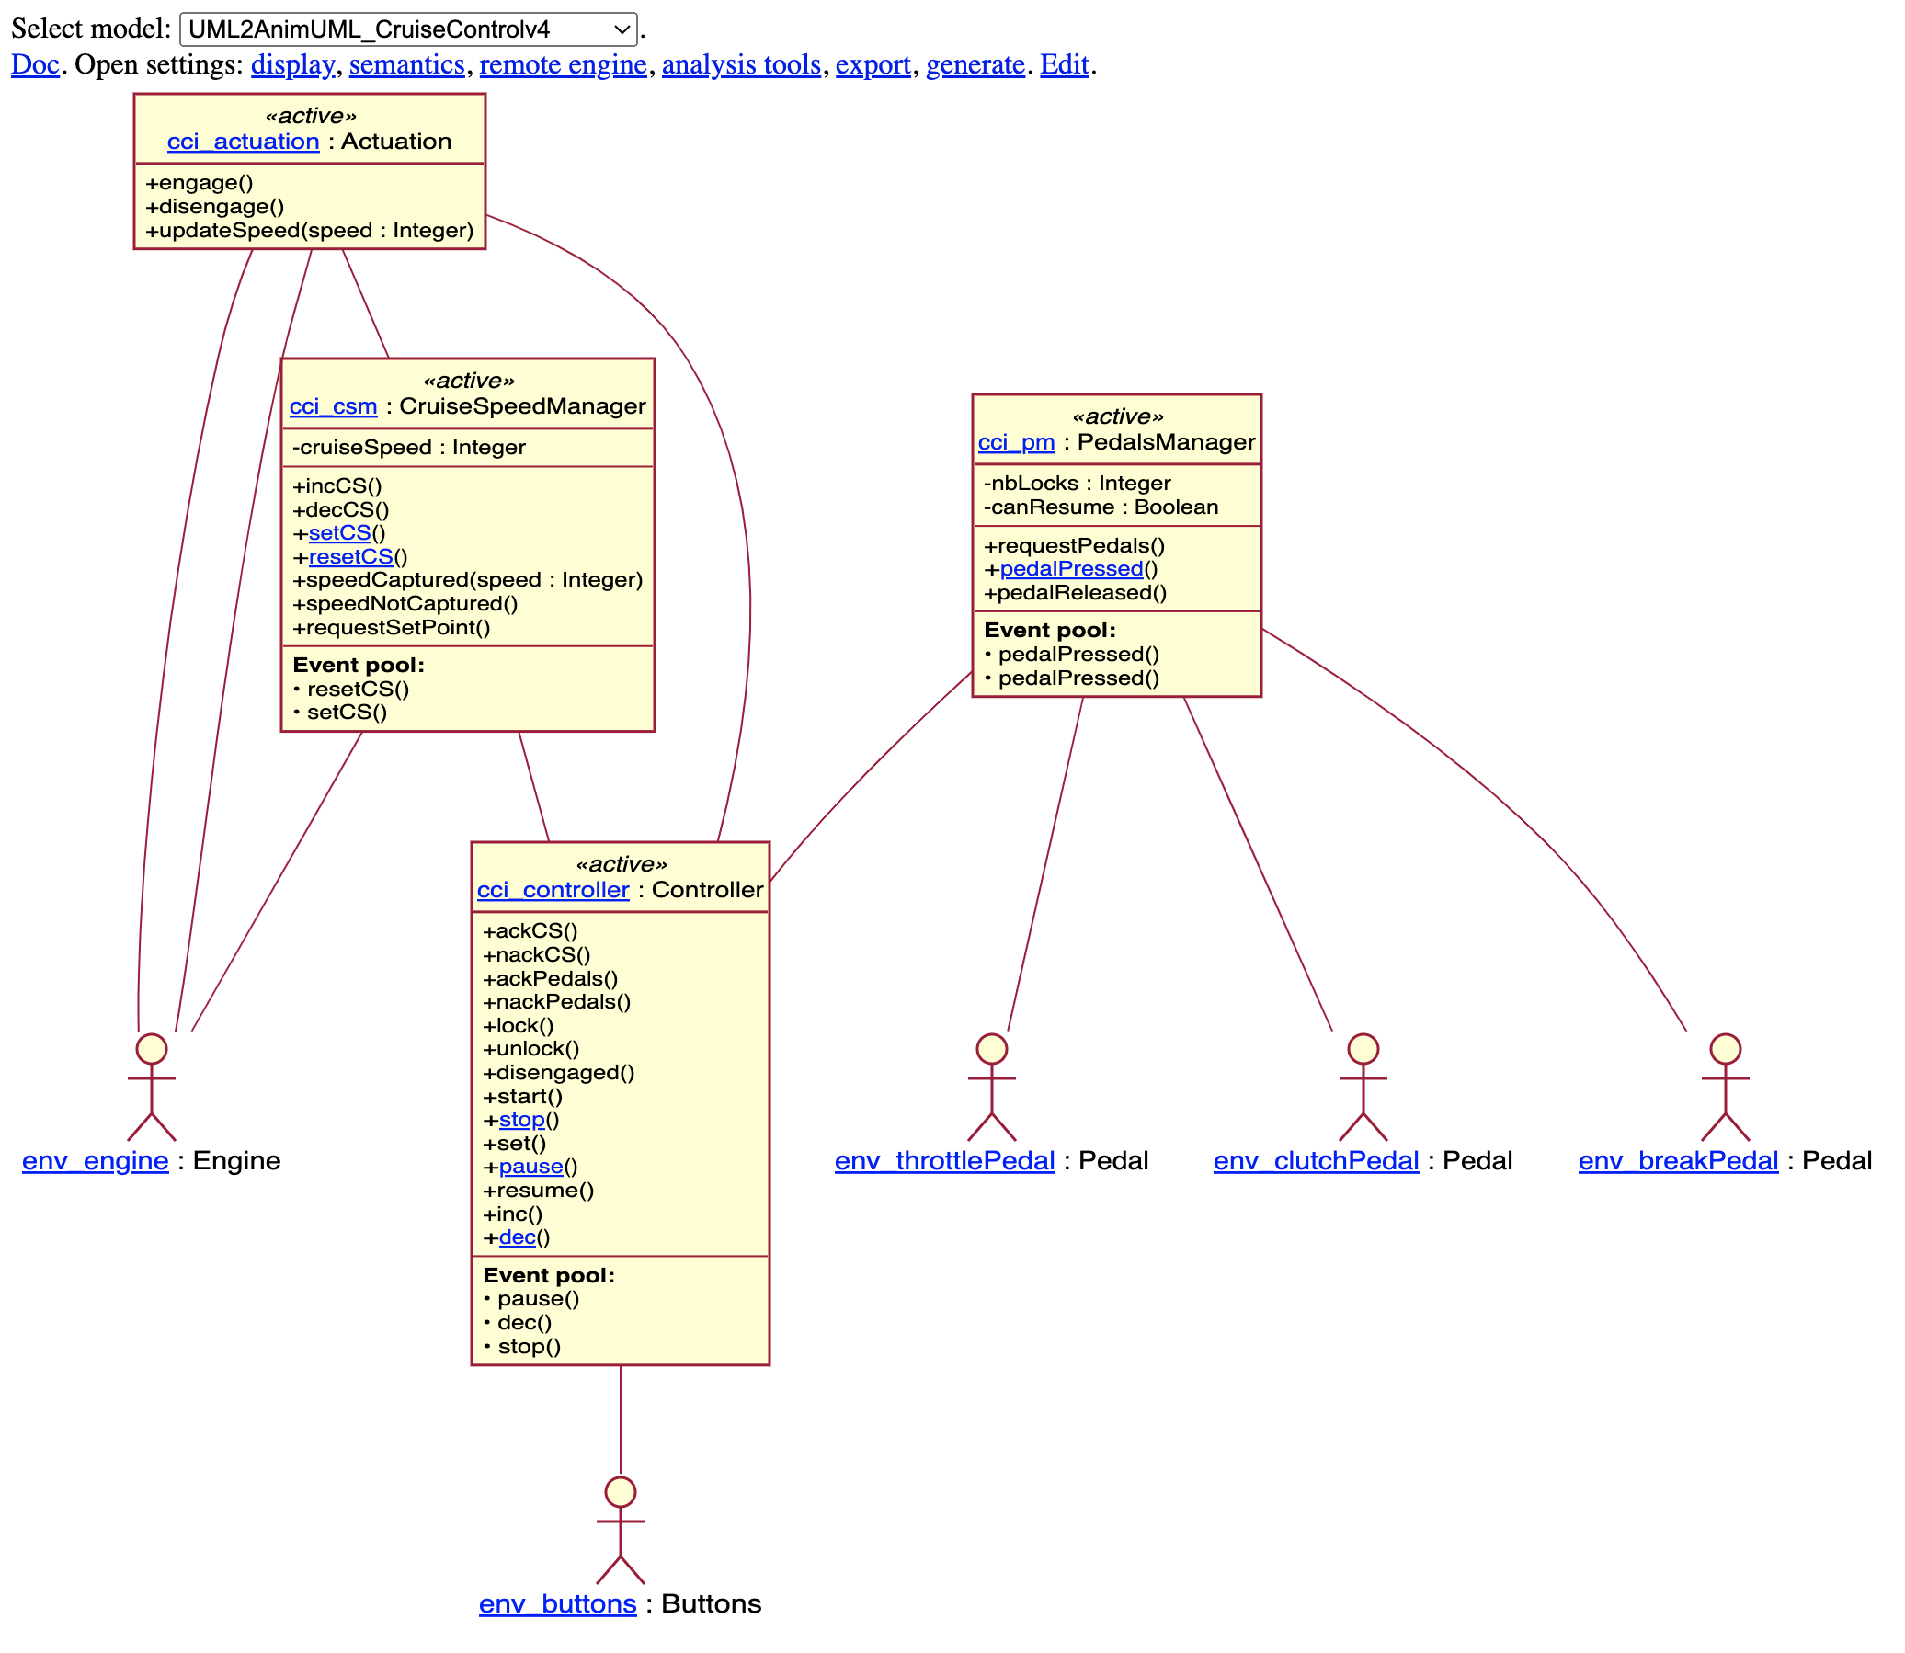
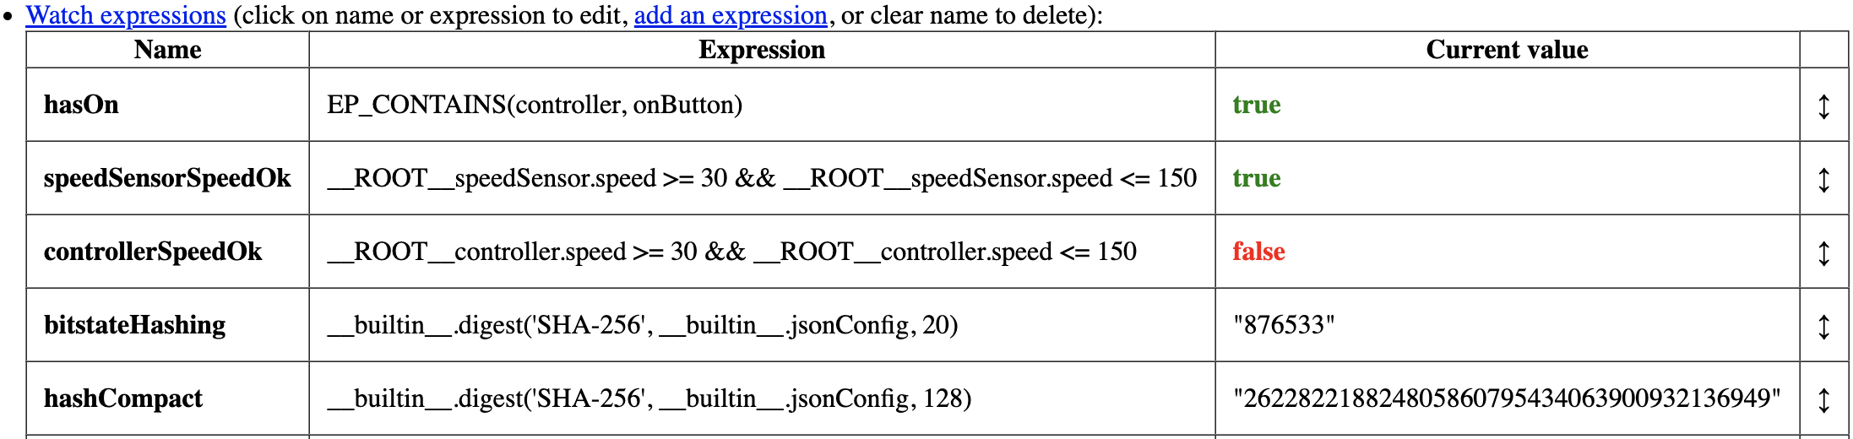
Designing, Animating, and Verifying Partial UML Models [MODELS’20].
AnimUML
https://github.com/ESEO-Tech/AnimUML
Reduced Multiverse Debugger
@ [MODELS’22]
Coverage
as heatmap overlay
Branching
history
generic
reductions

Slide 19
AnimUML Integration
  https://shorturl.at/bqz24

Slide 20
Conclusion & Perspectives
Temporal breakpoints increase conditional breakpoint expressivity
  taxonomy: state, step, safety and liveness
Enhance the genericity of language-agnostic multiverse debugging @ [MODELS’22]
Formalized in L∃∀N @ https://github.com/teodorov/temporal-multiverse-debugging
Illustrated through:
  Integration in the AnimUML modeling environment @ https://shorturl.at/bqz24
  3 different breakpoint languages: RegExp (reB), Statecharts (scB), LTL & Buchi AnimUML scB_{ba})
  Motivating case study: Debugging Paxos in the UML Multiverse @ [MoDeVVa’23]
Today
Relatively Easy:
User study
From a simple CLI to a nice GUI
Not so easy
Intuitive vs expressive breakpoints
Heterogeneous specs:
  eg. mixed-signal, abstractions
Tomorrow

Slide 21
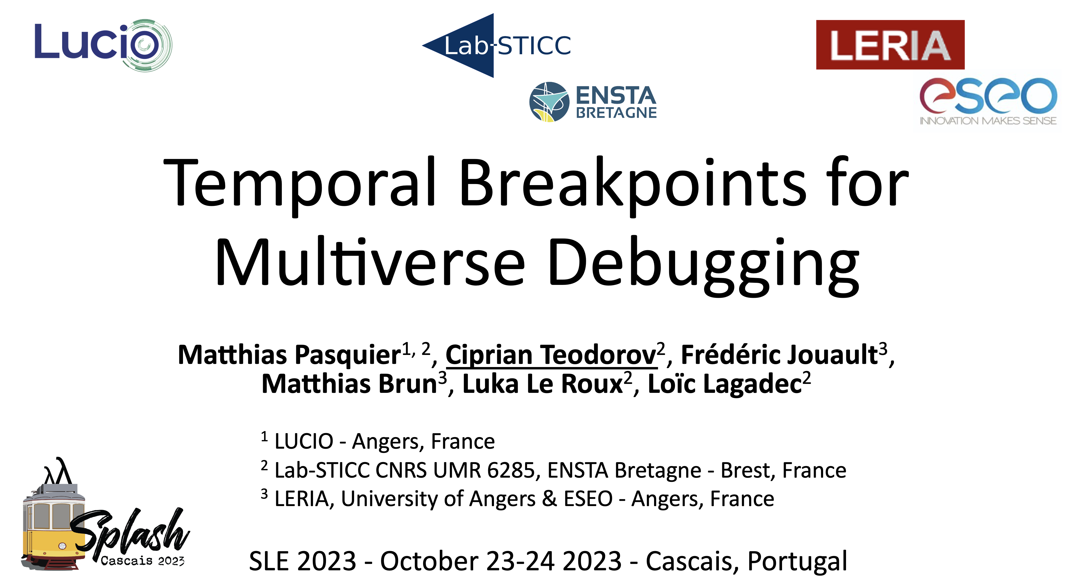

What do you think?
What do we miss?
How can we get from PoC to a tool that helps?
What are the UX-UI metaphors that can bridge between the semantics and the user?

Slide 22
Expression
Sequencer
interprets
execute
CEK-style
Semantics
SLI
Example CEK-style
C ≜ ⟨control, env, [Frame]⟩
A ≜ from-predicate ⟶ to-C
SLI Semantics for a CEK-style abstract machine
rules: { lookup, app, arg, body, … }
SLI.semantics: (C A) {
initial: set C := {⟨exp, ∅, []⟩}
actions: C → set A
| c => rules.where(r => r.enabledIn c)
execute: A → C → set C
| r c => { r.applyIn c }
}
Sequencer(sli) {
current = sli.initial.any
while (current != NULL) {
action = sli.actions(current).any
if (actions == NULL) break;
current= sli.execute(action,current).any
}
}
If sli exposes a deterministic semantics → exactly one sequence
<=>
∀ a c, |initial| = |actions c| = |execute a c| = 1

Slide 23
SLI for Lambda Calculus
Syntax:
E ≜ x //variable
| E₁ E₂ //application
| λ x. E //abstraction
CEK-style Semantics [ABM’14]:
lookup≜⟨ x, ρ , κ⟩⟶⟨ ρ[x].1, ρ[x].2 , κ⟩
app ≜⟨e₁ e₂, ρ , κ⟩⟶⟨ e₁, ρ ,⟨◯ e₂ ρ ⟩::κ⟩
arg ≜⟨ v, ρ₁, ⟨◯ e ρ₂⟩::κ⟩⟶⟨ e , ρ₂ ,⟨v ◯ ρ₁⟩::κ⟩
body ≜⟨ v, ρ₁, ⟨λx.e ◯ ρ₂⟩::κ⟩⟶⟨ e , ρ₂[x↦⟨v,ρ₁⟩], κ⟩
SLI Semantics Definition
rules: { lookup, app, arg, body }
semantics: (C A) {
initial: set C := {⟨exp, ∅, []⟩}
actions: C → set A
| c => rules.where(r => r.enabledIn c)
execute: A → C → set C
| r c => { r.applyIn c }
}
Domains:
Value ≜ λx.e Closure ≜ ⟨v,ρ⟩
ρ ≜ {variable ↦ closure}// Environment
Frame ≜ ⟨c ◯⟩ | ⟨◯ e ρ⟩
C ≜ ⟨E, ρ, [Frame]⟩ //Configuration
A ≜ ⟨ ⟩⟶⟨ ⟩ //Action = rule
[ABM’14] B. Accattoli, P. Barenbaum, and D. Mazza.
Distilling Abstract Machines. ICFP '14

