Slide 1
Practical Multiverse Debugging through User-defined Reductions:
Application to UML Models
Matthias Pasquier¹‾², Ciprian Teodorov², Frédéric Jouault³,
Matthias Brun³, Luka Le Roux², Loïc Lagadec²
¹ ERTOSGENER - Angers, France
² Lab-STICC CNRS UMR 6285 ENSTA Bretagne - Brest, France
³ ESEO - Angers, France
Models 2022 - Montréal, Canada - October 23-28 2022
Notes:
a method to adapt multiverse debugging scalability, and use it for debugging specification languages, such as UML

Slide 2
Context: Debugging Specification Languages
Debugging is useful
Useful early in the development lifecycle to fix problems as soon as possible
We need to adapt debuggers to specification languages specificities
A specification language is non-deterministic
Non-deterministic debugging, or multiverse debugging allows us to debug such systems, but face a scalability issue when searching for breakpoints
We propose to extend multiverse debugging by allowing the user to define reduction policies, creating under-approximations during the breakpoint search

Slide 3
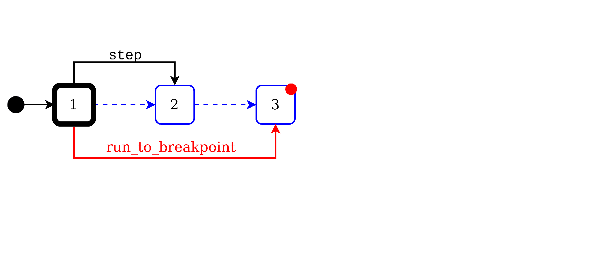
Evolution of debugging:
Step debugging
x := 1;
x := 2;
●x := 3;
Debug Actions:
step
run_to_breakpoint
Notes:
Partial modelling, appearing at a specific moment of the modelling process and to be concretized later
Modelling concurrent processes
To create a model of the environment, with a more unpredictable behaviour

Slide 4
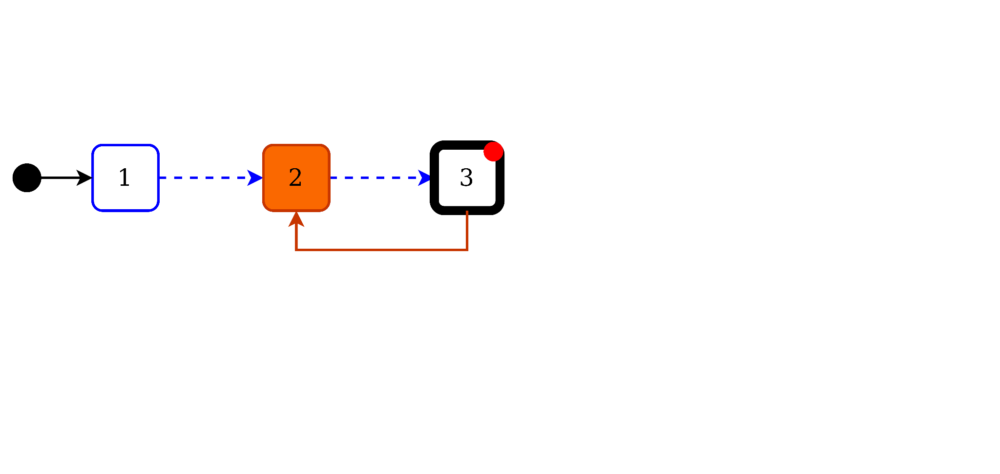
Evolution of debugging:
Step debugging
x := 1;
x := 2;
●x := 3;
Debug Actions:
step
run_to_breakpoint

Slide 5
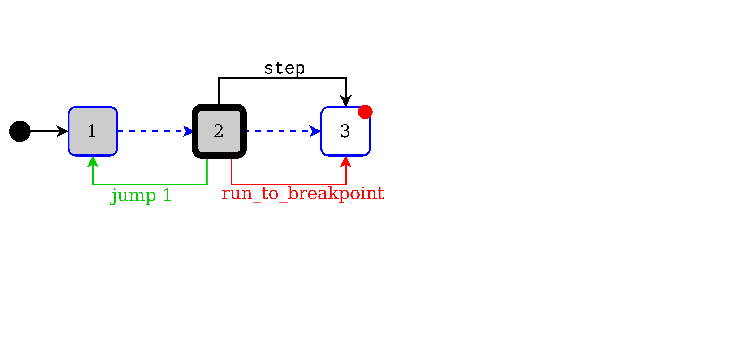
Evolution of debugging:
Omniscient debugging
x := 1;
x := 2;
●x := 3;
Debug Actions:
step
run_to_breakpoint
jump
Bil Lewis. Computing Research Repository 2003. “Debugging Backwards in Time.”

Slide 6
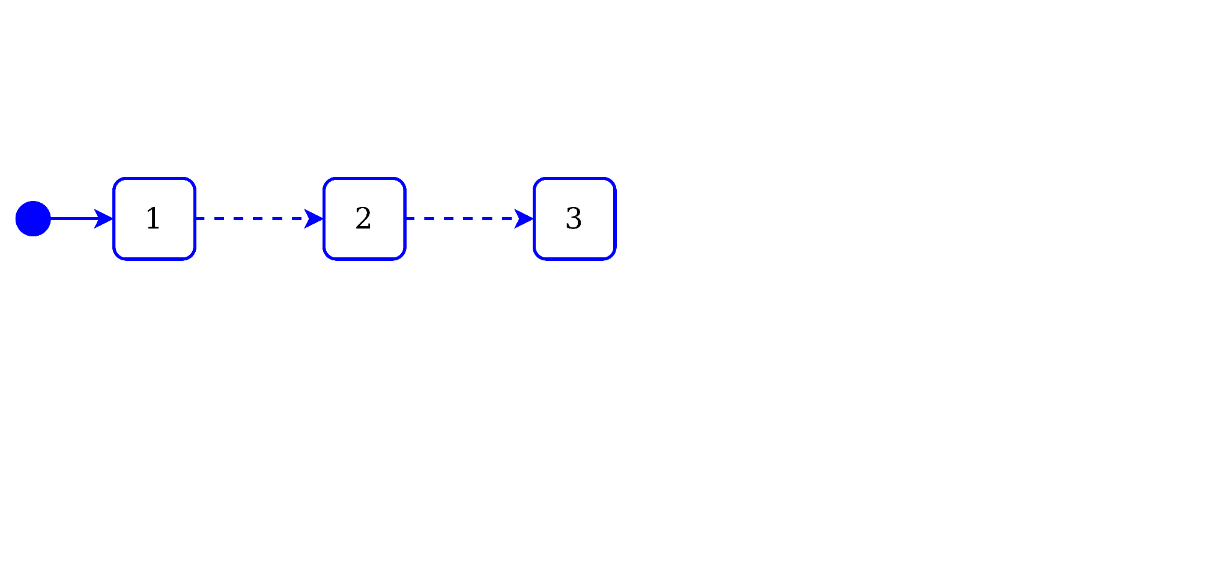
Specification Language:
How to handle non determinism ?
x := 1;
x := 2;
x := 3;
Notes:
Partial modelling, appearing at a specific moment of the modelling process and to be concretized later
Modelling concurrent processes
To create a model of the environment, with a more unpredictable behaviour

Slide 7
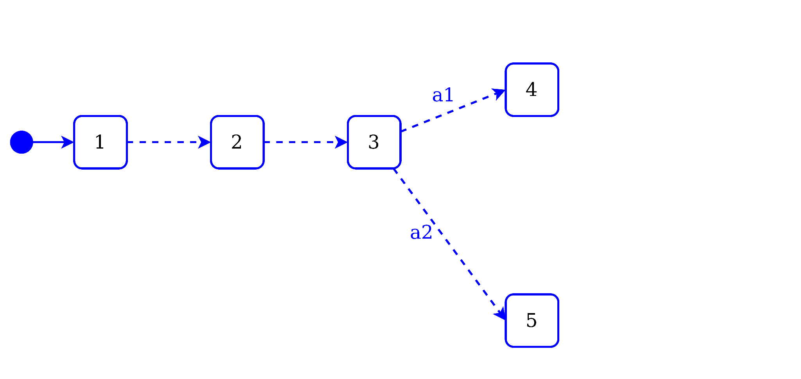
Specification Language:
How to handle non determinism ?
x := 1;
x := 2;
x := 3;
actions {
a1 -> {
x := 4;
}
a2 -> {
x := 5;
}
}

Slide 8
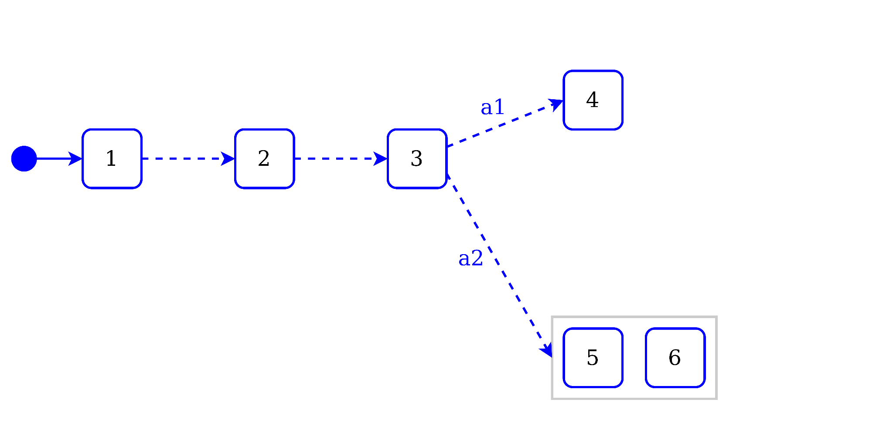
Specification Language:
How to handle non determinism ?
x := 1;
x := 2;
x := 3;
actions {
a1 -> {
x := 4;
}
a2 -> {
x := any of {5,6};
}
}

Slide 9
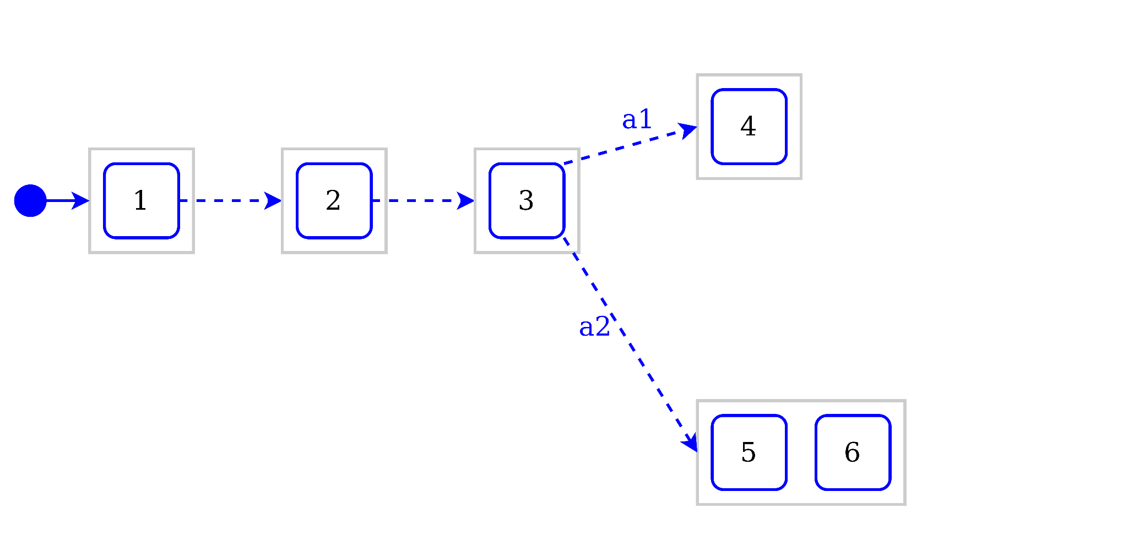
Specification Language:
How to handle non determinism ?
x := 1;
x := 2;
x := 3;
actions {
a1 -> {
x := 4;
}
a2 -> {
x := any of {5,6};
}
}

Slide 10
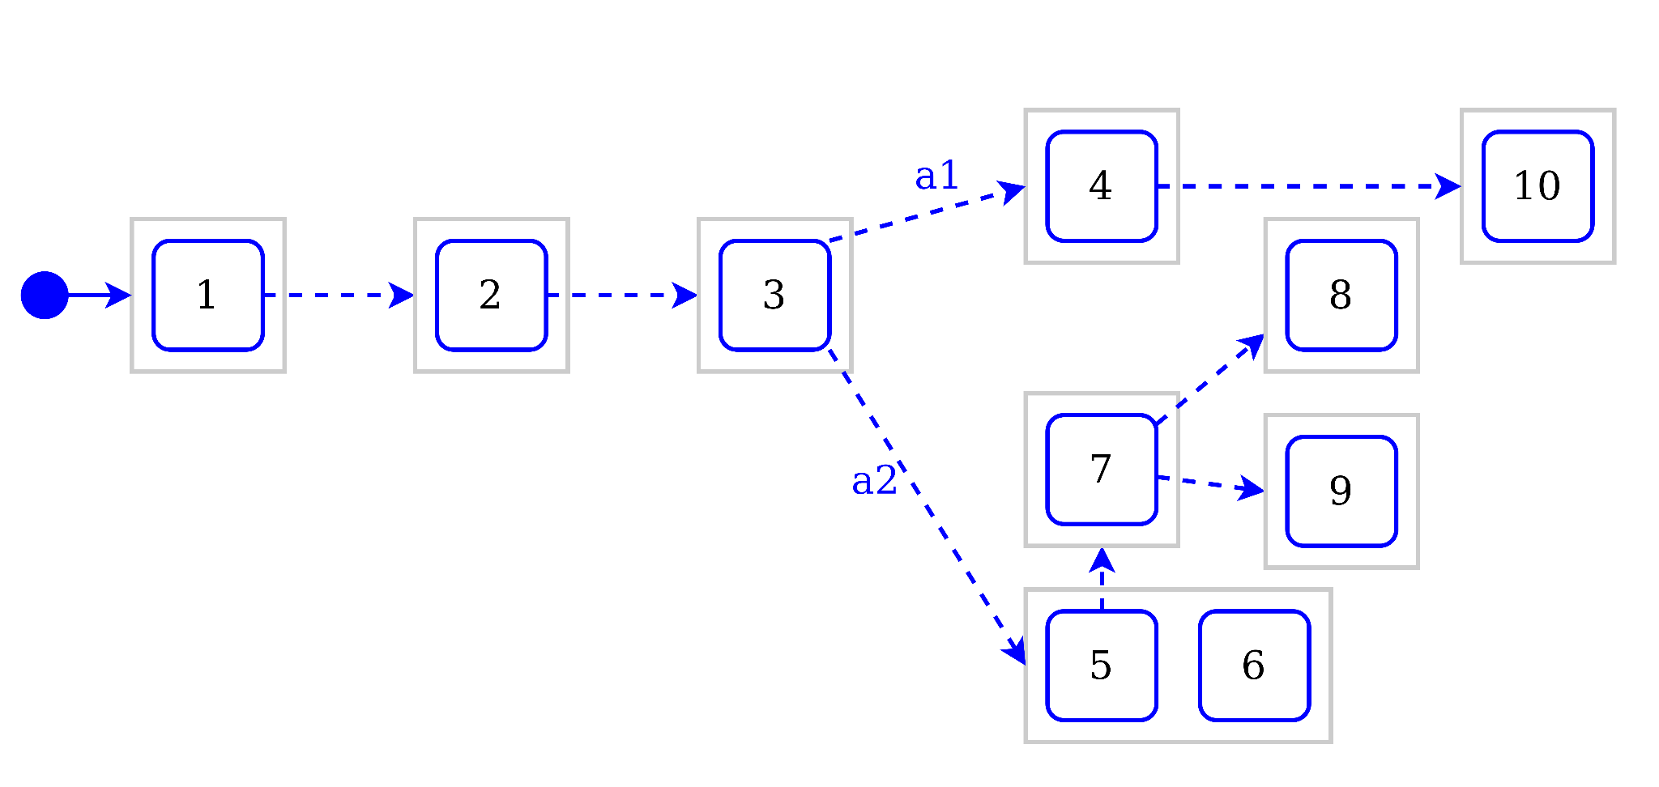
Specification Language:
How to handle non determinism ?
x := 1;
x := 2;
x := 3;
actions {
a1 -> {
x := 4;
x := 10;
}
a2 -> {
x := any of {5,6};
if (x == 5) {
x := 7;
actions {
-> x := 8;
-> x := 9;
}
}
}
}

Slide 11
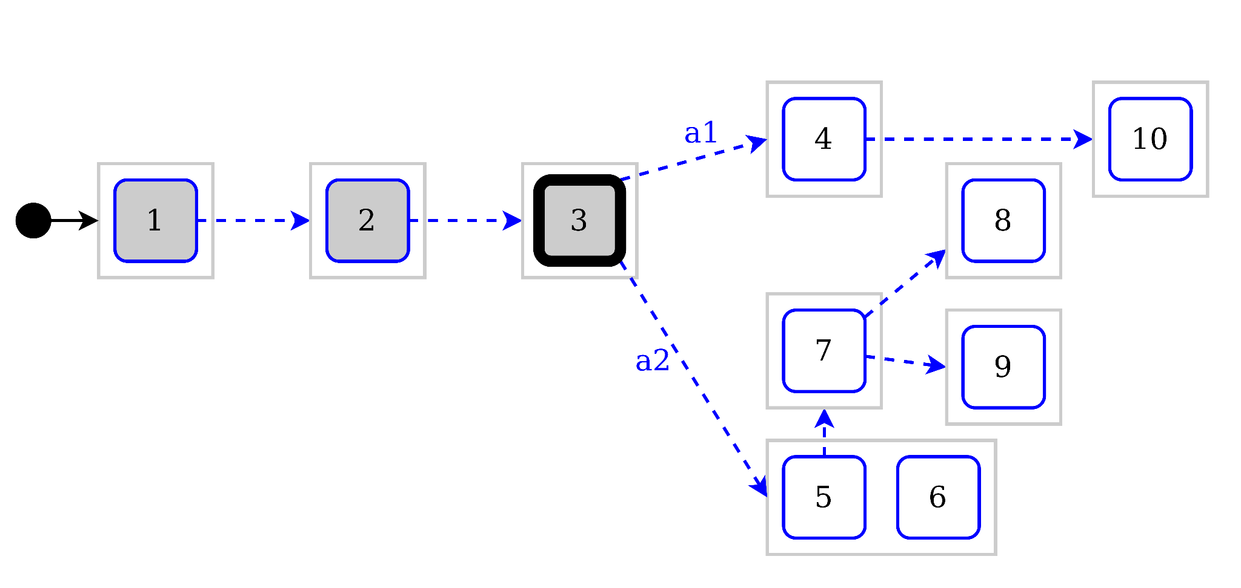
How to handle non-determinism requirements for debugging?
x := 1;
x := 2;
x := 3;
actions {
a1 -> {
x := 4;
x := 10;
}
a2 -> {
x := any of {5,6};
if (x == 5) {
x := 7;
actions {
-> x := 8;
-> x := 9;
}
}
}
}
Debug Actions:
step
run_to_breakpoint
jump
Carmen Torres et Al. 33rd European Conference on OOP 2019. "Multiverse Debugging: Non-deterministic Debugging for Non-deterministic Programs"
Valentin Besnard. Ph. D. Dissertation 2020. “EMI: An approach to unify analysis and embedded execution with a controllable model interpreter.”

Slide 12
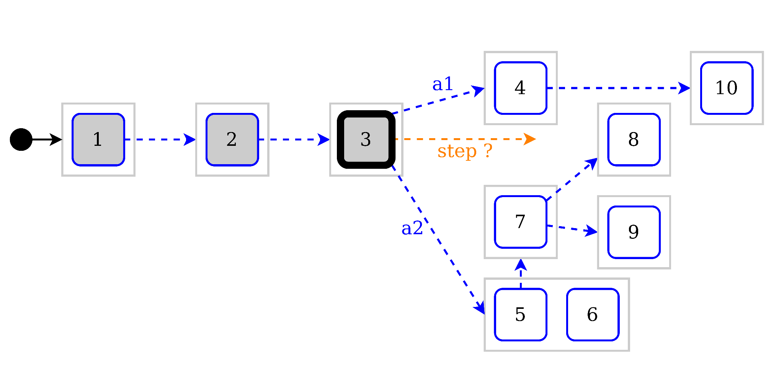
How to handle non-determinism requirements for debugging?
x := 1;
x := 2;
x := 3;
actions {
a1 -> {
x := 4;
x := 10;
}
a2 -> {
x := any of {5,6};
if (x == 5) {
x := 7;
actions {
-> x := 8;
-> x := 9;
}
}
}
}
Debug Actions:
step
run_to_breakpoint
jump
Solving problems with non determinism:
step: Navigating first case of non determinism
run_to_breakpoint
jump

Slide 13
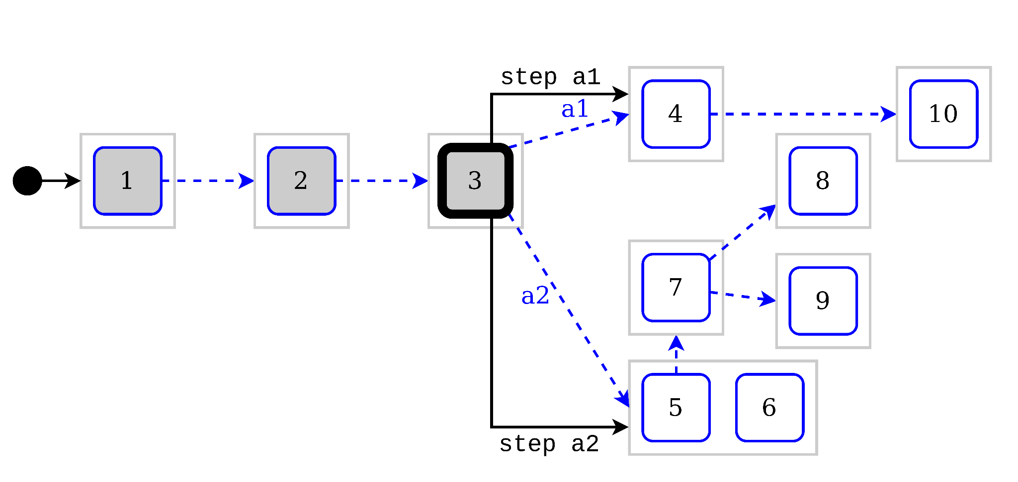
How to handle non-determinism requirements for debugging?
x := 1;
x := 2;
x := 3;
actions {
a1 -> {
x := 4;
x := 10;
}
a2 -> {
x := any of {5,6};
if (x == 5) {
x := 7;
actions {
-> x := 8;
-> x := 9;
}
}
}
}
Debug Actions:
step
run_to_breakpoint
jump
Solving problems with non determinism:
step: Exposing multiple possible steps
run_to_breakpoint
jump

Slide 14
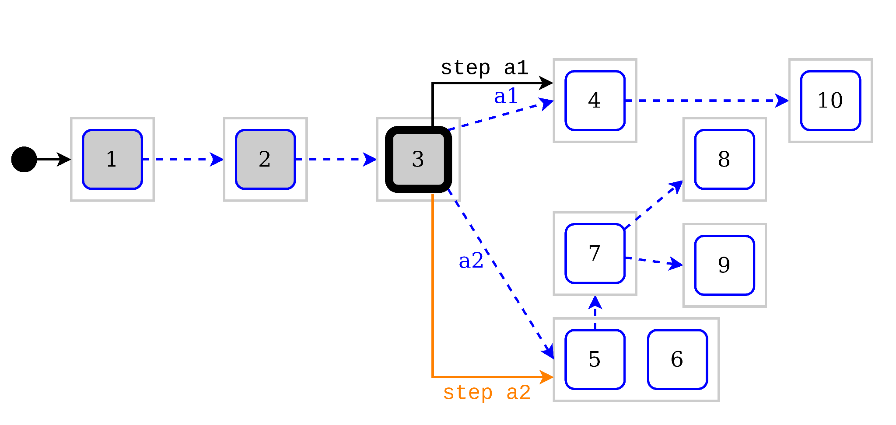
How to handle non-determinism requirements for debugging?
x := 1;
x := 2;
x := 3;
actions {
a1 -> {
x := 4;
x := 10;
}
a2 -> {
x := any of {5,6};
if (x == 5) {
x := 7;
actions {
-> x := 8;
-> x := 9;
}
}
}
}
Debug Actions:
step
run_to_breakpoint
jump
Solving problems with non determinism:
step: Exposing multiple possible steps; Navigating second case of ND
run_to_breakpoint
jump

Slide 15
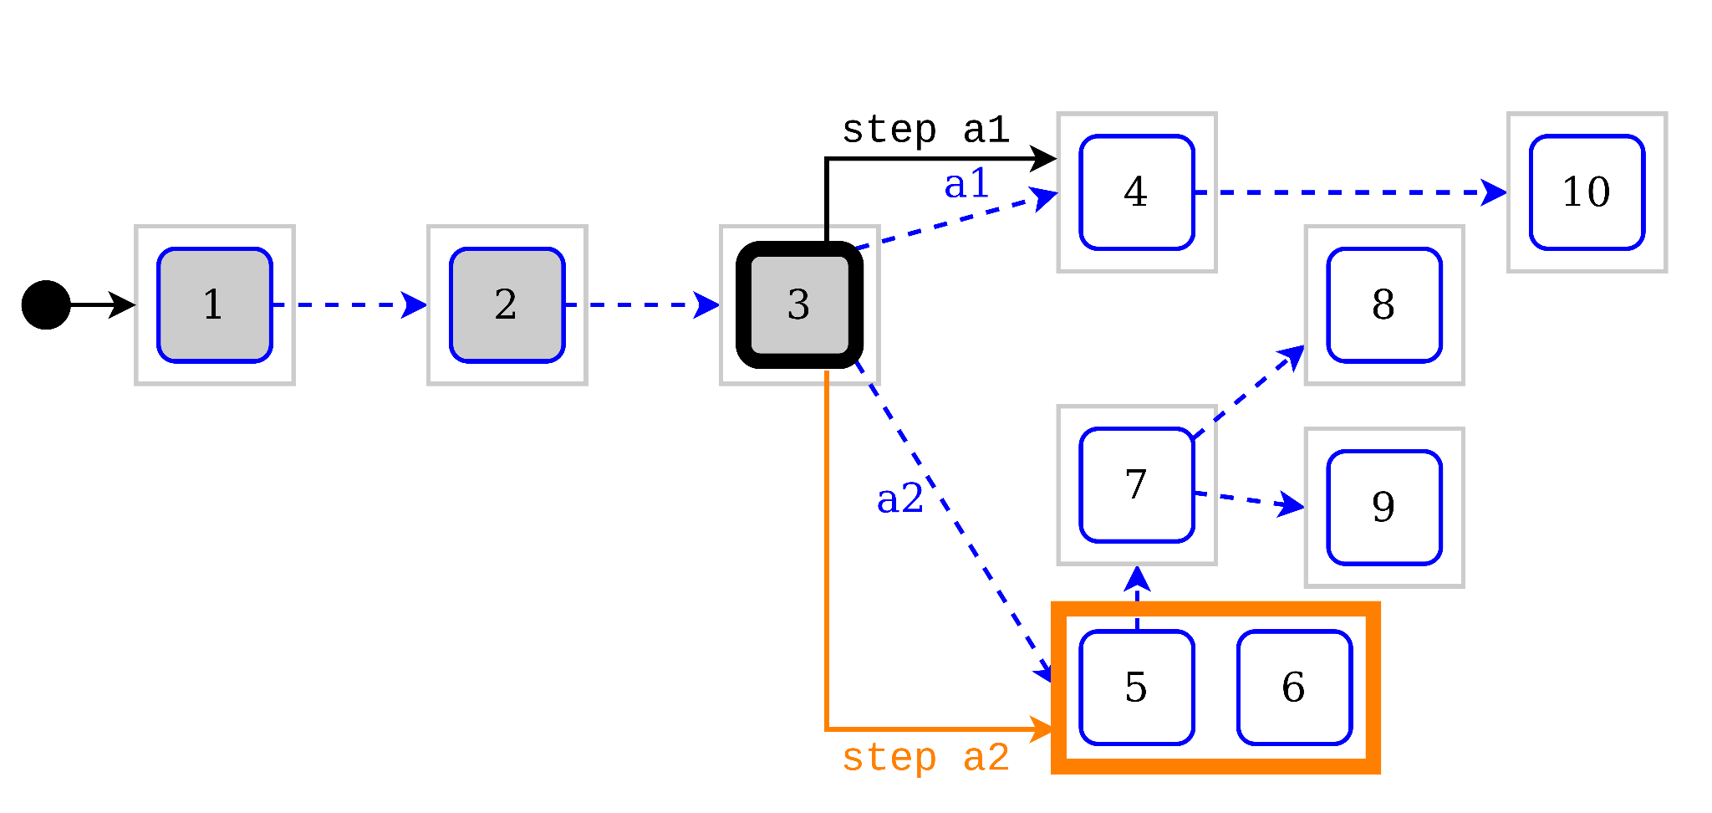
How to handle non-determinism requirements for debugging?
x := 1;
x := 2;
x := 3;
actions {
a1 -> {
x := 4;
x := 10;
}
a2 -> {
x := any of {5,6};
if (x == 5) {
x := 7;
actions {
-> x := 8;
-> x := 9;
}
}
}
}
Debug Actions:
step
run_to_breakpoint
jump
Solving problems with non determinism:
step: Exposing multiple possible steps; Navigating second case of ND
run_to_breakpoint
jump

Slide 16
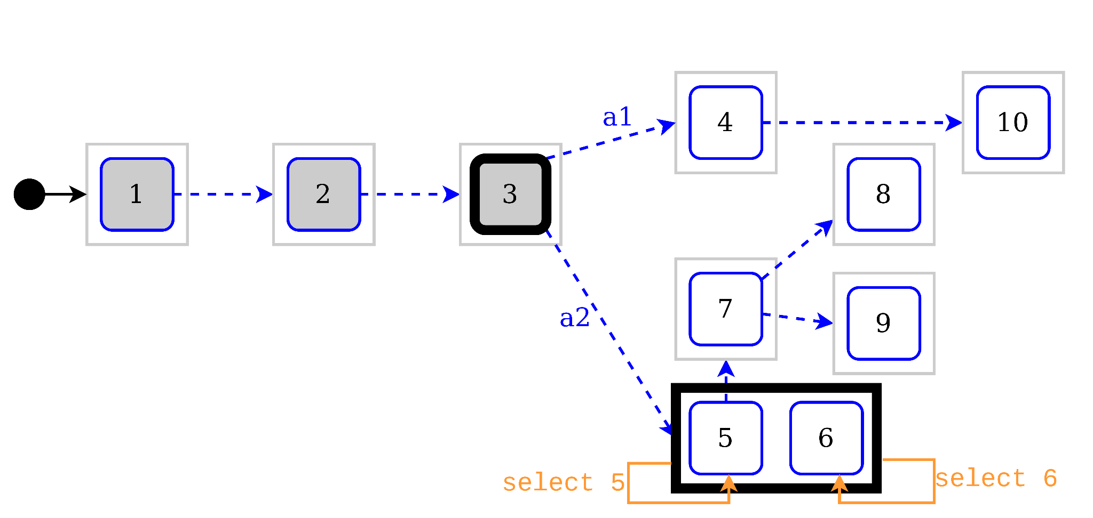
How to handle non-determinism requirements for debugging?
x := 1;
x := 2;
x := 3;
actions {
a1 -> {
x := 4;
x := 10;
}
a2 -> {
x := any of {5,6};
if (x == 5) {
x := 7;
actions {
-> x := 8;
-> x := 9;
}
}
}
}
Debug Actions:
step
run_to_breakpoint
jump
select
Solving problems with non determinism:
step: Exposing multiple possible steps; New select debug action
run_to_breakpoint
jump

Slide 17
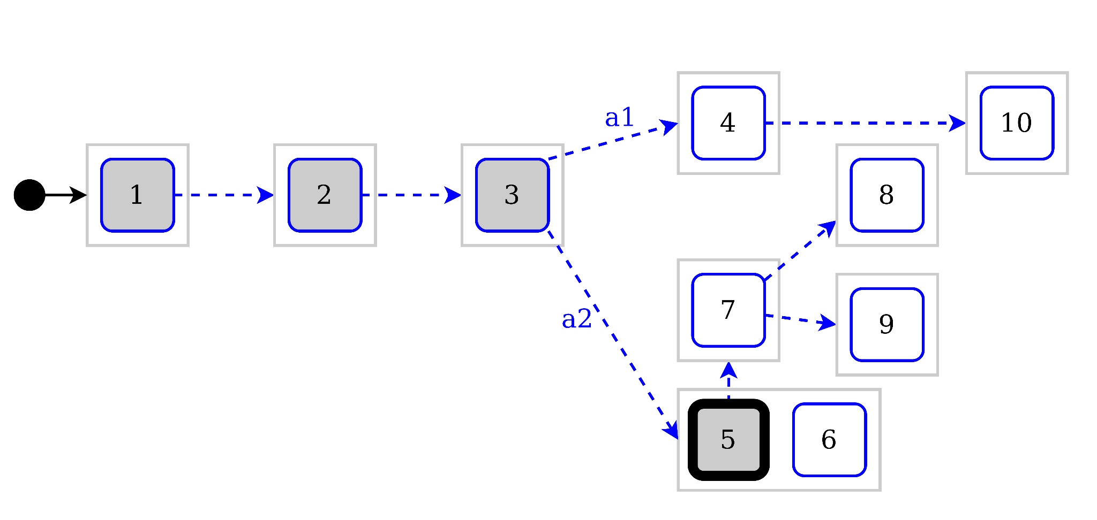
How to handle non-determinism requirements for debugging?
x := 1;
x := 2;
x := 3;
actions {
a1 -> {
x := 4;
x := 10;
}
a2 -> {
x := any of {5,6};
if (x == 5) {
x := 7;
actions {
-> x := 8;
-> x := 9;
}
}
}
}
Debug Actions:
step
run_to_breakpoint
jump
select
Solving problems with non determinism:
step: Exposing multiple possible steps; New select debug action
run_to_breakpoint
jump

Slide 18
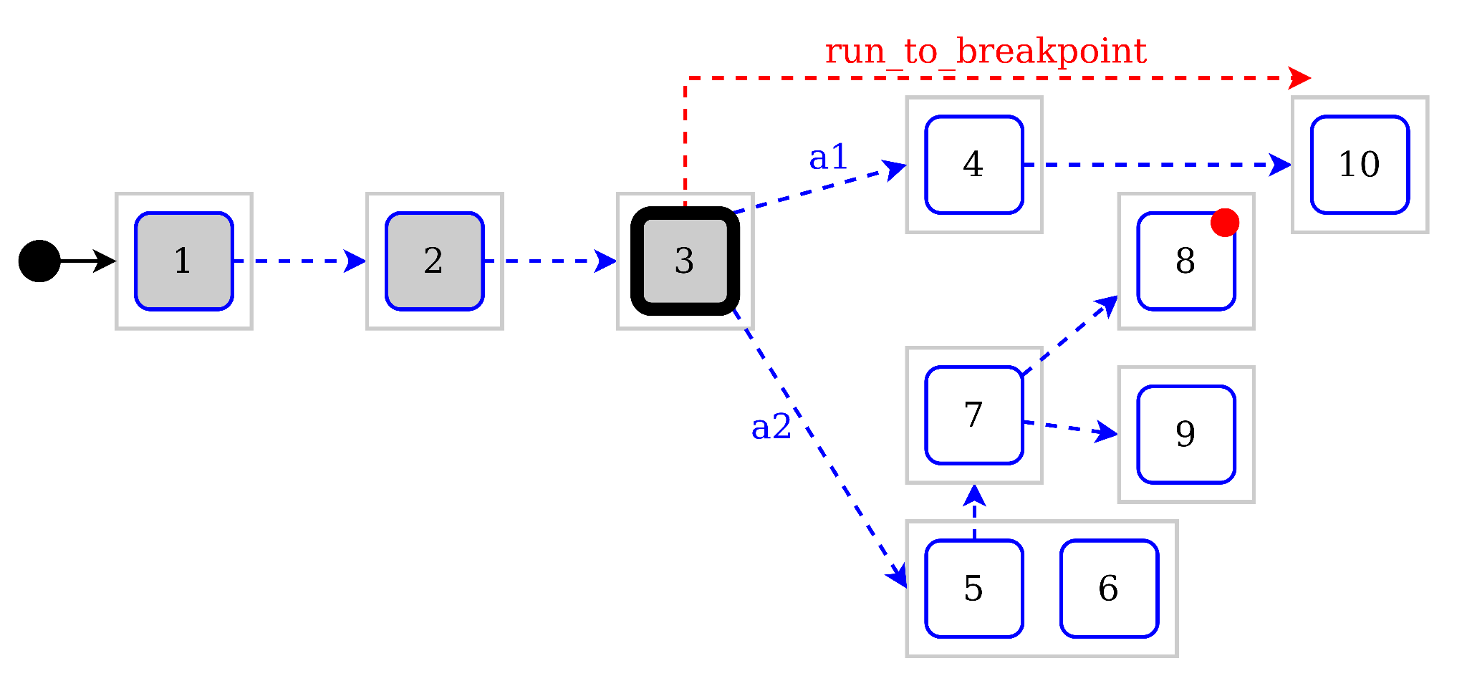
How to handle breakpoints in a ND system?
x := 1;
x := 2;
x := 3;
actions {
a1 -> {
x := 4;
x := 10;
}
a2 -> {
x := any of {5,6};
if (x == 5) {
x := 7;
actions {
● -> x := 8;
-> x := 9;
}
}
}
}
Debug Actions:
step
run_to_breakpoint
jump
select
Solving problems with non determinism:
step: Exposing multiple possible steps; New select debug action
run_to_breakpoint: Missing breakpoints when exploring a single branch
jump

Slide 19
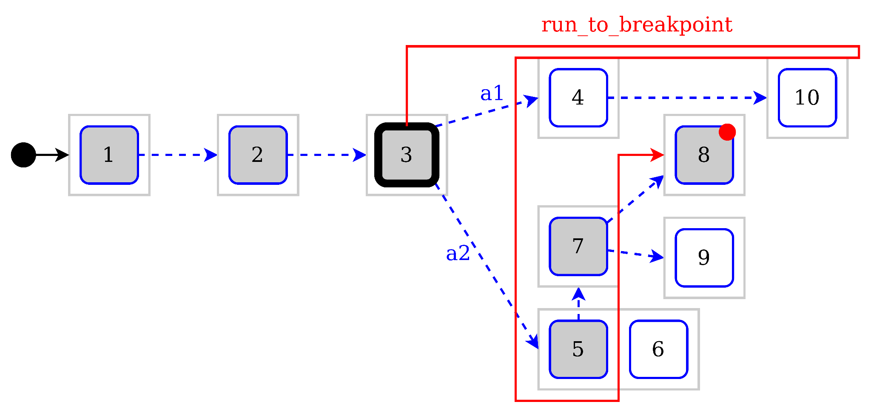
How to handle breakpoints in a ND system?
x := 1;
x := 2;
x := 3;
actions {
a1 -> {
x := 4;
x := 10;
}
a2 -> {
x := any of {5,6};
if (x == 5) {
x := 7;
actions {
● -> x := 8;
-> x := 9;
}
}
}
}
Debug Actions:
step
run_to_breakpoint
jump
select
Solving problems with non determinism:
step: Exposing multiple possible steps; New select debug action
run_to_breakpoint: Reachability query over the system
jump
Notes:
reachablility

Slide 20
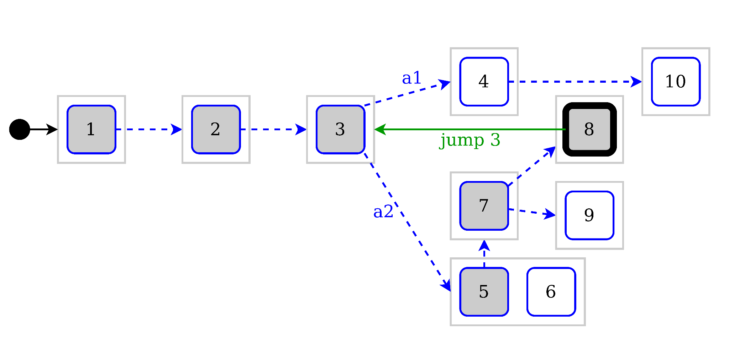
How to handle jumps in a ND system?
x := 1;
x := 2;
x := 3;
actions {
a1 -> {
x := 4;
x := 10;
}
a2 -> {
x := any of {5,6};
if (x == 5) {
x := 7;
actions {
-> x := 8;
-> x := 9;
}
}
}
}
Debug Actions:
step
run_to_breakpoint
jump
select
Solving problems with non determinism:
step: Exposing multiple possible steps; New select debug action
run_to_breakpoint: Reachability query over the system
jump

Slide 21
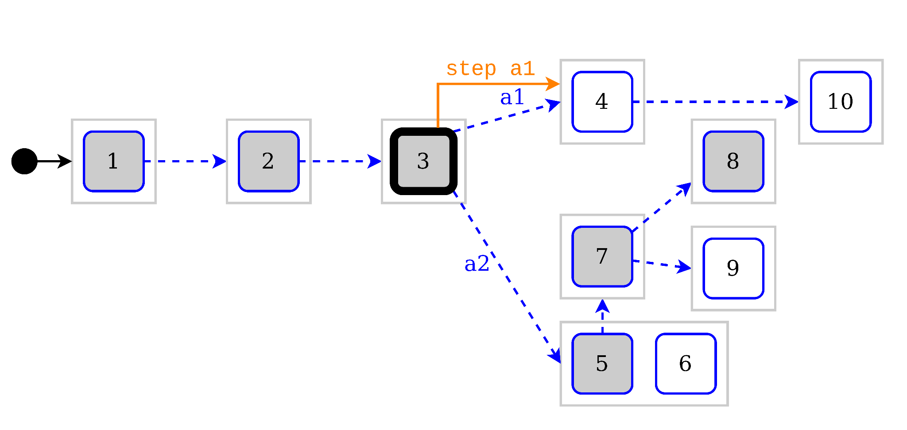
How to handle jumps in a ND system?
x := 1;
x := 2;
x := 3;
actions {
a1 -> {
x := 4;
x := 10;
}
a2 -> {
x := any of {5,6};
if (x == 5) {
x := 7;
actions {
-> x := 8;
-> x := 9;
}
}
}
}
Debug Actions:
step
run_to_breakpoint
jump
select
Solving problems with non determinism:
step: Exposing multiple possible steps; New select debug action
run_to_breakpoint: Reachability query over the system
jump: History is lost when switching to another end-to-end branch

Slide 22
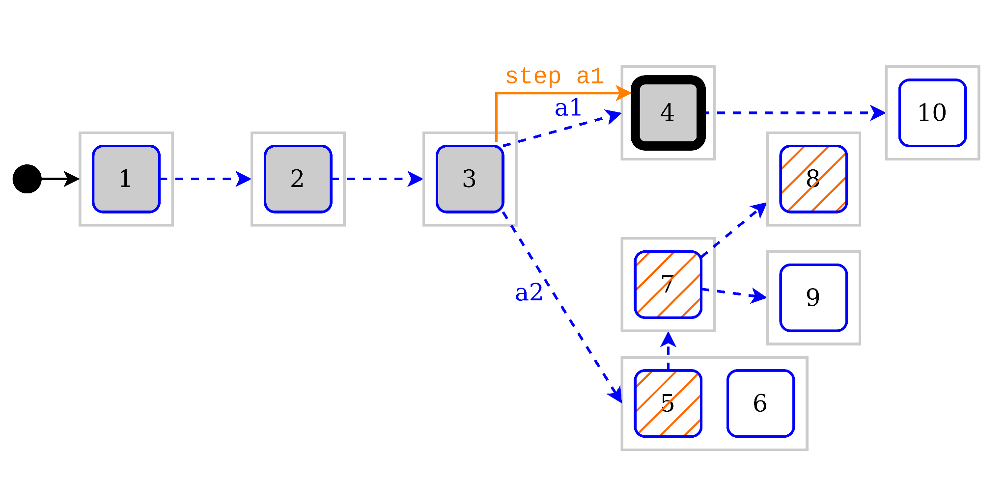
How to handle jumps in a ND system?
x := 1;
x := 2;
x := 3;
actions {
a1 -> {
x := 4;
x := 10;
}
a2 -> {
x := any of {5,6};
if (x == 5) {
x := 7;
actions {
-> x := 8;
-> x := 9;
}
}
}
}
Debug Actions:
step
run_to_breakpoint
jump
select
Solving problems with non determinism:
step: Exposing multiple possible steps; New select debug action
run_to_breakpoint: Reachability query over the system
jump: History is lost when switching to another end-to-end branch
Notes:
omniscient debugging only runs end-to-end traces, so history of previous trace disappears
We want to compare configurations on different traces

Slide 23
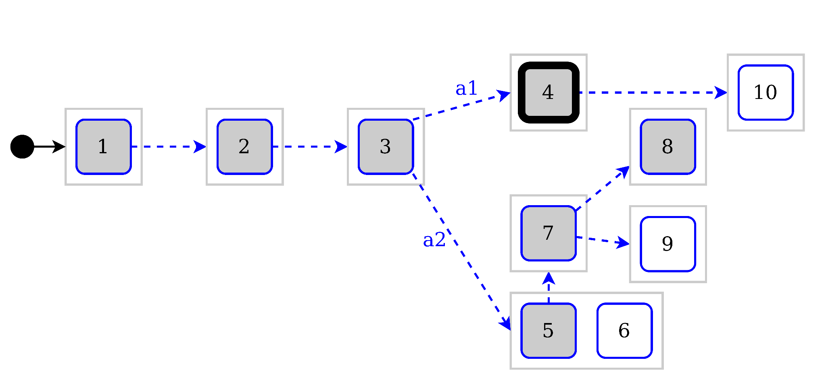
How to handle jumps in a ND system?
x := 1;
x := 2;
x := 3;
actions {
a1 -> {
x := 4;
x := 10;
}
a2 -> {
x := any of {5,6};
if (x == 5) {
x := 7;
actions {
-> x := 8;
-> x := 9;
}
}
}
}
Debug Actions:
step
run_to_breakpoint
jump
select
Solving problems with non determinism:
step: Exposing multiple possible steps; New select debug action
run_to_breakpoint: Reachability query over the system
jump: Storing the trace as a tree

Slide 24
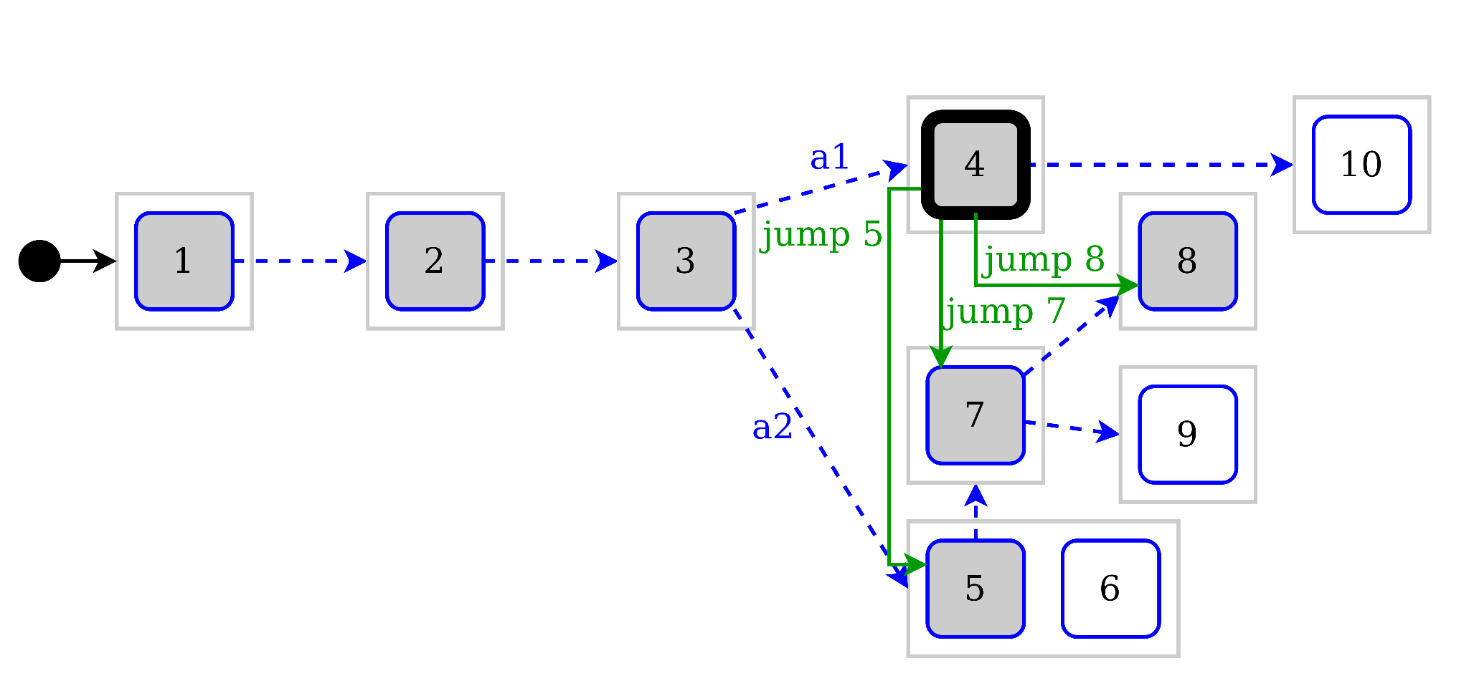
How to handle jumps in a ND system?
x := 1;
x := 2;
x := 3;
actions {
a1 -> {
x := 4;
x := 10;
}
a2 -> {
x := any of {5,6};
if (x == 5) {
x := 7;
actions {
-> x := 8;
-> x := 9;
}
}
}
}
Debug Actions:
step
run_to_breakpoint
jump
select
Solving problems with non determinism:
step: Exposing multiple possible steps; New select debug action
run_to_breakpoint: Reachability query over the system
jump: Storing the trace as a tree

Slide 25
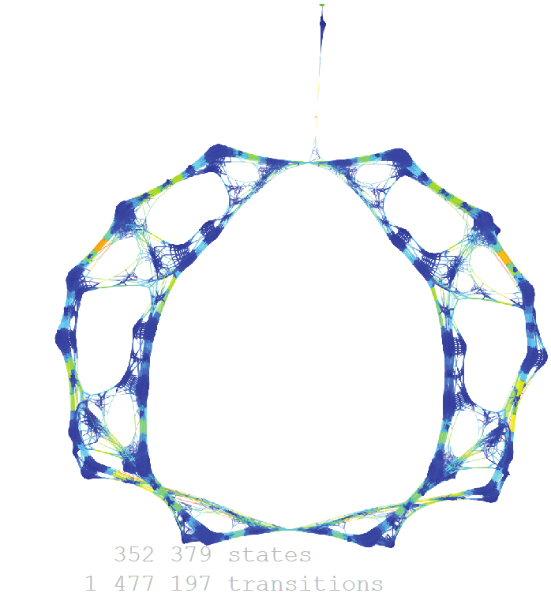
Problems of Multiverse debugging
Notes:
state-space explosion

Slide 26
Our contribution: Reduced Multiverse Debugging (RMD)
Keeping the useful aspects of multiverse debugging for specification languages
Explicit non-deterministic debug steps
Storing the trace as a tree
Searching for breakpoints on all branches
While making this approach scalable to real-size projects
By using reduction policies during breakpoint search
Debug semantics formalization¹
Making it easily adaptable to new target languages
Application to UML
[1] Valentin Besnard. Ph. D. Dissertation 2020. “EMI: An approach to unify analysis and embedded execution
with a controllable model interpreter.”
Notes:
stefan marr

Slide 27
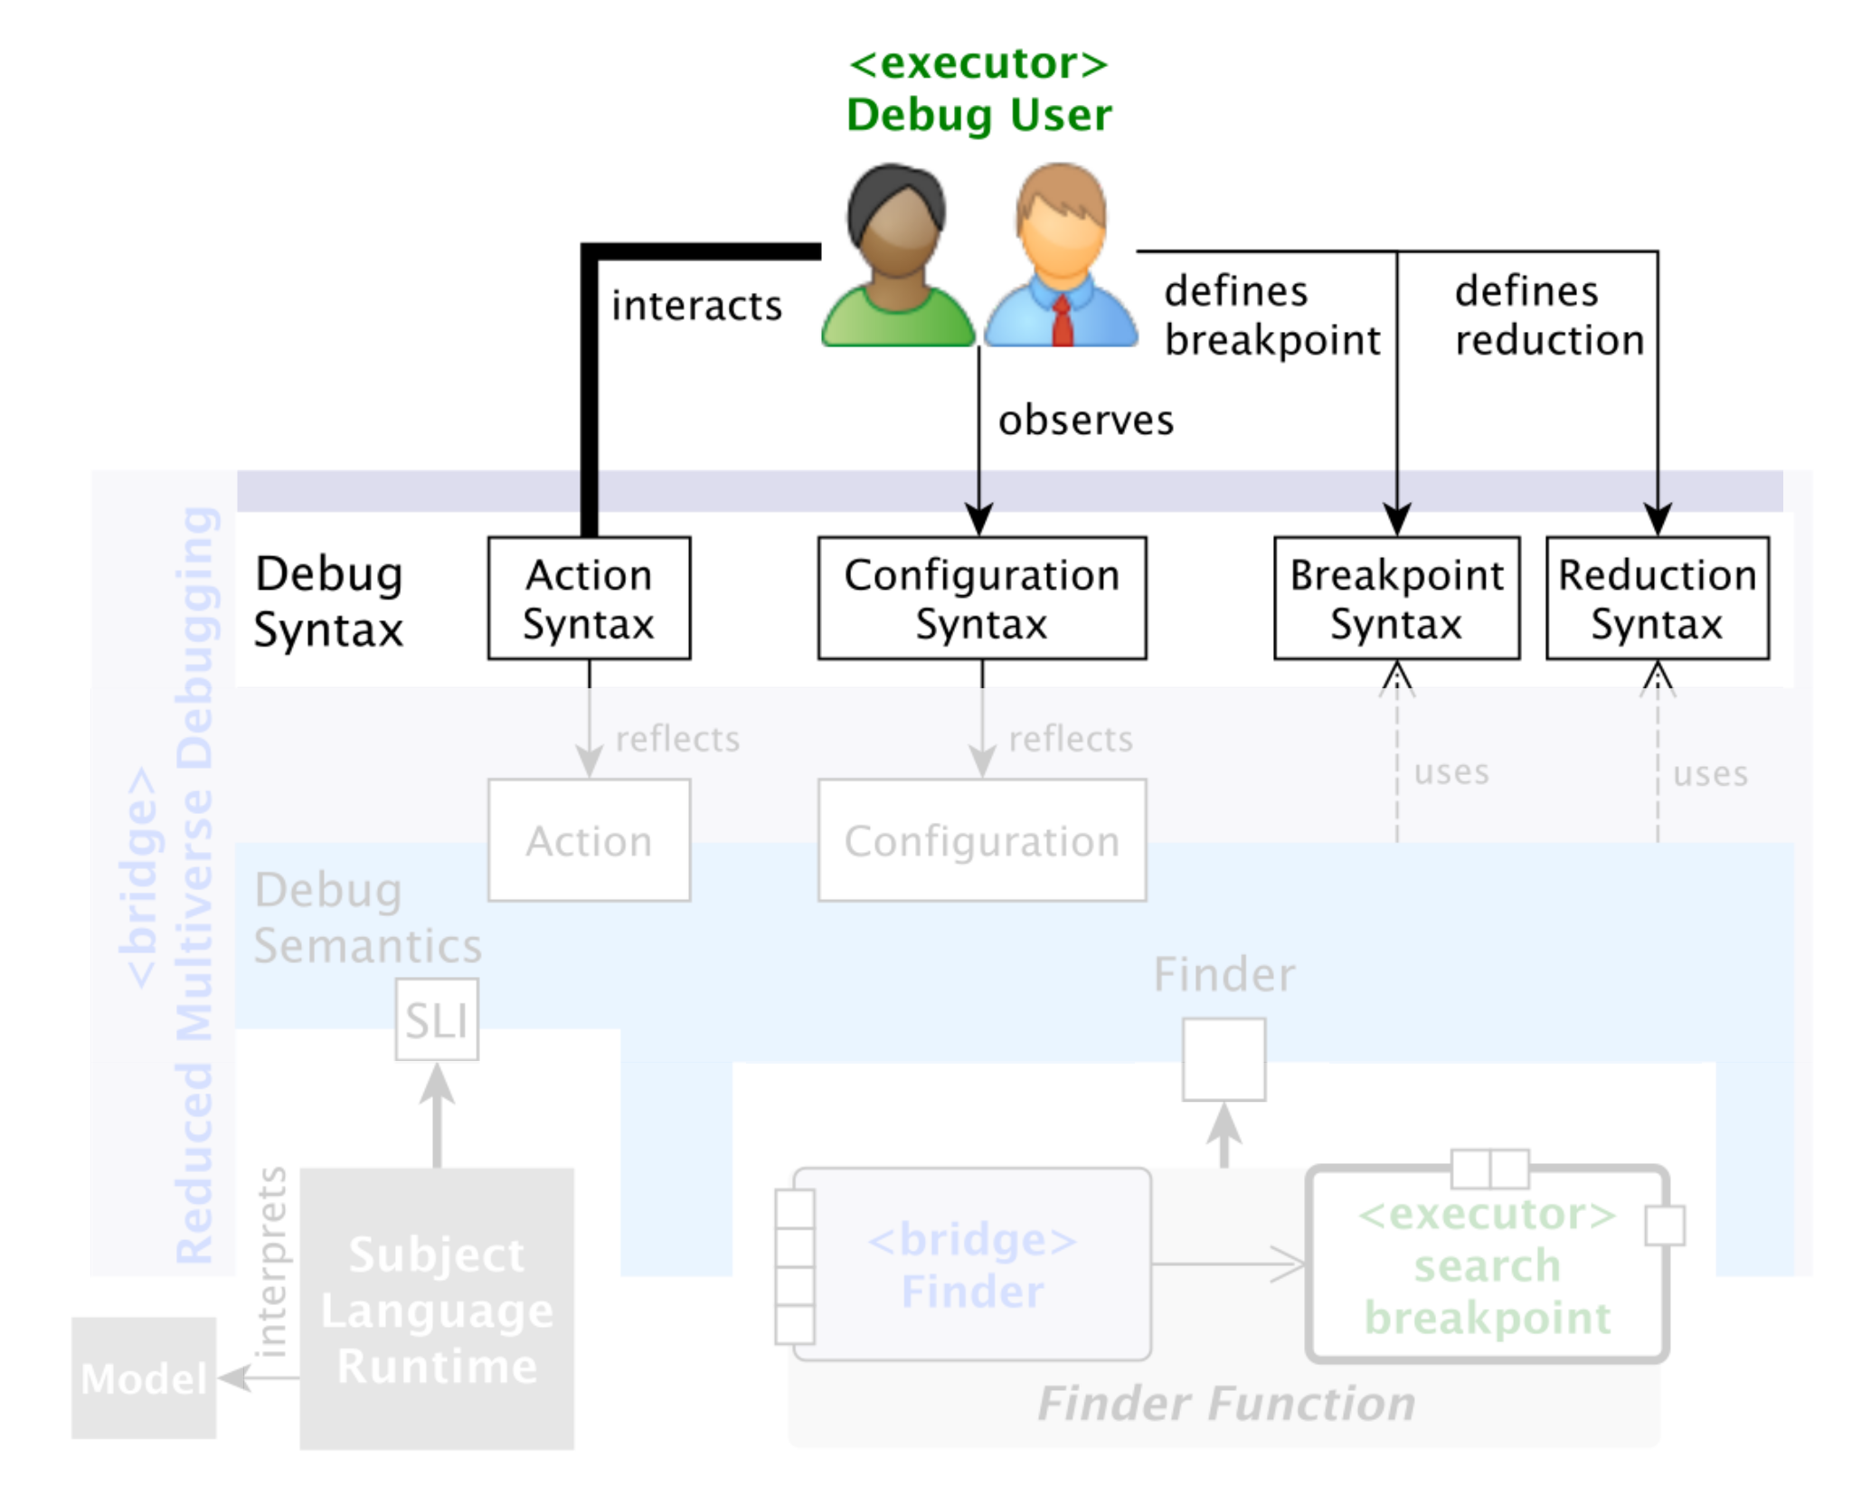
Architecture of Reduced Multiverse Debugging (RMD)

Slide 28
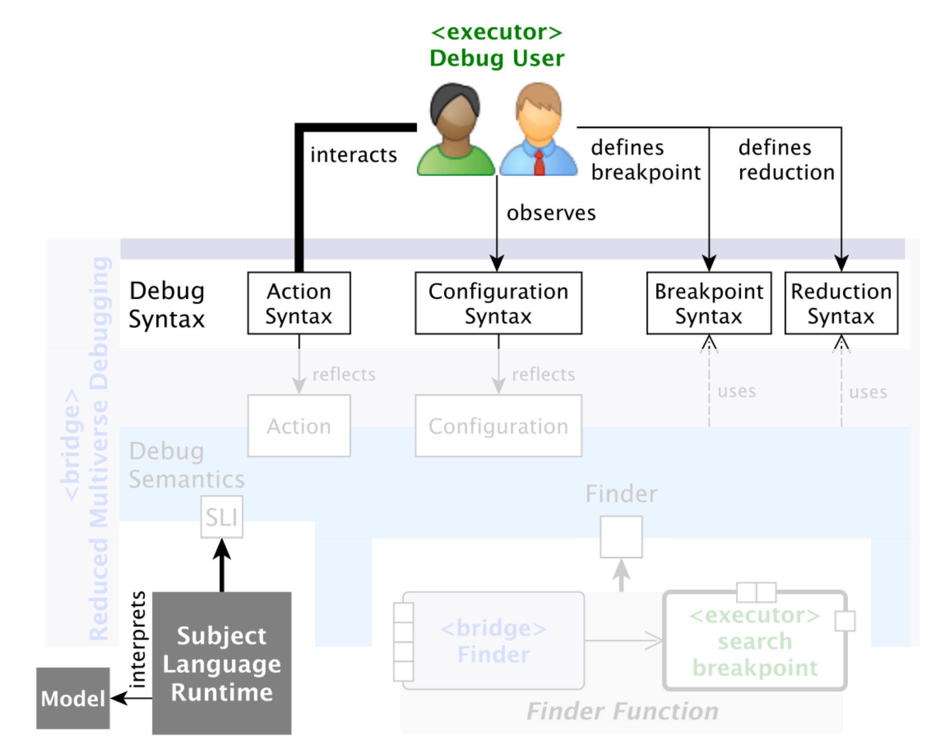
Architecture of Reduced Multiverse Debugging (RMD)
Notes:
runtime of the subject to debug to pilot it’s execution

Slide 29
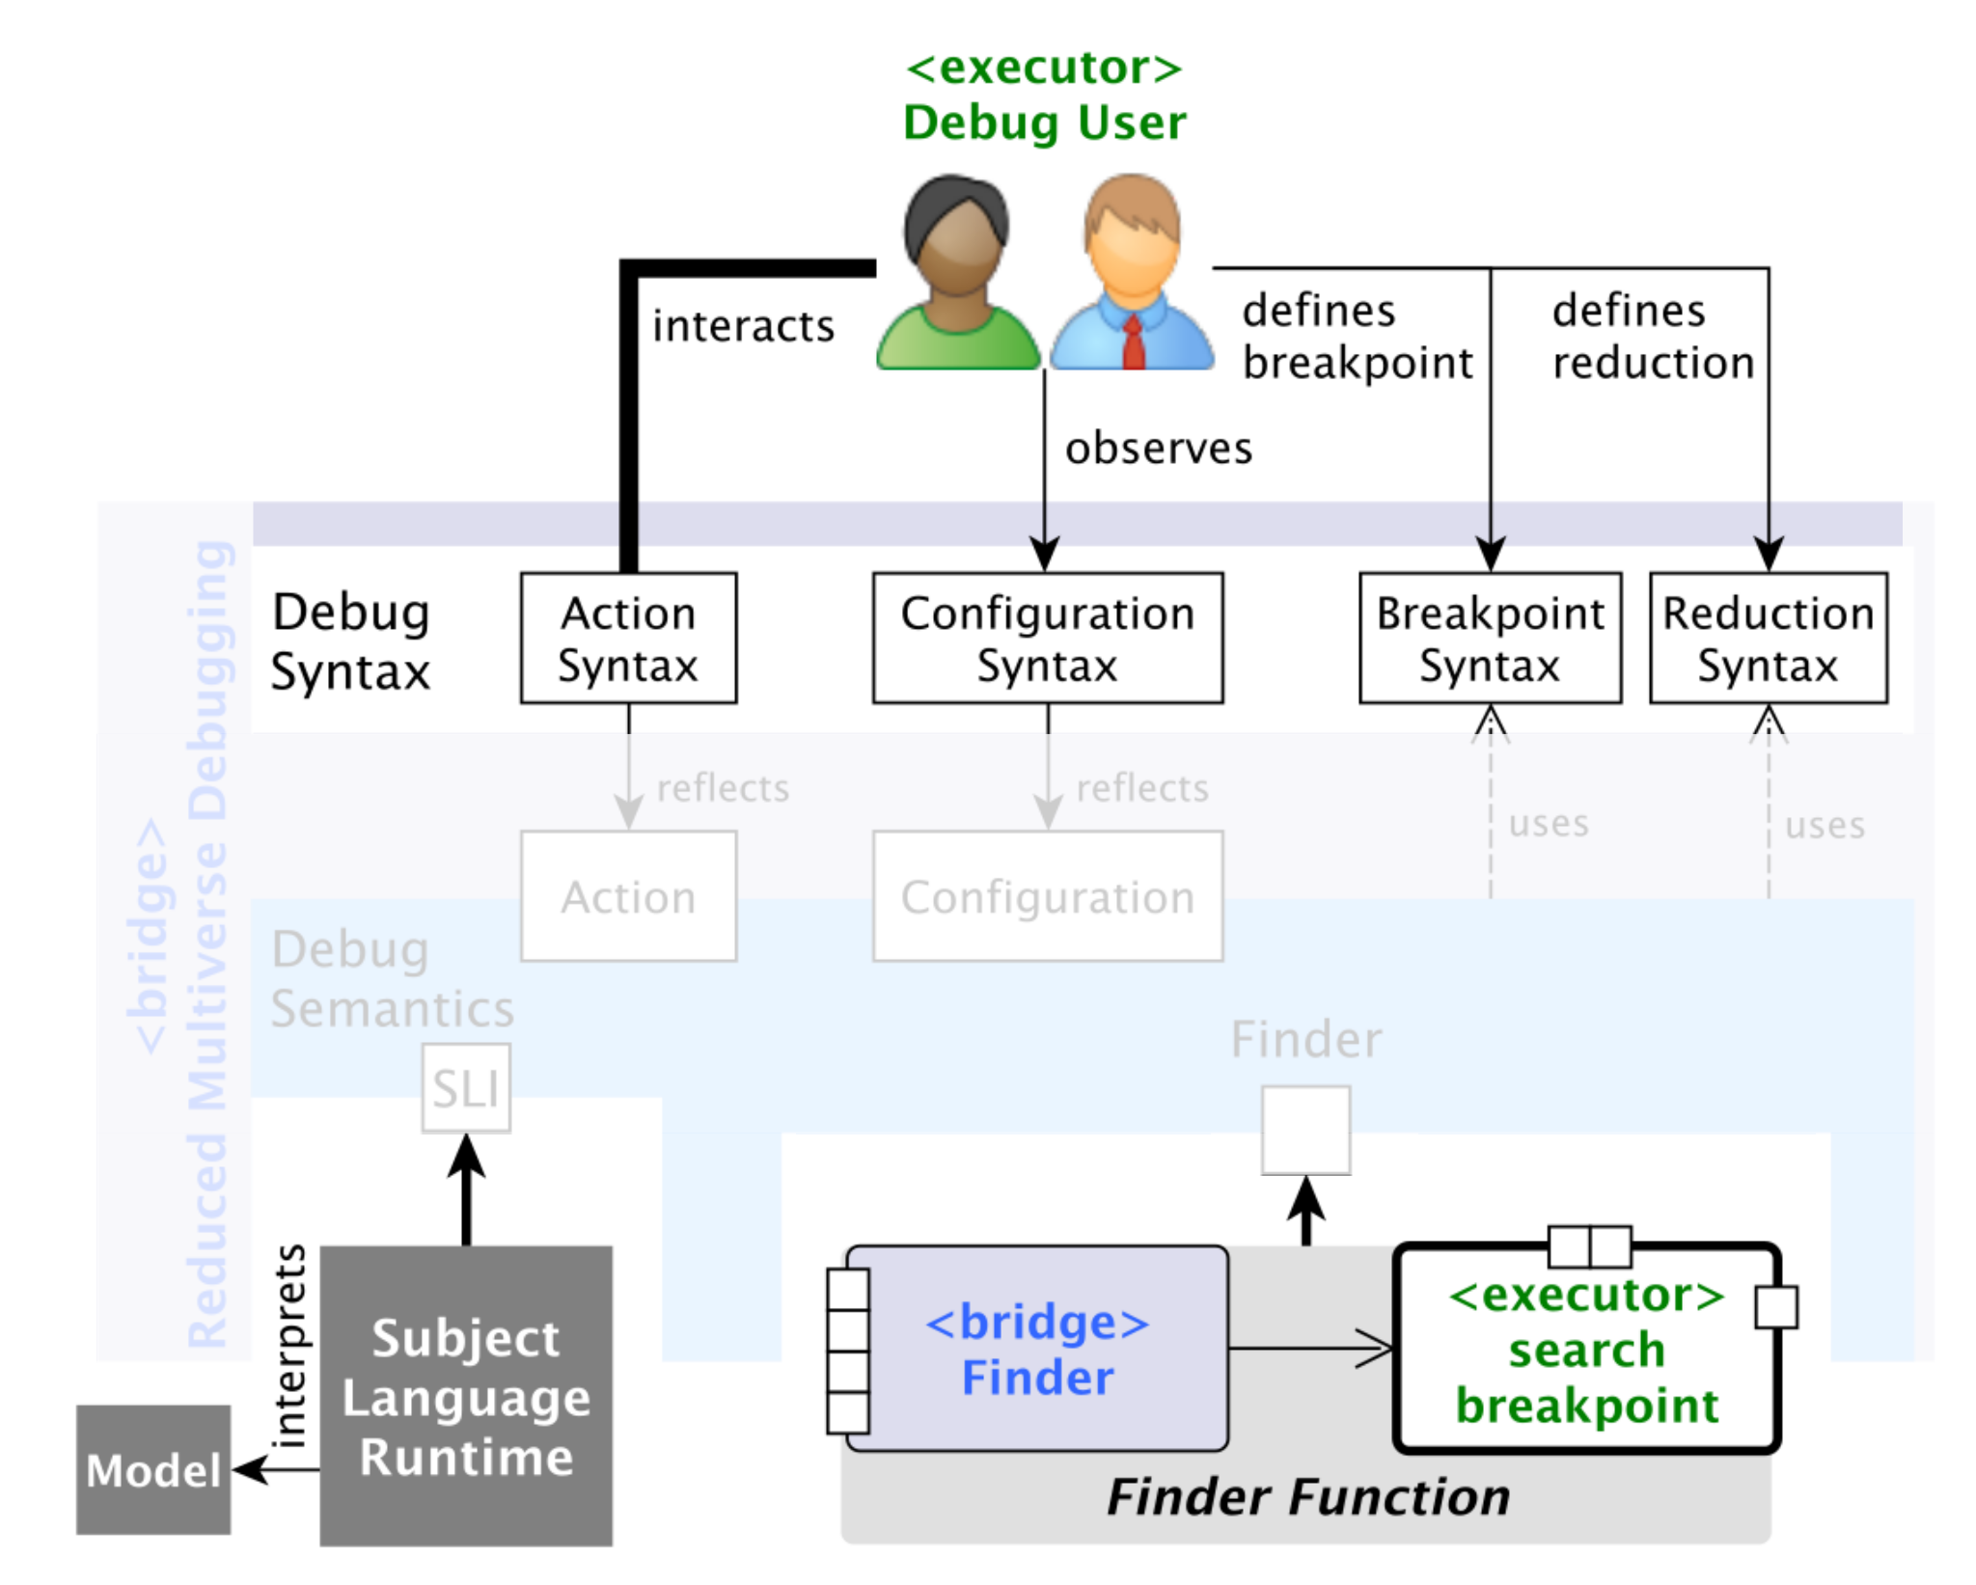
Architecture of Reduced Multiverse Debugging (RMD)

Slide 30
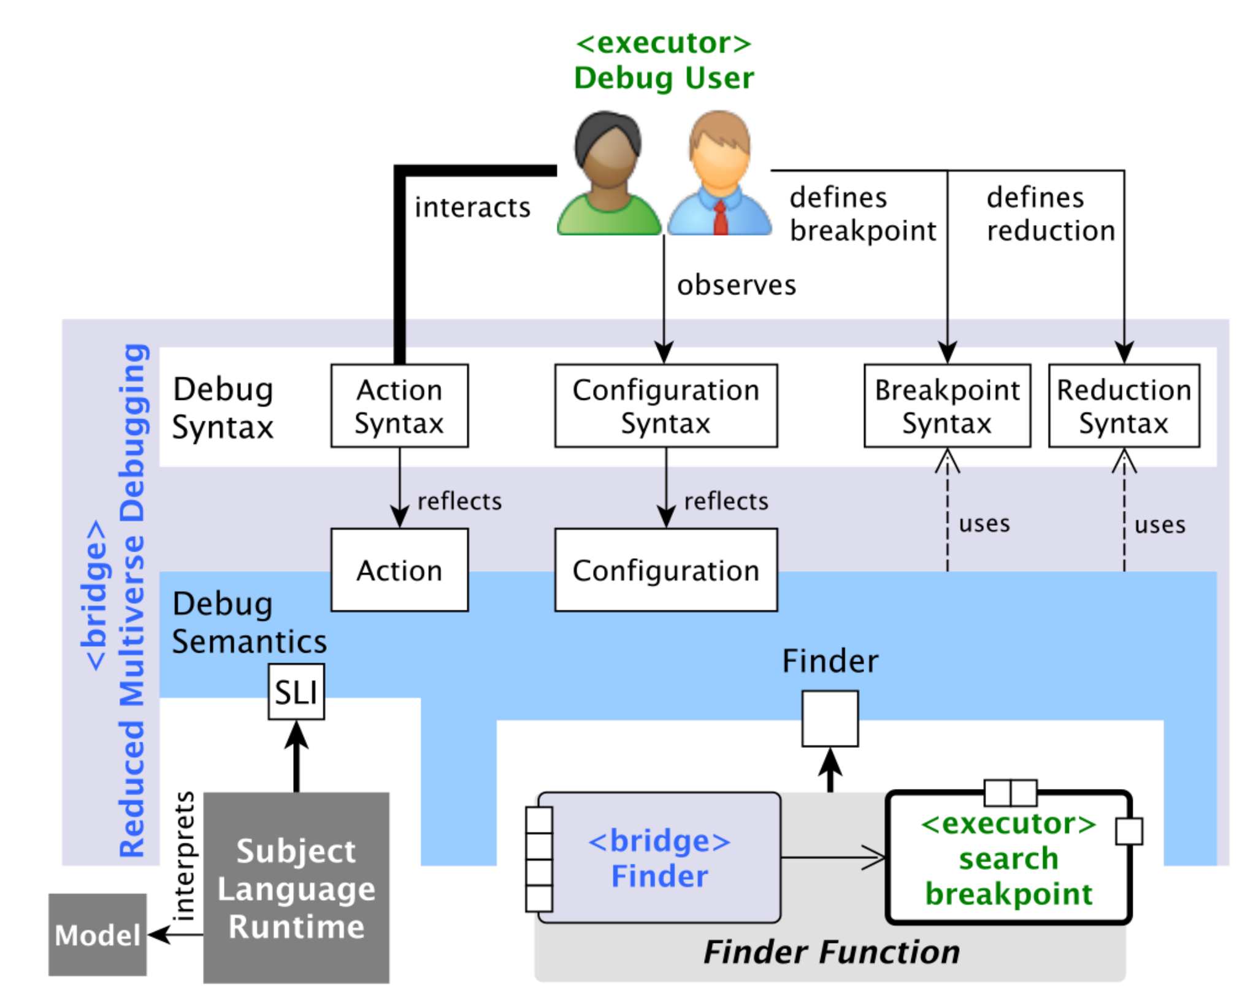
Architecture of Reduced Multiverse Debugging (RMD)

Slide 31
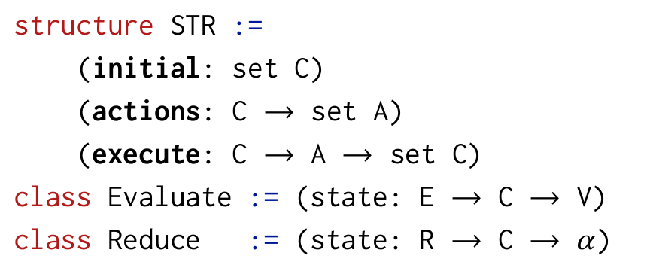
Semantic Language Interface
Control the model execution
Test an expression on a configuration
Used to find if a configuration match a breakpoint
Modify a configuration following a reduction syntax
Used to accelerate the breakpoint search
Notes:
Semantic Transition Relation
C the configuration type
A the action type
E the expression type (define breakpoints)
R the reduction syntax
V the value type
α the reduced configuration type

Slide 32
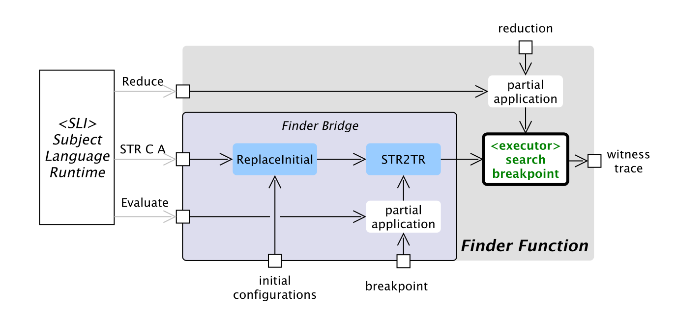
The Finder Function
Notes:
Used during breakpoint search
SLI as an input
reachability algorithm
adapted by
changing initial configuration, as we may start RTB from anywhere
partial applications of breakpoints and reduction

Slide 33
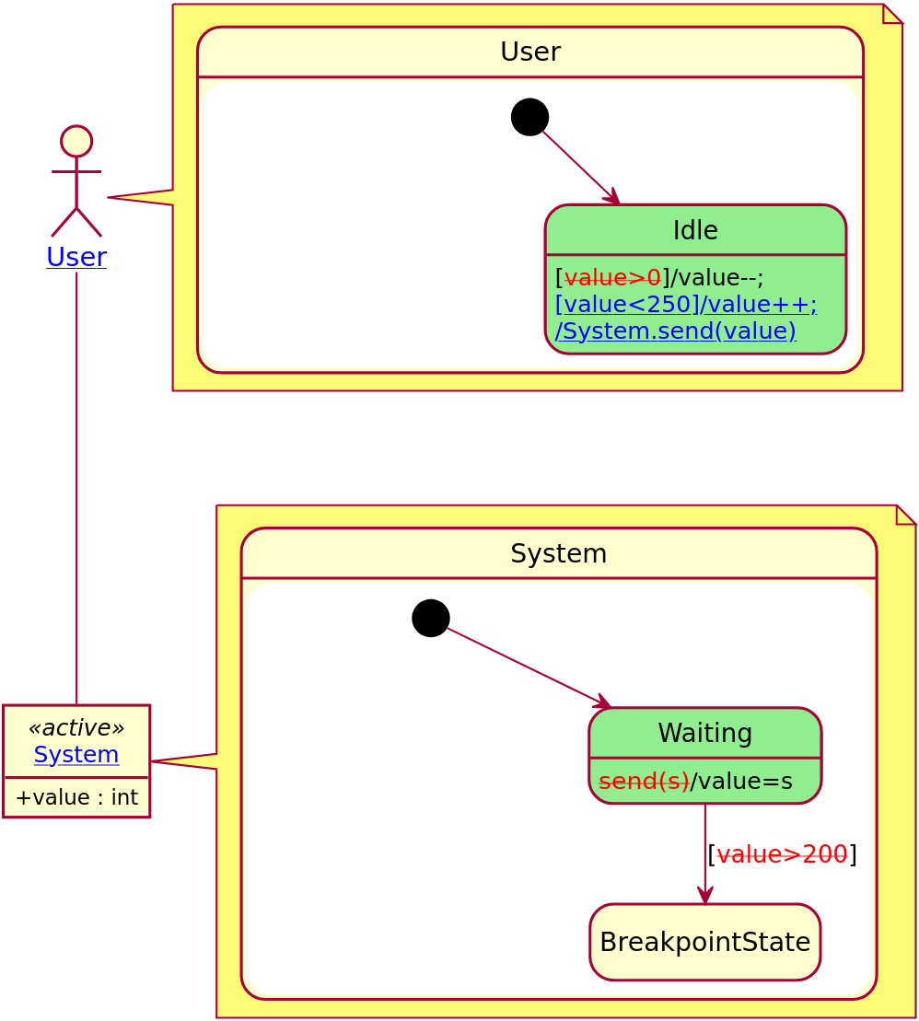
Experimentation:

Slide 34
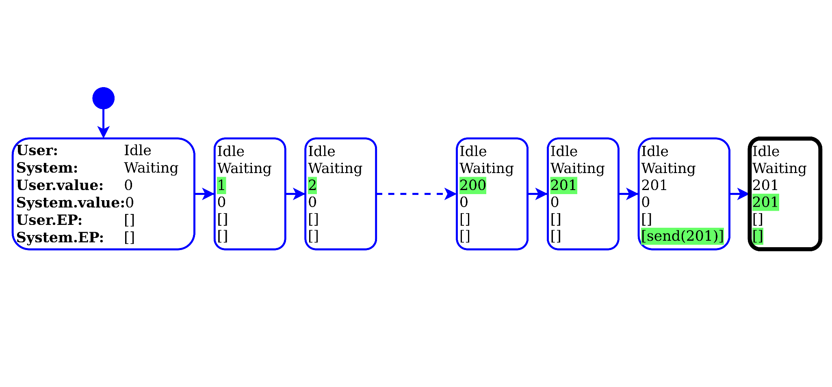
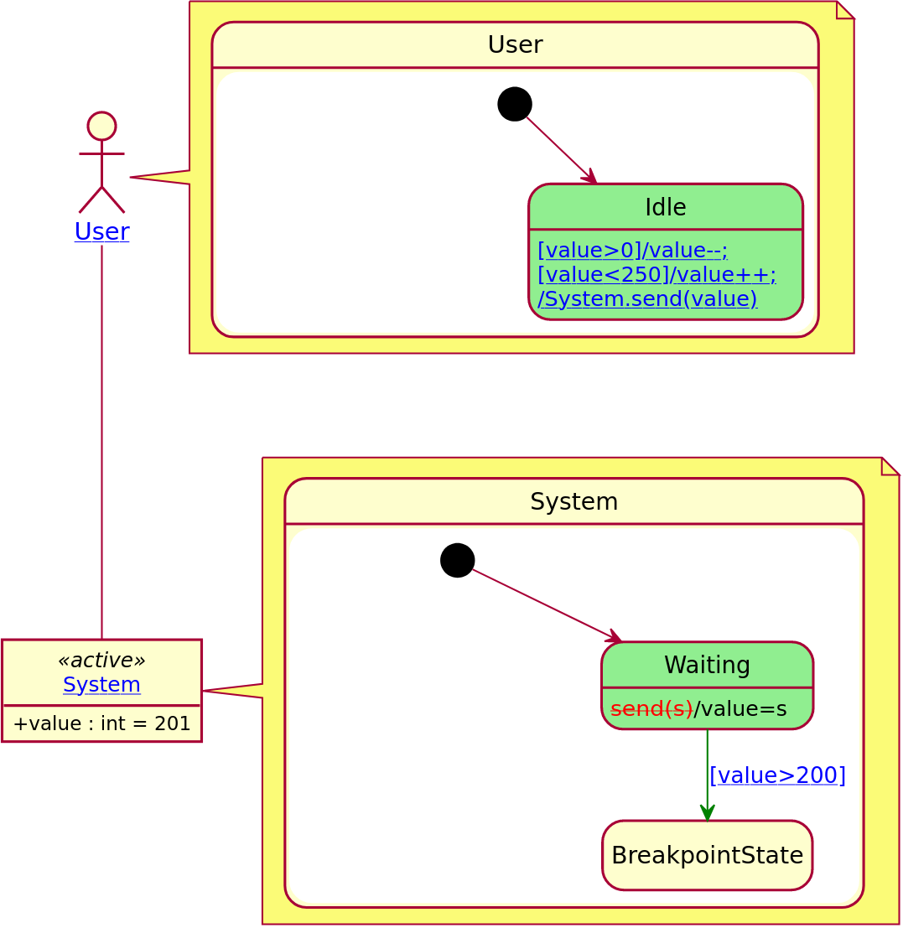
Experimentation

Slide 35
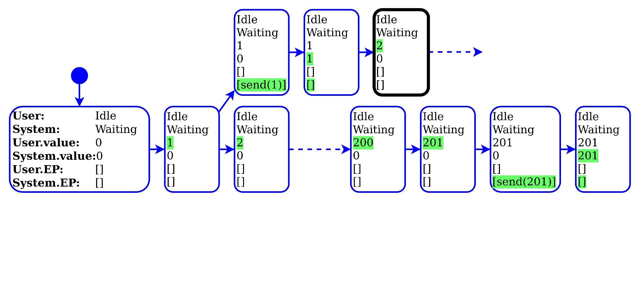
Experimentation

Slide 36
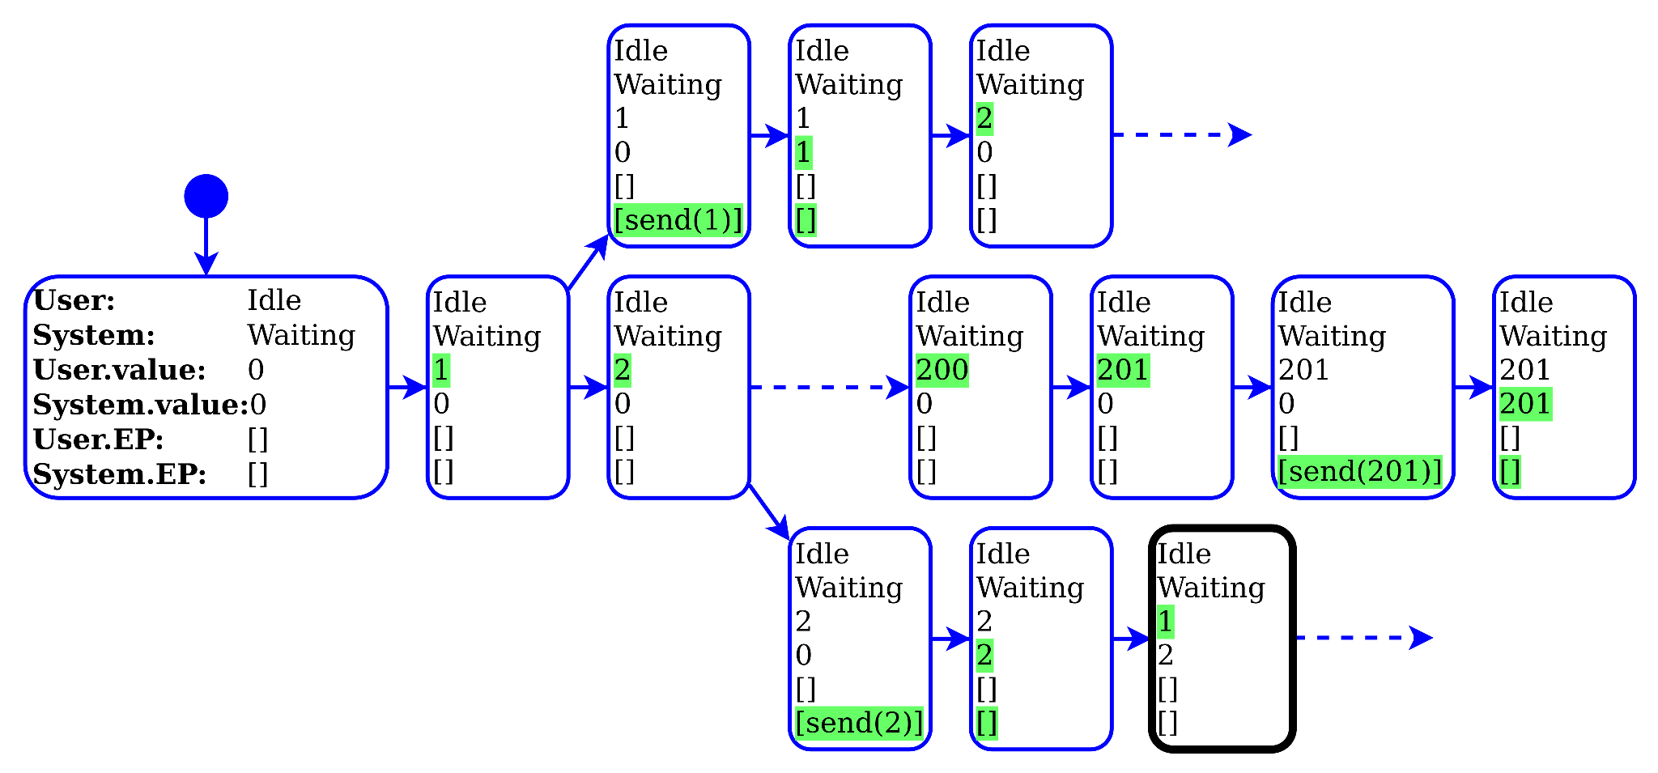
Experimentation

Slide 37
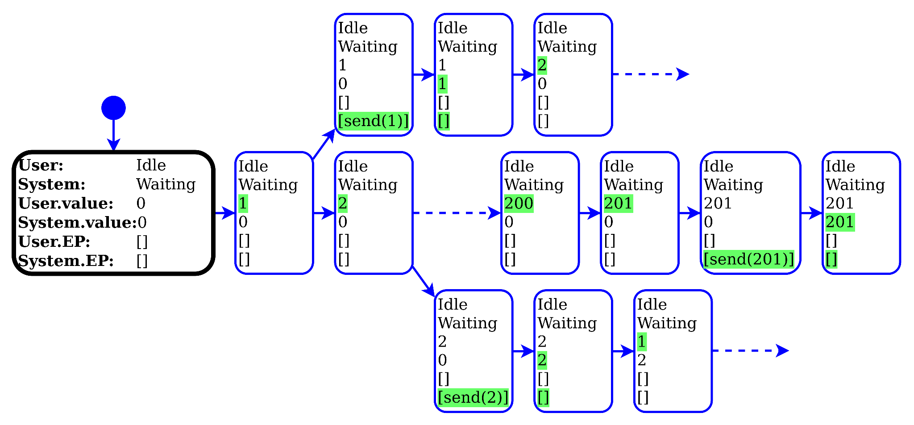
Applying a reduction function
Reduction function
States
User
System
Values
User.value
System.value
EventPools
User.EP
System.EP

Slide 38
Applying a reduction function
Reduction function
States
User
System
Values
User.value
System.value
EventPools
User.EP
System.EP
Predicates
System.EP.isEmpty()
System.value > 200

Slide 39
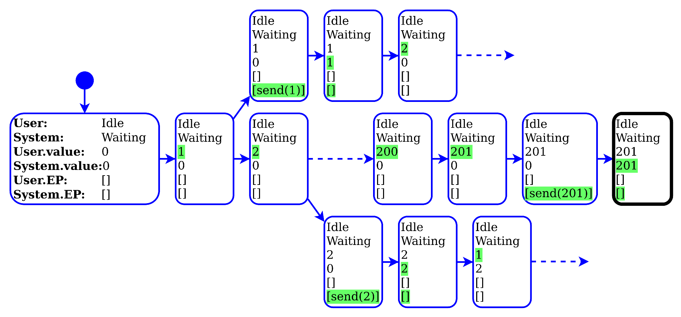
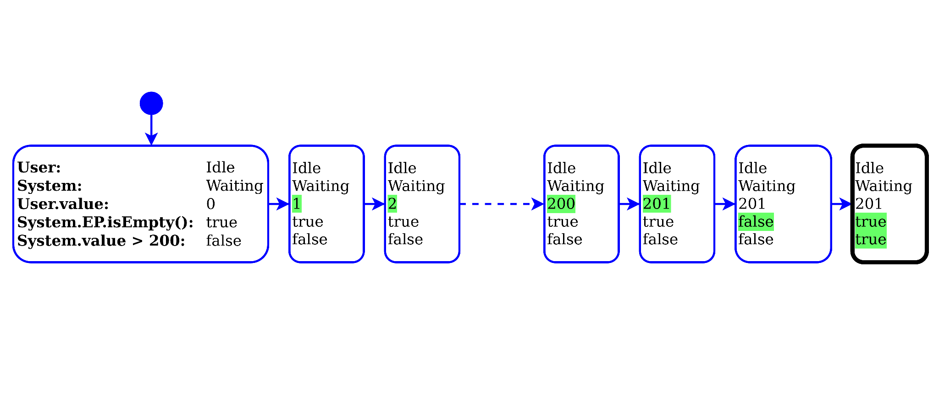
Applying a reduction function
Reduction function
States
User
System
Values
User.value
System.value
EventPools
User.EP
System.EP
Predicates
System.EP.isEmpty()
System.value > 200

Slide 40
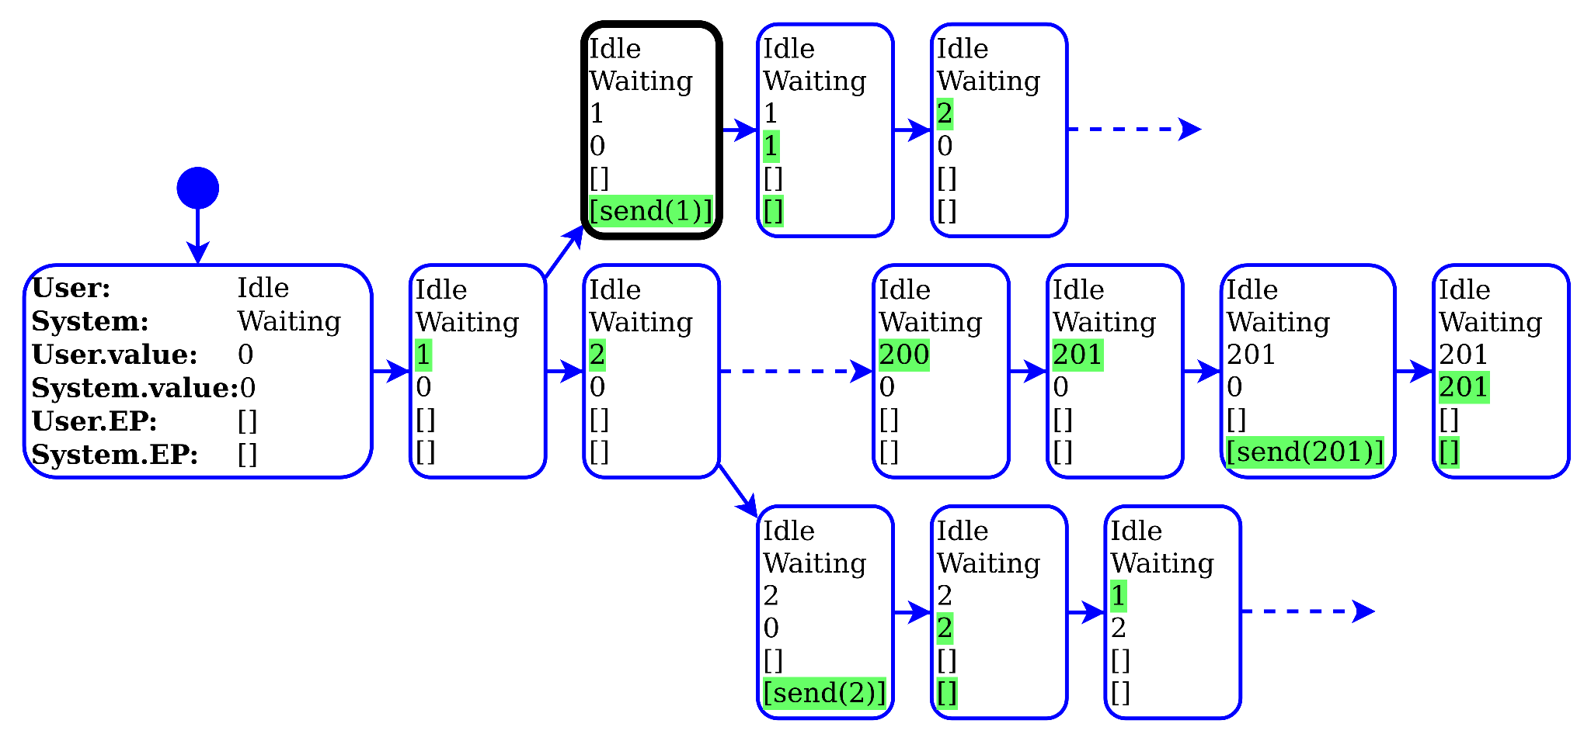
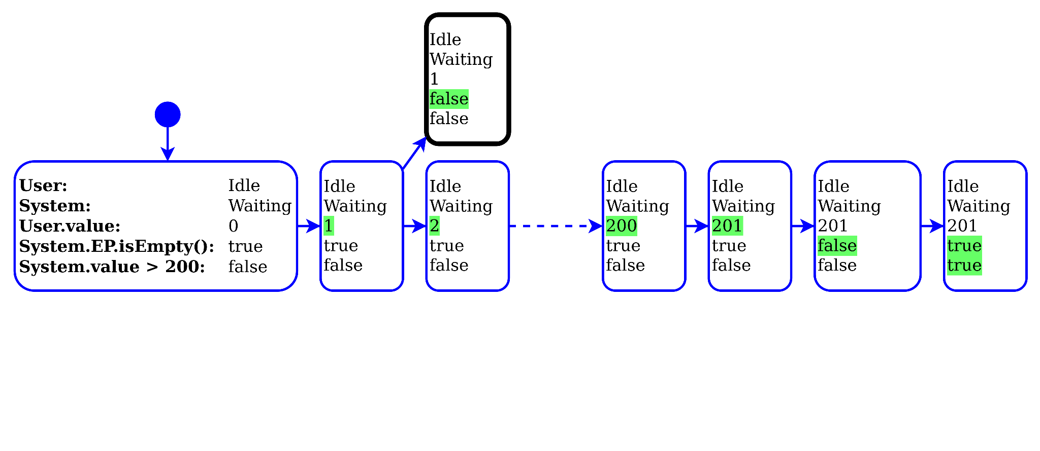
Applying a reduction function
Reduction function
States
User
System
Values
User.value
System.value
EventPools
User.EP
System.EP
Predicates
System.EP.isEmpty()
System.value > 200

Slide 41
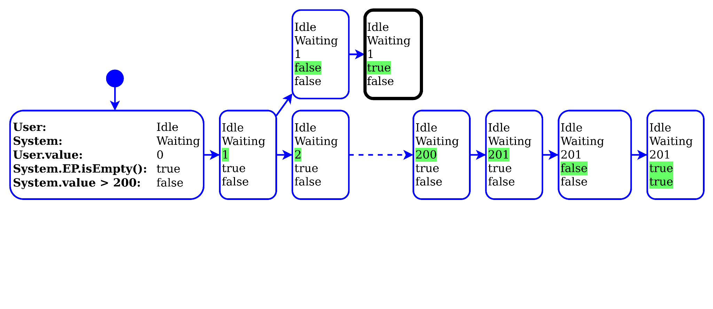
Applying a reduction function
Reduction function
States
User
System
Values
User.value
System.value
EventPools
User.EP
System.EP
Predicates
System.EP.isEmpty()
System.value > 200

Slide 42
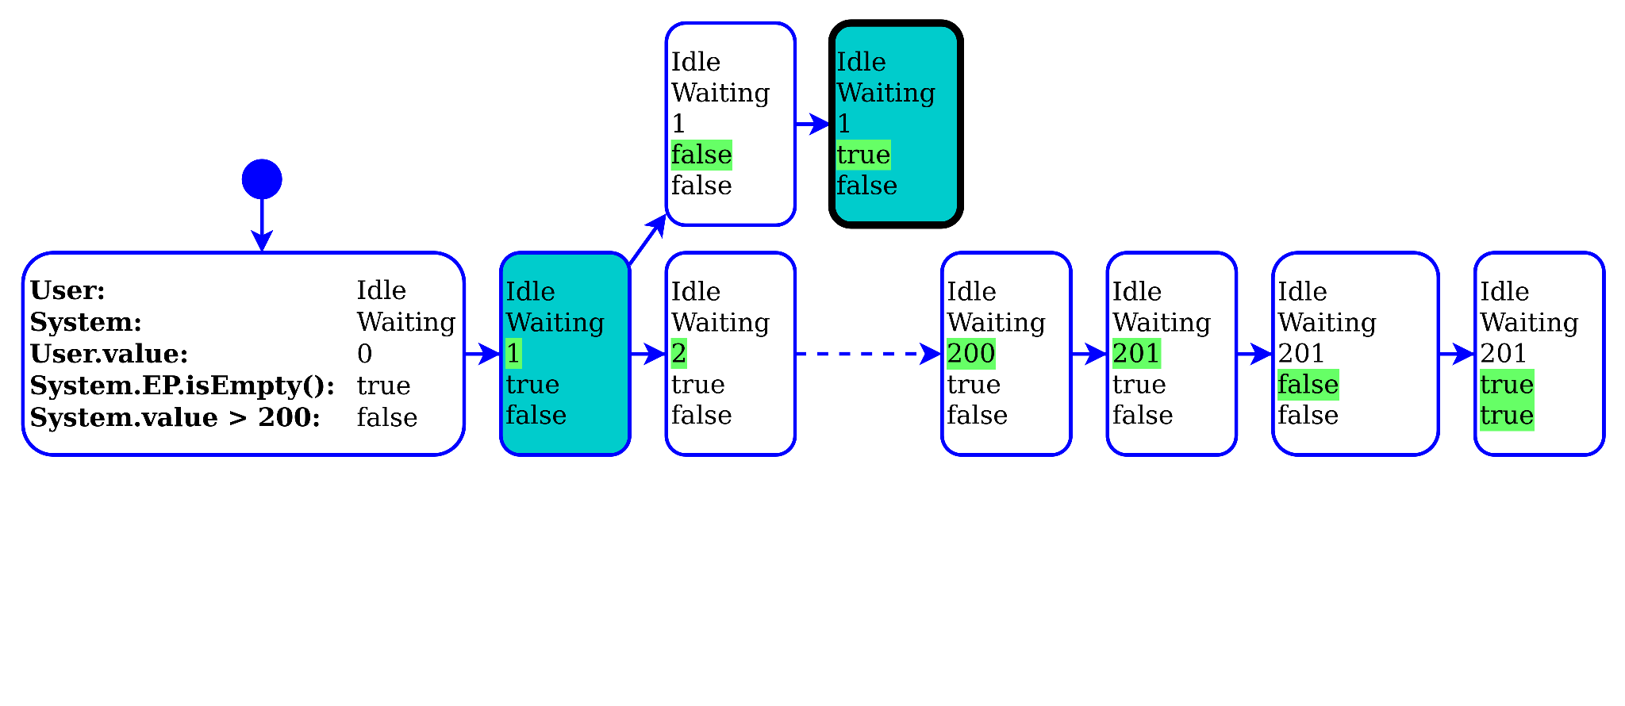
Applying a reduction function
Reduction function
States
User
System
Values
User.value
System.value
EventPools
User.EP
System.EP
Predicates
System.EP.isEmpty()
System.value > 200

Slide 43
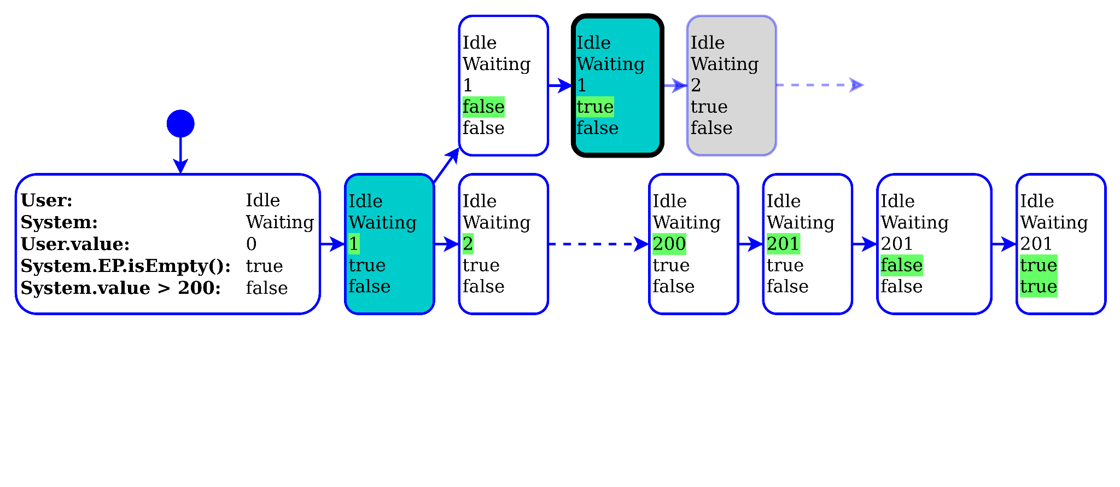
Applying a reduction function
Reduction function
States
User
System
Values
User.value
System.value
EventPools
User.EP
System.EP
Predicates
System.EP.isEmpty()
System.value > 200

Slide 44
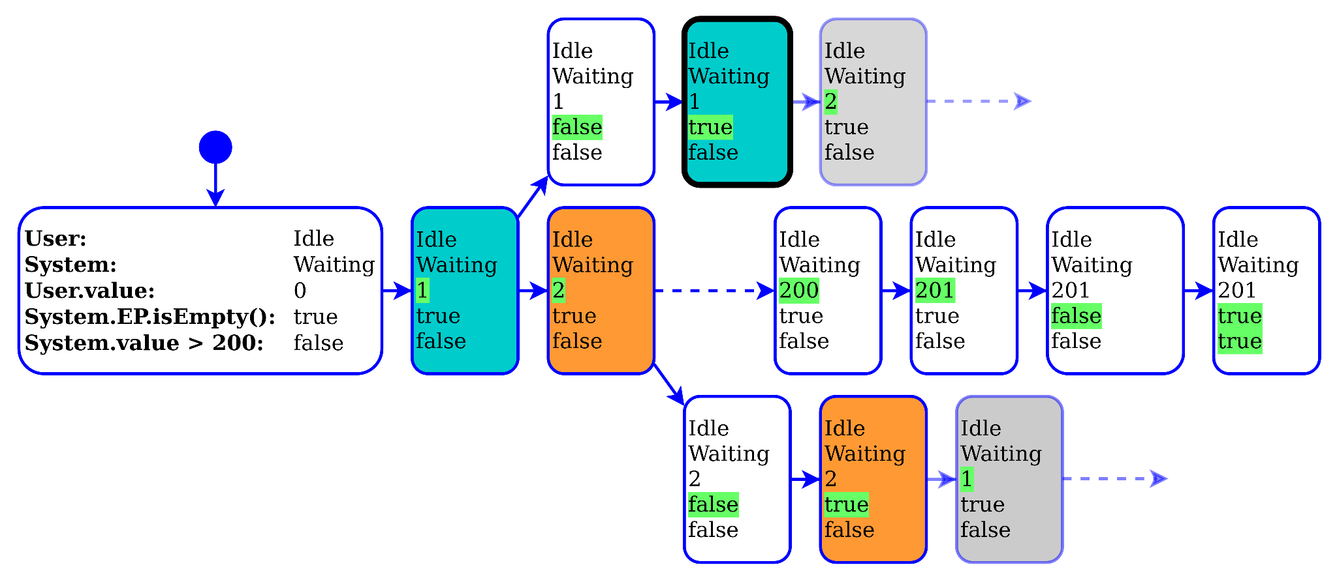
Applying a reduction function
 | No reduction | With reduction
Configurations | 60914 | 414
Time | 852 sec. | 13 sec.
Speedup |  | 66.7
Reduction function
States
User
System
Values
User.value
System.value
EventPools
User.EP
System.EP
Predicates
System.EP.isEmpty()
System.value > 200

Slide 45
More reduction functions
This technique allows us to use some common reduction techniques during our debugging session, for exemple:
Bitstate hashing¹
Dead variable reduction²
Symmetry reduction²
Predicate abstraction³
[1] Gerard J. Holzmann. Springer US 1996. “An analysis of bitstate hashing.”
[2] Kelly Androutsopoulos et Al. ACM Comput. Surv. 2013. “State-Based Model Slicing: A Survey.”
[3] Naoki Kobayashi et Al. PLDI 2011. “Predicate Abstraction and CEGAR for Higher-Order Model Checking”

Slide 46
Conclusion
Multiverse debugging is useful for working with non-deterministic specification languages.
Reduced Multiverse Debugging is a way to make multiverse debugging scalable to system with bigger, or even infinite state-space.
Questions?

