Slide 1
Guide SysML
Philippe Dhaussy, Ciprian Teodorov,
Jean-François Guillemette, Alain Poulhalec

Slide 2
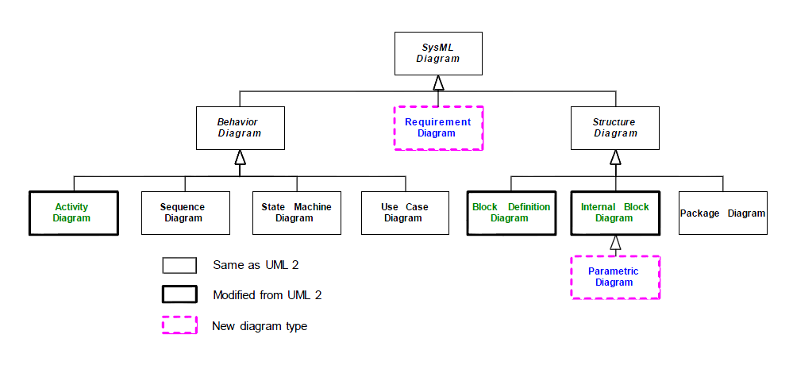
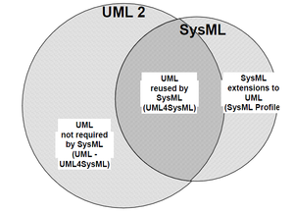
Profil SysML, extension d’UML2
Requirement formalisation
Requirement tracability
Architectural concepts modeling
Candidate architecture modeling
Functional architecture modeling. Flow transformations.
Client use case modeling
Behavioral modeling
Equational constraint modeling

Slide 3
First steps
IBM Rhapsody

Slide 4
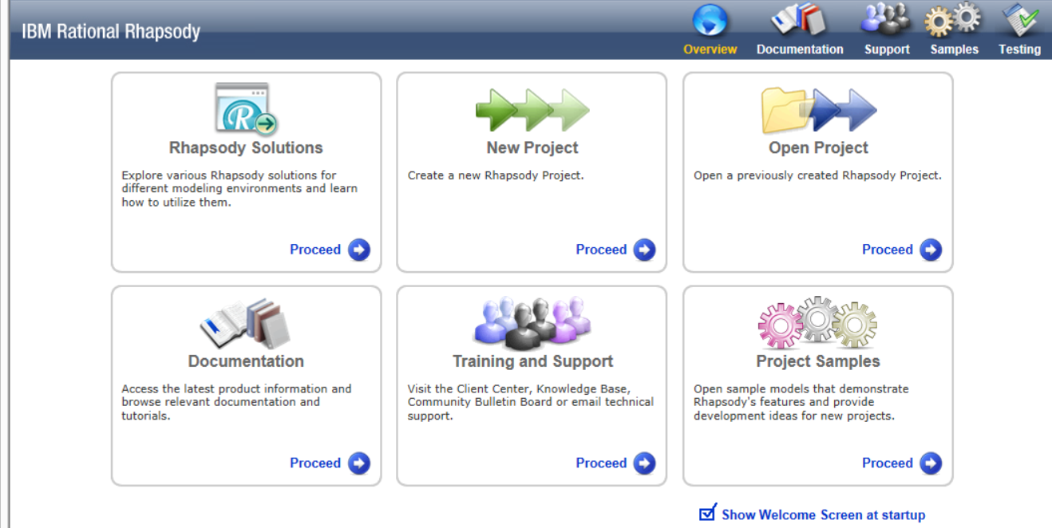
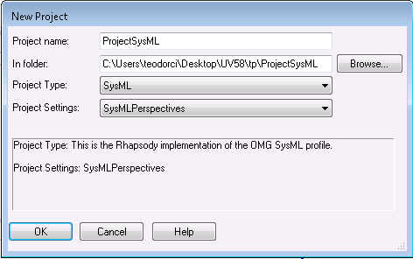
Model-based systems engineering SysML IBM Rhapsody
Start Rhapsody JAVA
Create a new project
Set a target folder
Give a name to your project
Choose SysML for the project type
Clock OK, then Yes

Slide 5
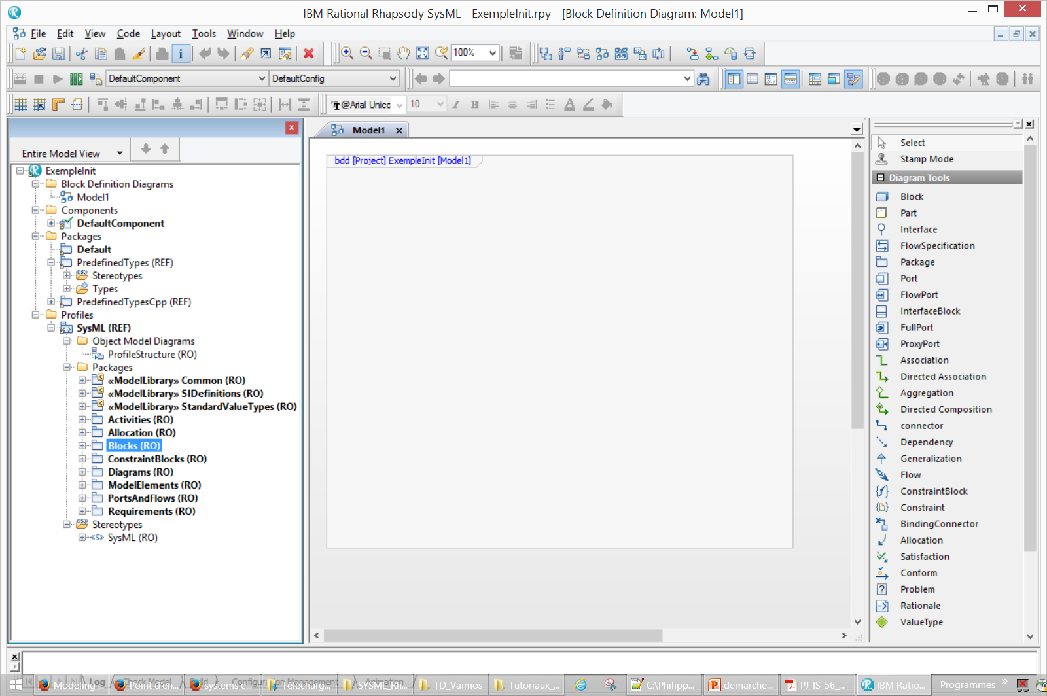
SysML IBM Rhapsody
Save
Diagrams
1er block crée par défaut (BDD)
Packages (à l’initialisation , « Default »)
Profil OMG SysML
Specification
(Read Only)
Contextual Toolbox

Slide 6
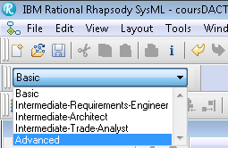
SysML IBM Rhapsody
Pour avoir accès à l’ensemble d’options SysML
Changer le mode de BASIC à ADVANCED

Slide 7
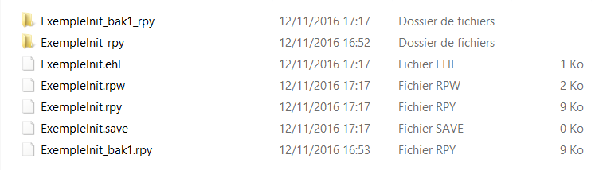
SysML IBM Rhapsody : generated files
xxx_rpy : folder containing all the model elements
xxx.rpy : main model file
xxx.ehl : animation event storage
xxx.rpw : session configuration file
xxx.save : backup file

Slide 8
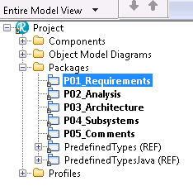
SysML IBM Rhapsody : Package organisation
The proposed structure for a better model
Package P01_Requirements : requirement model and diagrams
Package P02_Analysis : model elements and diagrams for functional analysis
Package P03_Architecture : structural elements, architectural design model and diagrams (blocks BDD, IBD, …)
Package P04_Subsystems : subsystem models
Package P05_Comments : documentation and annexes

Slide 9
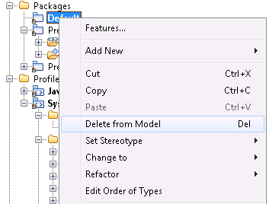


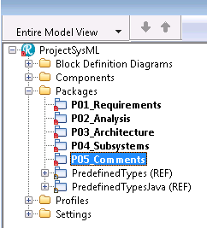
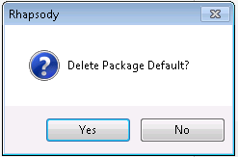
SysML IBM Rhapsody : Package organisation
Delete the default package

Slide 10
Client Needs Analysis
Bottom -> Up
SysML Diagrams
1. Requirements
Requirements diagram
2. Logical requirement groups
Top -> Down
3. Life cycle
4.1 Environment and function by life phase
4.2 Context and external interfaces
5. Function specification

Slide 11
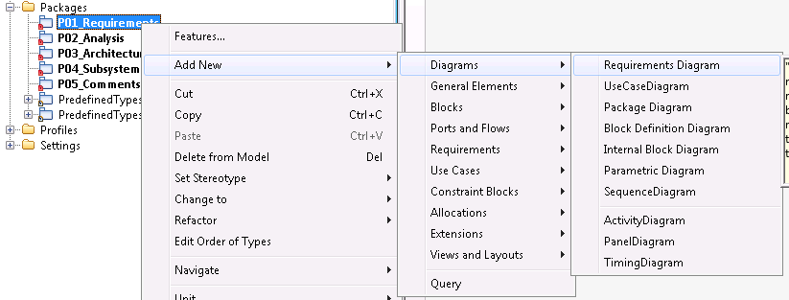
1. Client need Analysis : SysML
Requirement creation
  Right click on the Requirements package : Add new -> Requirement
Create a requirement diagram
    Right click on the Requirements package : Add new -> Diagrams -> Requirement Diagram

Slide 12
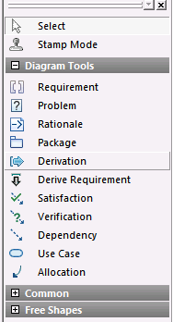
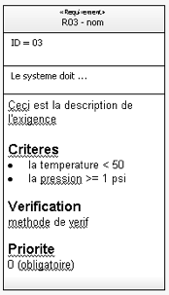
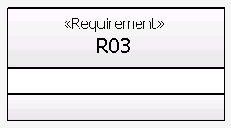
1. Client need analysis : Requirements

Slide 13
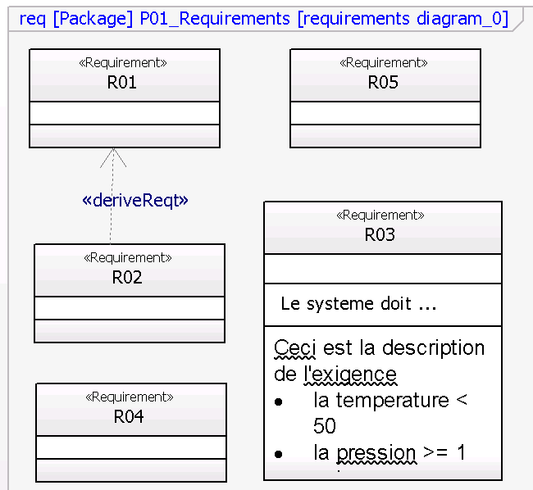
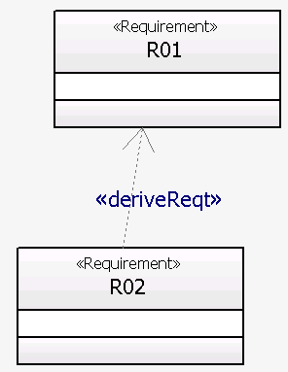
1. Client need analysis : Requirements
The requirement derivation
A low level requirement
can be derived
from a higher—level requirement

Slide 14
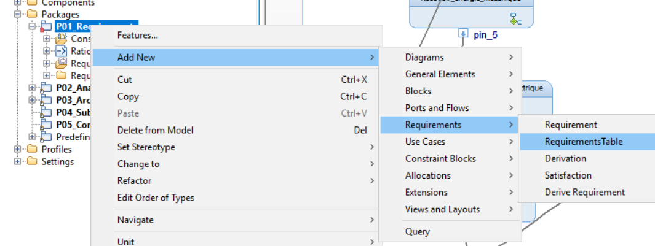
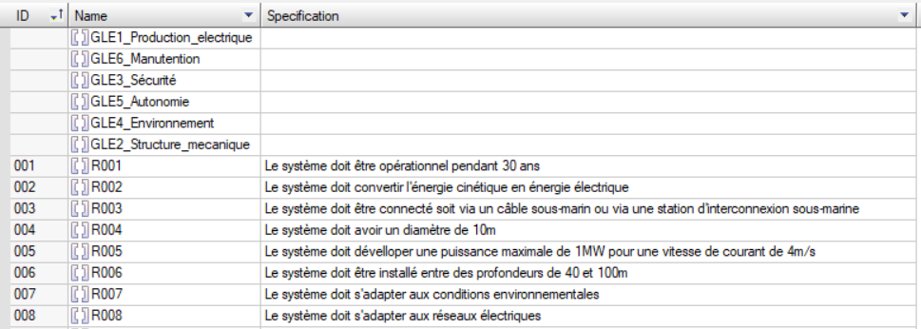
1. Client need Analysis : Requirements Table
TableRequirement creation
  Right click on the Requirements package :
  Add new -> Requirements -> RequirementsTable

Slide 15
Client Needs Analysis
Bottom -> Up
SysML Diagrams
1. Requirements
Requirements diagram
2. Logical requirement groups
Top -> Down
3. Life cycle
4.1 Environment and function by life phase
4.2 Context and external interfaces
5. Function specification

Slide 16
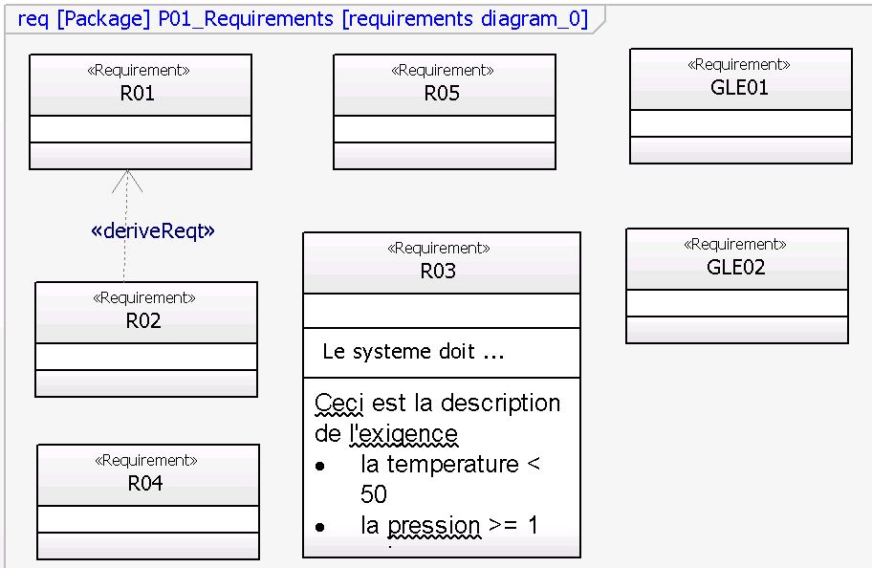
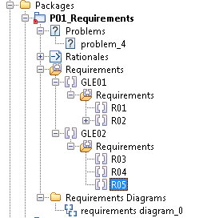
2. Client Needs Analysis : Logical Requirements Groups
For each requirement group we create a new requirement named GLEXX
The requirements are associated with the group by « drag-and-drop »

Slide 17
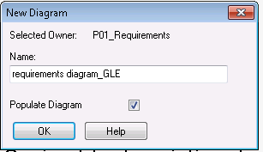
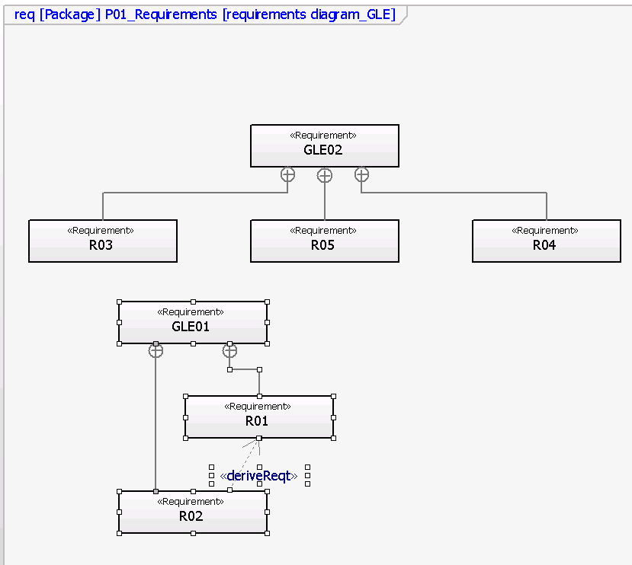
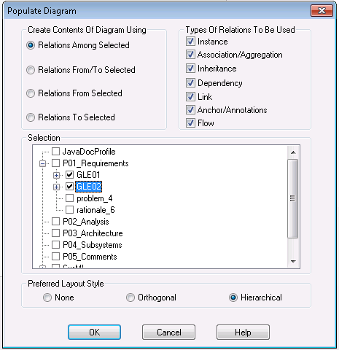
2. Client Needs Analysis : Logical Requirements Groups
Automated generation of a Requirement Group Diagram :
Create a new « requirement group »
Select « populate diagram »
Select the requirement group in the « populate diagram » window

Slide 18
Client Needs Analysis
Bottom -> Up
SysML Diagrams
1. Requirements
2. Logical requirement groups
Top -> Down
3. Life cycle
BDD + Statechart
4.1 Environment and function by life phase
4.2 Context and external interfaces
5. Function specification

Slide 19
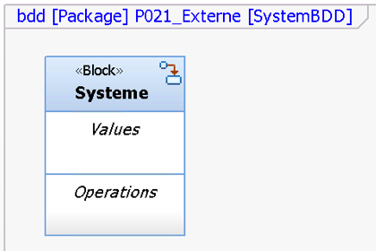
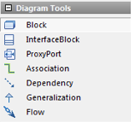

3. Client Needs Analysis : Lifecycle
Lifecycle modeling with a Block Definition Diagram
In the package P02_Analysis create a package P021_ExternalAnalysis
Right click on the package P021_ExternalAnalysis
  Add New -> Diagrams -> Block Definition Diagram (SystemBDD)
Block: Create a Block representing the system

Slide 20
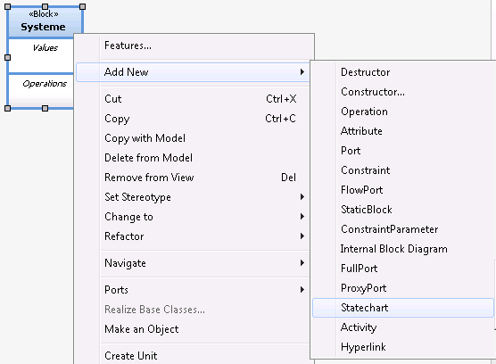
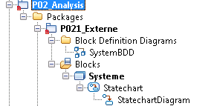
3. Client Needs Analysis : Lifecycle
Lifecycle phase modeling with a Statechart diagram
Creating a statechart :
Right click on the System Block
  Add new > Statechart
A statechart is associated with the system
Statecharts are an extension of state-machines

Slide 21
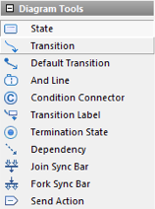
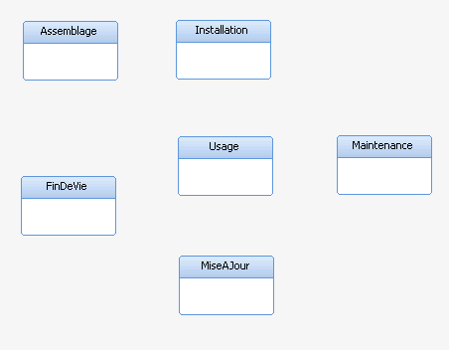
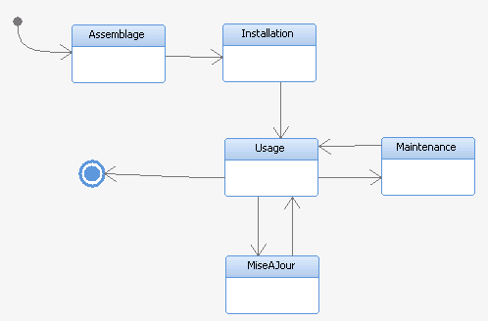
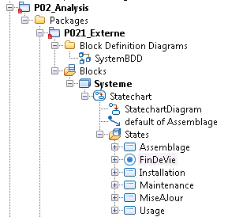
3. Client Needs Analysis : Lifecycle
Lifecycle phase modeling with a Statechart diagram
Model the system’s life phases with state nodes (State)
Model the life phase evolution
with statechart transitions (Transition)
Add a « default transition » to mark the initial life phase
Add a « termination state » to mark the end of life
The states and transition are added automatically in the tree view

Slide 22
Client Needs Analysis
Bottom -> Up
SysML Diagrams
1. Requirements
2. Logical requirement groups
Top -> Down
3. Life cycle
4.1 Environment and function by life phase
Use Case (APTE)
4.2 Context and external interfaces
5. Function specification

Slide 23
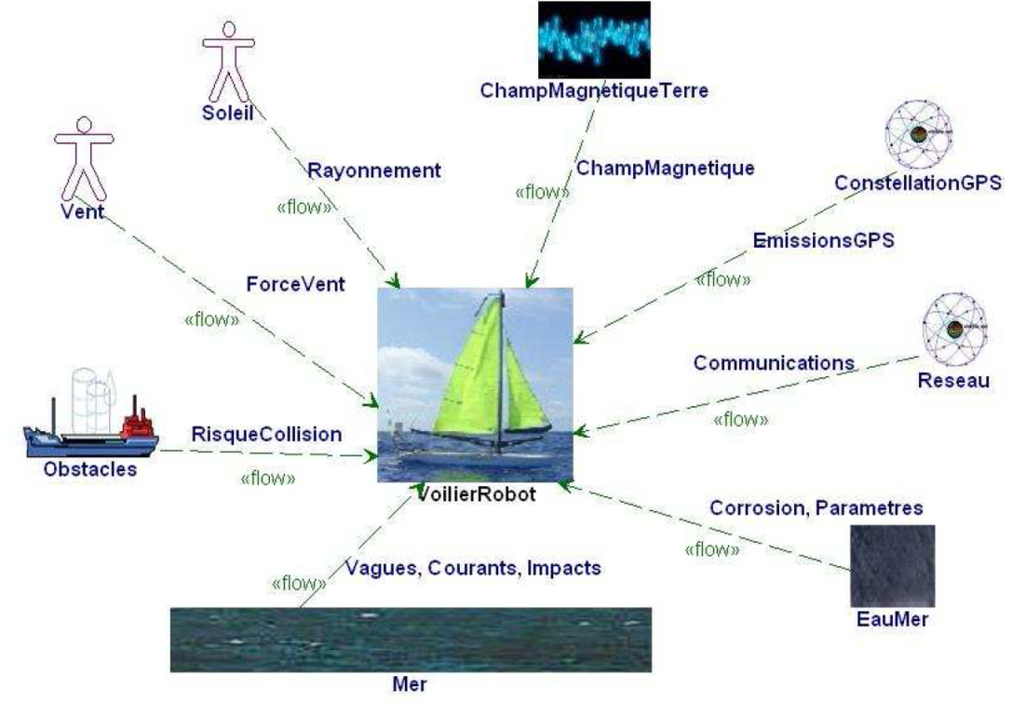
4.1. Client Needs Analysis : Environment Interaction during the Lifecycle
Inputs
  Life cycle phases
  The requirements and the logical requirements groups
Outputs
  Identified external actors
  SysML Context Diagram
    Input/output ports
    Nature of the I/O flows
2 possibilities
Use Case Diagram (our choice)
Block Definition Diagram
Actor creation
  Right click on the package P021_ExternalAnalysis :
    Add New → Use Case → Actor
  To add images on the external actors :
    Right click : Display Options -> Enable Image View (image file)

Slide 24
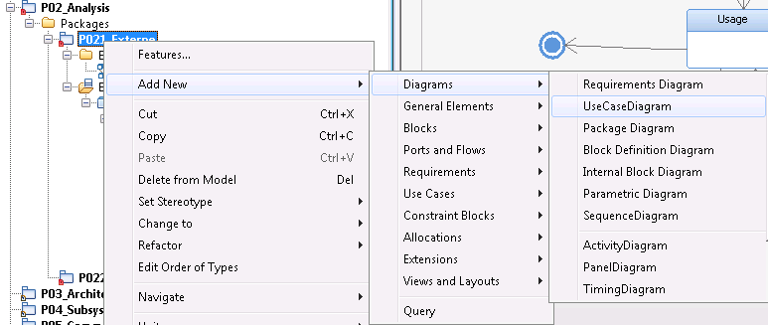
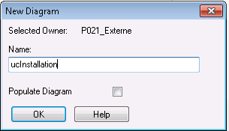
4.1 Client Needs Analysis : Discovering Functions
To identify the system functions we will use the « Use case diagram »
This will enable us to create APTE-like diagrams, mainly the « octopus »
Create one “Use case diagram” for each system lifecycle phase
The name of the diagram will be prefixed with ”uc”.
Exemple: ucInstallation

Slide 25
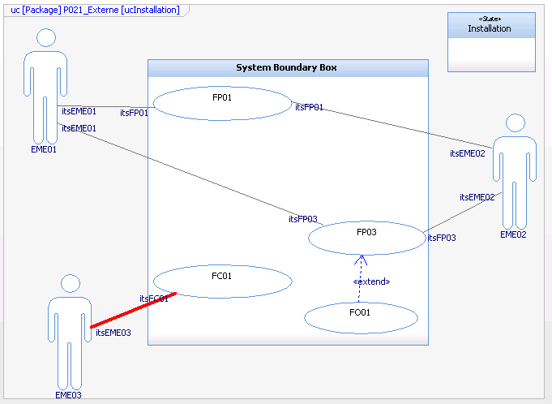
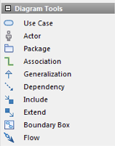
4.1 Client Needs Analysis : Discovering Functions
The system boundary is identified with a « Boundary Box ».
Each element of the environment (EMEXX) is identified by an « actor ».
The main functions (FXX) are represented by « use cases ».
The optional functions (FOXX) are represented by « use cases ».
The constraint functions (FCXX) are represented by « use cases ».
The main functions have inputs and outputs. Thus they have links from and to external actors.
The constraint functions are imposed on the system by an external actor.
The associated constraints arrive on the system, and should be handled.
Only one link from an external actor
EME = Element du Milieu Extérieur

Slide 26
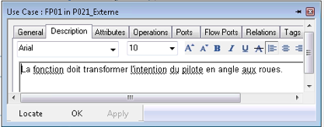
4.1 Client Needs Analysis : Discovering Functions
Describe the purpose of the function (the service rendered)
NB: The main functions create relations between the external actors (through the system).
The relations represent the flow of « energy » and/or « matter » (data, electricity, forces).
Input = raw data / matter / energy
Output = processed data / matter / energy

Slide 27
Client Needs Analysis
Bottom -> Up
SysML Diagrams
1. Requirements
2. Logical requirement groups
Top -> Down
3. Life cycle
4.1 Environment and function by life phase
BDD
4.2 Context and external interfaces
5. Function specification

Slide 28
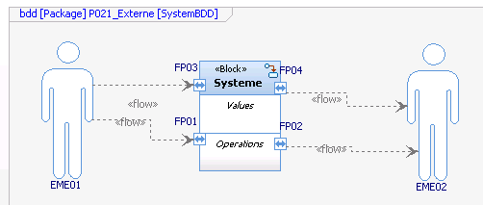
4.2 Client Needs Analysis : Context & External Interfaces
For each link that crosses the « system boundary box »
Add a port to the System block (in the previously created BDD diagram)
These ports represent the interfaces through which the system interacts with its environment
Drag the actors (from the life-phase use-case diagrams) to this BDD diagram
Connect these actors to the system BDD on the defined ports
Create connections between components
    Drag the icon « flow port » (connecteur)
    Drag the flow icon on the Draguer l’icône Flow sur le milieu du connecteur,
  puis click droit → Features : direction du flot : General → Direction et Flow Items

Slide 29
Client Needs Analysis
Bottom -> Up
SysML Diagrams
1. Requirements
2. Logical requirement groups
Top -> Down
3. Life cycle
4.1 Environment and function by life phase
4.2 Context and external interfaces
5. Function specification
Excel

Slide 30
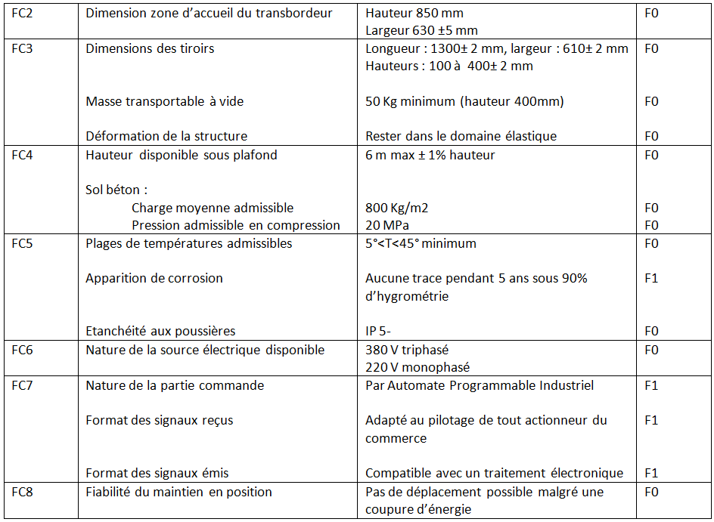
5. Client Needs Analysis : Function characterisation
Exemple de tableau de caractérisation de fonctions
Function
Criteria
Level
Flexibility
Qualitative flexibility :
from F0 (non negociable)
to F3 (very negociable)

Slide 31
Client Needs Analysis
Bottom -> Up
1. Requirements
Reiterate over the requirement set, to consolidate it.
Did your requirement set covered all functions and constraints discovered during the last steps ?
2. Logical requirement groups
Top -> Down
3. Life cycle
4.1 Environment and function by life phase
Theoretically this design loop should continue until :
no more requirements nor functions are added (a design fixpoint is reached) and
the client agrees with the identified design problem.
4.2 Context and external interfaces
5. Function specification

Slide 32
Internal Functional Analysis
SysML Diagrams
7. Function Decomposition
Use Case (FAST)
8. Traceability
Requirements diagram
9. Functional Architecture
Activity diagram

Slide 33
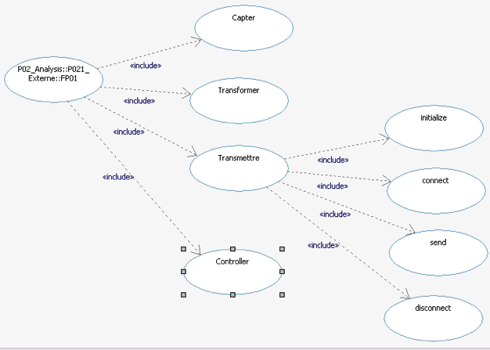
7. Internal Functional Analysis : FAST Refinement
Create a package P022_InternalAnalysis in the package P02_Analysis
For each function (main functions only):
  Create a use-case diagram in the package P022_InternalAnalysis
  Decompose the function in sub-functions (include relation)

Slide 34
Internal Functional Analysis
SysML Diagrams
7. Function Decomposition
8. Traceability
Requirements diagram
9. Functional Architecture

Slide 35
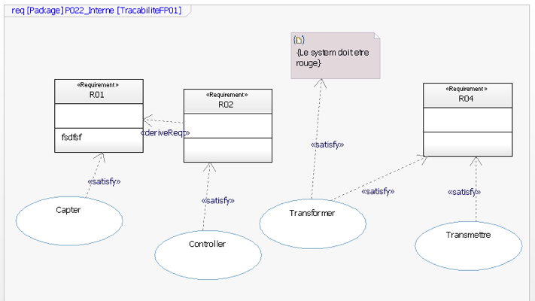
8. Internal Functional Analysis : Traceability

Slide 36
Internal Functional Analysis
SysML Diagrams
7. Function Decomposition
8. Traceability
9. Functional Architecture
Activity diagram

Slide 37
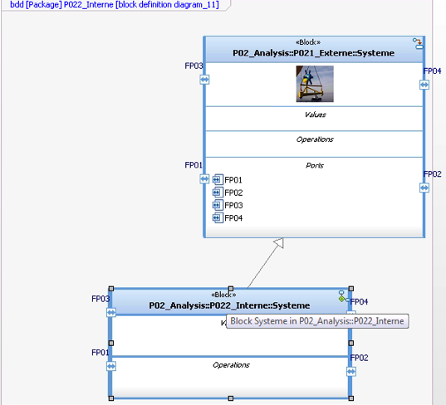
9. Functional Architecture
White box system modeling with a Block Definition Diagram
  Right click on the package P022_InternalAnalysis :
    Add New → Diagrams → Block Definition Diagram (SystemBDD)
  Block: System identification
    Create a Block which represents the system « white box »
    Add the « System » Block created during the external analysis
    Create an inheritance relation (generalization) between the new block and the previous one (this way previously defined interfaces are inherited -- the ports)

Slide 38
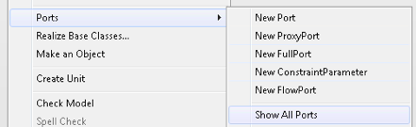
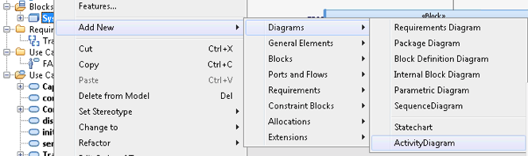
9. Functional Architecture
  To show the previously defined ports :
    Right click on the newly created block
    Port -> Show all ports
  Create an Activity Diagram in the model tree:
    Right click on the new block
    Add new -> Diagrams -> Activity Diagram

Slide 39
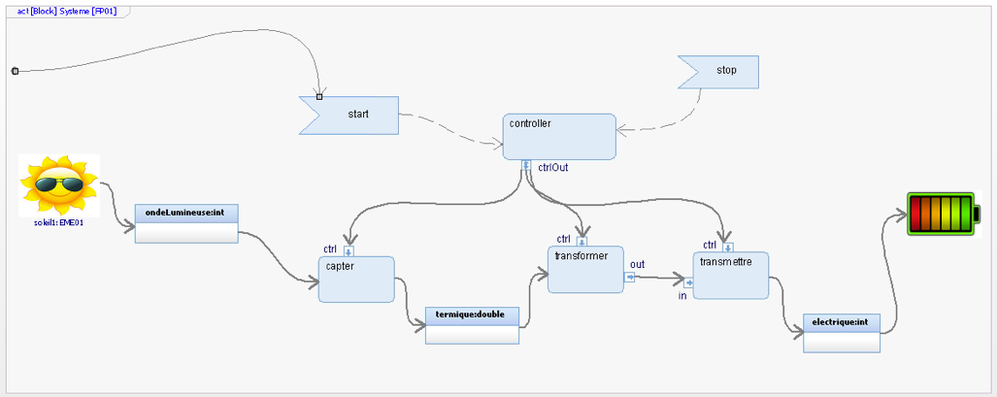
9. Functional Architecture
Activity Diagram exemple

Slide 40

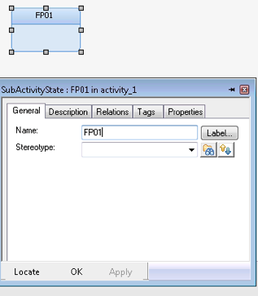
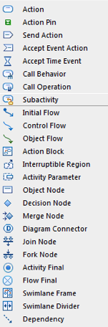
9. Functional Architecture
  Activity creation
  Create a subactivity, for each « main function »
  Drag & Drop in the Diagram and name it (ex FP01)
Fonction élémentaire
(niveau n)
Ports
Modélisation des flux entre sous-fonctions
Fonction de niveau supérieur (niveau n-1)
Description de la nature du flux concerné

Slide 41
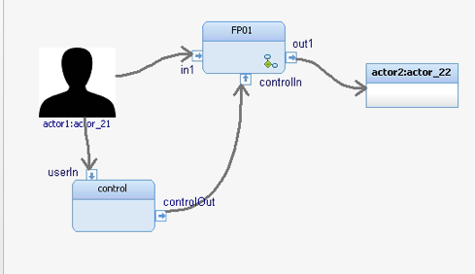

9. Functional Architecture
  Add the ports and the actors in the activities
    Click on « Action Pin » (right toolbar) and then click on the target activity
    Name the port and set its direction and its type (right click « feature »)
    Drag & Drop the actors created during the lifecycle analysis (external analysis)
    Connect the actors and the sub-functions with « object flow » links

Slide 42
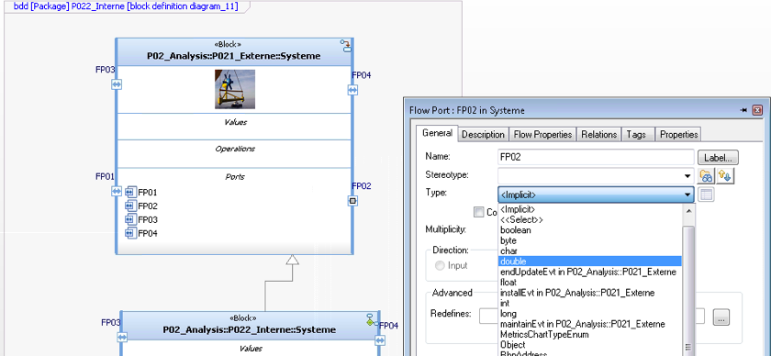

  If your ports are not unidirectional (they are bidirectional), set the type of you ports (either input or output)

Slide 43

9. Functional Architecture
  For each sub-function identified during the decompositons:
    Add an « action » if the function is « elementary »
    Add a « subactivity » if the function was decomposed further (if it has subfunction)
    For the « subactivities » add their corresponding ports
    Connect the sub-activities and actions with flows (« object flow »)
    Identify and set the nature of the flow: either by setting the type on the port, or by creating an « object node » of the needed type
    Repeat for all fuctions and subfucntions

Slide 44


9. Functional Architecture
  Define a functional architecture for each « main function »
  Right click on the sub-activity, the choose « Open sub activity »
  You can navigate in the hierarchy with : « Open Parent » or « Open Sub Activity »

Slide 45


9. Functional Architecture
  To specify the flow nature
« object node »
« type »
Port « type »

Slide 46



9. Functional Architecture
  Full functional architecture (collapse the hierarchy)
    Right click on one « Sub-activity » thend « Merge Back Sub Activity »
  To go back to a hierarchical view:
  Right click on the sub-activity, then choose «Create Sub Activity »

Slide 47
10. Architectural Design
SysML Diagrams
10. Work breakdown structure
Block Definition Diagram (BDD)
11. Allocation
Allocate relations
12. Physical Architecture
Internal Block Diagram (IBD)

Slide 48
10. Architectural Design
SysML Diagrams
10. Work Breakdown Structure
Block Definition Diagram (BDD)
11. Allocation
12. Physical Architecture

Slide 49


10. Physical Design : Work Breakdown Structure
  Sub-system creation:
    Create a BDD diagram, in the Package « P03_Architecture »
    Add a new « System » Block with a « generalization » relation with the « System » Block created during internal functional analysis (slide 36).
    For each identified sub-system, create a new Block
    Link the block System with the sub-system block using the « Directed Composition » relation
    Note that adding a « Directed Composition » between the system block and its sub-system will automatically define the subsystem as a component of the system

Slide 50

10. Architectural Design: Work Breakdown Structure
Exemple diagram

Slide 51
11. Architectural Design: Allocation
SysML Diagrams
10. Work breakdown structure
11. Allocation
Allocate relations
12. Physical Architecture

Slide 52


11. Architectural Design : Allocation
Function Allocation:
  Copy each activity diagram in the package « P03_Architecture »
  Add a « Swimlane Frame » in the diagram
  To obtain the sub-systems decompose the frame with « swimlane dividers »
  Associate a sub-system to each swimlane (right click on the Swimlane -> Features & choose the name of the sub-system)

Slide 53


11. Architectural Design: Allocation
Function allocation 2:
  By default the swimlane name is shown
  To show the name of the subsystem, Right click on the swimlane -> Display Options & choose the represents radio button
  Allocate the functions:
    Drag & Drop the previously imported functions to the « sub-systems » that should implement them.

Slide 54
12. Architectural Design: Physical Architecture
SysML Diagrams
10. Work breakdown structure
11. Allocation
12. Physical architecture
Internal Block Diagram (IBD)

Slide 55



12. Architectural Design: Physical Architecture
Physical Architecture 1st step:
  Create an Internal Block Diagram (IBD) in the « P03_Architecture » package
  Drag&Drop the « System » block (previously created)
  To create an instance of the « system », which will serve as basis for the physical architecture:
    Right click on the « System » block, and choose the « Make an Object » button.
Changement de vue : vue « spécification » ou « structurelle »
Résultat obtenu

Slide 56

12. Architectural Design: Physical Architecture
Physical Architecture 2nd step:
  Switch to the structural view
  Drag&Drop the sub-systems on the « system » instance
  Beaware to the placement of your sub-system (it should be inside the « system » - if not the block will be surounded by dotted lines)
  Add the « flowports » needed to preserve the functional flows to your sub-systems
  Connect these ports using the « Connector » element

Slide 57

12. Architectural Design: Physical Architecture
Physical Architecture 3nd step:
  You should obtain a hierarchical representation of your system, with all the internal ports connected.

Slide 58

12. Architectural Design: Physical Architecture
Physical Architecture 4nd step:
  Repeat the previous steps until all your sub-systems and their components are present

Slide 59
12. Architecture Physique : Physical Architecture
Attention :
  Allocating a function to multiple physical components will induce a flow between the components (the components should be connected together)
  In the following figure, the function « Ajuster le cap » (allocated to the « direction » sub-system) is realized by the joint action of a « servo-motor » and a tiller (« barre ») – The principle is simple: to change the direction the motor « sends » a force « flow » to the tiller.

